Slide 1

Phineas and Ferb Mathematics
https://www.youtube.com/watch?v=Xf3mRZ7SHu0

Slide 2
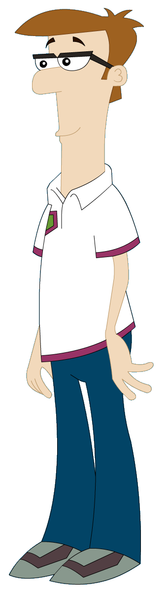
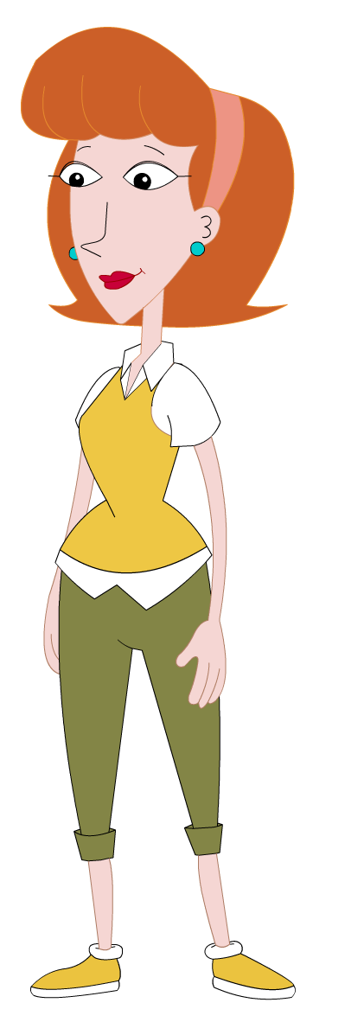
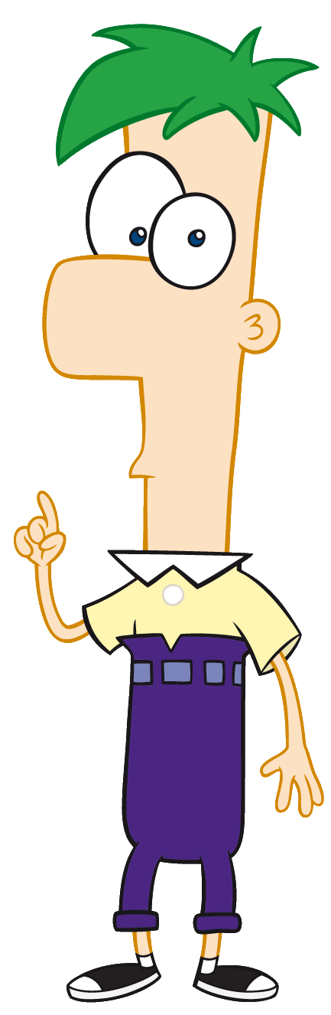
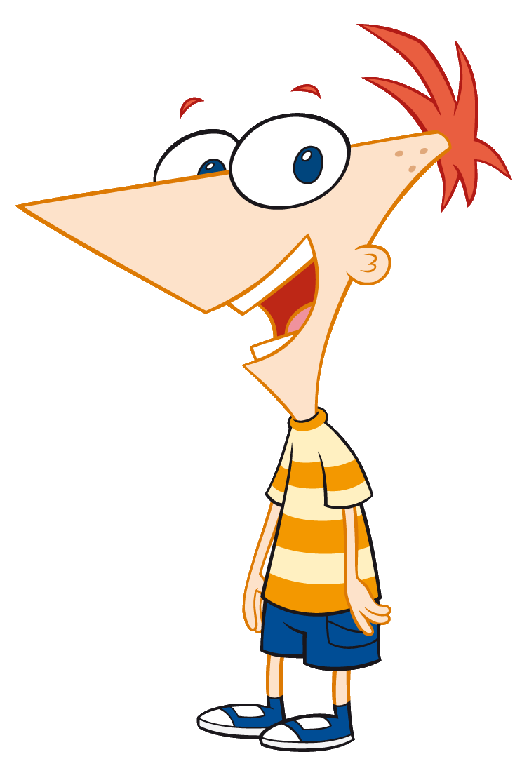

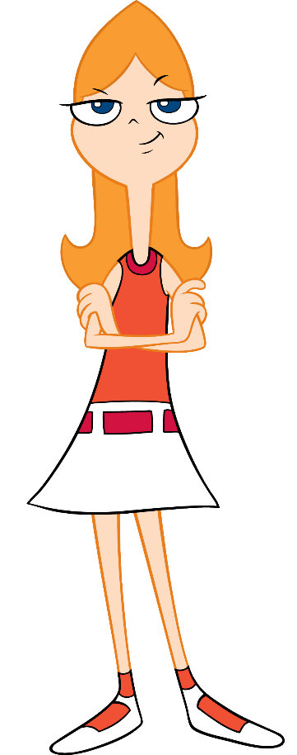


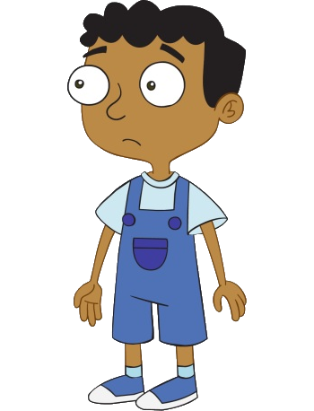
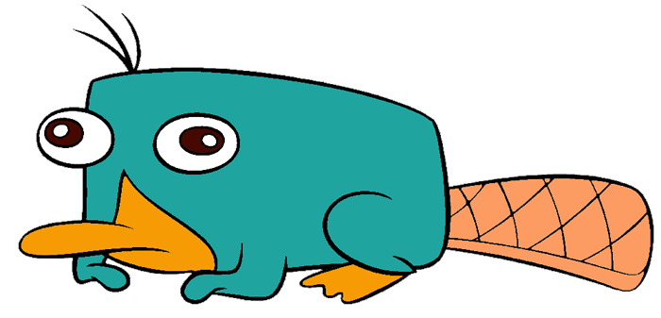
Phineas and Ferb and Friends…

Slide 3
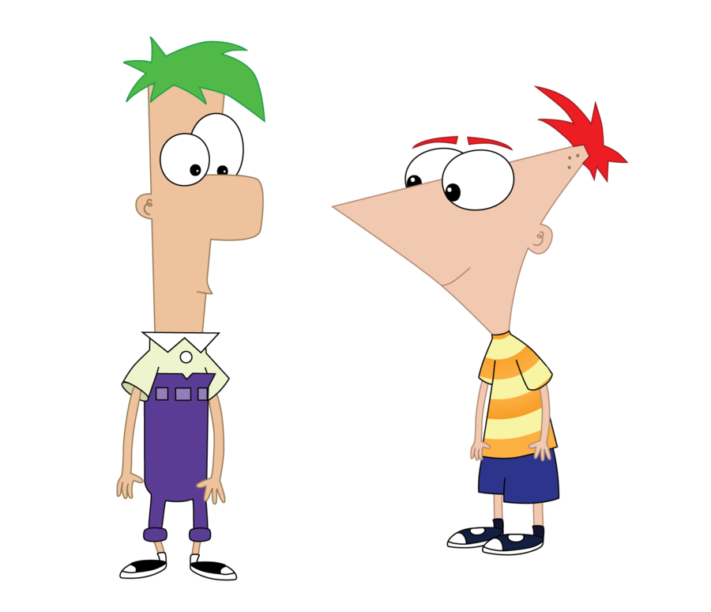
Mathematical Issue 1
Phineas and Ferb are designing a clock. They have three switches that can be programmed to touch a power source after a given number of minutes. A bell will sound when all three touch the power source at the same time.
They each suggest the following timings for the bell to sound every hour:
Phineas: 3 mins, 4 mins, 5mins.
Ferb: 4 mins, 5 mins, 6mins.
Candace: 3 mins, 4 mins, 6 mins.
Whose suggestion will work?
Answer:
Phineas and Ferb are correct

Slide 4
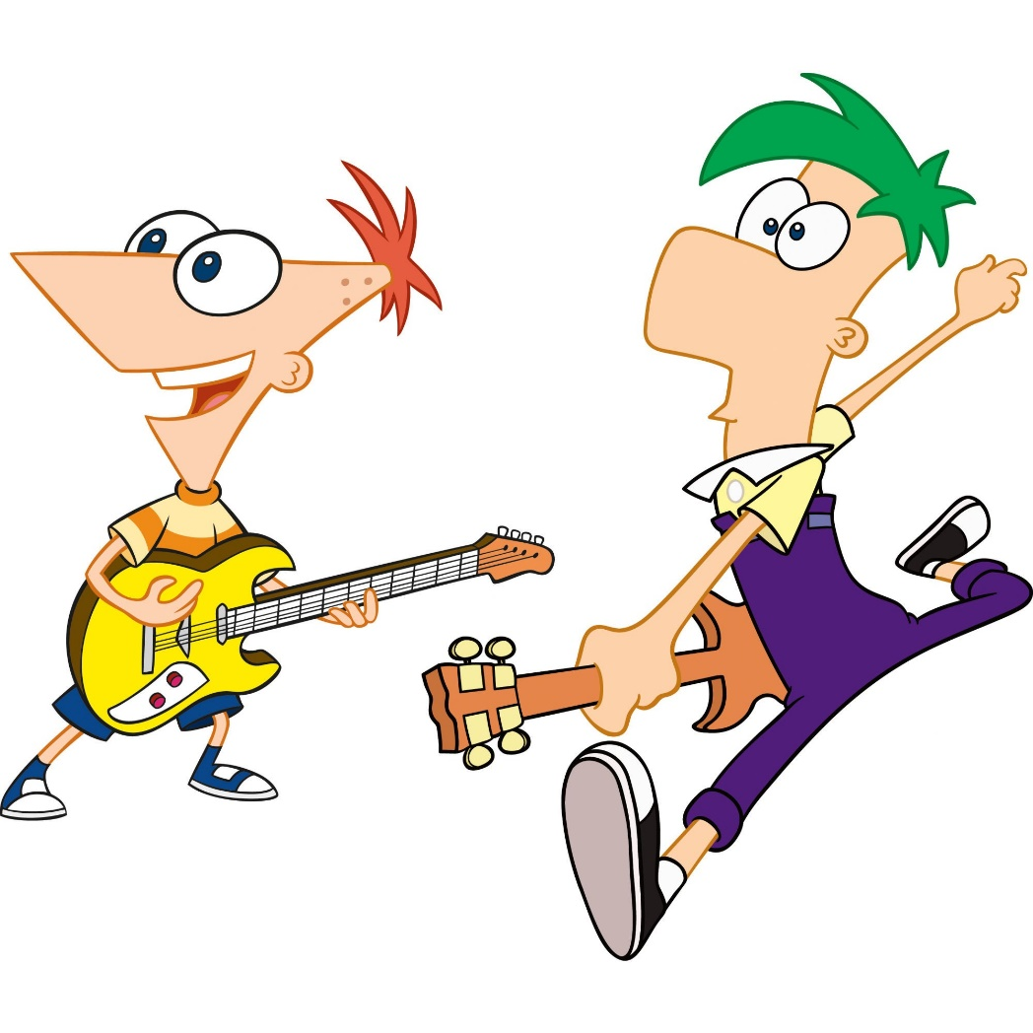
Mathematical Issue 2
Phineas, Ferb and all the gang are going to record a song. They each decide to hit their drums after so many beats:
Phineas: 3 beats
Ferb: 5 beats
Isabella: 4 beats
Buford: 2 beats
Baljeet: 9 beats
If they all start at the same time after how many beats will they all hit their drum at the simultaneously again?
Answer:
180 beats

Slide 5
Mathematical Issue 3
Phineas and Ferb’s parents are cycling around a track.
Mrs Flynn takes 30 seconds to complete a lap.
Mr Fletcher takes 35 seconds to complete a lap.
If they start at the same time, at what time will they next start a lap together?
Answer:
210 seconds (3 minutes 30 seconds)

Slide 6

Mathematical Issue 4
Agent P is organising his weapons cache. He has the following weapons in stock:
36 grenades
24 stun grenades
16 capture nets
Agent P wants to make equal sets (ie. each set must be identical).
How many of each of the three weapons will be in each set, and how many sets will there be?
Answer:
4 sets containing 9 grenades, 6 stun grenades and 4 capture nets

Slide 7
Mathematical Issue 5
Heinz Doofenschmirtz has built two weapons:
The Annihilator
The Rejuvinator
They have (predictably) malfunctioned.
The Annihilator fires every 18 hours.
The Rejuvinator fires every 32 hours.
If they fire at the same time they will destroy each other.
If they both malfunctioned at the same time how many days will it be until they destroy each other?
Answer:
12 days (288 hours)

Slide 8
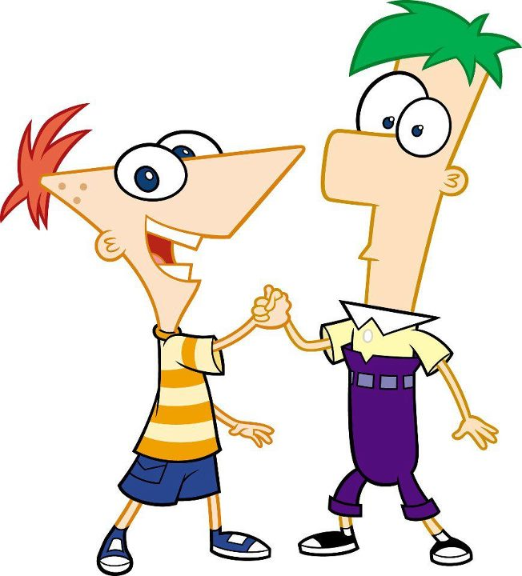
Thank you for all your help!

