Slide 1

Prime Factors Explosions
Can you fill in the blanks?

Slide 2

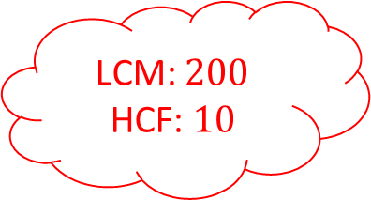


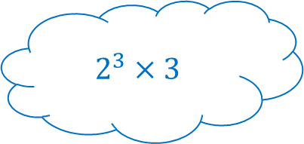

Prime Factors Explosions 1
LCM:
HCF:
$$15 \& 20$$
$$\& 36$$
Find the prime factors, LCM and HCF for the pairs of numbers
LCM: $200$
HCF: $10$
LCM:
HCF:
LCM: $288$
HCF: $4$
$$2^{3}×3$$
$$2×3×5$$

Slide 3




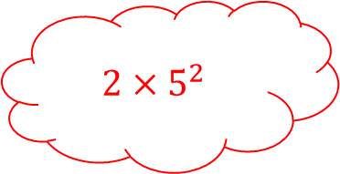
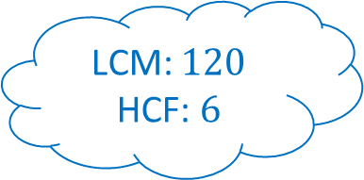

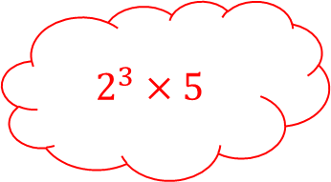



Prime Factors Explosions 1 - Answers
LCM: $60$
HCF: $5$
$$2^{2}×5$$
$$2^{5}$$
$$15 \& 20$$
$$32 \& 36$$
$$3×5$$
Find the prime factors, LCM and HCF for the pairs of numbers
$$2^{2}×3^{2}$$
LCM: $200$
HCF: $10$
$$24 \& 30$$
LCM: $120$
HCF: $6$
LCM: $288$
HCF: $4$
$$40 \& 50$$
$$2^{3}×3$$
$$2×5^{2}$$
$$2^{3}×5$$
$$2×3×5$$

Slide 4
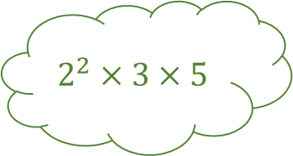
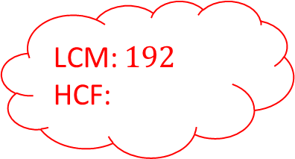




Prime Factors Explosions 2
LCM:
HCF:
$$2^{2}×3×5$$
$$3^{2}×5$$
Find the prime factors, LCM and HCF for the pairs of numbers
LCM: $192$
HCF:
$$54 \& 90$$
LCM:
HCF:
LCM: $540$
HCF: $36$
$$\& 64$$

Slide 5

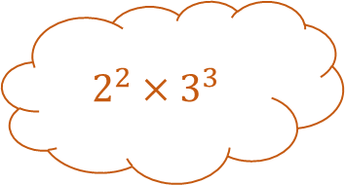





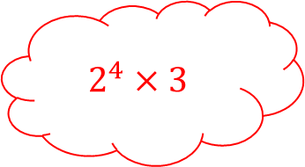

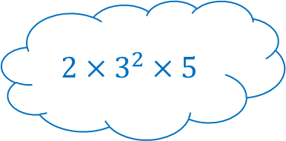


Prime Factors Explosions 2 - Answers
LCM: $180$
HCF: $15$
$$2^{2}×3×5$$
$$2^{2}×3^{3}$$
$$45 \& 60$$
$$108 \& 180$$
$$3^{2}×5$$
Find the prime factors, LCM and HCF for the pairs of numbers
$$2^{2}×3^{2}×5$$
LCM: $192$
HCF: $16$
$$54 \& 90$$
LCM: $270$
HCF: $18$
LCM: $540$
HCF: $36$
$$48 \& 64$$
$$2×3^{3}$$
$$2^{6}$$
$$2^{4}×3$$
$$2×3^{2}×5$$

Slide 6
Prime Factors Explosions Blank
Find the prime factors, LCM and HCF for the pairs of numbers

Slide 7
Prime Factors Explosions Blank
Find the prime factors, LCM and HCF for the pairs of numbers

