Slide 1
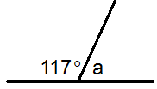
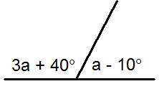
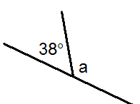
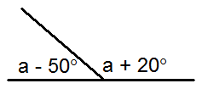
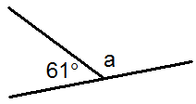
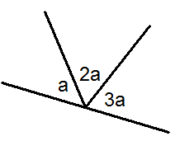
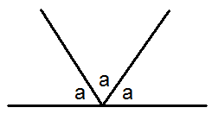
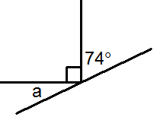
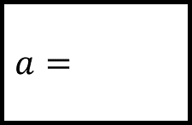
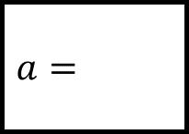

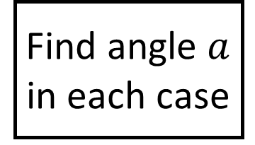



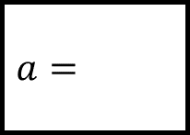

$$a=$$
Angles Spider 1
$$a=$$
$$a=$$
Find angle $a$ in each case
$$a=$$
$$a=$$
The diagrams are not to scale
$$a=$$
$$a=$$
$$a=$$

Slide 2
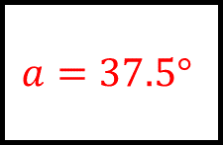
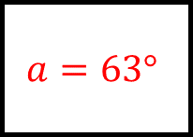
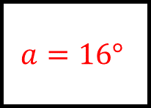
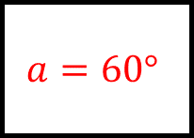
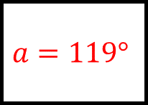
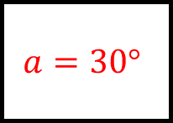
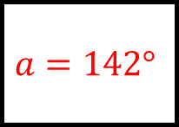
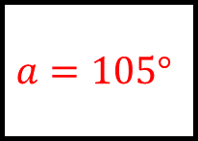
Angles Spider 1 Answers
$$a=63°$$
$$a=37.5°$$
$$a=142°$$
Find angle $a$ in each case
$$a=105°$$
$$a=119°$$
The diagrams are not to scale
$$a=30°$$
$$a=60°$$
$$a=16°$$

Slide 3
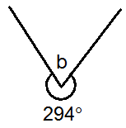
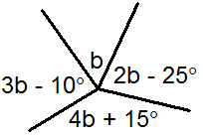
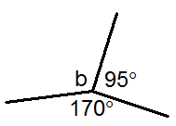
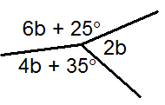
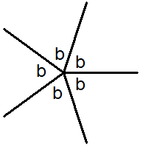
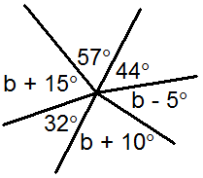
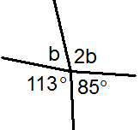
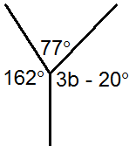
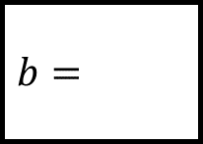
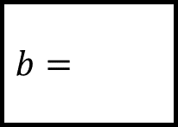

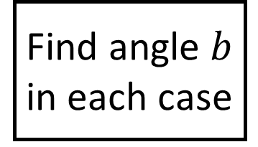
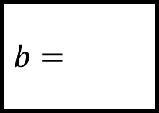


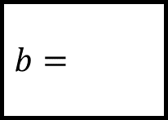

$$b=$$
$$b=$$
$$b=$$
Angles Spider 2
Find angle $b$ in each case
$$b=$$
$$b=$$
The diagrams are not to scale
$$b=$$
$$b=$$
$$b=$$

Slide 4
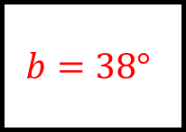
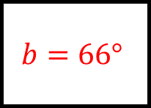
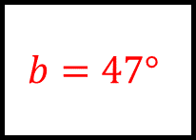
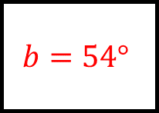
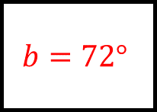
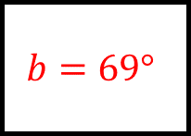
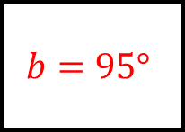
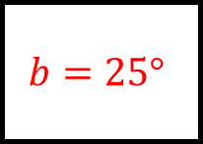
Angles Spider 2 Answers
$$b=66°$$
$$b=38°$$
$$b=95°$$
Find angle $b$ in each case
$$b=25°$$
$$b=72°$$
The diagrams are not to scale
$$b=69°$$
$$b=54°$$
$$b=47°$$

Slide 5
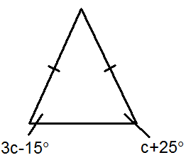
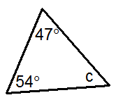
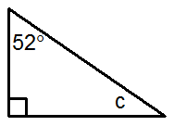
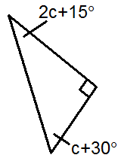
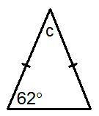
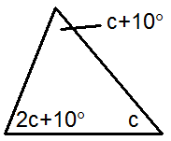
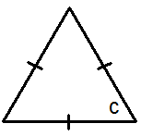
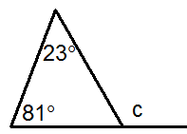
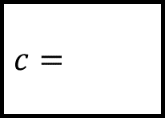








$$c=$$
Angles Spider 3
$$c=$$
$$c=$$
Find angle $c$ in each case
$$c=$$
$$c=$$
The diagrams are not to scale
$$c=$$
$$c=$$
$$c=$$

Slide 6








Angles Spider 3 Answers
$$c=79°$$
$$c=20°$$
$$c=38°$$
Find angle $c$ in each case
$$c=15°$$
$$c=56°$$
The diagrams are not to scale
$$c=40°$$
$$c=104°$$
$$c=60°$$

Slide 7

















$d$ is the number of sides a regular polygon contains with an interior angle of $165°$
Angles Spider 4
$$d=$$
$$d=$$
$$d=$$
Find angle $d$ in each case
$$d=$$
$$d=$$
$$d=$$
$$d=$$
$$d=$$
The diagrams are not to scale
Angle $d$ is the size of one exterior angle of a regular nonagon.
Angle $d$ is the sum of the interior angles in a heptagon

Slide 8








$d$ is the number of sides a regular polygon contains with an interior angle of $165°$
Angles Spider 4 Answers
$$d=24$$
$$d=75°$$
$$d=78°$$
Find angle $d$ in each case
$$d=135°$$
$$d=147°$$
$$d=40°$$
$$d=162°$$
$$d=900°$$
The diagrams are not to scale
Angle $d$ is the size of one exterior angle of a regular nonagon.
Angle $d$ is the sum of the interior angles in a heptagon

Slide 9











Angles Spider 5
$$e=$$
$$e=$$
Find angle $e$ in each case giving the angle property used
Corresponding angles are equal
$$e=121°$$
$$e=55°$$
Alternate angles are equal
$$e=$$
$$e=$$
The diagrams are not to scale

Slide 10








Angles Spider 5 Answers
Supplementary angles add to $180°$
Corresponding angles are equal
$$e=74°$$
$$e=105°$$
Find angle $e$ in each case giving the angle property used
Corresponding angles are equal
$$e=121°$$
$$e=55°$$
Alternate angles are equal
$$e=122°$$
$$e=133°$$
Vertically opposite angles are equal
Supplementary angles add to $180°$
The diagrams are not to scale

Slide 11













Angles Spider 6
$$f=$$
$$f=$$
Find angle $f$ in each case giving the angle property used
$$f=$$
$$f=$$
$$f=$$
$$f=$$
The diagrams are not to scale

Slide 12









Angles Spider 6 Answers
A radius and tangent meet at $90°$
Angle subtended from a diameter is $90°$
$$f=32°$$
$$f=54°$$
The angle at the centre is double the angle at the circumference
Find angle $f$ in each case giving the angle property used
Opposite angles in a cyclic quadrilateral add to $180°$
$$f=65°$$
$$f=82°$$
$$f=53°$$
$$f=73°$$
Alternate segment – angles are equal
Angles in the same segment are equal
The diagrams are not to scale

