Slide 1
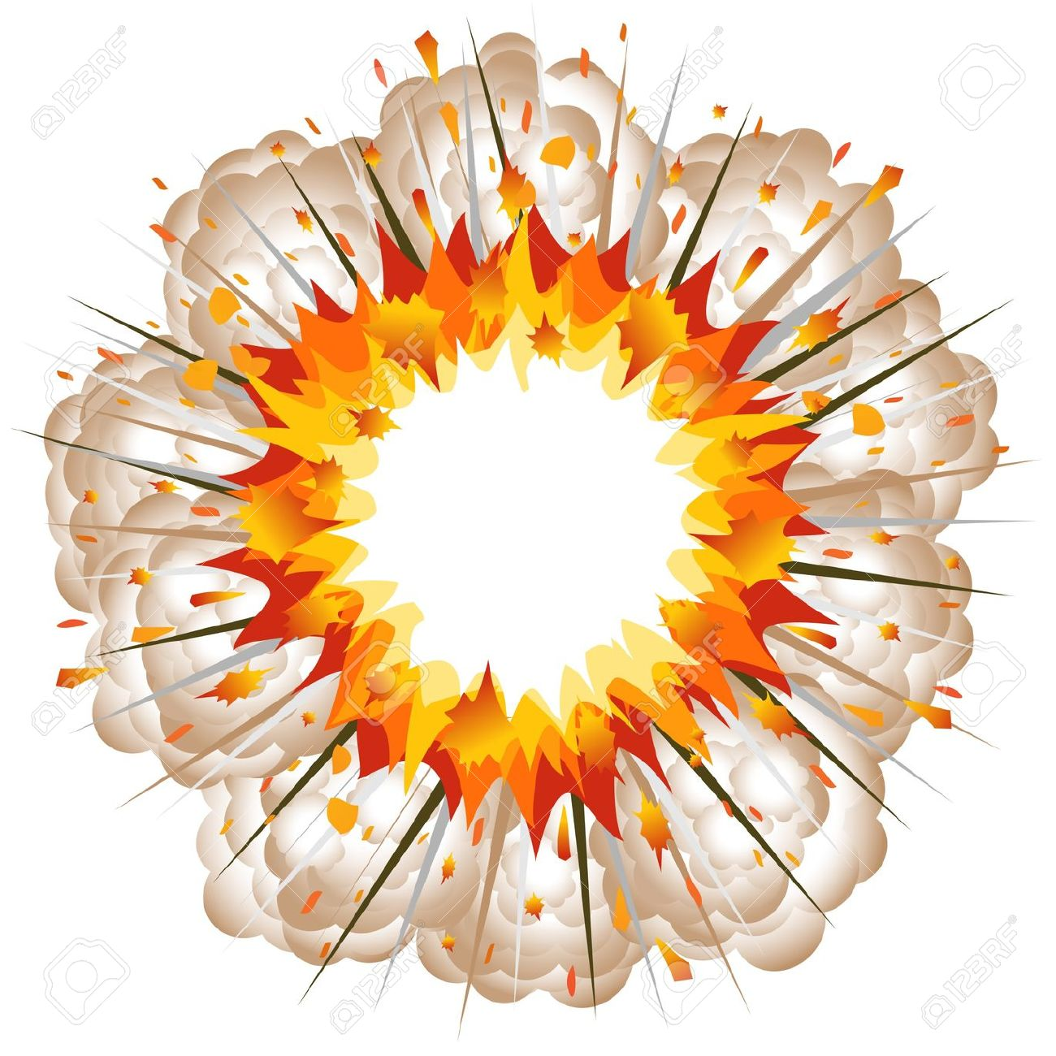
Completing The Square Explosions
Can you fill in the blanks?

Slide 2
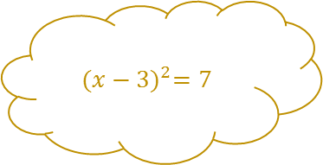
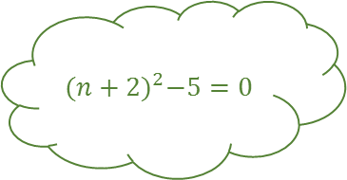
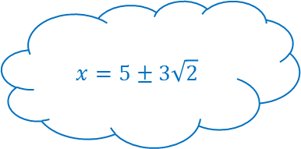
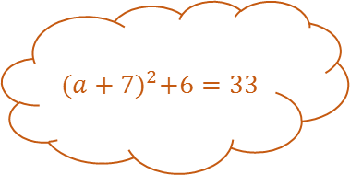
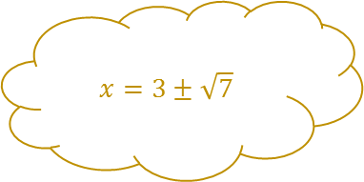
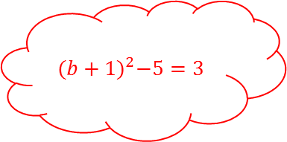
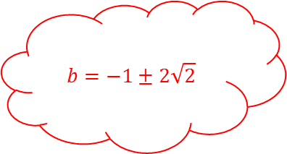
Completing The Square Explosions 1
$${(x−3)}^{2}=7$$
$$x=3±\sqrt{7}$$
$${(a+7)}^{2}+6=33$$
$${(n+2)}^{2}−5=0$$
Solve by completing the square
$$b=−1±2\sqrt{2}$$
$${(b+1)}^{2}−5=3$$
$$x=5±3\sqrt{2}$$

Slide 3
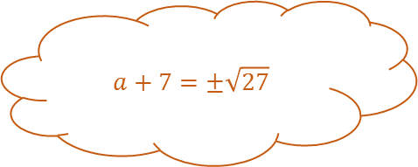
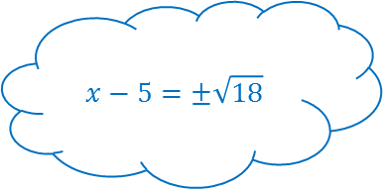
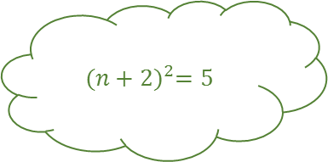
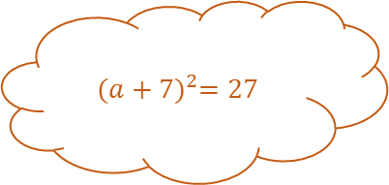
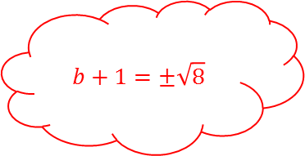
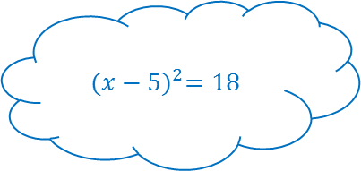
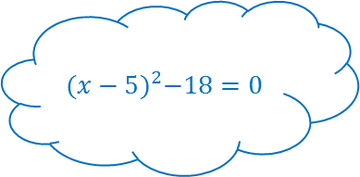

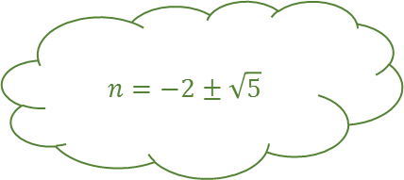


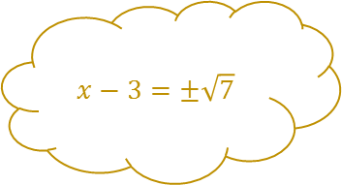
Completing The Square Explosions 1
$${(x−3)}^{2}=7$$
$$x−3=±\sqrt{7}$$
Answers
$$x=3±\sqrt{7}$$
$${(a+7)}^{2}=27$$
$${(a+7)}^{2}+6=33$$
$${(n+2)}^{2}−5=0$$
$${(n+2)}^{2}=5$$
$$a+7=±\sqrt{27}$$
Solve by completing the square
$$n+2=±\sqrt{5}$$
$$b=−1±2\sqrt{2}$$
$${(x−5)}^{2}−18=0$$
$$a=−7±3\sqrt{3}$$
$${(b+1)}^{2}−5=3$$
$$n=−2±\sqrt{5}$$
$${(x−5)}^{2}=18$$
$$b+1=±\sqrt{8}$$
$${(b+1)}^{2}=8$$
$$x−5=±\sqrt{18}$$
$$x=5±3\sqrt{2}$$

Slide 4
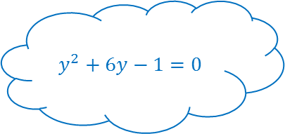
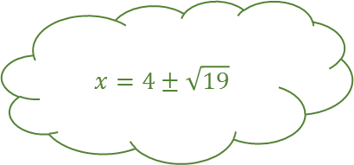
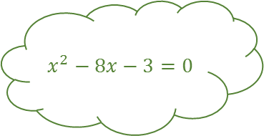


Completing The Square Explosions 2
$${(t+2)}^{2}−4−7=3$$
$$x^{2}−8x−3=0$$
Solve by completing the square
$$p=−5±\sqrt{31}$$
$$y^{2}+6y−1=0$$
$$x=4±\sqrt{19}$$

Slide 5

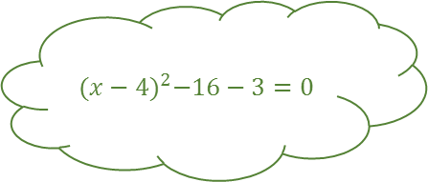


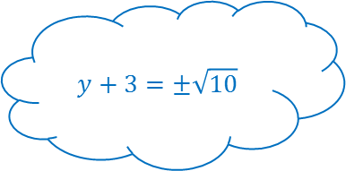



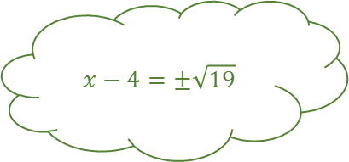
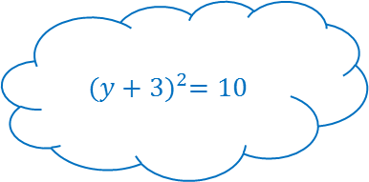


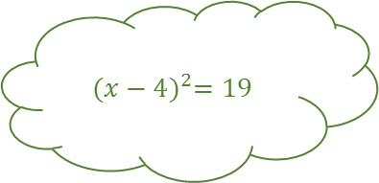
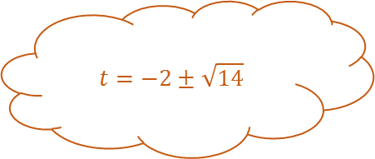

Completing The Square Explosions 2
$${(x−4)}^{2}−16−3=0$$
$${(x−4)}^{2}=19$$
Answers
$$t^{2}+4t−7=3$$
$${(t+2)}^{2}=14$$
$${(t+2)}^{2}−4−7=3$$
$$x^{2}−8x−3=0$$
$$x−4=±\sqrt{19}$$
$$t+2=±\sqrt{14}$$
Solve by completing the square
$$p=−5±\sqrt{31}$$
$$y^{2}+6y−1=0$$
$$x=4±\sqrt{19}$$
$$t=−2±\sqrt{14}$$
$$p^{2}+10p−6=0$$
$${(y+3)}^{2}−9−1=0$$
$$y=−3±\sqrt{10}$$
$$p+5=±\sqrt{31}$$
$${(p+5)}^{2}=31$$
$${(p+5)}^{2}−25−6=0$$
$${(y+3)}^{2}=10$$
$$y+3=±\sqrt{10}$$

Slide 6
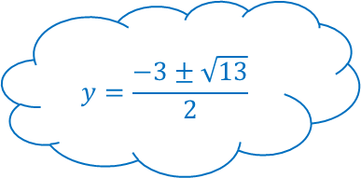
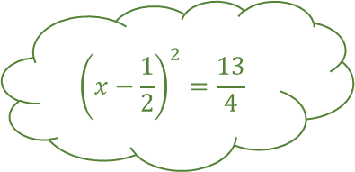
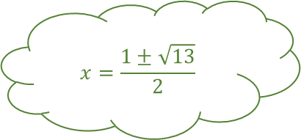
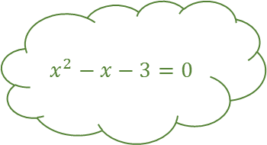

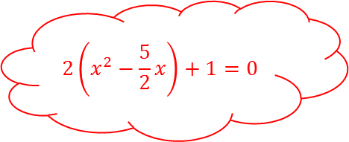
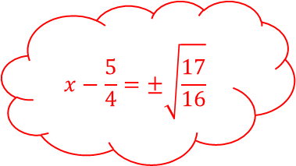


Completing The Square Explosions 3
$${\left(x−\frac{1}{2}\right)}^{2}=\frac{13}{4}$$
$$x−\frac{5}{4}=±\sqrt{\frac{17}{16}}$$
$$x^{2}−x−3=0$$
Solve by completing the square
$$y^{2}+3y−1=0$$
$$x=\frac{1±\sqrt{13}}{2}$$
$$2{\left(x−\frac{5}{4}\right)}^{2}−\frac{17}{8}=0$$
$${2x}^{2}−5x+1=0$$
$$y=\frac{−3±\sqrt{13}}{2}$$
$$2\left(x^{2}−\frac{5}{2}x\right)+1=0$$

Slide 7
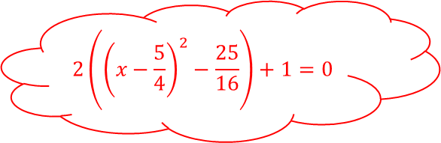
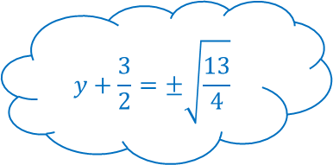
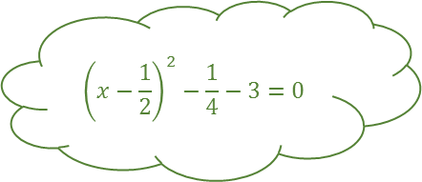
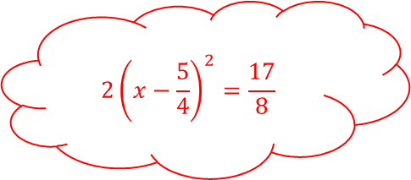

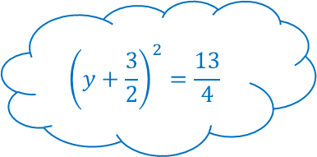
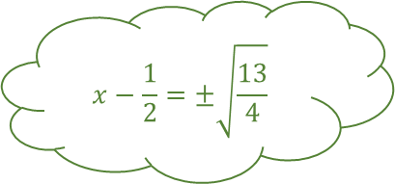
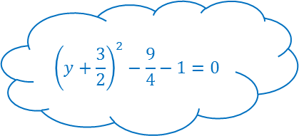
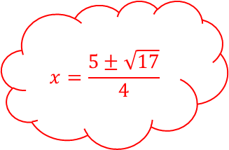

Completing The Square Explosions 3
$${\left(x−\frac{1}{2}\right)}^{2}−\frac{1}{4}−3=0$$
$${\left(x−\frac{1}{2}\right)}^{2}=\frac{13}{4}$$
Answers
$${\left(x−\frac{5}{4}\right)}^{2}=\frac{17}{16}$$
$$x−\frac{5}{4}=±\sqrt{\frac{17}{16}}$$
$$x^{2}−x−3=0$$
$$x−\frac{1}{2}=±\sqrt{\frac{13}{4}}$$
$$2{\left(x−\frac{5}{4}\right)}^{2}=\frac{17}{8}$$
$$x=\frac{5±\sqrt{17}}{4}$$
Solve by completing the square
$$y^{2}+3y−1=0$$
$$x=\frac{1±\sqrt{13}}{2}$$
$$2{\left(x−\frac{5}{4}\right)}^{2}−\frac{17}{8}=0$$
$${2x}^{2}−5x+1=0$$
$${\left(y+\frac{3}{2}\right)}^{2}−\frac{9}{4}−1=0$$
$$y=\frac{−3±\sqrt{13}}{2}$$
$$2\left({\left(x−\frac{5}{4}\right)}^{2}−\frac{25}{16}\right)+1=0$$
$$2\left(x^{2}−\frac{5}{2}x\right)+1=0$$
$${\left(y+\frac{3}{2}\right)}^{2}=\frac{13}{4}$$
$$y+\frac{3}{2}=±\sqrt{\frac{13}{4}}$$

