Slide 1
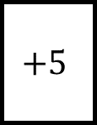
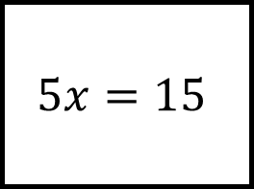
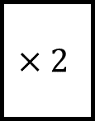
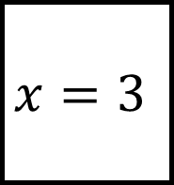
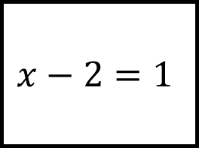
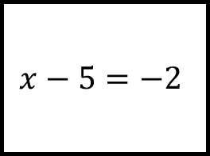
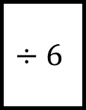
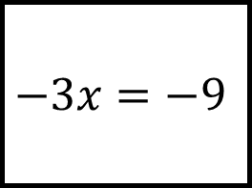
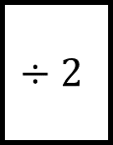
Solving Equations Spider 1
$$−3x=−9$$
$$5x=15$$
$$×2$$
$$x=3$$
$$÷6$$
$$+5$$
Fill in the blanks…
$$÷2$$
$$x−5=−2$$
$$x−2=1$$

Slide 2
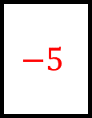
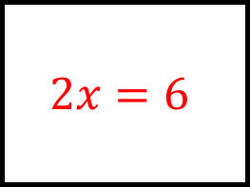
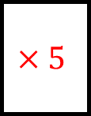
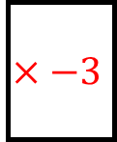
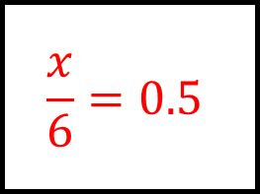
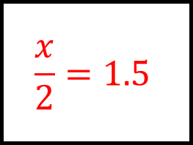
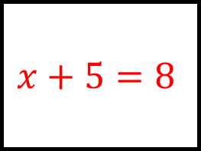
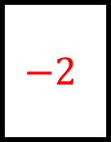
Solving Equations Spider 1 - Answers
$$2x=6$$
$$−3x=−9$$
$$5x=15$$
$$×2$$
$$×−3$$
$$×5$$
$$\frac{x}{6}=0.5$$
$$x=3$$
$$x+5=8$$
$$÷6$$
$$+5$$
Fill in the blanks…
$$−5$$
$$−2$$
$$÷2$$
$$x−5=−2$$
$$x−2=1$$
$$\frac{x}{2}=1.5$$

Slide 3
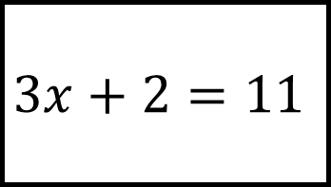
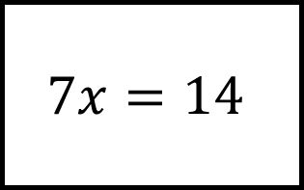
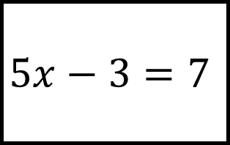
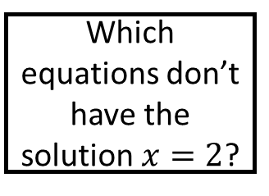
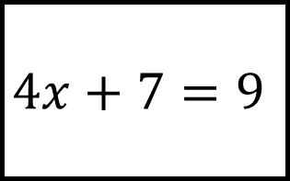
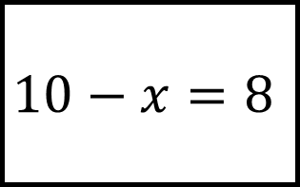
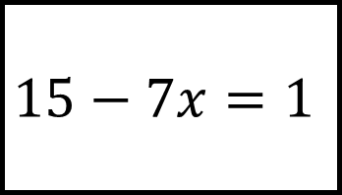
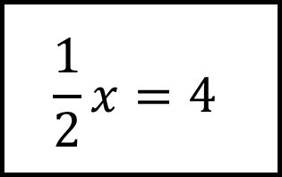
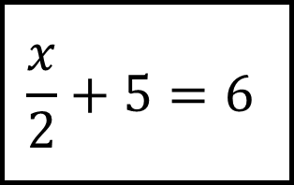
$$7x=14$$
$$15−7x=1$$
$$3x+2=11$$
Solving Equations Spider 2
$$4x+7=9$$
Which equations don’t have the solution $x=2$?
$$10−x=8$$
Fill in the gap with the stages of your workings
$$\frac{x}{2}+5=6$$
$$5x−3=7$$
$$\frac{1}{2}x=4$$

Slide 4
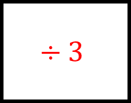
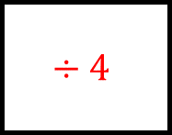
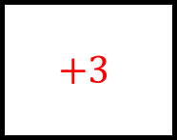
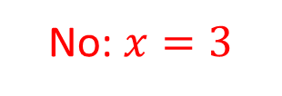
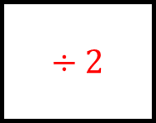
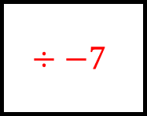
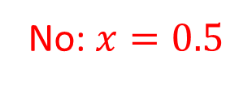
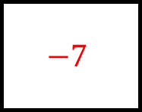
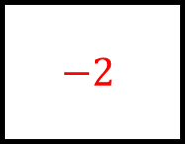
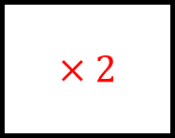
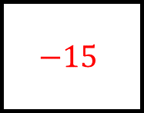
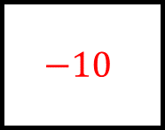
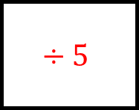
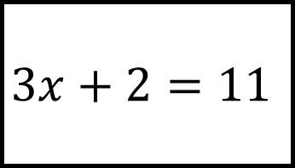
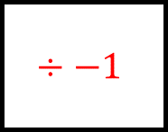
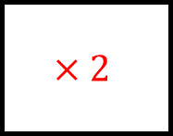
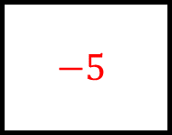
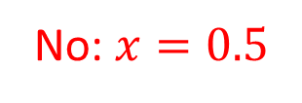
$$7x=14$$
$$15−7x=1$$
$$3x+2=11$$
$$−15$$
$$−2$$
No: $x=3$
$$÷−7$$
$$÷2$$
$$÷3$$
Solving Equations Spider 2 - Answers
$$4x+7=9$$
Which equations don’t have the solution $x=2$?
$$10−x=8$$
$$−7$$
$$÷4$$
$$÷−1$$
$$−10$$
No: $x=0.5$
Fill in the gap with the stages of your workings
$$×2$$
$$×2$$
$$÷5$$
$$\frac{x}{2}+5=6$$
$$5x−3=7$$
$$−5$$
$$+3$$
$$\frac{1}{2}x=4$$
No: $x=0.5$

Slide 5
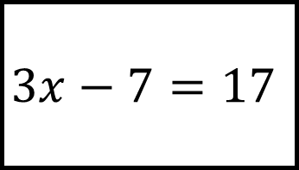
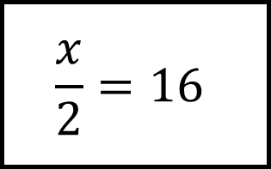
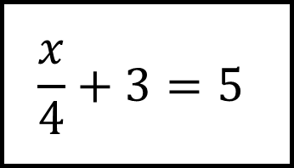
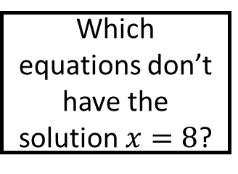
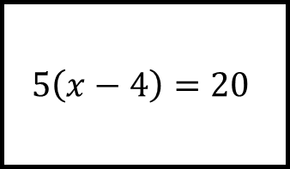
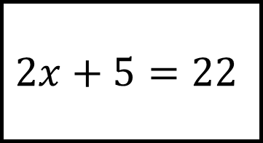



$$\frac{x}{2}=16$$
$$3\left(x+1\right)=27$$
$$3x−7=17$$
Solving Equations Spider 3
$$5\left(x−4\right)=20$$
Which equations don’t have the solution $x=8$?
$$2x+5=22$$
Fill in the gap with the stages of your workings
$$\frac{3x}{4}=6$$
$$\frac{x}{4}+3=5$$
$$1.5x=12$$

Slide 6
















$$\frac{x}{2}=16$$
$$3\left(x+1\right)=27$$
$$3x−7=17$$
$$÷3$$
$$+8$$
No: $x=32$
$$−1$$
$$×2$$
$$÷3$$
Solving Equations Spider 3 - Answers
$$5\left(x−4\right)=20$$
Which equations don’t have the solution $x=8$?
$$2x+5=22$$
$$÷5$$
$$+4$$
$$÷2$$
$$−5$$
No: $x=8.5$
Fill in the gap with the stages of your workings
$$÷3$$
$$÷1.5$$
$$×4$$
$$\frac{3x}{4}=6$$
$$\frac{x}{4}+3=5$$
$$×4$$
$$−3$$
$$1.5x=12$$

Slide 7









$$2x=6$$
$$5−4x=17$$
$$8−x=11$$
Solving Equations Spider 4
$$2\left(x+3\right)=2$$
Which equations don’t have the solution $x=−3$?
$$2x+7=1$$
Fill in the gap with the stages of your workings
$$7−2x=13$$
$$3x−2=−11$$
$$x+5=8$$

Slide 8
















$$2x=6$$
$$5−4x=17$$
$$8−x=11$$
$$−5$$
$$−8$$
No: $x=3$
$$÷−4$$
$$÷2$$
$$÷−1$$
Solving Equations Spider 4 - Answers
$$2\left(x+3\right)=2$$
Which equations don’t have the solution $x=−3$?
$$2x+7=1$$
$$÷2$$
$$−3$$
$$÷2$$
$$−7$$
No: $x=−2$
Fill in the gap with the stages of your workings
$$÷−2$$
$$−5$$
$$÷3$$
$$7−2x=13$$
$$3x−2=−11$$
$$−7$$
$$+2$$
$$x+5=8$$
No: $x=3$

Slide 9























Solving Equations Spider – Blank
Which equations don’t have the solution $x=$?
Fill in the gap with the stages of your workings

