Slide 1

Exploding
Inequalities
Can you fill in the blanks?

Slide 2
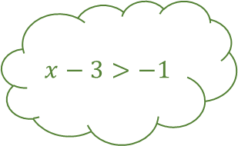
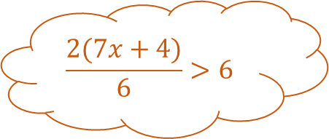
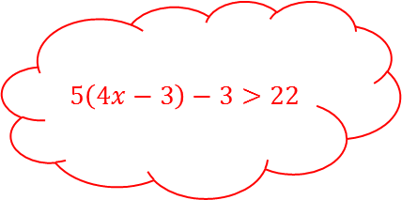

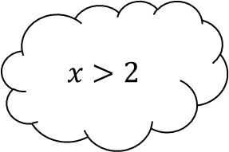
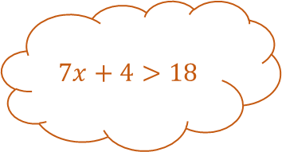




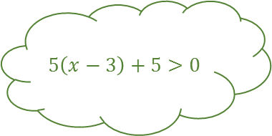

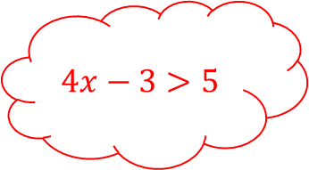
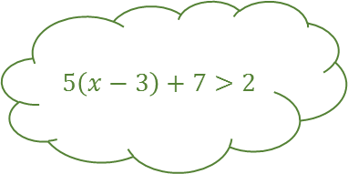



Exploding Inequalities 1
$$3x+8>14$$
$$÷7$$
$$7x+4>18$$
$$x−3>−1$$
$$×3$$
$$5\left(x−3\right)>−5$$
$$x>2$$
$$5\left(x−3\right)+7>2$$
$$5\left(4x−3\right)−3>22$$
$$\frac{2(7x+4)}{6}>6$$
$$+1$$
$$4x>8$$
$$÷3$$
$$5\left(x−3\right)+5>0$$
$$5\left(4x−3\right)>25$$
$$4x−3>5$$
$$×2$$

Slide 3



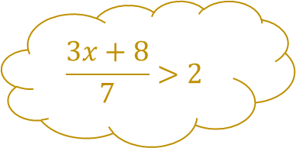


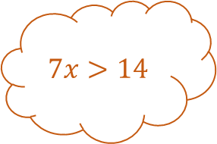




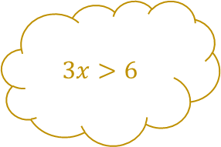
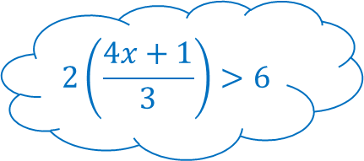


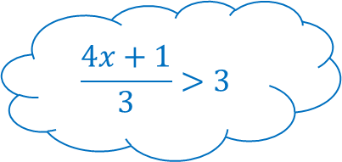




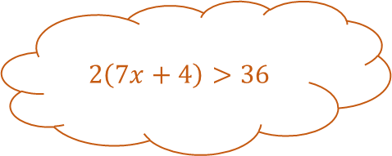
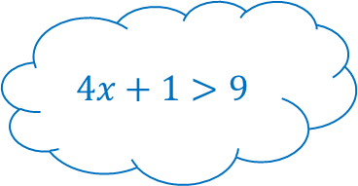
Exploding Inequalities 1 - Answers
$$3x>6$$
$$3x+8>14$$
$$+8$$
$$÷7$$
$$\frac{3x+8}{7}>2$$
$$7x+4>18$$
$$+4$$
$$7x>14$$
$$x−3>−1$$
$$×5$$
$$×3$$
$$5\left(x−3\right)>−5$$
$$×2$$
$$2\left(7x+4\right)>36$$
$$×7$$
$$+7$$
$$−3$$
$$x>2$$
$$5\left(x−3\right)+7>2$$
$$5\left(4x−3\right)−3>22$$
$$4x+1>9$$
$$÷6$$
$$×4$$
$$\frac{2(7x+4)}{6}>6$$
$$+1$$
$$−2$$
$$4x>8$$
$$÷3$$
$$\frac{4x+1}{3}>3$$
$$5\left(x−3\right)+5>0$$
$$−3$$
$$−3$$
$$5\left(4x−3\right)>25$$
$$4x−3>5$$
$$2\left(\frac{4x+1}{3}\right)>6$$
$$×5$$
$$×2$$

Slide 4

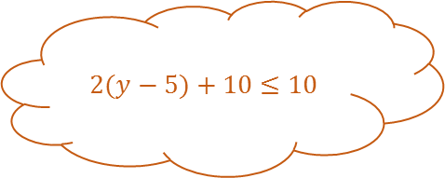


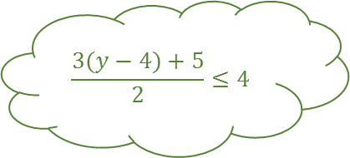
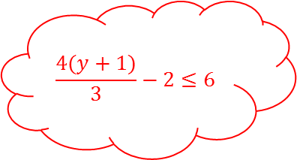

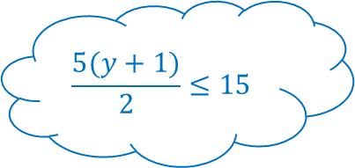



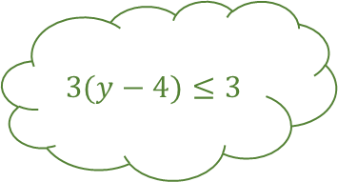

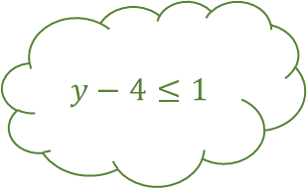
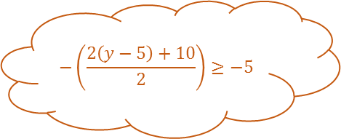
Exploding Inequalities 2
$$×2$$
$$÷8$$
$$y−4≤1$$
$$+3$$
$$3(y−4)≤3$$
$$2(y−5)+10≤10$$
$$y≤5$$
$$3(y−4)+5≤8$$
$$\frac{4(y+1)}{3}−2≤6$$
$$−\left(\frac{2\left(y−5\right)+10}{2}\right)≥−5$$
$$÷2$$
$$\frac{5(y+1)}{2}≤15$$
$$\frac{3(y−4)+5}{2}≤4$$
$$4(y+1)≤24$$
$$+3$$

Slide 5



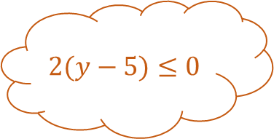

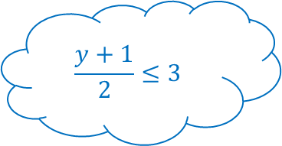


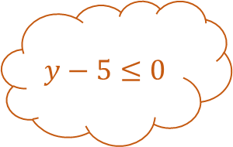
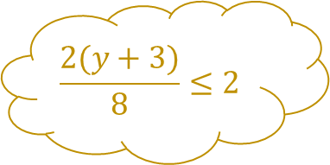








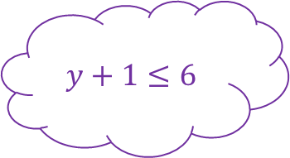
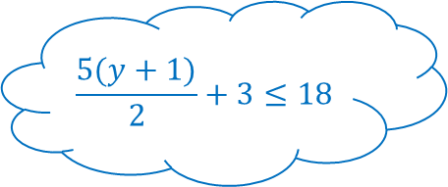

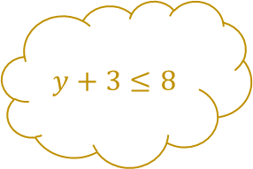


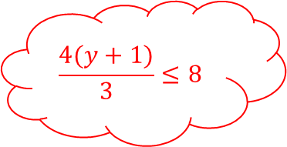
Exploding Inequalities 2 - Answers
$$y+3≤8$$
$$2(y+3)≤16$$
$$×2$$
$$÷8$$
$$\frac{2(y+3)}{8}≤2$$
$$2(y−5)≤0$$
$$×2$$
$$y−5≤0$$
$$y−4≤1$$
$$+3$$
$$×3$$
$$3(y−4)≤3$$
$$+10$$
$$2(y−5)+10≤10$$
$$−5$$
$$−4$$
$$+5$$
$$y≤5$$
$$3(y−4)+5≤8$$
$$\frac{4(y+1)}{3}−2≤6$$
$$\frac{y+1}{2}≤3$$
$$÷−2$$
$$+1$$
$$÷2$$
$$−\left(\frac{2\left(y−5\right)+10}{2}\right)≥−5$$
$$÷2$$
$$×5$$
$$y+1≤6$$
$$\frac{3(y−4)+5}{2}≤4$$
$$\frac{5(y+1)}{2}≤15$$
$$−2$$
$$×4$$
$$\frac{4(y+1)}{3}≤8$$
$$4(y+1)≤24$$
$$\frac{5(y+1)}{2}+3≤18$$
$$÷3$$
$$+3$$

Slide 6

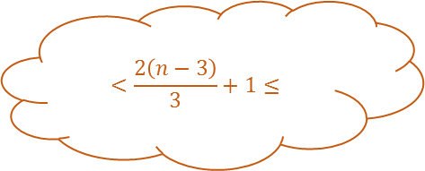
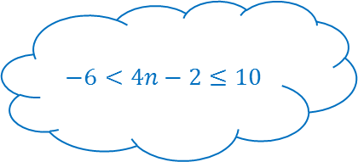



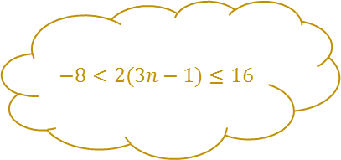

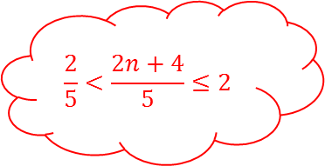





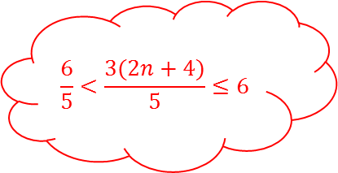

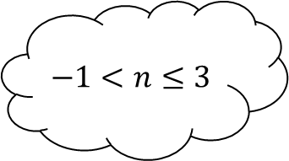
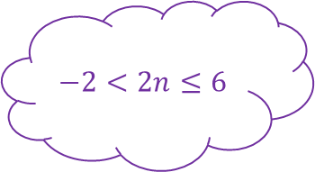
Exploding Inequalities 3
$$−8<2(3n−1)≤16$$
$$<2\left(n−5\right)≤$$
$$<n−5≤$$
$$×4$$
$$<\frac{2(n−5)}{3}≤$$
$$+2$$
$$+1$$
$$−1<n≤3$$
$$\frac{6}{5}<\frac{3(2n+4)}{5}≤6$$
$$−1$$
$$÷2$$
$$÷3$$
$$<\frac{2\left(n−3\right)}{3}+1≤$$
$$−2<2n≤6$$
$$\frac{2}{5}<\frac{2n+4}{5}≤2$$
$$2<2n+4≤10$$
$$×4$$
$$−6<4n−2≤10$$

Slide 7



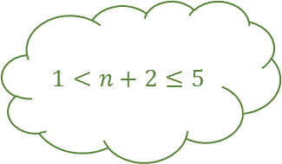


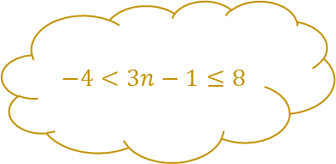





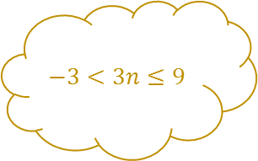



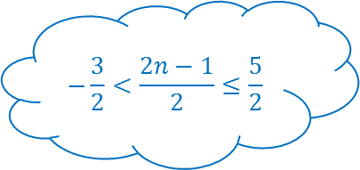



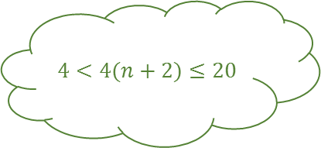
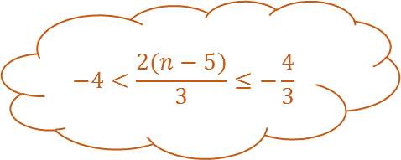

Exploding Inequalities 3 - Answers
$$−3<3n≤9$$
$$−4<3n−1≤8$$
$$−1$$
$$×2$$
$$−8<2(3n−1)≤16$$
$$−12<2\left(n−5\right)≤−4$$
$$−6<n−5≤−2$$
$$1<n+2≤5$$
$$×4$$
$$×2$$
$$4<4(n+2)≤20$$
$$×3$$
$$÷3$$
$$−4<\frac{2(n−5)}{3}≤−\frac{4}{3}$$
$$−5$$
$$+2$$
$$+1$$
$$−1<n≤3$$
$$5<4\left(n+2\right)+1≤21$$
$$\frac{6}{5}<\frac{3(2n+4)}{5}≤6$$
$$−3<2n−1≤5$$
$$+1$$
$$×2$$
$$−1$$
$$÷2$$
$$÷3$$
$$−3<\frac{2\left(n−5\right)}{3}+1≤−\frac{1}{3}$$
$$−2<2n≤6$$
$$−\frac{3}{2}<\frac{2n−1}{2}≤\frac{5}{2}$$
$$\frac{5}{3}<\frac{4\left(n+2\right)+1}{3}≤7$$
$$×3$$
$$+4$$
$$\frac{2}{5}<\frac{2n+4}{5}≤2$$
$$2<2n+4≤10$$
$$×4$$
$$−6<4n−2≤10$$
$$÷5$$

Slide 8
Exploding Inequalities

Slide 9
Exploding Inequalities

