Slide 1

Proportion Explosions
Can you fill in the blanks?

Slide 2
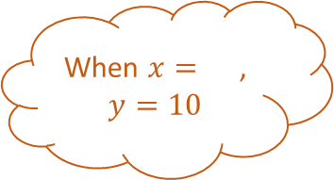
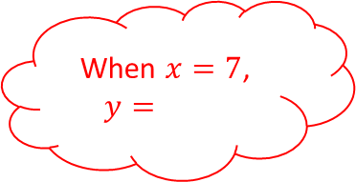
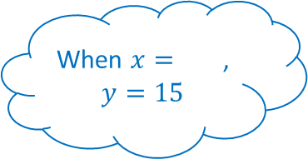
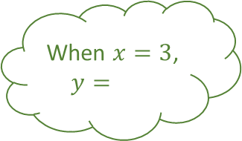
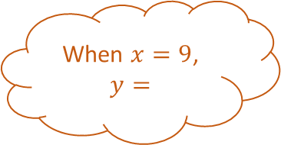
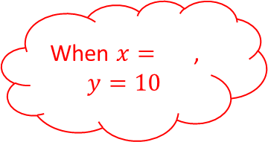
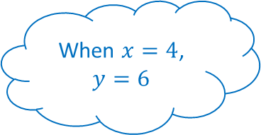
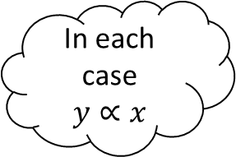
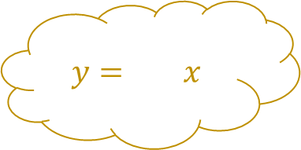

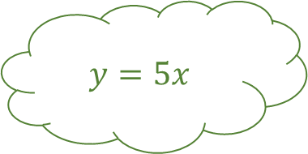
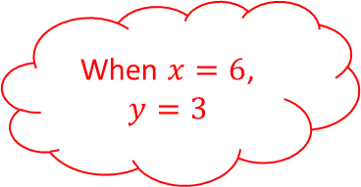
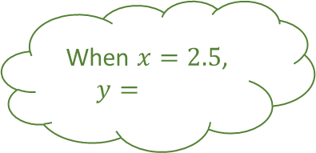
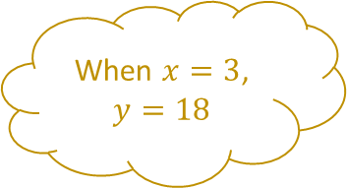

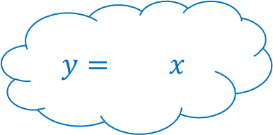
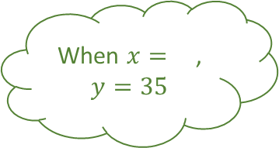
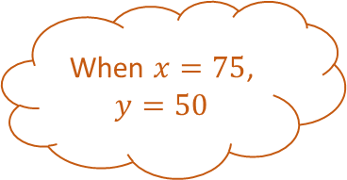
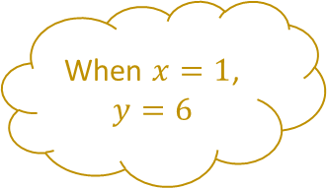
Proportion Explosions 1
When $x=1$, $y=6$
When $x=3$, $y=18$
$$y= x$$
When $x=$, $y=10$
When $x=9$, $y=$
When $x=3$, $y=$
When $x=$, $y=35$
When $x=75$, $y=50$
In each case $y∝x$
When $x=2.5$, $y=$
$$y=$$
When $x=4$, $y=6$
$$y=$$
When $x=6$, $y=3$
When $x=$, $y=15$
$$y=5x$$
When $x=7$, $y=$
When $x=$, $y=10$
$$y= x$$

Slide 3


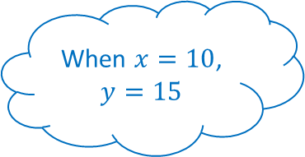
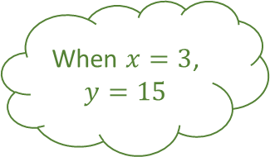

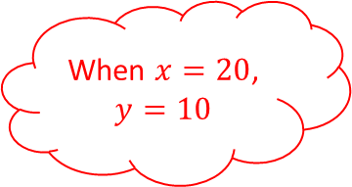
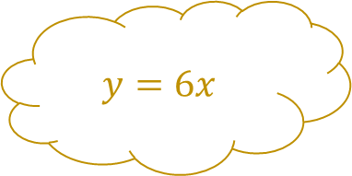
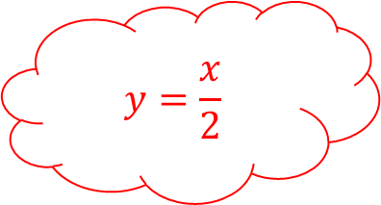
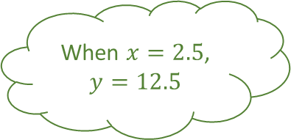

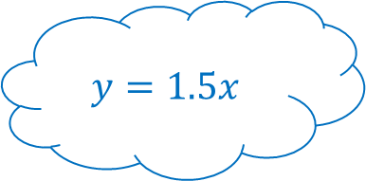
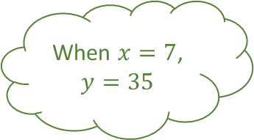
Proportion Explosions 1 - Answers
When $x=1$, $y=6$
When $x=3$, $y=18$
$$y=6x$$
When $x=15$, $y=10$
When $x=9$, $y=6$
When $x=3$, $y=15$
When $x=7$, $y=35$
When $x=75$, $y=50$
In each case $y∝x$
When $x=2.5$, $y=12.5$
$$y=\frac{x}{2}$$
When $x=4$, $y=6$
$$y=\frac{2x}{3}$$
When $x=6$, $y=3$
When $x=10$, $y=15$
$$y=5x$$
When $x=7$, $y=3.5$
When $x=20$, $y=10$
$$y=1.5x$$

Slide 4
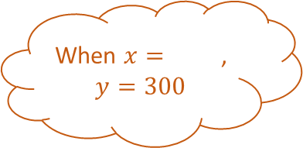

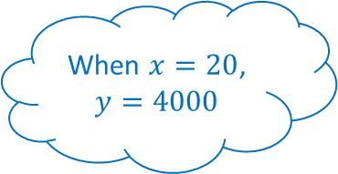
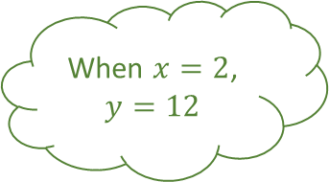

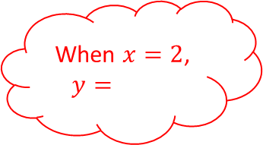
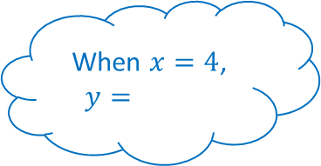
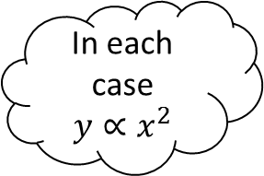

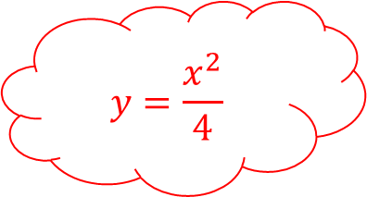

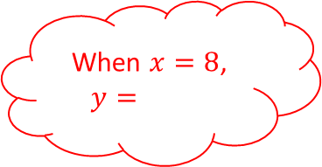
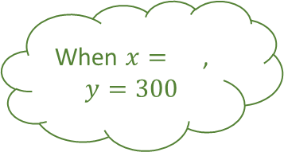
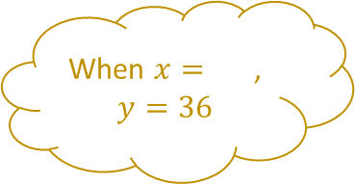


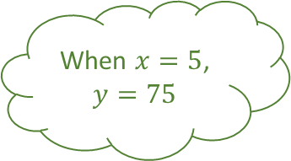

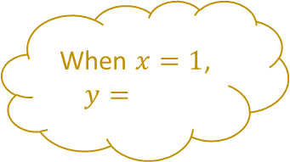
Proportion Explosions 2
When $x=1$, $y=$
When $x=$, $y=36$
$$y={4x}^{2}$$
When $x=$, $y=300$
When $x=2$, $y=3$
When $x=2$, $y=12$
When $x=5$, $y=75$
When $x=3$, $y=$
In each case $y∝x^{2}$
When $x=$, $y=300$
$$y=\frac{x^{2}}{4}$$
When $x=4$, $y=$
$$y=$$
When $x=8$, $y=$
When $x=20$, $y=4000$
$$y=$$
When $x=$, $y=25$
When $x=2$, $y=$
$$y=$$

Slide 5


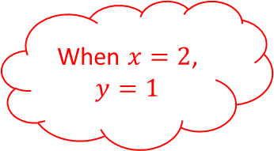
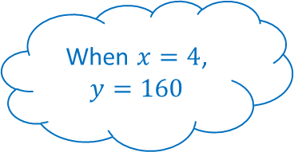
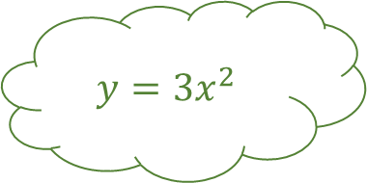
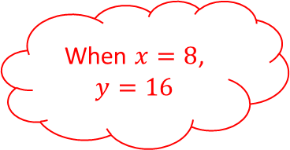


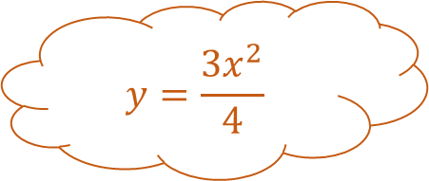
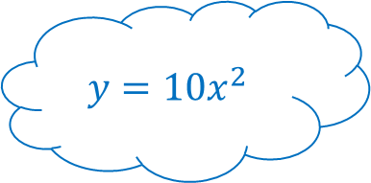


Proportion Explosions 2 - Answers
When $x=1$, $y=4$
When $x=3$, $y=36$
$$y={4x}^{2}$$
When $x=20$, $y=300$
When $x=2$, $y=3$
When $x=2$, $y=12$
When $x=5$, $y=75$
When $x=3$, $y=6.75$
In each case $y∝x^{2}$
When $x=10$, $y=300$
$$y=\frac{x^{2}}{4}$$
When $x=4$, $y=160$
$$y=\frac{{3x}^{2}}{4}$$
When $x=8$, $y=16$
When $x=20$, $y=4000$
$$y={3x}^{2}$$
When $x=10$, $y=25$
When $x=2$, $y=1$
$$y={10x}^{2}$$

Slide 6
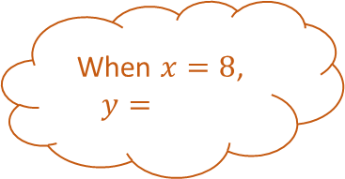


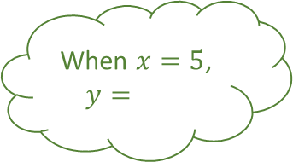


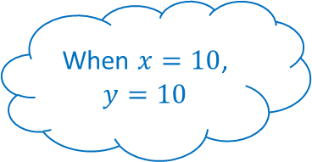
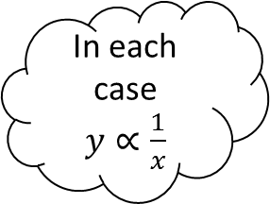

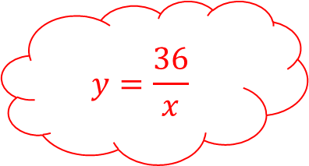
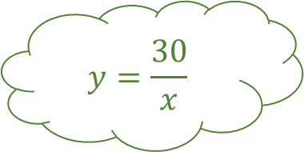

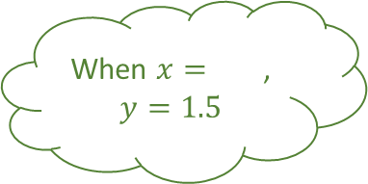





Proportion Explosions 3
When $x=$, $y=3$
When $x=12$, $y=1$
$$y=$$
When $x=8$, $y=$
When $x=$, $y=1000$
When $x=5$, $y=$
When $x=10$, $y=$
When $x=5$, $y=80$
In each case $y∝\frac{1}{x}$
When $x=$, $y=1.5$
$$y=\frac{36}{x}$$
When $x=10$, $y=10$
$$y=$$
When $x=$, $y=18$
When $x=$, $y=25$
$$y=\frac{30}{x}$$
When $x=$, $y=24$
When $x=6$, $y=$
$$y=$$

Slide 7













Proportion Explosions 3 - Answers
When $x=4$, $y=3$
When $x=12$, $y=1$
$$y=\frac{12}{x}$$
When $x=8$, $y=50$
When $x=\frac{2}{5}$, $y=1000$
When $x=5$, $y=6$
When $x=10$, $y=3$
When $x=5$, $y=80$
In each case $y∝\frac{1}{x}$
When $x=20$, $y=1.5$
$$y=\frac{36}{x}$$
When $x=10$, $y=10$
$$y=\frac{400}{x}$$
When $x=2$, $y=18$
When $x=4$, $y=25$
$$y=\frac{30}{x}$$
When $x=1.5$, $y=24$
When $x=6$, $y=6$
$$y=\frac{100}{x}$$

Slide 8



















Proportion Explosions 4
When $x=4$, $y=$
When $x=$, $y=5$
$$y=\frac{20}{\sqrt{x}}$$
When $x=$, $y=6$
When $x=81$, $y=4$
When $x=36$, $y=4$
When $x=64$, $y=$
When $x=100$, $y=$
In each case $y∝\frac{1}{\sqrt{x}}$
When $x=100$, $y=$
$$y=$$
When $x=144$, $y=$
$$y=$$
When $x=100$, $y=20$
When $x=$, $y=4$
$$y=$$
When $x=$, $y=8$
When $x=16$, $y=$
$$y=\frac{60}{\sqrt{x}}$$

Slide 9













Proportion Explosions 4 - Answers
When $x=4$, $y=10$
When $x=16$, $y=5$
$$y=\frac{20}{\sqrt{x}}$$
When $x=36$, $y=6$
When $x=81$, $y=4$
When $x=36$, $y=4$
When $x=64$, $y=3$
When $x=100$, $y=3.6$
In each case $y∝\frac{1}{\sqrt{x}}$
When $x=100$, $y=2.4$
$$y=\frac{200}{\sqrt{x}}$$
When $x=144$, $y=5$
$$y=\frac{36}{\sqrt{x}}$$
When $x=100$, $y=20$
When $x=225$, $y=4$
$$y=\frac{24}{\sqrt{x}}$$
When $x=625$, $y=8$
When $x=16$, $y=50$
$$y=\frac{60}{\sqrt{x}}$$

Slide 10
Proportion Explosions

Slide 11
Proportion Explosions

