Slide 1

Solving Quadratics Explosions
Can you fill in the blanks?

Slide 2


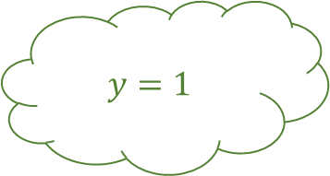
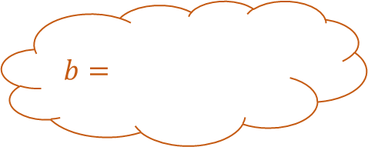
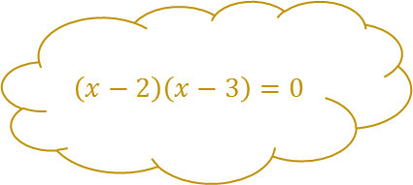

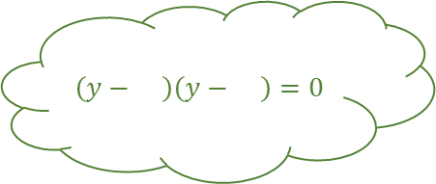
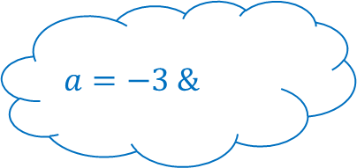
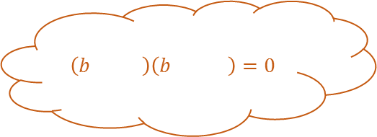
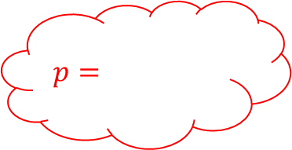

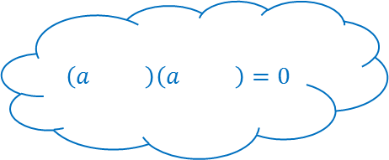

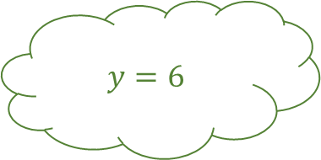
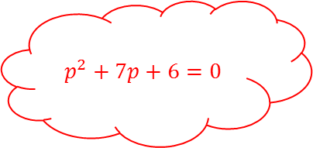
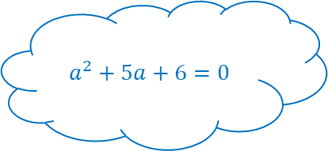
Solving Quadratics Explosions 1
$$\left(x−2\right)\left(x−3\right)=0$$
$$x= \&$$
$$\left(b \right)\left(b \right)=0$$
$$b^{2}−7b+12=0$$
$$\left(y− \right)\left(y− \right)=0$$
$$b=$$
All these quadratics factorise
$$y=1$$
$$p=$$
$$a^{2}+5a+6=0$$
$$b=$$
$$p^{2}+7p+6=0$$
$$\left(a \right)\left(a \right)=0$$
$$y=6$$
$$p=$$
$$\left(p+ \right)\left(p \right)=0$$
$$a=−3 \&$$

Slide 3


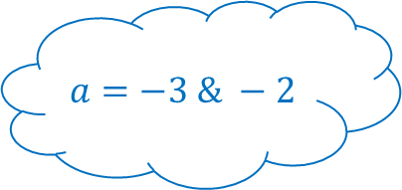
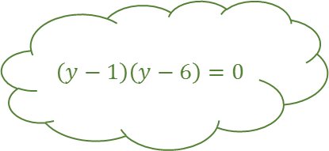

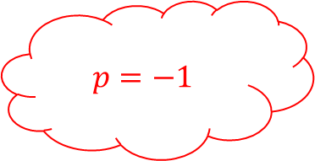

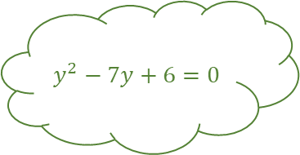
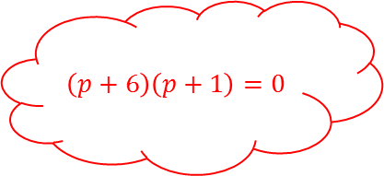
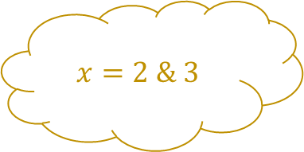


Solving Quadratics Explosions 1
$$x^{2}−5x+6=0$$
$$\left(x−2\right)\left(x−3\right)=0$$
Answers
$$x=2 \& 3$$
$$\left(b−3\right)\left(b−4\right)=0$$
$$b^{2}−7b+12=0$$
$$y^{2}−7y+6=0$$
$$\left(y−1\right)\left(y−6\right)=0$$
$$b=3$$
All these quadratics factorise
$$y=1$$
$$p=−6$$
$$a^{2}+5a+6=0$$
$$b=4$$
$$p^{2}+7p+6=0$$
$$\left(a+2\right)\left(a+3\right)=0$$
$$y=6$$
$$p=−1$$
$$\left(p+6\right)\left(p+1\right)=0$$
$$a=−3 \& −2$$

Slide 4
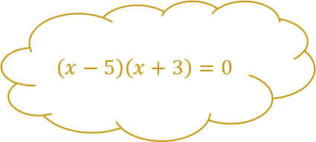


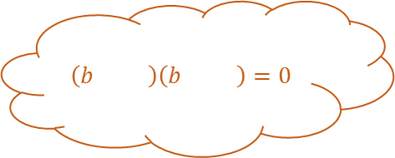
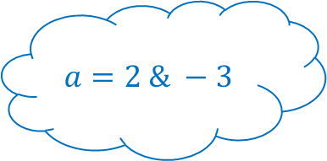

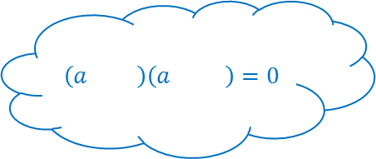
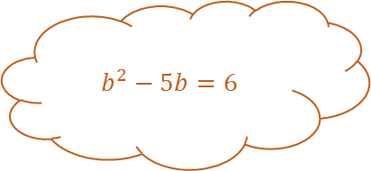


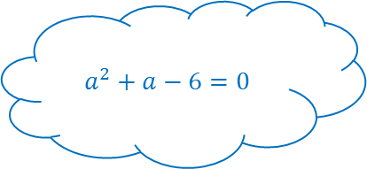

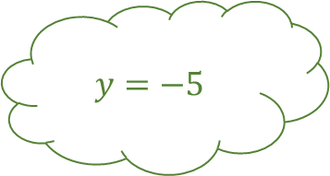

Solving Quadratics Explosions 2
$$\left(x−5\right)\left(x+3\right)=0$$
$$x= \&$$
$$\left(b \right)\left(b \right)=0$$
$$b^{2}−5b=6$$
$$y^{2}+ y− =0$$
$$\left(y+ \right)\left(y− \right)=0$$
$$b=$$
All these quadratics factorise
$$y=−5$$
$$p=−2$$
$$a^{2}+a−6=0$$
$$b=$$
$$p^{2}−3p−10=0$$
$$\left(a \right)\left(a \right)=0$$
$$y=3$$
$$p=$$
$$\left(p \right)\left(p \right)=0$$
$$a=2 \& −3$$

Slide 5


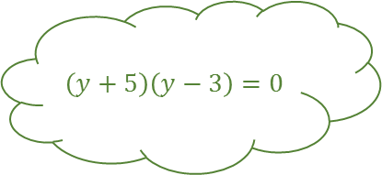

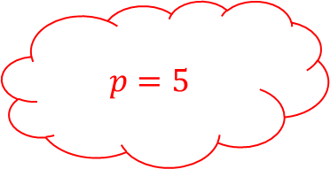
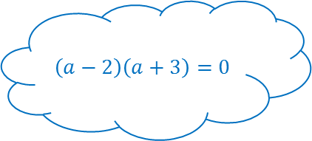




Solving Quadratics Explosions 2
$$x^{2}−2x−15=0$$
$$\left(x−5\right)\left(x+3\right)=0$$
Answers
$$x=5 \& −3$$
$$\left(b−6\right)\left(b+1\right)=0$$
$$b^{2}−5b=6$$
$$y^{2}+2y−15=0$$
$$\left(y+5\right)\left(y−3\right)=0$$
$$b=6$$
All these quadratics factorise
$$y=−5$$
$$p=−2$$
$$a^{2}+a−6=0$$
$$b=−1$$
$$p^{2}−3p−10=0$$
$$\left(a−2\right)\left(a+3\right)=0$$
$$y=3$$
$$p=5$$
$$\left(p−5\right)\left(p+2\right)=0$$
$$a=2 \& −3$$

Slide 6
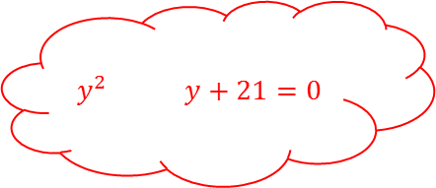




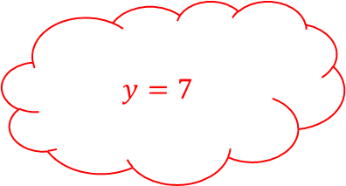

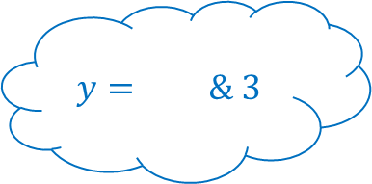







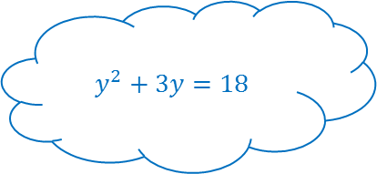
Solving Quadratics Explosions 3
$$x^{2}+4x+3=0$$
$$\left(x \right)\left(x \right)=0$$
$$x= \&$$
$$a^{2}−a−2=10$$
$$\left(x \right)\left(x \right)=0$$
$$a=$$
All these quadratics factorise
$$x=4$$
$$y=7$$
$$y^{2}+3y=18$$
$$a=$$
$$y^{2} y+21=0$$
$$\left(y \right)\left(y \right)=0$$
$$x=5$$
$$y=$$
$$\left(y \right)\left(y \right)=0$$
$$y= \& 3$$

Slide 7

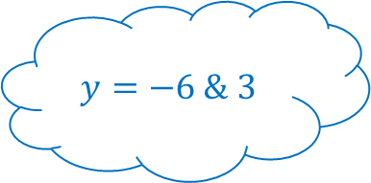


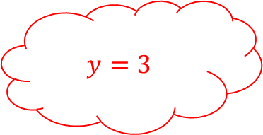



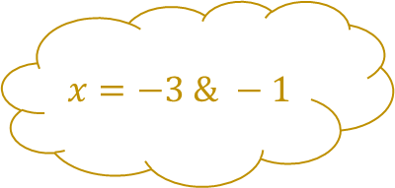

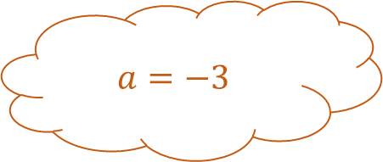

Solving Quadratics Explosions 3
$$x^{2}+4x+3=0$$
$$\left(x+3\right)\left(x+1\right)=0$$
Answers
$$x=−3 \& −1$$
$$\left(a−4\right)\left(a+3\right)=0$$
$$a^{2}−a−2=10$$
$$x^{2}−9x+20=0$$
$$\left(x−4\right)\left(x−5\right)=0$$
$$a=4$$
All these quadratics factorise
$$x=4$$
$$y=7$$
$$y^{2}+3y=18$$
$$a=−3$$
$$y^{2}−10y+21=0$$
$$\left(y+6\right)\left(y−3\right)=0$$
$$x=5$$
$$y=3$$
$$\left(y−3\right)\left(y−7\right)=0$$
$$y=−6 \& 3$$

Slide 8








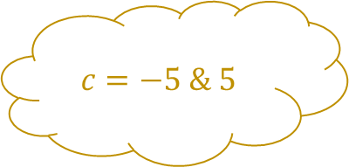

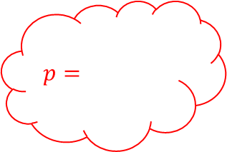


Solving Quadratics Explosions 4
$$\left(c \right)\left(c \right)=0$$
$$c=−5 \& 5$$
$$\left(2x−1\right)\left(x−1\right)=0$$
$$a=−\frac{3}{2}$$
All these quadratics factorise
$$x=$$
$$p=$$
$${3y}^{2}+4y+1=0$$
$$a=\frac{1}{2}$$
$${4p}^{2}=9$$
$$\left(3y \right)\left(y \right)=0$$
$$x=$$
$$p=$$
$$y= \&$$

Slide 9

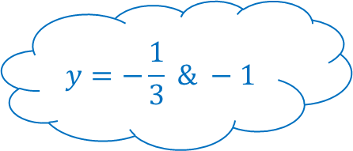




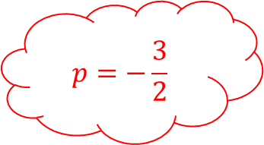

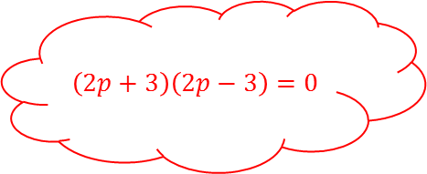
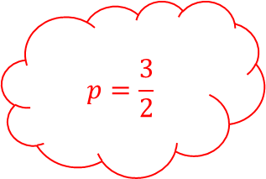
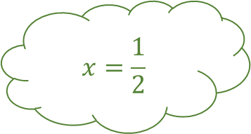

Solving Quadratics Explosions 4
$$c^{2}−25=0$$
$$\left(c+5\right)\left(c−5\right)=0$$
Answers
$$c=−5 \& 5$$
$$\left(2a+3\right)\left(2a−1\right)=0$$
$$4a^{2}+4a−3=0$$
$${2x}^{2}−3x+1=0$$
$$\left(2x−1\right)\left(x−1\right)=0$$
$$a=−\frac{3}{2}$$
All these quadratics factorise
$$x=\frac{1}{2}$$
$$p=\frac{3}{2}$$
$${3y}^{2}+4y+1=0$$
$$a=\frac{1}{2}$$
$${4p}^{2}=9$$
$$\left(3y+1\right)\left(y+1\right)=0$$
$$x=1$$
$$p=−\frac{3}{2}$$
$$\left(2p+3\right)\left(2p−3\right)=0$$
$$y=−\frac{1}{3} \& −1$$

Slide 10
Solving Quadratics Explosions

Slide 11
Solving Quadratics Explosions

