Slide 1

Exploding Linear Graphs
Can you fill in the blanks?

Slide 2





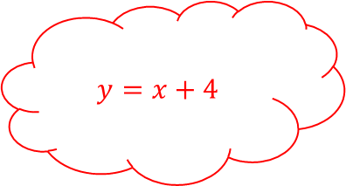

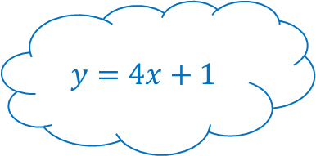




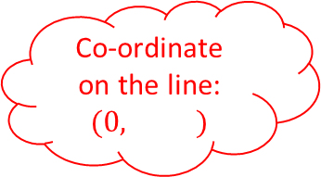



Exploding Linear Graphs 1
Gradient is $3$
Co-ordinate on the line: $(0,2)$
$$y=$$
Co-ordinate on the line:
$$( , )$$
Gradient is $−2$
Gradient is $2$
Co-ordinate on the line: $(0,−1)$
Co-ordinate on the line: $(3,−7)$
Each graph is linear
Co-ordinate on the line:
$$(5, )$$
$$y=x+4$$
Gradient is
$$y=$$
Gradient is
Co-ordinate on the line:
$$(0, )$$
$$y=$$
Co-ordinate on the line:
$( ,1)$
Co-ordinate on the line: $(0, )$
$$y=4x+1$$

Slide 3


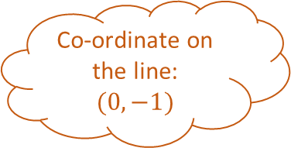
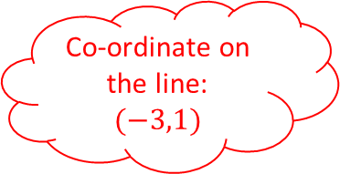


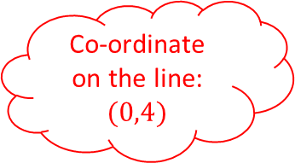
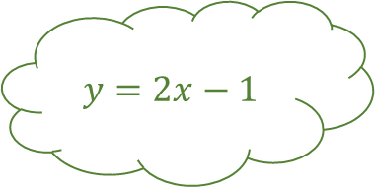
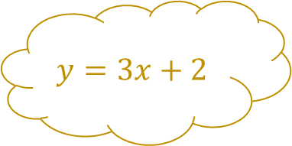




Exploding Linear Graphs 1
Gradient is $3$
Co-ordinate on the line:
$$(0,2)$$
Answers
$$y=3x+2$$
Co-ordinate on the line:
$$(0,−1)$$
Gradient is $−2$
Gradient is $2$
Co-ordinate on the line:
$$(0,−1)$$
Co-ordinate on the line:
$$(3,−7)$$
Each graph is linear
Co-ordinate on the line:
$$(5,9)$$
$$y=x+4$$
Gradient is $4$
$$y=−2x−1$$
Gradient is $1$
Co-ordinate on the line:
$$(0,1)$$
$$y=2x−1$$
Co-ordinate on the line:
$$(−3,1)$$
Co-ordinate on the line:
$$(0,4)$$
$$y=4x+1$$

Slide 4





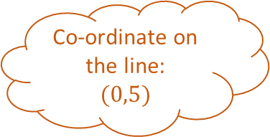


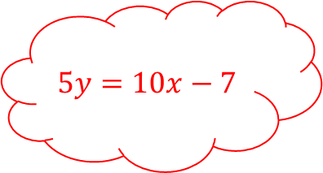
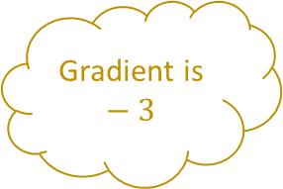

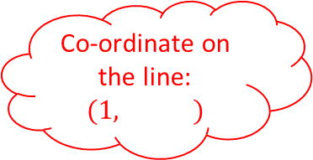
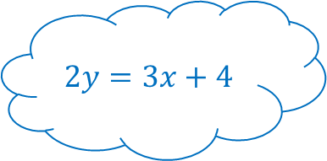
Exploding Linear Graphs 2
Gradient is $−3$
Co-ordinate on the line:
$$(0,5)$$
$$y=$$
Co-ordinate on the line:
$$(0,5)$$
Gradient is $−1$
Gradient is
Co-ordinate on the line:
$$(0, )$$
Co-ordinate on the line:
$$( ,−1)$$
Each graph is linear
Co-ordinate on the line:
$$( ,9)$$
$$5y=10x−7$$
Gradient is
Gradient is
Co-ordinate on the line:
$$(0, )$$
$$y=7−x$$
Co-ordinate on the line:
$$(1, )$$
Co-ordinate on the line:
$$(0, )$$
$$2y=3x+4$$

Slide 5


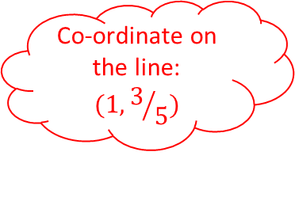



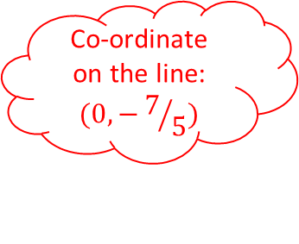
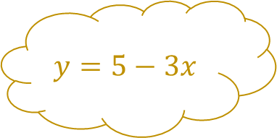



Exploding Linear Graphs 2
Gradient is $−3$
Co-ordinate on the line:
$$(0,5)$$
Answers
$$y=5−3x$$
Co-ordinate on the line:
$$(0,5)$$
Gradient is $−1$
Gradient is $−1$
Co-ordinate on the line:
$$(0,7)$$
Co-ordinate on the line:
$$(6,−1)$$
Each graph is linear
Co-ordinate on the line:
$$(−2,9)$$
$$5y=10x−7$$
Gradient is $1.5$
$$x+y=5$$
Gradient is $2$
Co-ordinate on the line:
$$(0,2)$$
$$y=7−x$$
Co-ordinate on the line:
$$(1,3/5)$$
Co-ordinate on the line:
$$(0,−7/5)$$
$$2y=3x+4$$

Slide 6










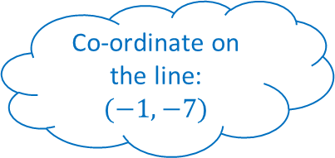




Exploding Linear Graphs 3
Gradient is $1$
Co-ordinate on the line:
$$(2,−1)$$
$$y=$$
Co-ordinate on the line:
$$(4,5)$$
Gradient is
Gradient is
Co-ordinate on the line:
$$(1,4)$$
Co-ordinate on the line:
$$(−6,0)$$
Each graph is linear
Co-ordinate on the line:
$$(6, )$$
$$y=$$
Gradient is $2$
$$y=$$
Gradient is $−2$
Co-ordinate on the line:
$$(−1,−7)$$
$y=3x+$ ……
Co-ordinate on the line:
$$( ,9)$$
Co-ordinate on the line:
$$(1,3)$$
$$y=$$

Slide 7

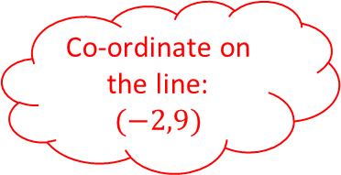

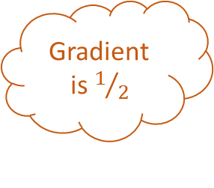
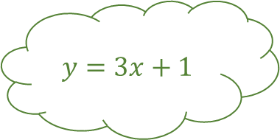

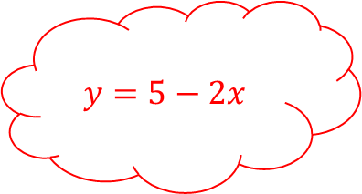

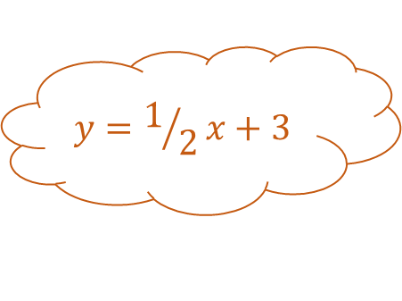
Exploding Linear Graphs 3
Gradient is $1$
Co-ordinate on the line:
$$(2,−1)$$
Answers
$$y=x−3$$
Co-ordinate on the line:
$$(4,5)$$
Gradient is $1/2$
Gradient is $3$
Co-ordinate on the line:
$$(1,4)$$
Co-ordinate on the line:
$$(−6,0)$$
Each graph is linear
Co-ordinate on the line:
$$(6,19)$$
$$y=5−2x$$
Gradient is $2$
$$y=1/2x+3$$
Gradient is $−2$
Co-ordinate on the line:
$$(−1,−7)$$
$$y=3x+1$$
Co-ordinate on the line:
$$(−2,9)$$
Co-ordinate on the line:
$$(1,3)$$
$$y=2x−5$$

Slide 8











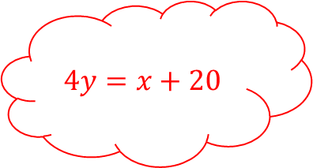
Exploding Linear Graphs 4
Gradient is
Co-ordinate on the line:
$$(−2,6)$$
$$x+y=$$
Co-ordinate on the line:
$$(8, )$$
Gradient is
Gradient is
Co-ordinate on the line:
$$(2,1)$$
Co-ordinate on the line:
$$( ,−2)$$
Each graph is linear
Co-ordinate on the line:
$$(−1,10)$$
$$4y=x+20$$
Gradient is
$$x−y=7$$
Gradient is
Co-ordinate on the line:
$$( ,3)$$
$$y=$$
Co-ordinate on the line:
$$( ,4)$$
Co-ordinate on the line:
$$(8, )$$
$$3x+2y=12$$

Slide 9



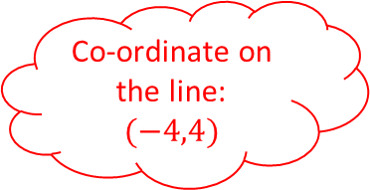


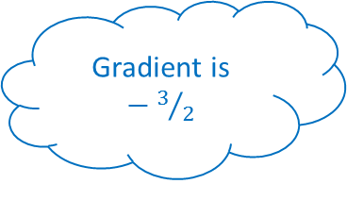


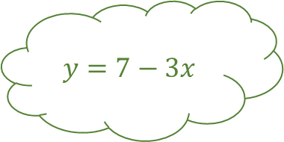

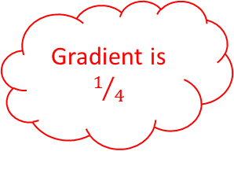
Exploding Linear Graphs 4
Gradient is $−1$
Co-ordinate on the line:
$$(−2,6)$$
Answers
$$x+y=4$$
Co-ordinate on the line:
$$(8,1)$$
Gradient is $1$
Gradient is $−3$
Co-ordinate on the line:
$$(2,1)$$
Co-ordinate on the line:
$$(5,−2)$$
Each graph is linear
Co-ordinate on the line:
$$(−1,10)$$
$$4y=x+20$$
Gradient is $−3/2$
$$x−y=7$$
Gradient is $1/4$
Co-ordinate on the line:
$$(2,3)$$
$$y=7−3x$$
Co-ordinate on the line:
$$(−4,4)$$
Co-ordinate on the line:
$$(8,7)$$
$$3x+2y=12$$

Slide 10
Exploding Linear Graphs

Slide 11
Exploding Linear Graphs

