Slide 1
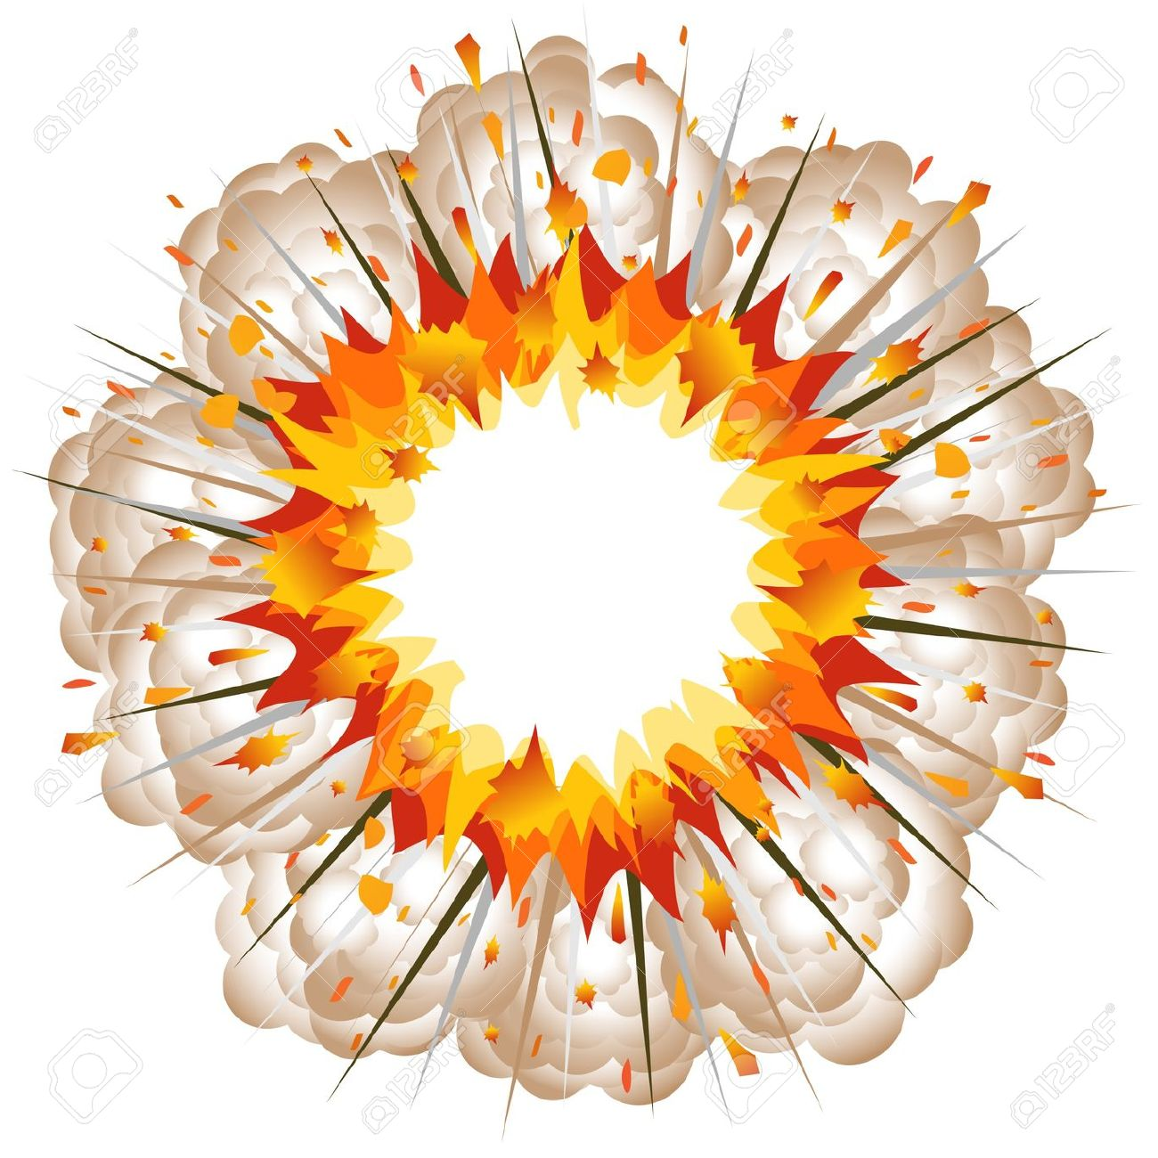
Exploding Equations
Can you fill in the blanks?

Slide 2

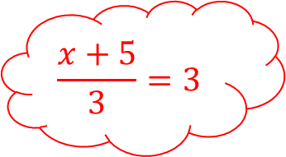
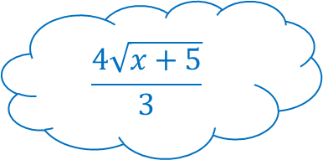


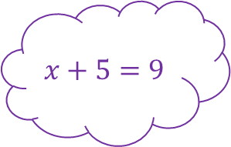
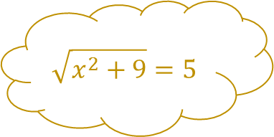

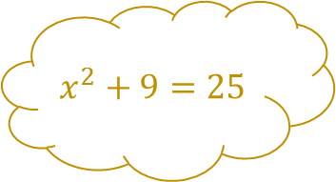

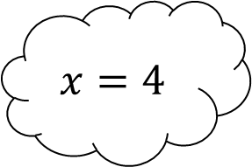

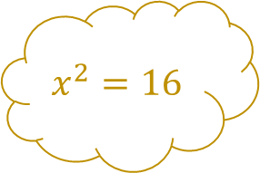

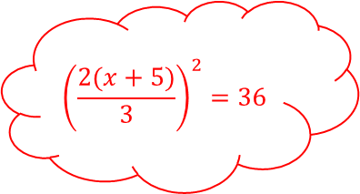


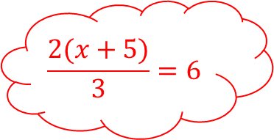
Exploding Equations – Set 1
$$x^{2}=16$$
$$x^{2}+9=25$$
$$\sqrt{x^{2}+9}=5$$
$$−3$$
$$+1$$
$$×3$$
$$×2$$
$$×3$$
$$+7$$
$$x=4$$
$${\left(\frac{2(x+5)}{3}\right)}^{2}=36$$
$$÷6$$
$$+5$$
$$÷5$$
$$x+5=9$$
$$\frac{2(x+5)}{3}=6$$
$$\frac{x+5}{3}=3$$
$$\frac{4\sqrt{x+5}}{3}$$

Slide 3

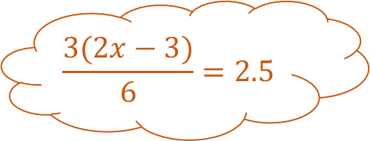
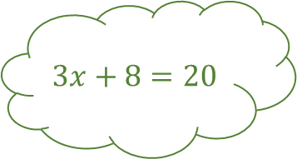
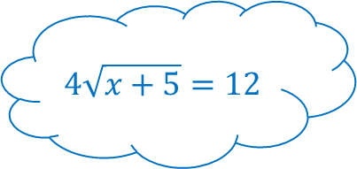


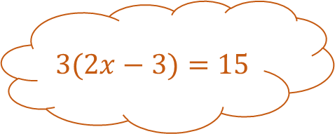


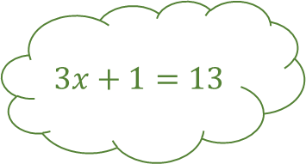
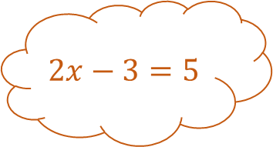

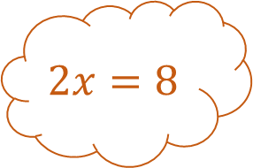

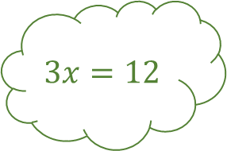


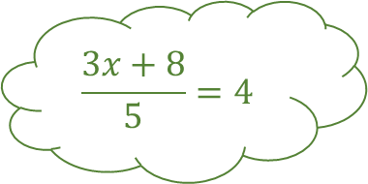
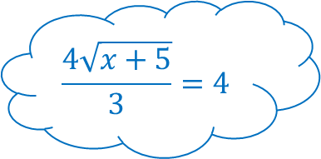
Exploding Equations – Set 1
$$x^{2}=16$$
$$x^{2}+9=25$$
$$+9$$
Answers
$$\sqrt{x^{2}+9}=5$$
$$2x−3=5$$
$$−3$$
$$2x=8$$
$$3x=12$$
$$+1$$
Square
$$3x+1=13$$
$$×3$$
$$3(2x−3)=15$$
$$×2$$
$$×3$$
$$+7$$
$$x=4$$
$$3x+8=20$$
$${\left(\frac{2(x+5)}{3}\right)}^{2}=36$$
$$\sqrt{x+5}=3$$
$$÷6$$
$$+5$$
$$\frac{3(2x−3)}{6}=2.5$$
$$÷5$$
$$x+5=9$$
$$×4$$
$$4\sqrt{x+5}=12$$
$$\frac{3x+8}{5}=4$$
Square
$$÷3$$
$$\frac{2(x+5)}{3}=6$$
$$\frac{x+5}{3}=3$$
$$\frac{4\sqrt{x+5}}{3}=4$$
$$×2$$
$$÷3$$

Slide 4

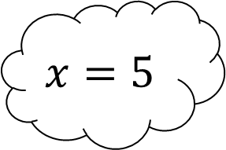
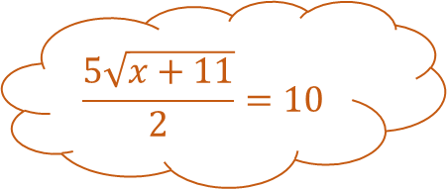

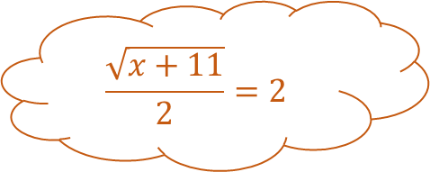


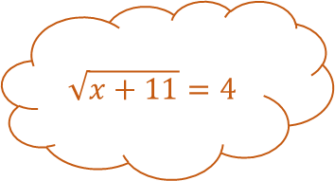
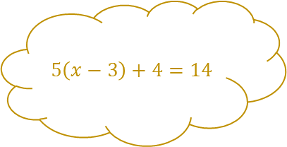
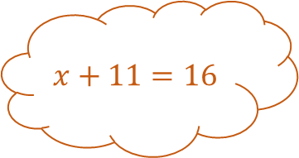

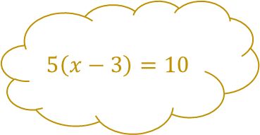
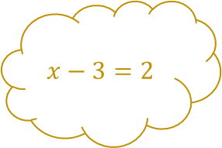
Exploding Equations – Set 2
$$x−3=2$$
$$5\left(x−3\right)=10$$
$$5\left(x−3\right)+4=14$$
$$\sqrt{x+11}=4$$
$$x+11=16$$
Square
$$\frac{\sqrt{x+11}}{2}=2$$
$$+3$$
$$−4$$
$$x=5$$
$$\sqrt[3]{\frac{x^{2}+7}{4}}=2$$
$$\frac{5\sqrt{x+11}}{2}=10$$
$$÷15$$
$$\frac{{3x}^{2}−5}{7}=10$$

Slide 5


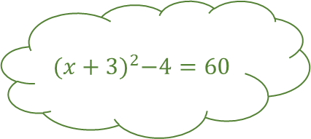
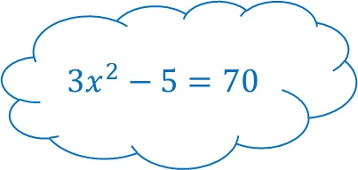


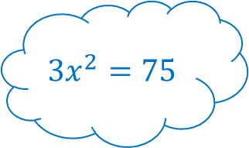


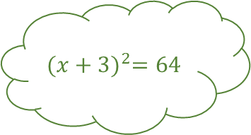
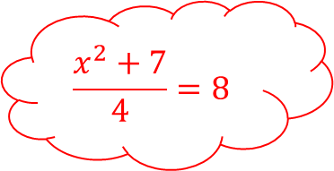



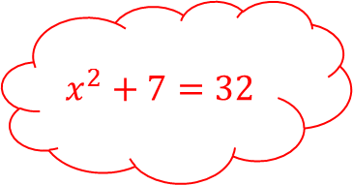

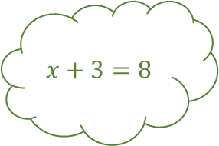



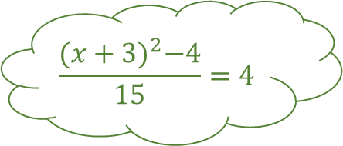
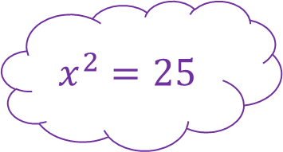
Exploding Equations – Set 2
$$x−3=2$$
$$×5$$
$$5\left(x−3\right)=10$$
$$+4$$
Answers
$$5\left(x−3\right)+4=14$$
$$\sqrt{x+11}=4$$
$$x+11=16$$
$$x+3=8$$
Square
$$−3$$
$${(x+3)}^{2}=64$$
$$÷2$$
$$\frac{\sqrt{x+11}}{2}=2$$
$$+11$$
$$+3$$
$$−4$$
$$x=5$$
$${(x+3)}^{2}−4=60$$
$$\sqrt[3]{\frac{x^{2}+7}{4}}=2$$
$${3x}^{2}=75$$
$$×5$$
Square
$$\frac{5\sqrt{x+11}}{2}=10$$
$$×3$$
$$÷15$$
$$x^{2}=25$$
$$−5$$
$${3x}^{2}−5=70$$
$$\frac{{(x+3)}^{2}−4}{15}=4$$
$$\sqrt[3]{}$$
$$+7$$
$$\frac{x^{2}+7}{4}=8$$
$$x^{2}+7=32$$
$$÷7$$
$$\frac{{3x}^{2}−5}{7}=10$$
$$÷4$$

Slide 6


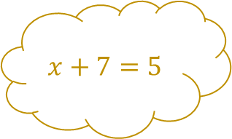



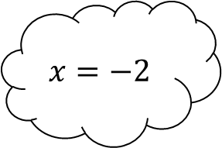

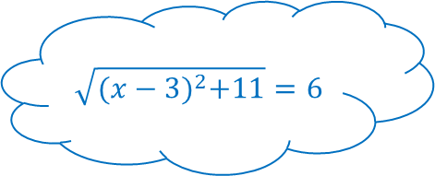

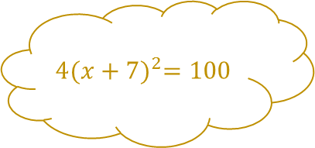

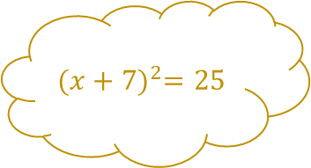
Exploding Equations – Set 3
$$x+7=5$$
$${(x+7)}^{2}=25$$
$$4{(x+7)}^{2}=100$$
$$−3$$
$$×5$$
$$+3$$
Square
$$×5$$
$$x=−2$$
$${\left(\frac{6−2x}{5}\right)}^{3}=8$$
$$÷2$$
Square
$$−6$$
$$\sqrt{{(x−3)}^{2}+11}=6$$

Slide 7


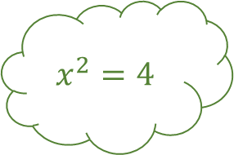


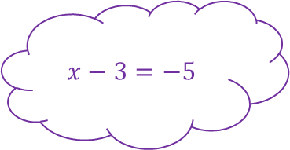

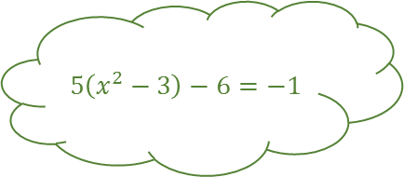

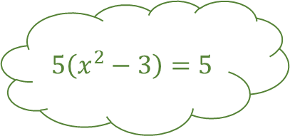
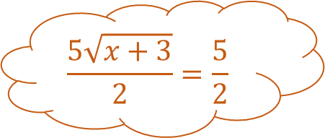
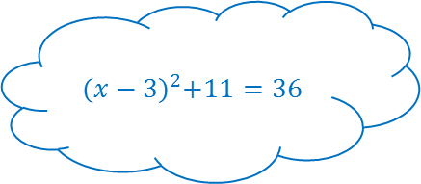





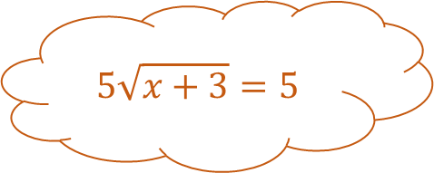
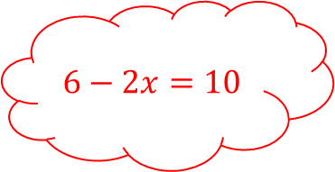

Exploding Equations – Set 3
$$x+7=5$$
$${(x+7)}^{2}=25$$
Square
$$×4$$
Answers
$$4{(x+7)}^{2}=100$$
$$\sqrt{x+3}=1$$
$$x+3=1$$
$$x^{2}=4$$
$$−3$$
$$+7$$
$$x^{2}−3=1$$
$$×5$$
$$5\sqrt{x+3}=5$$
$$+3$$
Square
$$×5$$
$$x=−2$$
$$5\left(x^{2}−3\right)=5$$
$${\left(\frac{6−2x}{5}\right)}^{3}=8$$
$${(x−3)}^{2}=25$$
$$÷2$$
$$−3$$
$$\frac{5\sqrt{x+3}}{2}=\frac{5}{2}$$
Square
$$−6$$
$$x−3=−5$$
$$+11$$
$${(x−3)}^{2}+11=36$$
$$5\left(x^{2}−3\right)−6=−1$$
Cube
$$×−2$$
$$\frac{6−2x}{5}=2$$
$$6−2x=10$$
$$\sqrt{{(x−3)}^{2}+11}=6$$
$$÷5$$

Slide 8





Exploding Equations – Set 4
$${\left(4x+1\right)}^{2}=9$$
$$\frac{5(10x+15)}{2}−3=47$$
$$\frac{2\left(x+3\right)−2}{5}=1$$
$$\frac{8x^{2}+7}{2}=4.5$$
$$\frac{{(10x−3)}^{2}}{4}=1$$

Slide 9





























Exploding Equations – Set 4
$$4x=2$$
$$4x+1=3$$
$$+1$$
Square
Answers
$${\left(4x+1\right)}^{2}=9$$
$$2\left(x+3\right)=7$$
$$×2$$
$$x+3=3\frac{1}{2}$$
$$x^{2}=\frac{1}{4}$$
$$×8$$
$$×4$$
$$8x^{2}=2$$
$$−2$$
$$2\left(x+3\right)−2=5$$
$$+3$$
Square
$$+7$$
$$x=\frac{1}{2}$$
$$8x^{2}+7=9$$
$$\frac{5(10x+15)}{2}−3=47$$
$$10x−3=2$$
$$÷5$$
$$×10$$
$$\frac{2\left(x+3\right)−2}{5}=1$$
$$−3$$
$$÷2$$
$$10x=5$$
Square
$${(10x−3)}^{2}=4$$
$$\frac{8x^{2}+7}{2}=4.5$$
$$−3$$
$$+15$$
$$\frac{5(10x+15)}{2}=50$$
$$10x+15=20$$
$$\frac{{(10x−3)}^{2}}{4}=1$$
$$×2.5$$
$$÷4$$

Slide 10
Exploding Equations

Slide 11
Exploding Equations

Slide 12





































Exploding Equations – Template

