Slide 1
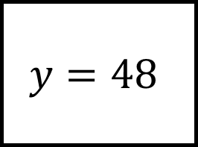
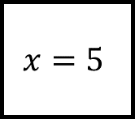
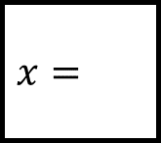
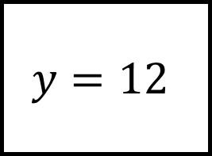
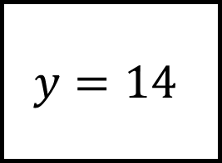

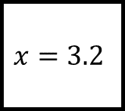
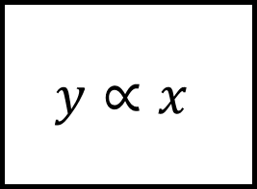

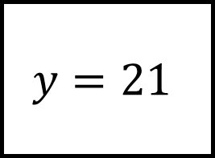
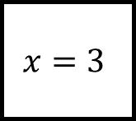
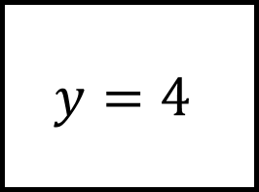
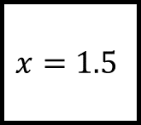
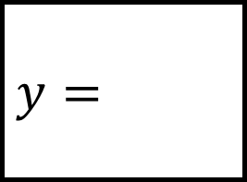
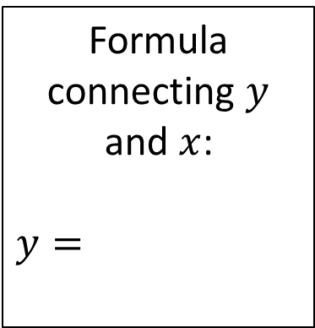
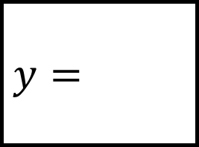
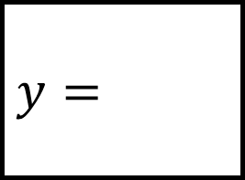

Proportion Spider 1
$$y=12$$
$$y=21$$
$$y=4$$
$$x=3$$
$$x=$$
$$x=$$
$$y=$$
$$y∝x$$
$$y=$$
$$x=3.2$$
$$x=5$$
$$x=$$
$$x=$$
$$x=1.5$$
Formula connecting $y$ and $x$:
$$y=$$
Use the leg at “12 o’clock” to calculate all the missing values
$$y=14$$
$$y=48$$
$$y=$$

Slide 2
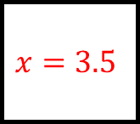
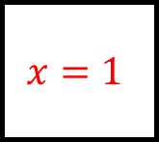
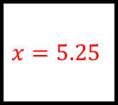
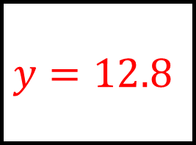
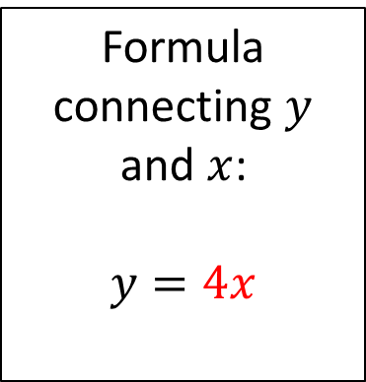
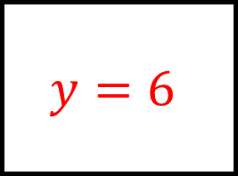
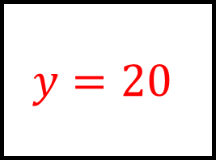
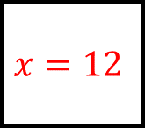
Proportion Spider 1 - Answers
$$y=12$$
$$y=21$$
$$y=4$$
$$x=3$$
$$x=5.25$$
$$x=1$$
$$y=12.8$$
$$y∝x$$
$$y=20$$
$$x=3.2$$
$$x=5$$
$$x=3.5$$
$$x=12$$
$$x=1.5$$
Formula connecting $y$ and $x$:
$$y=4x$$
Use the leg at “12 o’clock” to calculate all the missing values
$$y=14$$
$$y=48$$
$$y=6$$

Slide 3
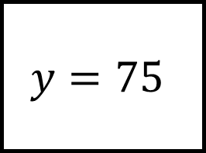
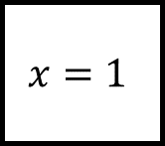
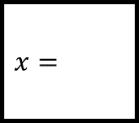
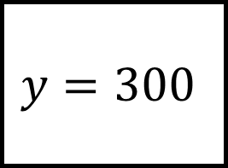
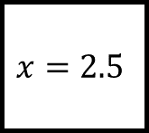
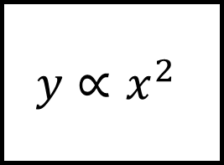
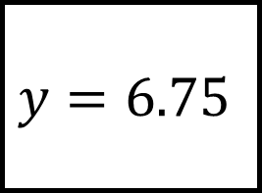
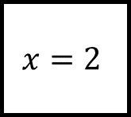
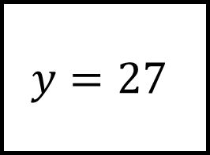
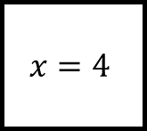
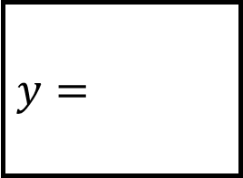
Proportion Spider 2
$$y=12$$
$$y=6.75$$
$$y=27$$
$$x=2$$
$$x=$$
$$x=$$
$$y=$$
$$y∝x^{2}$$
$$y=$$
$$x=2.5$$
$$x=1$$
$$x=$$
$$x=$$
$$x=4$$
Formula connecting $y$ and $x$:
$$y=$$
Use the leg at “12 o’clock” to calculate all the missing values
$$y=300$$
$$y=75$$
$$y=$$

Slide 4
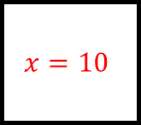
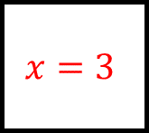
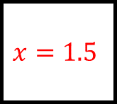
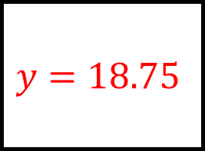
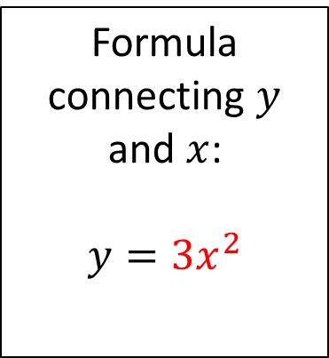
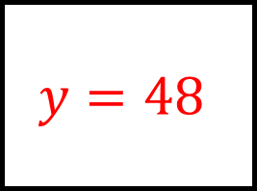
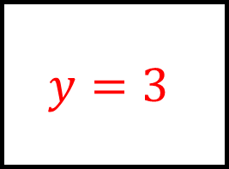
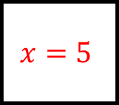
Proportion Spider 2 - Answers
$$y=12$$
$$y=6.75$$
$$y=27$$
$$x=2$$
$$x=1.5$$
$$x=3$$
$$y=18.75$$
$$y∝x^{2}$$
$$y=3$$
$$x=2.5$$
$$x=1$$
$$x=10$$
$$x=5$$
$$x=4$$
Formula connecting $y$ and $x$:
$$y={3x}^{2}$$
Use the leg at “12 o’clock” to calculate all the missing values
$$y=300$$
$$y=75$$
$$y=48$$

Slide 5
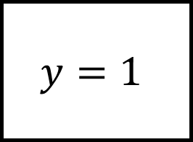
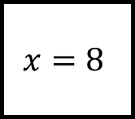
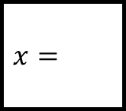
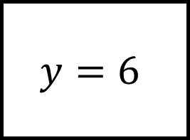
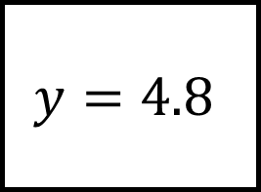
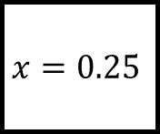
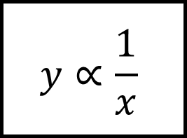
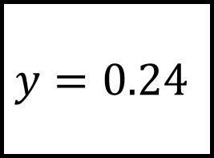



Proportion Spider 3
$$y=6$$
$$y=0.24$$
$$y=12$$
$$x=4$$
$$x=$$
$$x=$$
$$y=$$
$$y∝\frac{1}{x}$$
$$y=$$
$$x=0.25$$
$$x=8$$
$$x=$$
$$x=$$
$$x=48$$
Formula connecting $y$ and $x$:
$$y=$$
Use the leg at “12 o’clock” to calculate all the missing values
$$y=4.8$$
$$y=1$$
$$y=$$

Slide 6







Proportion Spider 3 - Answers
$$y=6$$
$$y=0.24$$
$$y=12$$
$$x=4$$
$$x=100$$
$$x=2$$
$$y=96$$
$$y∝\frac{1}{x}$$
$$y=3$$
$$x=0.25$$
$$x=8$$
$$x=5$$
$$x=24$$
$$x=48$$
Formula connecting $y$ and $x$:
$$y=\frac{24}{x}$$
Use the leg at “12 o’clock” to calculate all the missing values
$$y=4.8$$
$$y=1$$
$$y=0.5$$

Slide 7







Proportion Spider 4
$$y=12$$
$$y=48$$
$$y=8$$
$$x=4$$
$$x=$$
$$x=$$
$$y=$$
$$y∝\frac{1}{\sqrt{x}}$$
$$y=$$
$$x=1.44$$
$$x=1$$
$$x=$$
$$x=$$
$$x=64$$
Formula connecting $y$ and $x$:
$$y=$$
Use the leg at “12 o’clock” to calculate all the missing values
$$y=2.4$$
$$y=6$$
$$y=$$

Slide 8








Proportion Spider 4 - Answers
$$y=12$$
$$y=48$$
$$y=8$$
$$x=4$$
$$x=0.25$$
$$x=9$$
$$y=20$$
$$y∝\frac{1}{\sqrt{x}}$$
$$y=24$$
$$x=1.44$$
$$x=1$$
$$x=100$$
$$x=16$$
$$x=64$$
Formula connecting $y$ and $x$:
$$y=\frac{24}{\sqrt{x}}$$
Use the leg at “12 o’clock” to calculate all the missing values
$$y=2.4$$
$$y=6$$
$$y=3$$

Slide 9




















Proportion Spider 5
$$y=$$
$$y=$$
$$y=135$$
$$y=24$$
$$x=3$$
$$x=2$$
$$y=4x^{3}$$
In all these
$$y∝x^{3}$$
Fill in the blanks
$$y=2x^{3}$$
$$y=$$
$$x=5$$
$$x=1$$
$$y=$$
$$x=$$
$$x=$$
$$y=8x^{3}$$
The formula connecting $y$ and $x$ is always at the end of each leg.
$$y=\frac{1}{2}x^{3}$$
$$y=1$$
$$y=32$$

Slide 10






Proportion Spider 5 - Answers
$$y=5x^{3}$$
$$y=3x^{3}$$
$$y=135$$
$$y=24$$
$$x=3$$
$$x=2$$
$$y=4x^{3}$$
In all these
$$y∝x^{3}$$
Fill in the blanks
$$y=2x^{3}$$
$$y=500$$
$$x=5$$
$$x=1$$
$$y=2$$
$$x=0.5$$
$$x=4$$
$$y=8x^{3}$$
The formula connecting $y$ and $x$ is always at the end of each leg.
$$y=\frac{1}{2}x^{3}$$
$$y=1$$
$$y=32$$

Slide 11












Proportion Spider 6
$$y=$$
$$y=$$
$$y=2$$
$$y=5$$
$$x=6$$
$$x=2$$
$$y=\frac{400}{x^{2}}$$
In all these
$$y∝\frac{1}{x^{2}}$$
Fill in the blanks
$$y=\frac{36}{x^{2}}$$
$$y=$$
$$x=10$$
$$x=3$$
$$y=$$
$$x=$$
$$x=$$
$$y=\frac{800}{x^{2}}$$
The formula connecting $y$ and $x$ is always at the end of each leg.
$$y=\frac{100}{x^{2}}$$
$$y=2$$
$$y=4$$

Slide 12






Proportion Spider 6 - Answers
$$y=\frac{72}{x^{2}}$$
$$y=\frac{20}{x^{2}}$$
$$y=2$$
$$y=5$$
$$x=6$$
$$x=2$$
$$y=\frac{400}{x^{2}}$$
In all these
$$y∝\frac{1}{x^{2}}$$
Fill in the blanks
$$y=\frac{36}{x^{2}}$$
$$y=4$$
$$x=10$$
$$x=3$$
$$y=4$$
$$x=20$$
$$x=5$$
$$y=\frac{800}{x^{2}}$$
The formula connecting $y$ and $x$ is always at the end of each leg.
$$y=\frac{100}{x^{2}}$$
$$y=2$$
$$y=4$$

Slide 13














Proportion Spider 7
$$y=$$
$$y=$$
$$y=8\sqrt{5}$$
$$y=2\sqrt{3}$$
$$x=20$$
$$x=3$$
$$y=2\sqrt{x}$$
In all these
$$y∝\sqrt{x}$$
Fill in the blanks
$$y=5\sqrt{x}$$
$$y=$$
$$x=18$$
$$x=2$$
$$y=$$
$$x=$$
$$x=$$
$$y=10\sqrt{x}$$
The formula connecting $y$ and $x$ is always at the end of each leg and should be written in surd form.
$$y=3\sqrt{x}$$
$$y=40\sqrt{3}$$
$$y=6\sqrt{3}$$

Slide 14






Proportion Spider 7 - Answers
$$y=4\sqrt{x}$$
$$y=2\sqrt{x}$$
$$y=8\sqrt{5}$$
$$y=2\sqrt{3}$$
$$x=20$$
$$x=3$$
$$y=2\sqrt{x}$$
In all these
$$y∝\sqrt{x}$$
Fill in the blanks
$$y=5\sqrt{x}$$
$$y=6\sqrt{2}$$
$$x=18$$
$$x=2$$
$$y=5\sqrt{2}$$
$$x=48$$
$$x=12$$
$$y=10\sqrt{x}$$
The formula connecting $y$ and $x$ is always at the end of each leg and should be written in surd form.
$$y=3\sqrt{x}$$
$$y=40\sqrt{3}$$
$$y=6\sqrt{3}$$

Slide 15




















Proportion Spider 8
$$y=$$
$$y=$$
$$y=\frac{2}{3\sqrt{3}}$$
$$y=\frac{5}{\sqrt{3}}$$
$$x=75$$
$$x=3$$
$$y=\frac{8}{\sqrt{x}}$$
In all these
$$y∝\frac{1}{\sqrt{x}}$$
Fill in the blanks
$$y=\frac{7}{\sqrt{x}}$$
$$y=$$
$$x=28$$
$$x=2$$
$$y=$$
$$x=$$
$$x=$$
$$y=\frac{2}{\sqrt{x}}$$
$$y=\frac{3}{\sqrt{x}}$$
$$y=\frac{1}{2\sqrt{2}}$$
The formula connecting $y$ and $x$ is at the end of each leg and should be written in surd form, simplified where possible.
$$y=\frac{3}{5\sqrt{2}}$$

Slide 16






Proportion Spider 8 - Answer
$$y=\frac{10}{3\sqrt{x}}$$
$$y=\frac{5}{\sqrt{x}}$$
$$y=\frac{2}{3\sqrt{3}}$$
$$y=\frac{5}{\sqrt{3}}$$
$$x=75$$
$$x=3$$
$$y=\frac{8}{\sqrt{x}}$$
In all these
$$y∝\frac{1}{\sqrt{x}}$$
Fill in the blanks
$$y=\frac{7}{\sqrt{x}}$$
$$y=\frac{4}{\sqrt{7}}$$
$$x=28$$
$$x=2$$
$$y=\frac{7}{\sqrt{2}}$$
$$x=32$$
$$x=50$$
$$y=\frac{2}{\sqrt{x}}$$
$$y=\frac{3}{\sqrt{x}}$$
$$y=\frac{1}{2\sqrt{2}}$$
The formula connecting $y$ and $x$ is at the end of each leg and should be written in surd form, simplified where possible.
$$y=\frac{3}{5\sqrt{2}}$$

