Slide 1

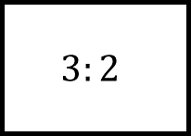


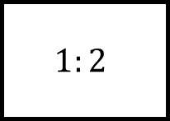
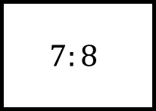
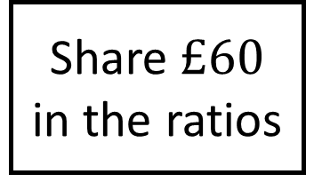
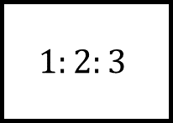

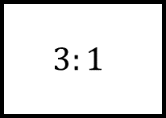

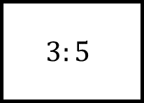
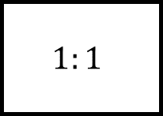


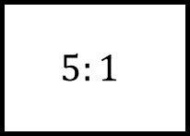
$$:$$
$$:$$
$$:$$
Ratio Spider 1
$$1:1$$
$$3:5$$
$$3:1$$
: :
Share $£60$ in the ratios
$$:$$
$$1:2:3$$
$$1:2$$
$$7:8$$
$$3:2$$
$$5:1$$
$$:$$
$$:$$
$$:$$

Slide 2
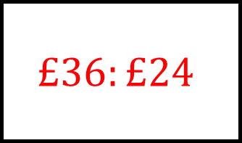
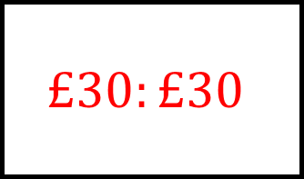
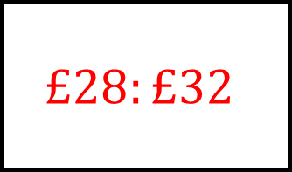
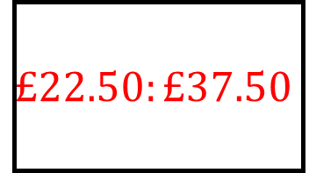
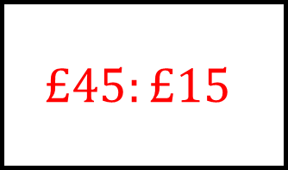
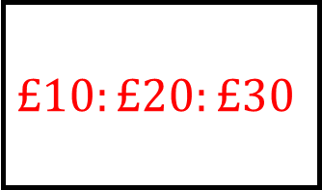
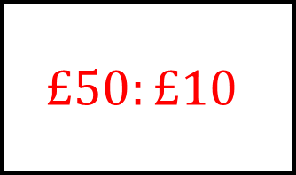
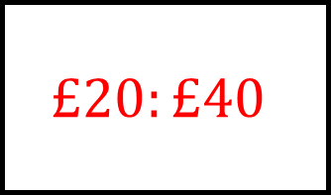
$$£30:£30$$
$$£22.50:£37.50$$
$$£45:£15$$
Ratio Spider 1 - Answers
$$1:1$$
$$3:5$$
$$3:1$$
$$£10:£20:£30$$
Share $£60$ in the ratios
$$£20:£40$$
$$1:2:3$$
$$1:2$$
$$7:8$$
$$3:2$$
$$5:1$$
$$£28:£32$$
$$£36:£24$$
$$£50:£10$$

Slide 3

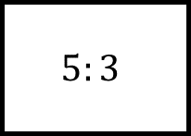
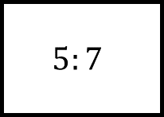
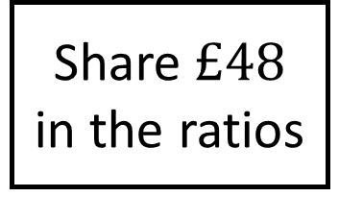
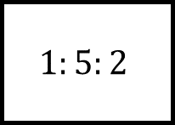
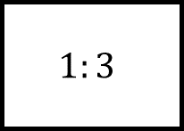
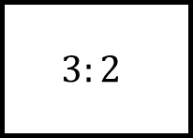
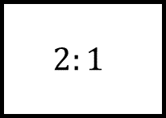
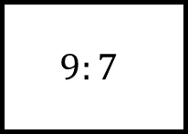
$$:$$
$$:$$
$$:$$
Ratio Spider 2
$$2:1$$
$$3:2$$
$$1:3$$
: :
Share $£48$ in the ratios
$$:$$
$$1:5:2$$
$$5:3$$
$$5:7$$
$$5:1$$
$$9:7$$
$$:$$
$$:$$
$$:$$

Slide 4
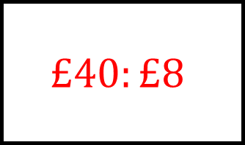
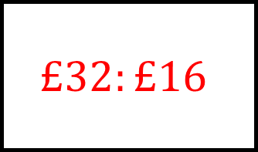
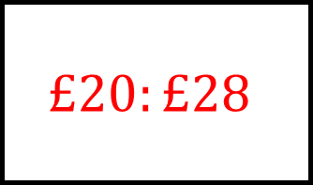
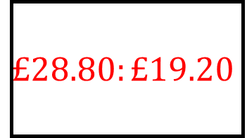
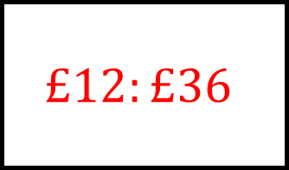
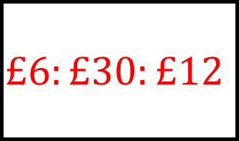
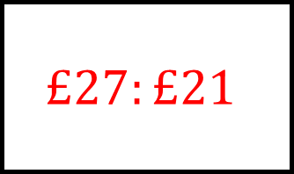
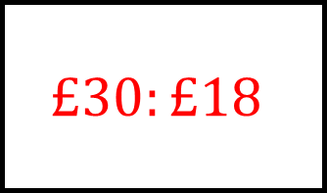
$$£32:£16$$
$$£28.80:£19.20$$
$$£12:£36$$
Ratio Spider 2 - Answers
$$2:1$$
$$3:2$$
$$1:3$$
$$£6:£30:£12$$
Share $£48$ in the ratios
$$£30:£18$$
$$1:5:2$$
$$5:3$$
$$5:7$$
$$5:1$$
$$9:7$$
$$£20:£28$$
$$£40:£8$$
$$£27:£21$$

Slide 5

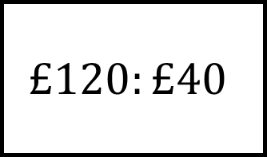

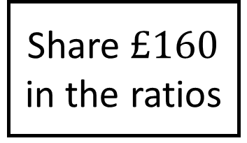
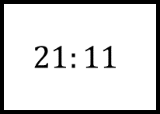

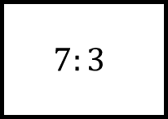
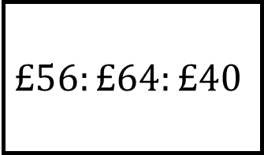
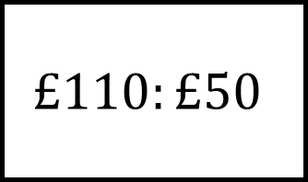
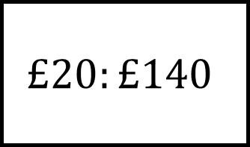
$$£120:£40$$
$$:$$
$$:$$
Ratio Spider 3
$$:$$
$$7:3$$
$$3:5$$
$$£56:£64:£40$$
Share $£160$ in the ratios
$$£20:£140$$
: :
$$:$$
$$21:11$$
$$3:2$$
$$:$$
$$:$$
$$:$$
$$£110:£50$$

Slide 6
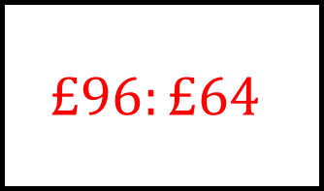
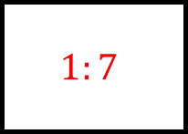
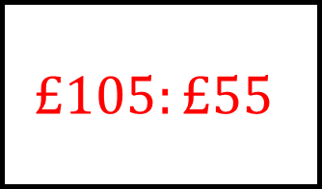
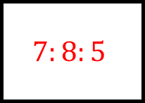
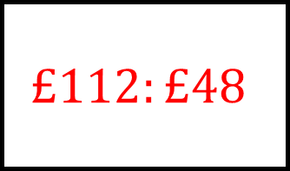
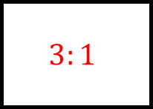
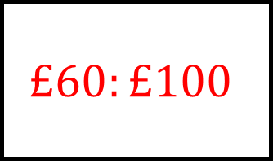
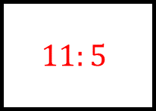
$$£120:£40$$
$$£112:£48$$
$$£60:£100$$
Ratio Spider 3 - Answers
$$3:1$$
$$7:3$$
$$3:5$$
$$£56:£64:£40$$
Share $£160$ in the ratios
$$£20:£140$$
$$7:8:5$$
$$1:7$$
$$21:11$$
$$3:2$$
$$11:5$$
$$£105:£55$$
$$£96:£64$$
$$£110:£50$$

Slide 7
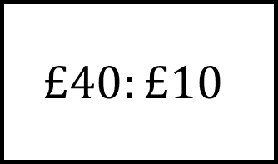

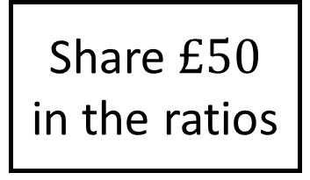






$$£40:£10$$
$$:$$
$$:$$
Ratio Spider 4
$$:$$
$$9:11$$
$$3:2$$
$$£24:£16:£10$$
Share $£50$ in the ratios
$$£5:£45$$
: :
$$:$$
$$8:17$$
$$7:3$$
$$:$$
$$:$$
$$:$$
$$£42:£8$$

Slide 8








$$£40:£10$$
$$£22.50:£27.50$$
$$£30:£20$$
Ratio Spider 4 - Answers
$$4:1$$
$$9:11$$
$$3:2$$
$$£24:£16:£10$$
Share $£50$ in the ratios
$$£5:£45$$
$$12:8:5$$
$$1:9$$
$$8:17$$
$$7:3$$
$$21:4$$
$$£16:£34$$
$$£35:£15$$
$$£42:£8$$

Slide 9









$8$ people
people
people
Ratio Spider 5
$$1kg$$
$$500g$$
$15$ people
$100g$ feeds 4 people
$6$ people
$$225g$$
$$50g$$
people
people
$3$ people

Slide 10








$8$ people
$40$ people
$20$ people
Ratio Spider 5 - Answers
$$200g$$
$$1kg$$
$$500g$$
$15$ people
$100g$ feeds 4 people
$6$ people
$$375g$$
$$150g$$
$$225g$$
$$50g$$
$$75g$$
$9$ people
$2$ people
$3$ people

Slide 11







$12$ people
people
people
Ratio Spider 6
$$0.9kg$$
$$240g$$
$18$ people
$60g$ feeds 4 people
$6$ people
$$225g$$
$$75g$$
people
people
$7$ people

Slide 12








$12$ people
$60$ people
$16$ people
Ratio Spider 6 - Answers
$$180g$$
$$0.9kg$$
$$240g$$
$18$ people
$60g$ feeds 4 people
$6$ people
$$270g$$
$$90g$$
$$225g$$
$$75g$$
$$105g$$
$15$ people
$5$ people
$7$ people

