Slide 1
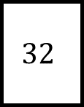
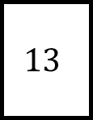
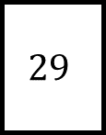

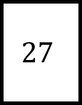
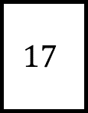
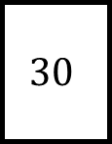
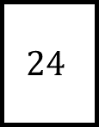
Multiples and Factors Spider 1
$$8$$
$$29$$
$$13$$
List the factors of each leg…
$$32$$
$$30$$
Which numbers only have two factors?
What is the highest common factor (HCF) of:
8 and 24?
27 and 30?
13 and 32?
$$24$$
$$27$$
$$17$$

Slide 2
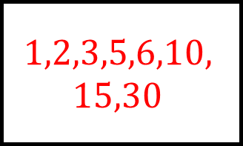
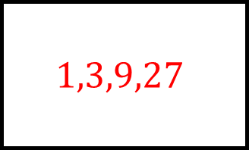
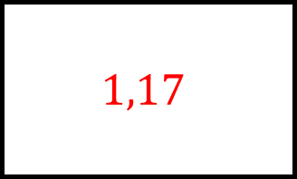
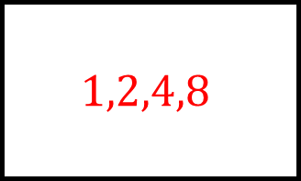
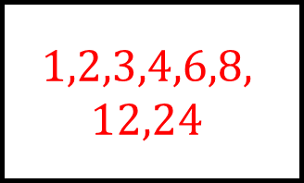
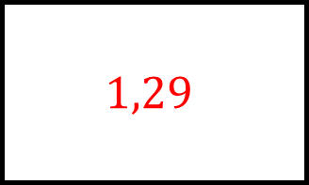
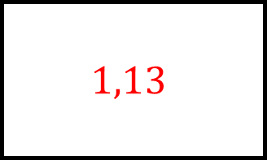
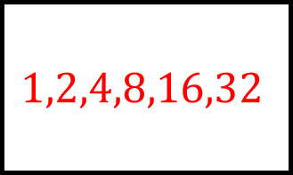
Multiples and Factors Spider 1 - Answers
$$1,2,4,8$$
$$1,29$$
$$1,13$$
$$8$$
$$29$$
$$13$$
$$1,2,4,8,16,32$$
List the factors of each leg…
$$1,2,3,5,6,10,$$
$$15,30$$
$$32$$
$$30$$
Which numbers only have two factors?
What is the highest common factor (HCF) of:
8 and 24?
27 and 30?
13 and 32?
$$24$$
$$27$$
$$17$$
$$1,2,3,4,6,8,$$
$$12,24$$
$$1,17$$
$$1,3,9,27$$

Slide 3
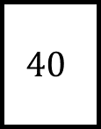
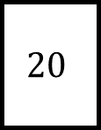
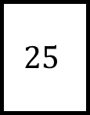
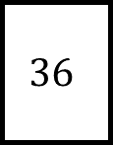
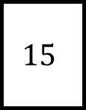
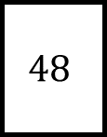

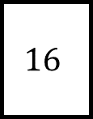
Multiples and Factors Spider 2
$$12$$
$$48$$
$$15$$
List the factors of each leg…
$$36$$
$$20$$
Which numbers have an odd number of factors?
What is the highest common factor (HCF) of:
15 and 40?
36 and 48?
16 and 48?
$$25$$
$$16$$
$$40$$

Slide 4
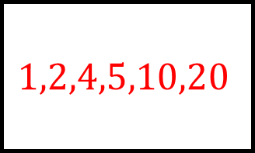
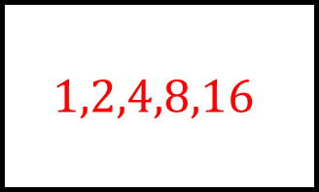
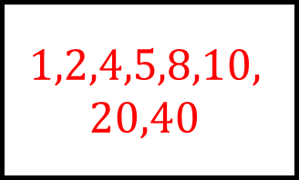
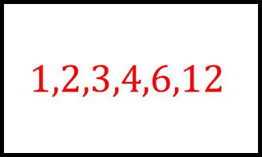
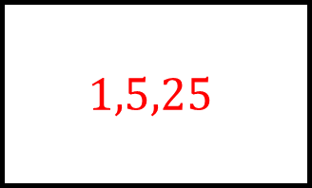
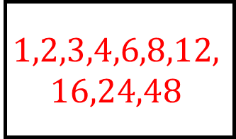
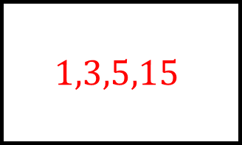
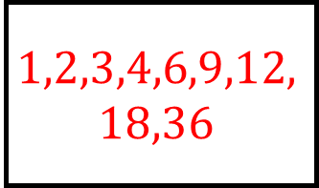
Multiples and Factors Spider 2 - Answers
$$1,2,3,4,6,12$$
$$1,2,3,4,6,8,12,$$
$$16,24,48$$
$$1,3,5,15$$
$$12$$
$$48$$
$$15$$
$$1,2,3,4,6,9,12,$$
$$18,36$$
List the factors of each leg…
$$1,2,4,5,10,20$$
$$36$$
$$20$$
Which numbers have an odd number of factors?
What is the highest common factor (HCF) of:
15 and 40?
36 and 48?
16 and 48?
$$25$$
$$16$$
$$40$$
$$1,5,25$$
$$1,2,4,5,8,10,$$
$$20,40$$
$$1,2,4,8,16$$

Slide 5



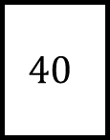
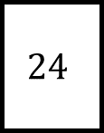


Multiples and Factors Spider 3
$$6$$
$$48$$
$$8$$
Find the first 8 multiples of each leg…
$$40$$
$$12$$
Are there any sets of multiples that are linked?
What is the lowest common multiple (LCM) of:
6 and 8?
15 and 40?
36 and 48?
$$36$$
$$24$$
$$15$$

Slide 6
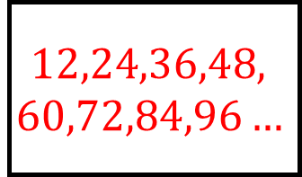
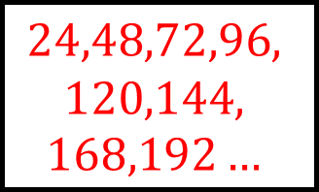
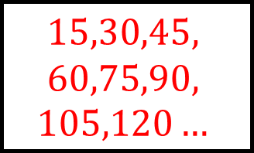
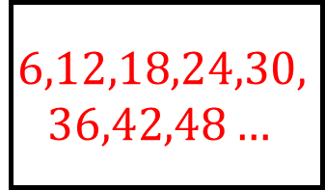
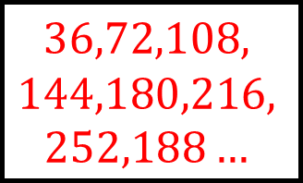
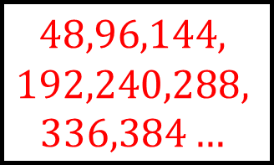
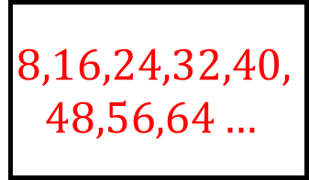
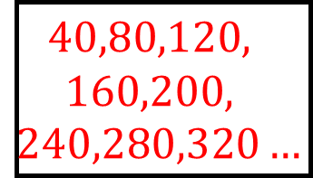
Multiples and Factors Spider 3 - Answers
$$6,12,18,24,30,$$
$$36,42,48…$$
$$48,96,144,$$
$$192,240,288,$$
$$336,384…$$
$$8,16,24,32,40,$$
$$48,56,64…$$
$$6$$
$$48$$
$$8$$
$$40,80,120,$$
$$160,200,$$
$$240,280,320…$$
Find the first 8 multiples of each leg…
$$12,24,36,48,$$
$$60,72,84,96…$$
$$40$$
$$12$$
Are there any sets of multiples that are linked?
What is the lowest common multiple (LCM) of:
6 and 8?
15 and 40?
36 and 48?
$$36$$
$$24$$
$$15$$
$$36,72,108,$$
$$144,180,216,$$
$$252,188…$$
$$15,30,45,$$
$$60,75,90,$$
$$105,120…$$
$$24,48,72,96,$$
$$120,144,$$
$$168,192…$$

Slide 7




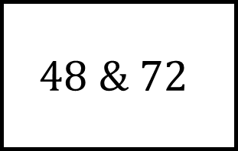

Multiples and Factors Spider
$$60 \& 108$$
$$10 \& 15$$
HCF:
HCF:
LCM:
LCM:
$$36 \& 90$$
Find HCF and LCM of each leg…
$$12 \& 20$$
HCF:
LCM:
LCM:
HCF:
LCM:
LCM:
$$48 \& 72$$
$$24 \& 30$$
HCF:
HCF:

Slide 8
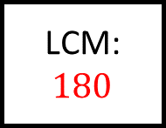

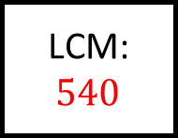
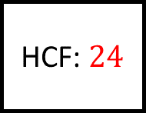
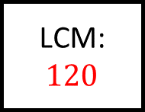

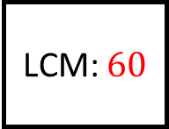


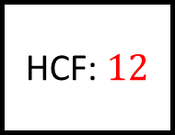
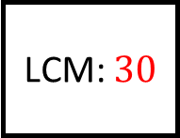
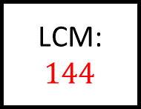
Multiples and Factors Spider 4 - Answers
$$60 \& 108$$
$$10 \& 15$$
HCF: $12$
HCF: $5$
LCM:$540$
LCM: $30$
$$36 \& 90$$
Find HCF and LCM of each leg…
$$12 \& 20$$
HCF:$18$
LCM: $180$
LCM: $60$
HCF: $4$
LCM: $144$
LCM: $120$
$$48 \& 72$$
$$24 \& 30$$
HCF: $24$
HCF: $6$

