Slide 1

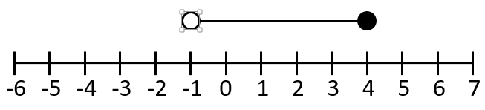
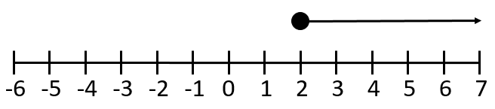
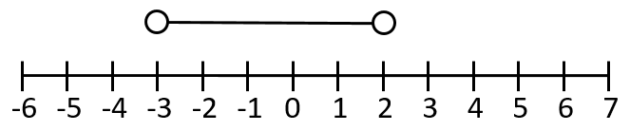
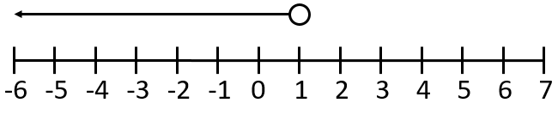
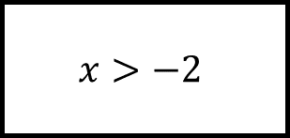
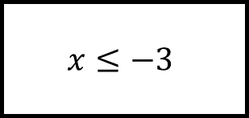
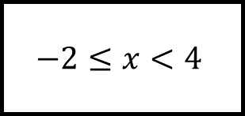
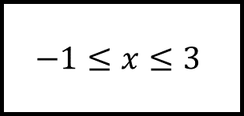
Inequalities Spider 1
$$x≤−3$$
Fill in the blanks…
$$−2≤x<4$$
$$x>−2$$
Draw or use the number lines for the inequality on each leg.
$$−1≤x≤3$$

Slide 2
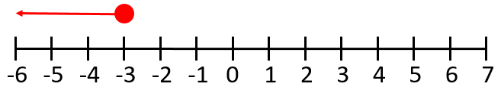
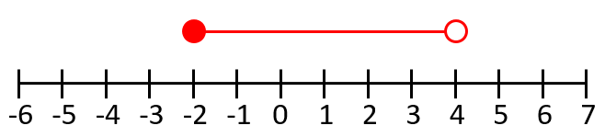
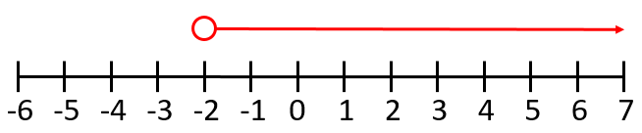
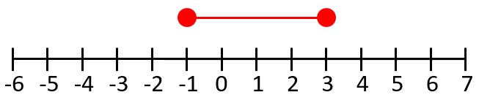
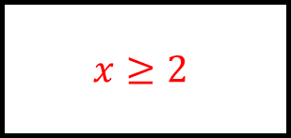
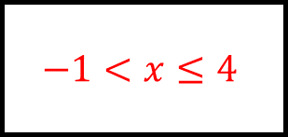
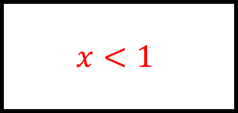
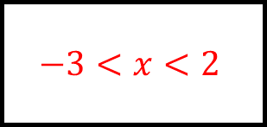
$$x≤−3$$
Inequalities Spider 1 - Answers
$$−1<x≤4$$
$$x≥2$$
Fill in the blanks…
$$−2≤x<4$$
$$x>−2$$
Draw or use the number lines for the inequality on each leg.
$$−3<x<2$$
$$−1≤x≤3$$
$$x<1$$

Slide 3
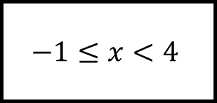
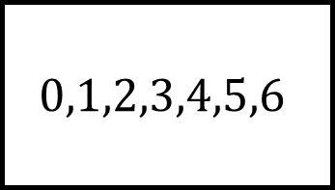
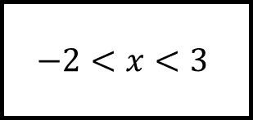
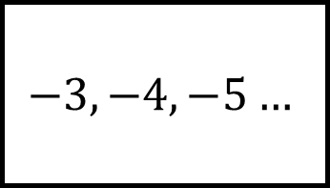
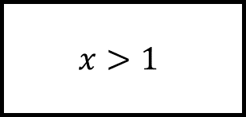
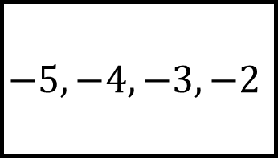
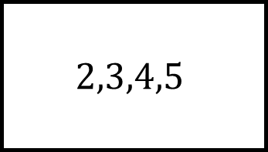
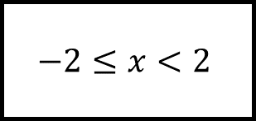
$$0,1,2,3,4,5,6$$
$$−3,−4,−5…$$
Inequalities Spider 2
$$x>1$$
Fill in the blanks…
$$−2≤x<2$$
$$−2<x<3$$
Find or use the integer solutions for each leg.
Is there more than one answer for any legs?
$$−1≤x<4$$
$$2,3,4,5$$
$$−5,−4,−3,−2$$

Slide 4
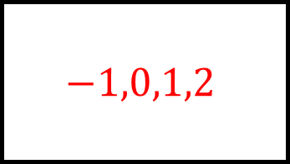
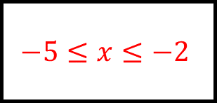
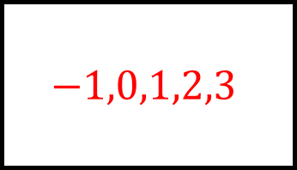
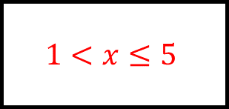
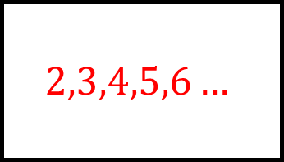
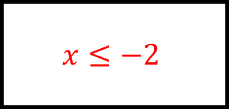
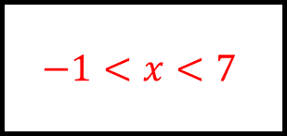
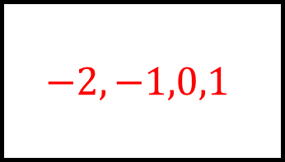
$$2,3,4,5,6…$$
$$0,1,2,3,4,5,6$$
$$−3,−4,−5…$$
$$x>1$$
Inequalities Spider 2 - Answers
$$−1<x<7$$
$$x≤−2$$
$$−2,−1,0,1$$
Fill in the blanks…
$$−1,0,1,2$$
$$−2≤x<2$$
$$−2<x<3$$
Find or use the integer solutions for each leg.
Is there more than one answer for any legs?
$$1<x≤5$$
$$−1≤x<4$$
$$−5≤x≤−2$$
$$2,3,4,5$$
$$−5,−4,−3,−2$$
$$−1,0,1,2,3$$

Slide 5
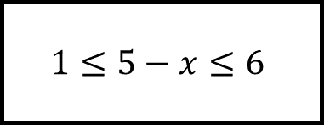
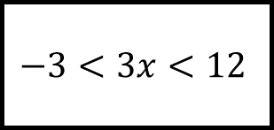
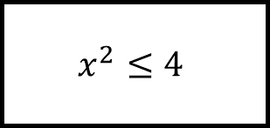
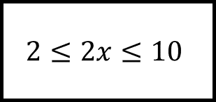
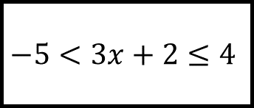
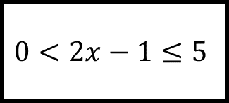
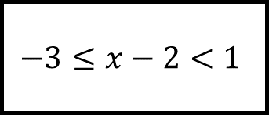
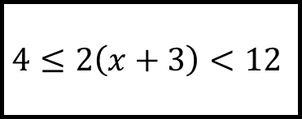
Inequalities Spider 3
$$2≤2x≤10$$
$$x^{2}≤4$$
$$−3<3x<12$$
Fill in the blanks…
$$1≤5−x≤6$$
$$−3≤x−2<1$$
Find the integer solutions for each leg.
$$4≤2\left(x+3\right)<12$$
$$−5<3x+2≤4$$
$$0<2x−1≤5$$

Slide 6
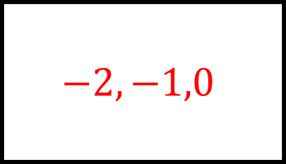
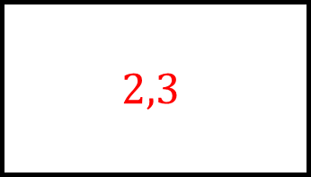
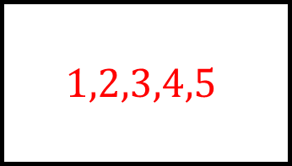
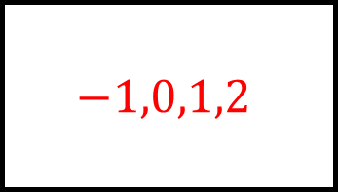
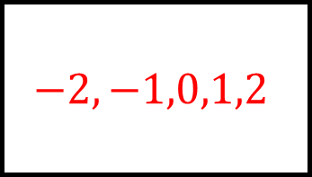
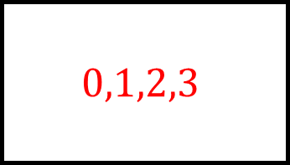
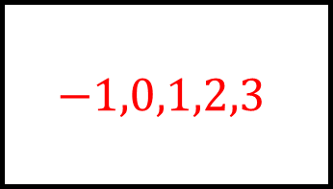
$$1,2,3,4,5$$
$$−2,−1,0,1,2$$
$$0,1,2,3$$
$$2≤2x≤10$$
Inequalities Spider 3 - Answers
$$x^{2}≤4$$
$$−3<3x<12$$
$$−1,0,1,2,3$$
Fill in the blanks…
$$−1,0,1,2$$
$$1≤5−x≤6$$
$$−3≤x−2<1$$
Find the integer solutions for each leg.
$$4≤2\left(x+3\right)<12$$
$$−5<3x+2≤4$$
$$0<2x−1≤5$$
$$−1,0,1,2$$
$$2,3$$
$$−2,−1,0$$

Slide 7
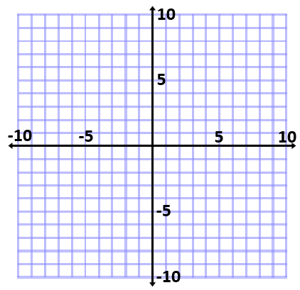
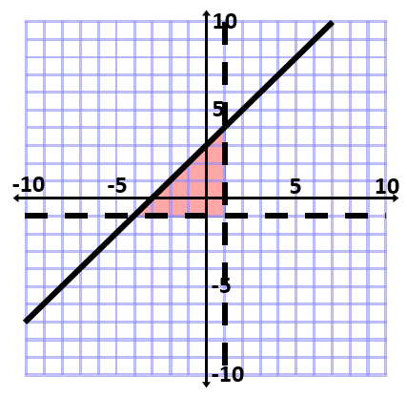
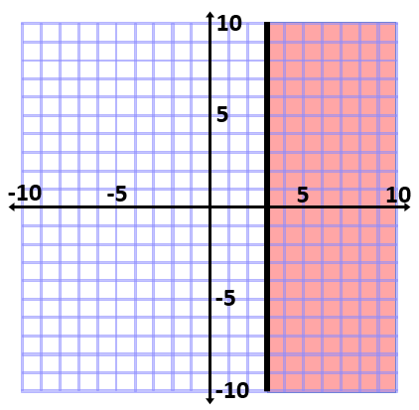






Inequalities Spider 4
$$y>4$$
Fill in the blanks…
$$x≥0$$
$$y≥0$$
$$x+y<5$$
$$x≤−5$$
Describe or draw the shaded area in each case.
$$−3<x≤1$$

Slide 8








Inequalities Spider 4 - Answers
$$x<1$$
$$y>1$$
$$y≤x+3$$
$$y>4$$
$$x≥3$$
Fill in the blanks…
$$x≥0$$
$$y≥0$$
$$x+y<5$$
$$x≤−5$$
Describe or draw the shaded area in each case.
$$x<−2$$
$$x≥4$$
$$−3<x≤1$$
$$y<−1$$

