Slide 1
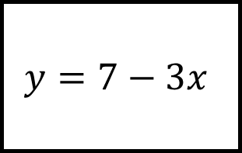
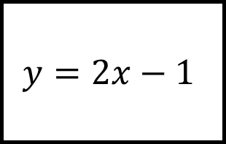
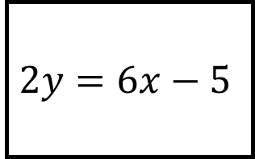
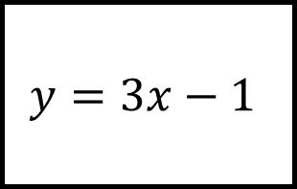
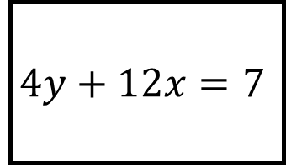
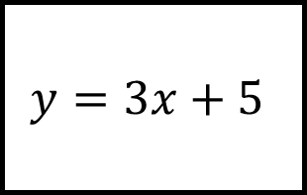
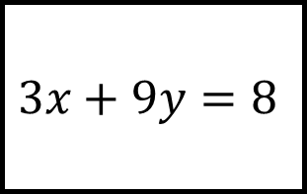
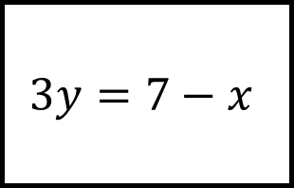
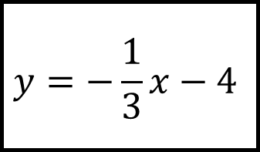
Parallel and Perpendicular Lines Spider 1
$$y=2x−1$$
$$4y+12x=7$$
$$y=3x+5$$
$$3x+9y=8$$
$$y=3x−1$$
$$y=−\frac{1}{3}x−4$$
State whether each line is parallel, perpendicular or neither to the line in the centre.
$$2y=6x−5$$
$$y=7−3x$$
$$3y=7−x$$

Slide 2
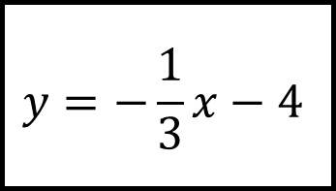
Parallel and Perpendicular Lines Spider 1 - Answers
$$y=2x−1$$
$$4y+12x=7$$
$$y=3x+5$$
Neither
Neither
Parallel
$$3x+9y=8$$
$$y=3x−1$$
$$y=−\frac{1}{3}x−4$$
Perp.
Perp.
State whether each line is parallel, perpendicular or neither to the line in the centre.
Parallel
Neither
Perp.
$$2y=6x−5$$
$$y=7−3x$$
$$3y=7−x$$

Slide 3
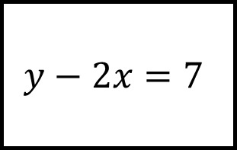
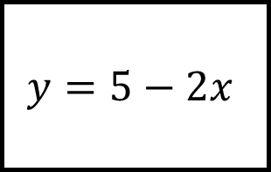
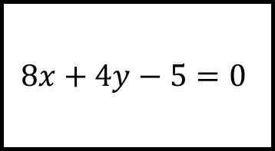
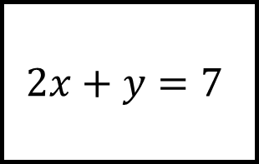
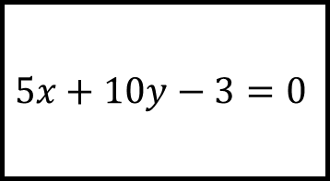
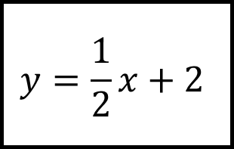
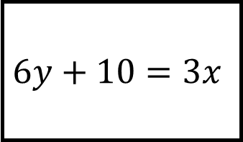
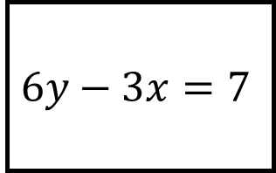
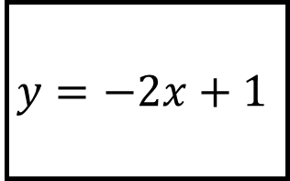
Parallel and Perpendicular Lines Spider 2
$$y=5−2x$$
$$5x+10y−3=0$$
$$y=\frac{1}{2}x+2$$
$$6y+10=3x$$
$$2x+y=7$$
$$y=−2x+1$$
State whether each line is parallel, perpendicular or neither to the line in the centre.
$$8x+4y−5=0$$
$$y−2x=7$$
$$6y−3x=7$$

Slide 4
Parallel and Perpendicular Lines Spider 2 - Answer
$$y=5−2x$$
$$5x+10y−3=0$$
$$y=\frac{1}{2}x+2$$
Parallel
Neither
Perp.
$$6y+10=3x$$
$$2x+y=7$$
$$y=−2x+1$$
Perp.
Parallel
State whether each line is parallel, perpendicular or neither to the line in the centre.
Parallel
Neither
Perp.
$$8x+4y−5=0$$
$$y−2x=7$$
$$6y−3x=7$$

Slide 5
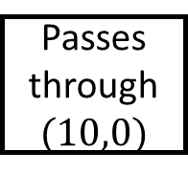
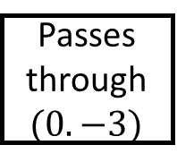
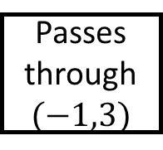
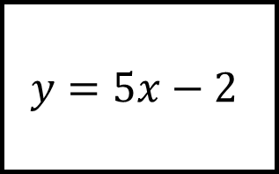
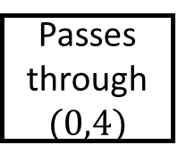
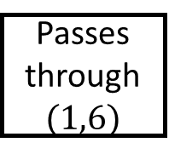
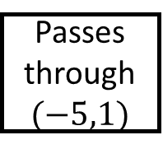
Parallel and Perpendicular Lines Spider 3
Passes through$(10,0)$
Passes through $(0,4)$
Perp.
Parallel
$$y=5x−2$$
Passes through $(−5,1)$
Perp.
Perp.
Passes through $(0.−3)$
Parallel
Parallel
Passes through$(−1,3)$
Complete the equation given the properties
Passes through $(1,6)$

Slide 6
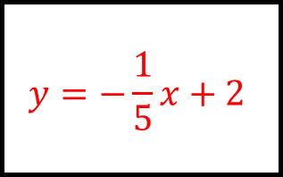
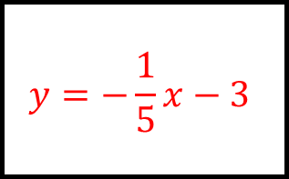
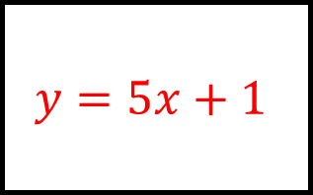
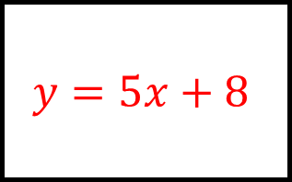
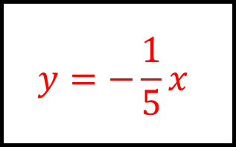
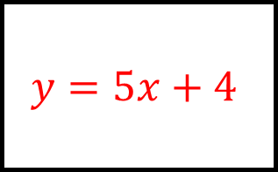
Parallel and Perpendicular Lines Spider 3 - Answers
$$y=−\frac{1}{5}x+2$$
$$y=5x+4$$
Passes through$(10,0)$
Passes through $(0,4)$
Perp.
Parallel
$$y=−\frac{1}{5}x$$
$$y=5x−2$$
$$y=−\frac{1}{5}x−3$$
Passes through $(−5,1)$
Perp.
Perp.
Passes through $(0.−3)$
Parallel
Parallel
$$y=5x+8$$
$$y=5x+1$$
Passes through$(−1,3)$
Complete the equation given the properties
Passes through $(1,6)$

Slide 7
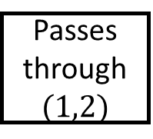
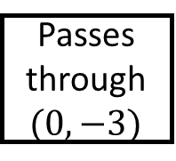
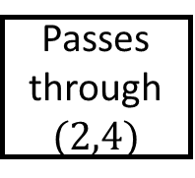
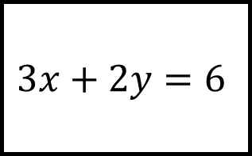
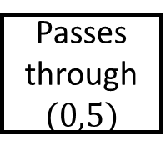
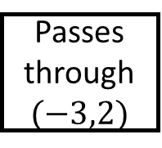

Parallel and Perpendicular Lines Spider 4
Passes through $(1,2)$
Passes through $(0,5)$
Parallel
Parallel
$$3x+2y=6$$
Passes through $(3,−3)$
Perp.
Perp.
Passes through $(0,−3)$
Parallel
Perp.
Passes through $(2,4)$
Complete the equation given the properties
Passes through $(−3,2)$

Slide 8

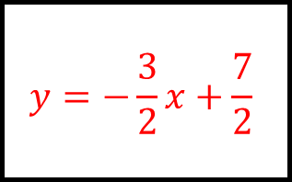
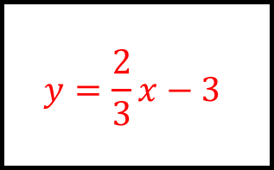
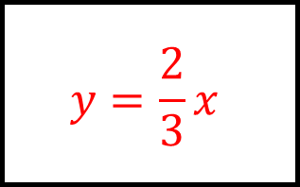
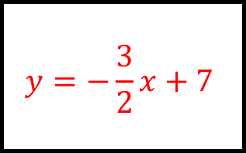

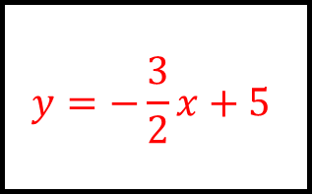
Parallel and Perpendicular Lines Spider 4 - Answers
$$y=−\frac{3}{2}x+\frac{7}{2}$$
$$y=−\frac{3}{2}x+5$$
Passes through $(1,2)$
Passes through $(0,5)$
Parallel
Parallel
$$y=\frac{2}{3}x−5$$
$$3x+2y=6$$
$$y=\frac{2}{3}x−3$$
Passes through $(3,−3)$
Perp.
Perp.
Passes through $(0,−3)$
Parallel
Perp.
$$y=−\frac{3}{2}x+7$$
$$y=\frac{2}{3}x$$
Passes through $(2,4)$
Complete the equation given the properties
Passes through $(3,2)$

