Slide 1
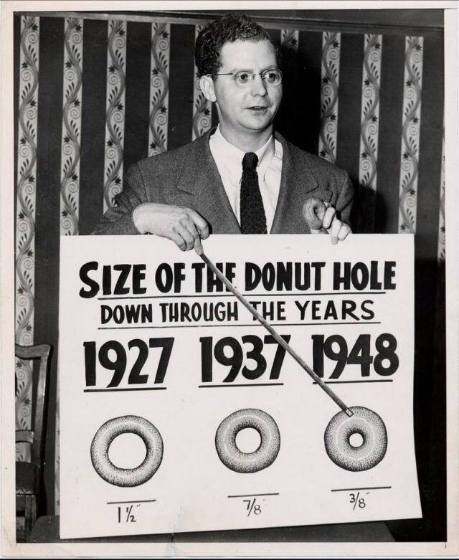
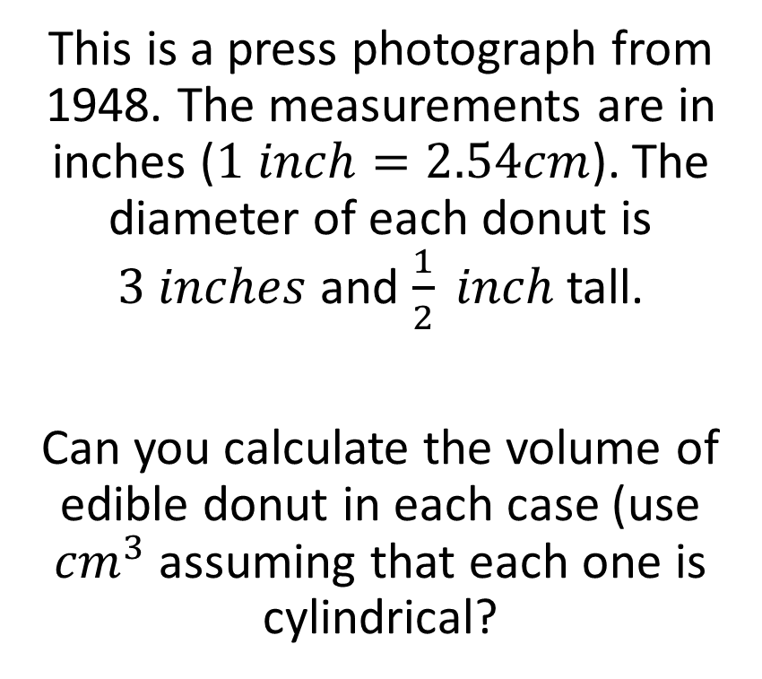
Donut Mathematics
This is a press photograph from 1948. The measurements are in inches ($1 inch=2.54cm$). The diameter of each donut is $3 inches$ and $\frac{1}{2} inch$tall.
Can you calculate the volume of edible donut in each case (use ${cm}^{3}$ assuming that each one is cylindrical?

Slide 2
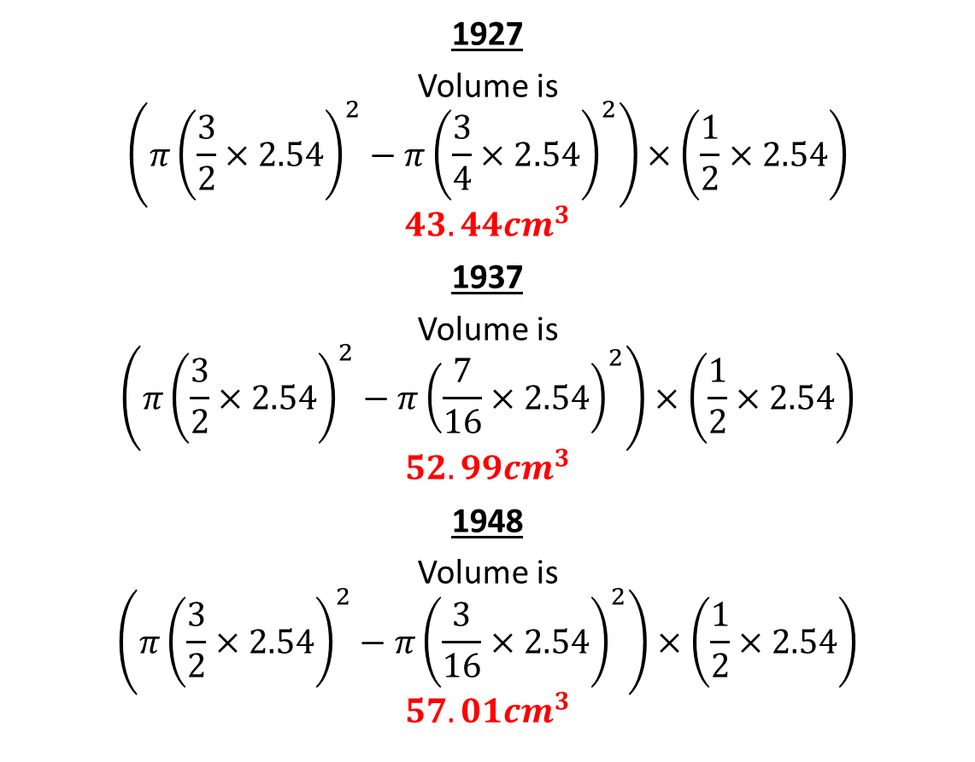
Donut Mathematics - Volume
1927
Volume is
$$\left(π{\left(\frac{3}{2}×2.54\right)}^{2}−π{\left(\frac{3}{4}×2.54\right)}^{2}\right)×\left(\frac{1}{2}×2.54\right)$$
$$43.44{cm}^{3}$$
1937
Volume is
$$\left(π{\left(\frac{3}{2}×2.54\right)}^{2}−π{\left(\frac{7}{16}×2.54\right)}^{2}\right)×\left(\frac{1}{2}×2.54\right)$$
$$52.99{cm}^{3}$$
1948
Volume is
$$\left(π{\left(\frac{3}{2}×2.54\right)}^{2}−π{\left(\frac{3}{16}×2.54\right)}^{2}\right)×\left(\frac{1}{2}×2.54\right)$$
$$57.01{cm}^{3}$$

Slide 3
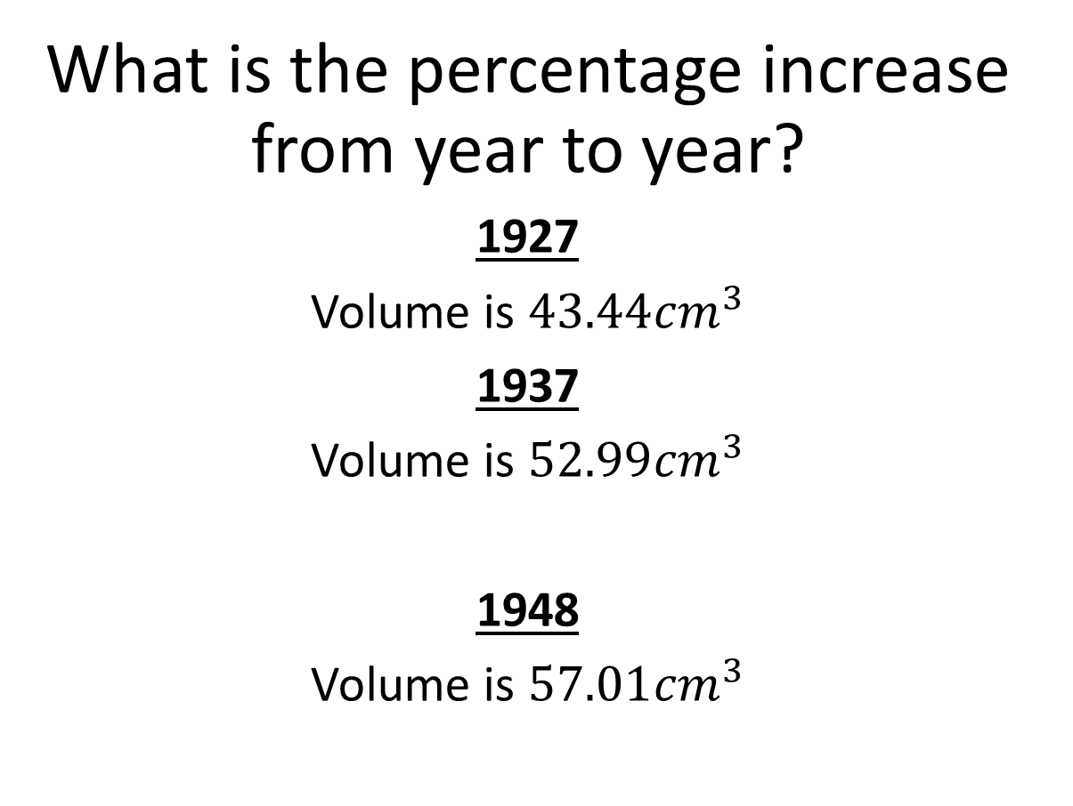


Donut Mathematics - Percentages
What is the percentage increase from year to year?
1927
Volume is $43.44{cm}^{3}$
1937
Volume is $52.99{cm}^{3}$
1948
Volume is $57.01{cm}^{3}$
$$22\%$$
$$7.6\%$$

