Slide 1
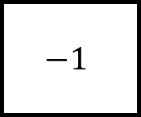
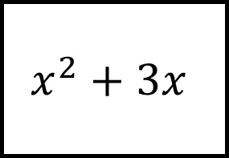
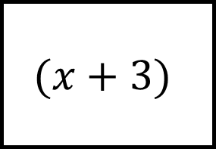
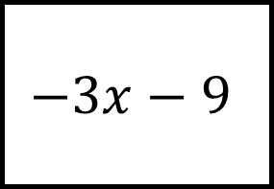
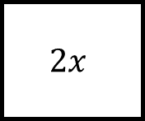
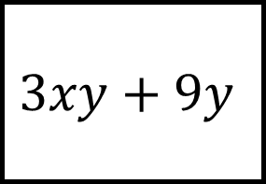
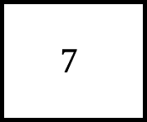
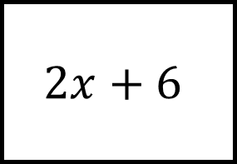
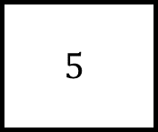
Expanding Brackets Spider 1
$$3xy+9y$$
$$2x+6$$
$$−1$$
$$(x+3)$$
$$2x$$
$$5$$
Fill in the blanks by using knowledge of expanding and factorising single brackets
$$7$$
$$−3x−9$$
$$x^{2}+3x$$

Slide 2
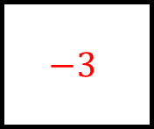
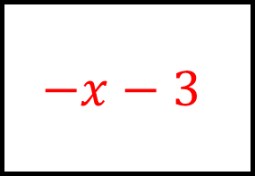
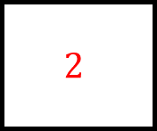
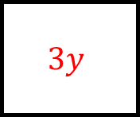
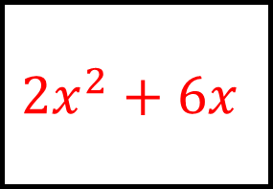
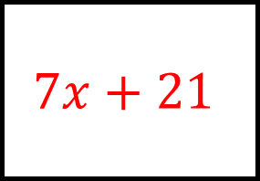
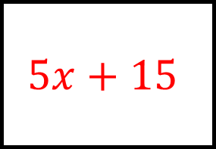
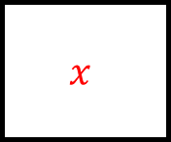
Expanding Brackets Spider 1 - Answers
$$−x−3$$
$$3xy+9y$$
$$2x+6$$
$$−1$$
$$3y$$
$$2$$
$${2x}^{2}+6x$$
$$(x+3)$$
$$5x+15$$
$$2x$$
$$5$$
Fill in the blanks by using knowledge of expanding and factorising single brackets
$$−3$$
$$x$$
$$7$$
$$−3x−9$$
$$x^{2}+3x$$
$$7x+21$$

Slide 3
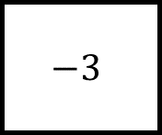
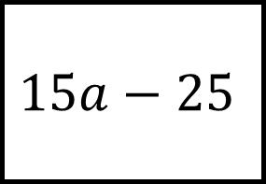
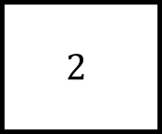
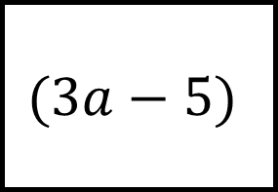
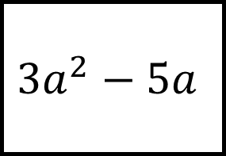
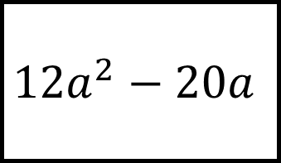
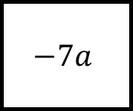
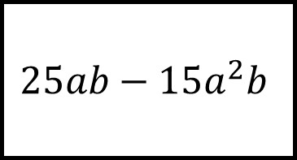
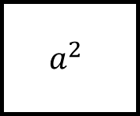
Expanding Brackets Spider 2
$$25ab−15a^{2}b$$
$$15a−25$$
$$2$$
$$(3a−5)$$
$$−7a$$
$$−3$$
Fill in the blanks by using knowledge of expanding and factorising single brackets
$$a^{2}$$
$${12a}^{2}−20a$$
$${3a}^{2}−5a$$

Slide 4

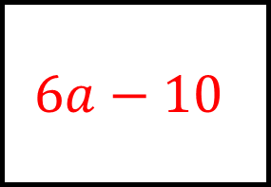
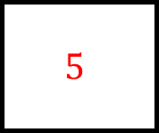
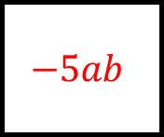
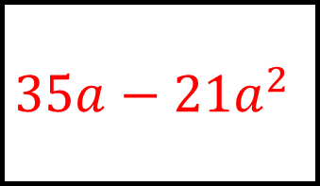
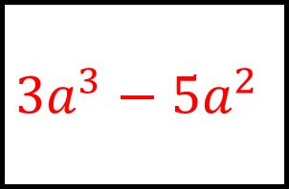
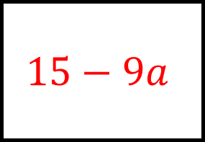

Expanding Brackets Spider 2
$$6a−10$$
$$25ab−15a^{2}b$$
$$15a−25$$
$$2$$
$$−5ab$$
$$5$$
$$35a−{21a}^{2}$$
$$(3a−5)$$
$$15−9a$$
$$−7a$$
$$−3$$
Fill in the blanks by using knowledge of expanding and factorising single brackets
$$4a$$
$$a$$
$$a^{2}$$
$${12a}^{2}−20a$$
$${3a}^{2}−5a$$
$${3a}^{3}−{5a}^{2}$$

Slide 5
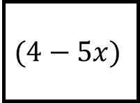
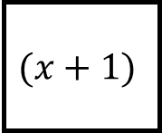
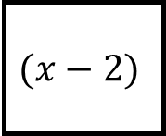
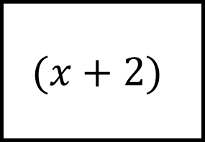
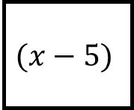
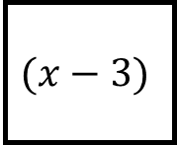
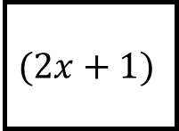
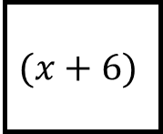
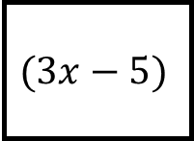
Expanding Brackets Spider 3
$$(x+1)$$
$$(4−5x)$$
$$(x+6)$$
$$(x+2)$$
$$(3x−5)$$
$$(x−3)$$
$$(2x+1)$$
$$(x−5)$$
$$(x−2)$$
Expand the brackets on each leg

Slide 6
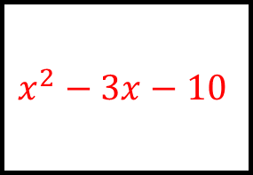
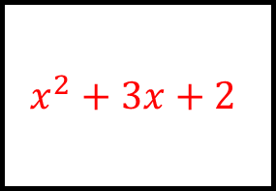
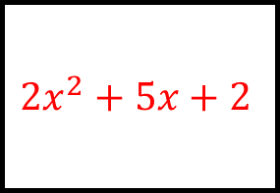
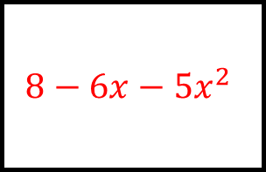
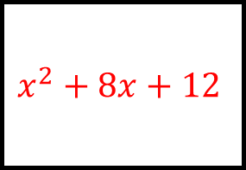
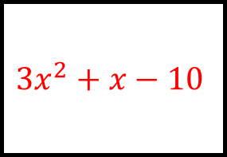
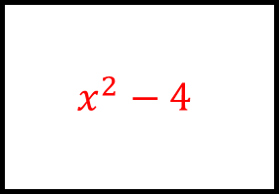
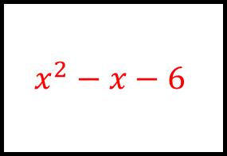
Expanding Brackets Spider 3 - Answers
$$x^{2}+3x+2$$
$$8−6x−{5x}^{2}$$
$$x^{2}+8x+12$$
$$(x+1)$$
$$(4−5x)$$
$$(x+6)$$
$${3x}^{2}+x−10$$
$$(x+2)$$
$$x^{2}−x−6$$
$$(3x−5)$$
$$(x−3)$$
$$(2x+1)$$
$$(x−5)$$
$$(x−2)$$
Expand the brackets on each leg
$${2x}^{2}+5x+2$$
$$x^{2}−3x−10$$
$$x^{2}−4$$

Slide 7
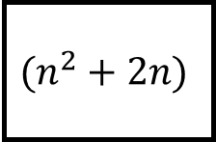








Expanding Brackets Spider 4
$$(n−2)$$
$$(n^{2}+2n)$$
$$(n−5)$$
$$(n−4)$$
$$(5n−2)$$
$$(n+4)$$
$$(3n+1)$$
$$(n+1)$$
$$(n−4)$$
Expand the brackets on each leg

Slide 8








Expanding Brackets Spider 4 - Answers
$$n^{2}−6n+8$$
$$n^{3}−{2n}^{2}−8n$$
$$n^{2}−9n+20$$
$$(n−2)$$
$$(n^{2}+2n)$$
$$(n−5)$$
$${5n}^{2}−22n+8$$
$$(n−4)$$
$$n^{2}−16$$
$$(5n−2)$$
$$(n+4)$$
$$(3n+1)$$
$$(n+1)$$
$$(n−4)$$
Expand the brackets on each leg
$${3n}^{2}−11n−4$$
$$n^{2}−3n−4$$
$$n^{2}−8n+16$$

Slide 9









Expanding Brackets Spider 5
$$a^{2}+5a+4$$
$${5a}^{2}+19a−4$$
$$a^{2}+7a+12$$
$${2a}^{2}+11a+12$$
$$(a+4)$$
$$a^{2}−a−20$$
Expand the brackets on each leg
$$a^{2}−16$$
$$a^{2}+3a−4$$
$$a^{2}+8a+16$$

Slide 10








Expanding Brackets Spider 5 - Answers
$$a^{2}+5a+4$$
$${5a}^{2}+19a−4$$
$$a^{2}+7a+12$$
$$(a+1)$$
$$(5a−1)$$
$$(a+3)$$
$${2a}^{2}+11a+12$$
$$(a+4)$$
$$a^{2}−a−20$$
$$(2a+3)$$
$$(a−5)$$
$$(a−4)$$
$$(a−1)$$
$$(a+4)$$
Expand the brackets on each leg
$$a^{2}−16$$
$$a^{2}+3a−4$$
$$a^{2}+8a+16$$

Slide 11








Expanding Brackets Spider 6
$$y^{2}−5y+6$$
$${4y}^{2}−5y−6$$
$$y^{2}−3y+2$$
$${2y}^{2}−9y+10$$
$$y^{2}+2y−8$$
Factorise each quadratic; the centre is a factor of each
$$y^{2}−8y+12$$
$$y^{2}+y−6$$
$$y^{2}−4$$

Slide 12









Expanding Brackets Spider 6 - Answers
$$y^{2}−5y+6$$
$${4y}^{2}−5y−6$$
$$y^{2}−3y+2$$
$$(y−3)$$
$$(4y+3)$$
$$(y−1)$$
$${2y}^{2}−9y+10$$
$$(y−2)$$
$$y^{2}+2y−8$$
$$(2y−5)$$
$$(y+4)$$
$$(y−6)$$
$$(y+3)$$
$$(y+2)$$
Factorise each quadratic; the centre is a factor of each
$$y^{2}−8y+12$$
$$y^{2}+y−6$$
$$y^{2}−4$$

Slide 13






















Expanding Brackets Spider 7
Factorise each quadratic expression

