Slide 1
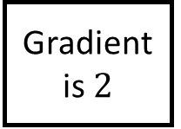
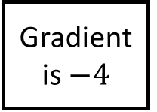
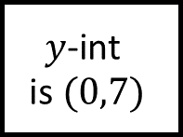
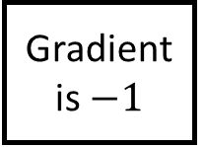
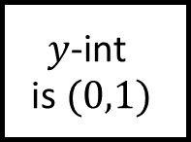
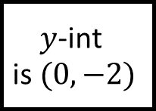
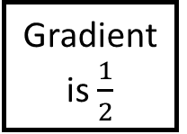
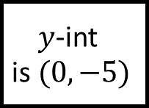
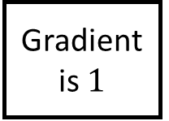
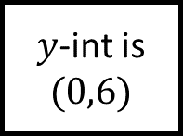

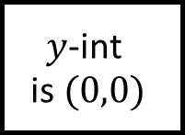
$y$-int is $(0,6)$
$$y\text{−}\text{int} \text{is} (0,1)$$
Gradient is $\frac{1}{2}$
Gradient is $2$
Linear Graphs Spider 1
Write the equation of the lines given…
$$y\text{−}\text{int} \text{is} (0,−5)$$
Gradient is $−1$
Gradient is $3$
$$y\text{−}\text{int} \text{is} (0,0)$$
Gradient is $−4$
Gradient is $1$
$$y\text{−}\text{int} \text{is} (0,7)$$
$$y\text{−}\text{int} \text{is} (0,−2)$$

Slide 2
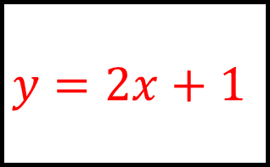
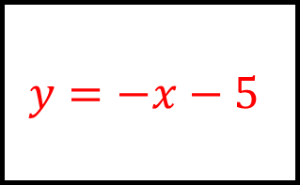
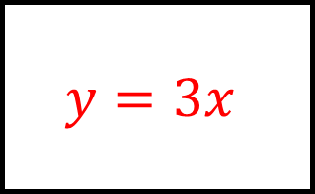
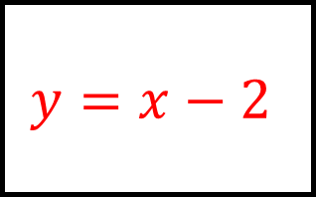
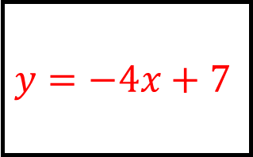
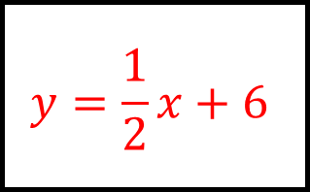
$$y=\frac{1}{2}x+6$$
$$y=2x+1$$
$y$-int is $(0,6)$
$$y\text{−}\text{int} \text{is} (0,1)$$
Gradient is $\frac{1}{2}$
Gradient is $2$
Linear Graphs Spider 1 - Answers
$$y=−x−5$$
Write the equation of the lines given…
$$y=3x$$
$$y\text{−}\text{int} \text{is} (0,−5)$$
Gradient is $−1$
Gradient is $3$
$$y\text{−}\text{int} \text{is} (0,0)$$
Gradient is $−4$
Gradient is $1$
$$y=−4x+7$$
$$y=x−2$$
$$y\text{−}\text{int} \text{is} (0,7)$$
$$y\text{−}\text{int} \text{is} (0,−2)$$

Slide 3
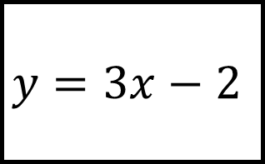
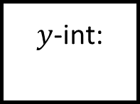
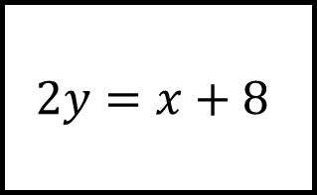
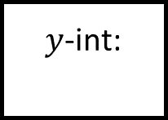
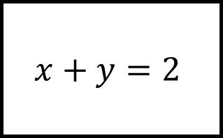
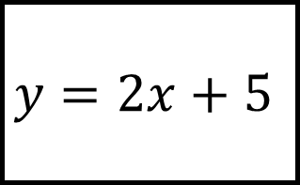
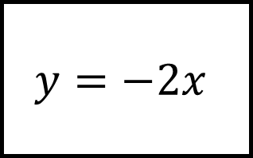

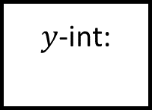
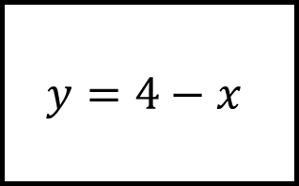
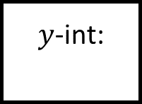
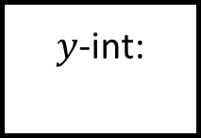
$$x+y=2$$
$$y=3x−2$$
$y$-int:
$y$-int:
Gradient:
Gradient:
Linear Graphs Spider 2
$$2y=x+8$$
Fill in the blanks from the equation…
$$y=2x+5$$
$y$-int:
Gradient:
Gradient:
$y$-int:
Gradient:
Gradient:
$$y=4−x$$
$$y=−2x$$
$y$-int:
$y$-int:

Slide 4
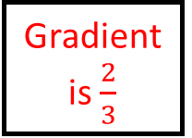
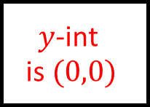
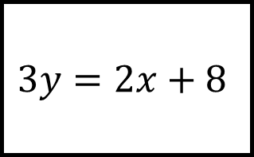
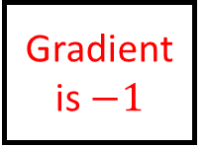
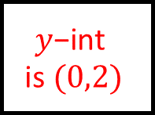
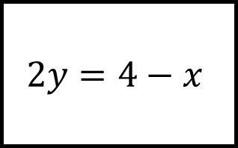
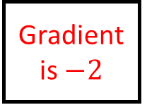
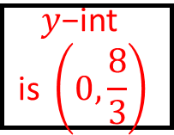
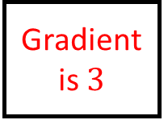
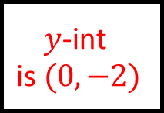
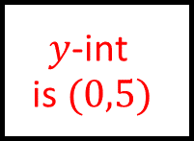
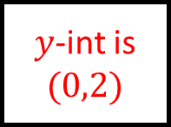

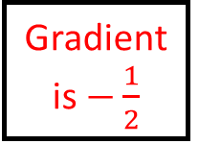
$$x+y=2$$
$$y=3x−2$$
$y$-int is $(0,2)$
$$y\text{−}\text{int} \text{is} (0,−2)$$
Gradient is $−1$
Gradient is $3$
Linear Graphs Spider 2 - Answers
$$3y=2x+8$$
Fill in the blanks from the equation…
$$y=2x+5$$
$$y\text{−}\text{int} \text{is} \left(0,\frac{8}{3}\right)$$
Gradient is $\frac{2}{3}$
Gradient is $3$
$$y\text{−}\text{int} \text{is} (0,5)$$
Gradient is $−\frac{1}{2}$
Gradient is $−2$
$$2y=4−x$$
$$y=−2x$$
$$y\text{−}\text{int} \text{is} (0,2)$$
$$y\text{−}\text{int} \text{is} (0,0)$$

Slide 5
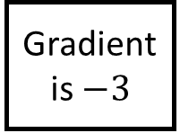
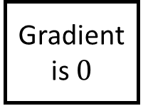
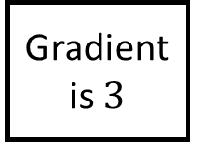
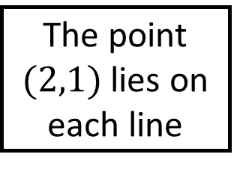
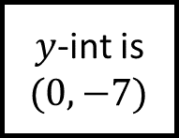
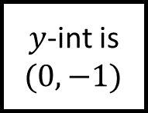
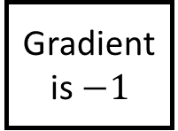
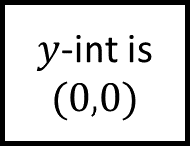
Linear Graphs Spider 3
Gradientis $−3$
Gradient is $0$
Graph is vertical
The point $(2,1)$ lies on each line
$y$-int is $(0,0)$
$y$-int is $(0,−1)$
Find the equation of the line on each leg
Gradientis $−1$
Gradient is $3$
$y$-int is $(0,−7)$

Slide 6
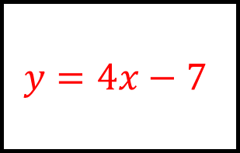















$$y=1$$
$$y=7−3x$$
$$x=2$$
Linear Graphs Spider 3 - Answers
Gradientis $−3$
Gradient is $0$
Graph is vertical
$$y=\frac{1}{2}x$$
The point $(2,1)$ lies on each line
$$y=x−1$$
$y$-int is $(0,0)$
$y$-int is $(0,−1)$
Find the equation of the line on each leg
Gradientis $−1$
Gradient is $3$
$y$-int is $(0,−7)$
$$y=3−x$$
$$y=4x−7$$
$$y=3x−5$$

Slide 7









Linear Graphs Spider 4
$y$-int is $(0,1)$
Gradient is $1$
Gradient is $−\frac{1}{2}$
The point $\left(−2,3\right)$ lies on each line
Gradient is $\frac{1}{2}$
$y$-int is $(0,7)$
Find the equation of the line on each leg
$y$-int is $(0,0)$
Gradient is $−2$
Gradient is $4$

Slide 8








$$y=1−x$$
$$y=2−\frac{1}{2}x$$
$$y=x+5$$
Linear Graphs Spider 4 - Answers
$y$-int is $(0,1)$
Gradient is $1$
Gradient is $−\frac{1}{2}$
$$y=\frac{1}{2}x+4$$
The point $\left(−2,3\right)$ lies on each line
$$y=2x+7$$
Gradient is $\frac{1}{2}$
$y$-int is $(0,7)$
Find the equation of the line on each leg
$y$-int is $(0,0)$
Gradient is $−2$
Gradient is $4$
$$y=−\frac{3}{2}x$$
$$y=4x+11$$
$$y=−2x−1$$

Slide 9












$$(−4,−1)$$
$$(3,14)$$
$$(4,3)$$
$$(0,5)$$
Linear Graphs Spider 5
Find the equations of the lines given the points…
$$(5,−17)$$
$$(−2,−3)$$
$$(0,4)$$
$$(4,0)$$
$$(−2,2)$$
$$(1,2)$$
$$(1,8)$$
$$(2,3)$$

Slide 10






$$y=\frac{1}{2}x+1$$
$$y=3x+5$$
$$(−4,−1)$$
$$(3,14)$$
$$(4,3)$$
$$(0,5)$$
Linear Graphs Spider 5 - Answers
$$y=−2x−7$$
Find the equations of the lines given the points…
$$y=4−x$$
$$(5,−17)$$
$$(−2,−3)$$
$$(0,4)$$
$$(4,0)$$
$$(−2,2)$$
$$(1,2)$$
$$y=2x+6$$
$$y=x+1$$
$$(1,8)$$
$$(2,3)$$

