Slide 1
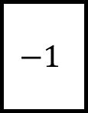
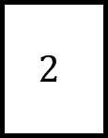
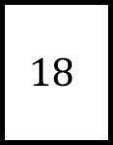
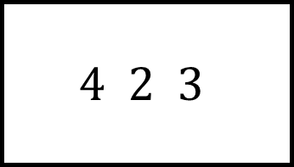
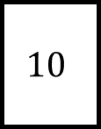
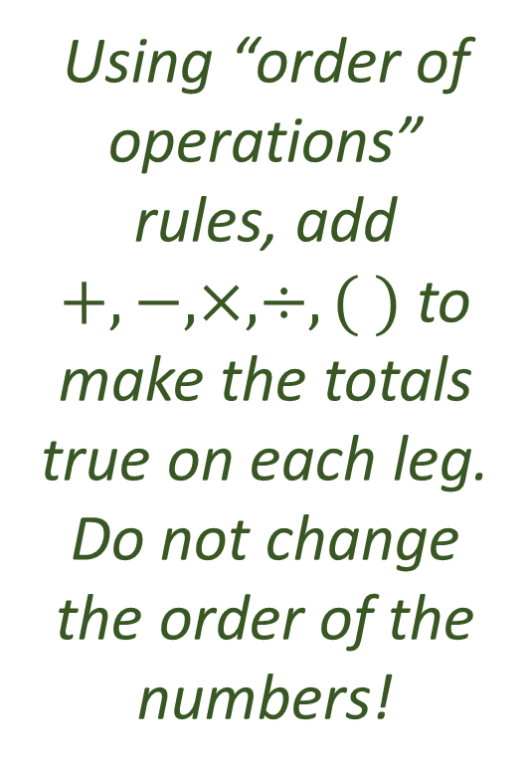
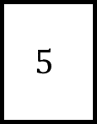
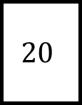
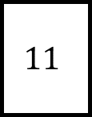
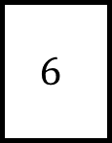
Bidmas Spider 1
$$2$$
$$−1$$
$$11$$
Using “order of operations” rules, add $+,−,×,÷,( )$ to make the totals true on each leg.
Do not change the order of the numbers!
$$4 2 3$$
$$6$$
$$5$$
$$20$$
$$10$$
Is there more than one answer for any?
$$18$$

Slide 2
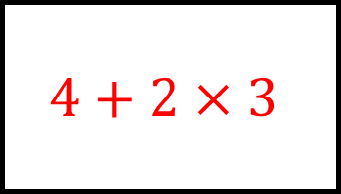
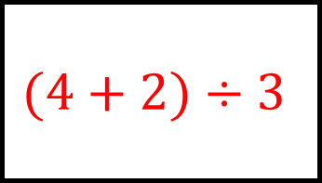
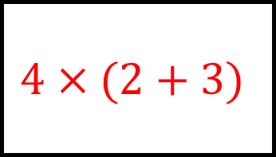
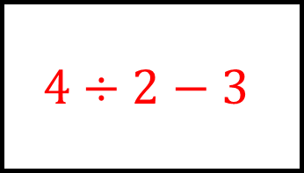
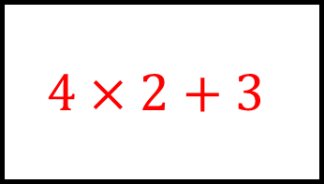
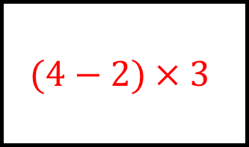
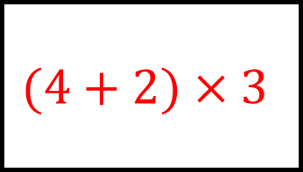
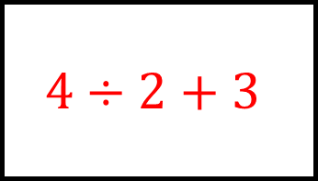
$$(4+2)÷3$$
Bidmas Spider 1 - Answers
$$4÷2−3$$
$$4×2+3$$
$$2$$
$$−1$$
$$11$$
Using “order of operations” rules, add $+,−,×,÷,( )$ to make the totals true on each leg.
Do not change the order of the numbers!
$$(4−2)×3$$
$$4 2 3$$
$$4÷2+3$$
$$6$$
$$5$$
$$20$$
$$10$$
Is there more than one answer for any?
$$18$$
$$4×(2+3)$$
$$4+2×3$$
$$(4+2)×3$$

Slide 3
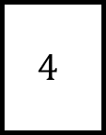
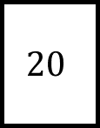
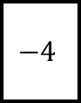
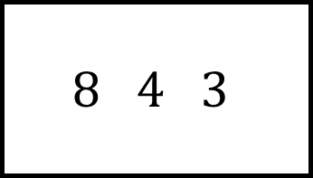
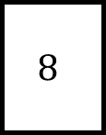
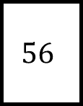

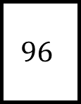
Bidmas Spider 2
$$20$$
$$4$$
$$12$$
Using “order of operations” rules, add $+,−,×,÷,( )$ to make the totals true on each leg.
Do not change the order of the numbers!
$$8 4 3$$
$$96$$
$$5$$
$$56$$
$$8$$
Is there more than one answer for any?
$$−4$$

Slide 4
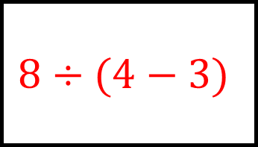
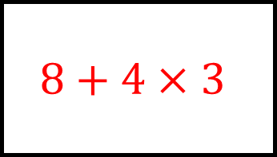
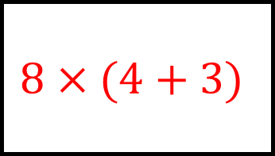
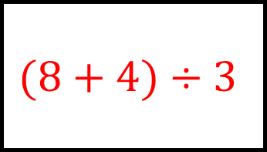
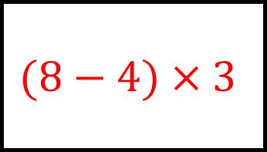
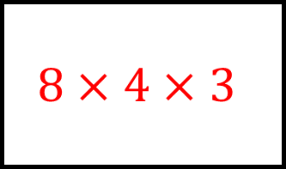
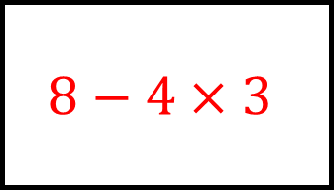
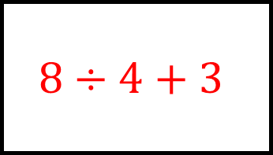
$$8+4×3$$
Bidmas Spider 2 - Answers
$$(8+4)÷3$$
$$(8−4)×3$$
$$20$$
$$4$$
$$12$$
Using “order of operations” rules, add $+,−,×,÷,( )$ to make the totals true on each leg.
Do not change the order of the numbers!
$$8×4×3$$
$$8 4 3$$
$$8÷4+3$$
$$96$$
$$5$$
$$56$$
$$8$$
Is there more than one answer for any?
$$−4$$
$$8×(4+3)$$
$$8÷(4−3)$$
$$8−4×3$$

Slide 5
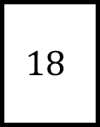
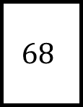
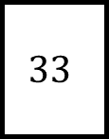
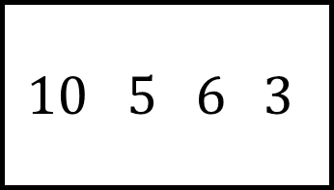
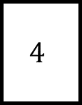
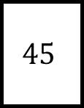
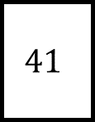
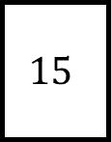
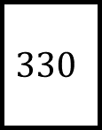
Bidmas Spider 3
$$68$$
$$18$$
$$15$$
Using “order of operations” rules, add $+,−,×,÷,( )$ to make the totals true on each leg.
Do not change the order of the numbers!
$$10 5 6 3$$
$$330$$
$$45$$
$$41$$
$$4$$
Is there more than one answer for any?
$$33$$

Slide 6
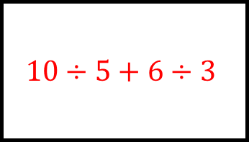
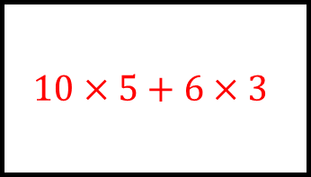
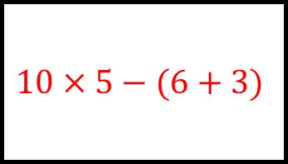
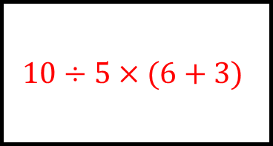
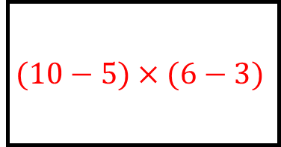
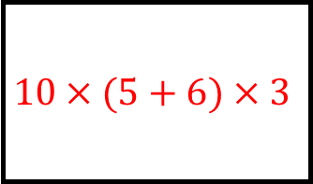
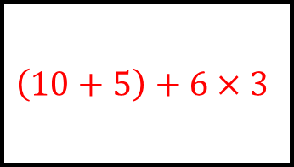
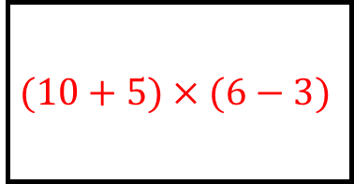
$$10×5+6×3$$
Bidmas Spider 3 - Answers
$$10÷5×(6+3)$$
$$(10−5)×(6−3)$$
$$68$$
$$18$$
$$15$$
Using “order of operations” rules, add $+,−,×,÷,( )$ to make the totals true on each leg.
Do not change the order of the numbers!
$$10×(5+6)×3$$
$$10 5 6 3$$
$$(10+5)×(6−3)$$
$$330$$
$$45$$
$$41$$
$$4$$
Is there more than one answer for any?
$$33$$
$$10×5−(6+3)$$
$$10÷5+6÷3$$
$$\left(10+5\right)+6×3$$

Slide 7









Bidmas Spider 4
$$52$$
$$220$$
$$5$$
Using “order of operations” rules, add $+,−,×,÷,( )$ to make the totals true on each leg.
Do not change the order of the numbers!
$$15 5 8 4$$
$$45$$
$$240$$
$$22$$
$$7$$
Is there more than one answer for any?
$$59$$

Slide 8








$$\left(15+5\right)+8×4$$
Bidmas Spider 4 - Answers
$$(15+5×8)×4$$
$$15÷5+8÷4$$
$$52$$
$$220$$
$$5$$
Using “order of operations” rules, add $+,−,×,÷,( )$ to make the totals true on each leg.
Do not change the order of the numbers!
$$15×(5−8÷4)$$
$$15 5 8 4$$
$$(15+5)×(8+4)$$
$$45$$
$$240$$
$$22$$
$$7$$
Is there more than one answer for any?
$$59$$
$$15+(5+8÷4)$$
$$15÷5+(8−4)$$
$$15+5×8+4$$

Slide 9










Bidmas Spider Challenge
Using “order of operations” rules, add $+,−,×,÷,\left( \right)$ and powers/roots to make the totals true on each leg.
Do not change the order of the numbers!
$$32$$
$$6$$
$$28$$
$$4 8 2$$
$$40$$
$$8$$
$$12$$
$$18$$
Is there more than one answer for any?
$$20$$

Slide 10








Bidmas Spider Challenge - Answers
$$4^{2}+8×2$$
$$\sqrt{4}+\sqrt[3]{8}+2$$
$$4×8−2^{2}$$
Using “order of operations” rules, add $+,−,×,÷,\left( \right)$ and powers/roots to make the totals true on each leg.
Do not change the order of the numbers!
$$32$$
$$6$$
$$28$$
$$4+{(8−2)}^{2}$$
$$4 8 2$$
$$\left(4+8\right)−2^{2}$$
$$40$$
$$8$$
$$12$$
$$18$$
Is there more than one answer for any?
$$20$$
$$4+8^{2}÷2^{3}$$
$$\sqrt{4}+8×2$$
$$4^{2}+8÷2$$

