Slide 1
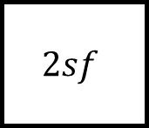
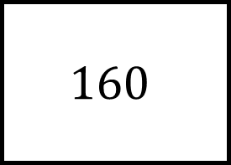
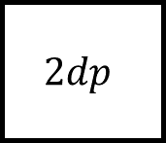
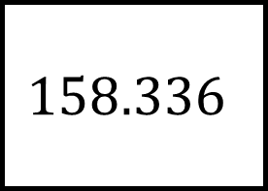
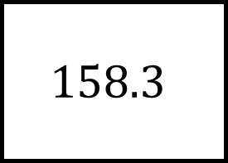
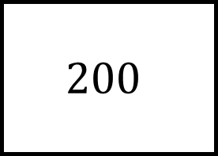
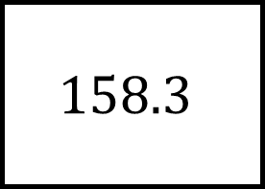
Rounding Spider 1
$$158.3$$
$$160$$
Nearest 100
$$158.336$$
$$2sf$$
Nearest unit
No “small squares” can be repeated but answers can appear more than once
$$2dp$$
$$200$$
$$158.3$$

Slide 2
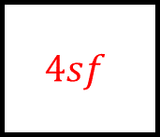

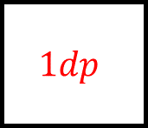

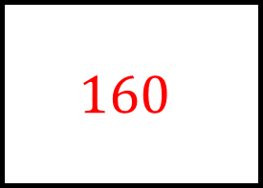
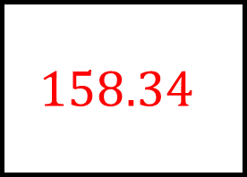
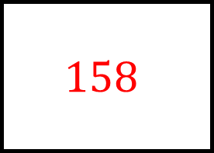
Rounding Spider 1 - Answer
$$200$$
$$158.3$$
$$160$$
Nearest 100
$$4sf$$
Nearest 10
$$160$$
$$158.336$$
$$158$$
$$2sf$$
Nearest unit
$$1sf$$
$$1dp$$
No “small squares” can be repeated but answers can appear more than once
$$2dp$$
$$200$$
$$158.3$$
$$158.34$$

Slide 3
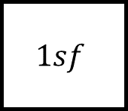
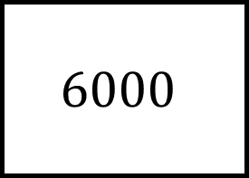
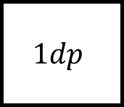
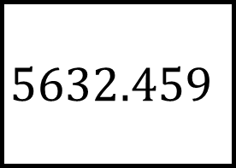
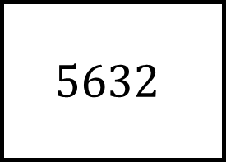
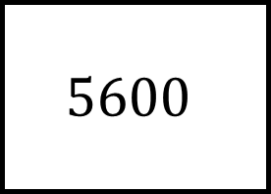

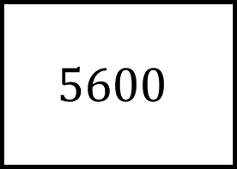

Rounding Spider 2
$$5600$$
$$6000$$
$$1dp$$
$$5632.459$$
$$2dp$$
$$1sf$$
No “small squares” can be repeated but answers can appear more than once
$$4sf$$
$$5600$$
$$5632$$

Slide 4
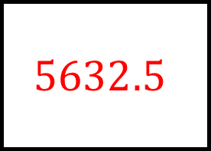
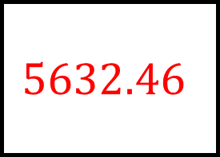
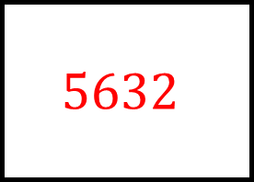

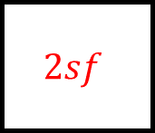
Rounding Spider 2 - Answers
$$5632.5$$
$$5600$$
$$6000$$
$$1dp$$
$$2sf$$
Nearest 1000
$$5632.46$$
$$5632.459$$
$$6000$$
$$2dp$$
$$1sf$$
Nearest 100
Nearest unit
No “small squares” can be repeated but answers can appear more than once
$$4sf$$
$$5600$$
$$5632$$
$$5632$$

Slide 5
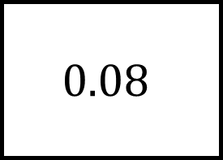
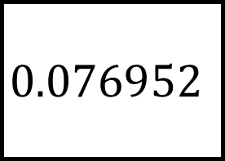
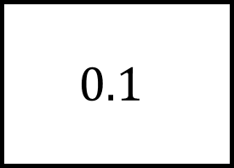
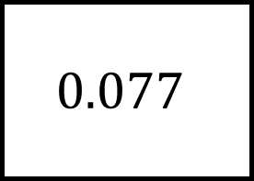
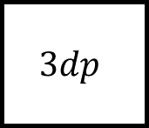
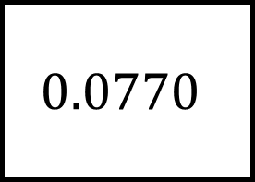
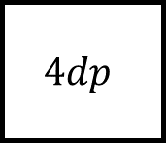
Rounding Spider 3
$$0.0770$$
$$0.08$$
$$1dp$$
$$0.076952$$
$$3dp$$
$$1sf$$
No “small squares” can be repeated but answers can appear more than once
$$4dp$$
$$0.077$$
$$0.1$$

Slide 6
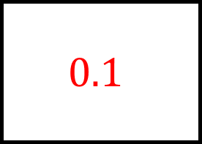
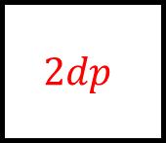

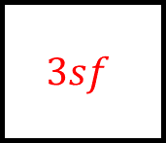
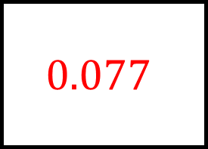
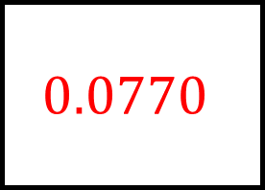
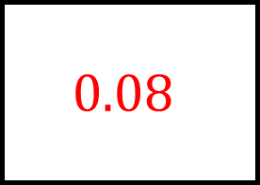
Rounding Spider 3 - Answers
$$0.1$$
$$0.0770$$
$$0.08$$
$$1dp$$
$$3sf$$
$$2dp$$
$$0.077$$
$$0.076952$$
$$0.08$$
$$3dp$$
$$1sf$$
$$2sf$$
Nearest tenth
No “small squares” can be repeated but answers can appear more than once
$$4dp$$
$$0.077$$
$$0.1$$
$$0.0770$$

Slide 7
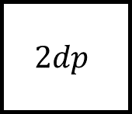
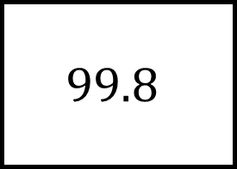
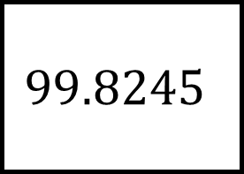
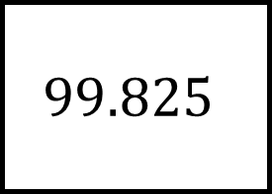
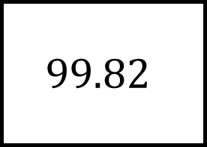
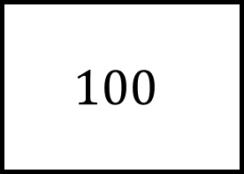
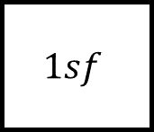
Rounding Spider 4
$$100$$
$$99.8$$
$$1dp$$
$$99.8245$$
$$2sf$$
$$2dp$$
No “small squares” can be repeated but answers can appear more than once
$$1sf$$
$$99.82$$
$$99.825$$

Slide 8
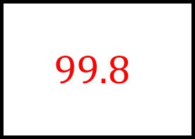




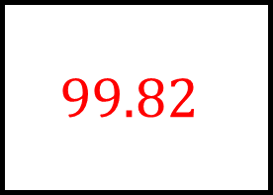
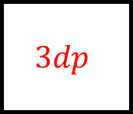
Rounding Spider 4 - Answers
$$99.8$$
$$100$$
$$99.8$$
$$1dp$$
Nearest ten
$$3sf$$
$$100$$
$$99.8245$$
$$99.82$$
$$2sf$$
$$2dp$$
$$4sf$$
$$3dp$$
No “small squares” can be repeated but answers can appear more than once
$$1sf$$
$$99.82$$
$$99.825$$
$$100$$

