Slide 1
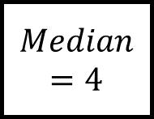
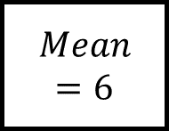
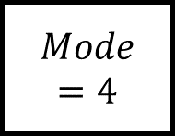
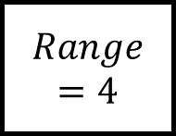
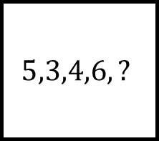
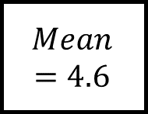
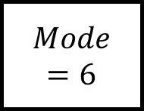
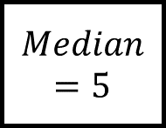
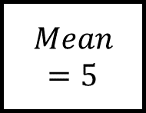
Place a number in each rectangle to make each “leg” true.
Average and Range Spider 1
$$Mode=6$$
$$Mean=4.6$$
$$Mode=4$$
$$5,3,4,6,?$$
$$Range=4$$
$$Median=4$$
$$Mean=5$$
$$Mean=6$$
$$Median=5$$
Is there more than one answer for some questions?

Slide 2
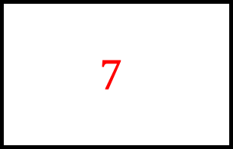
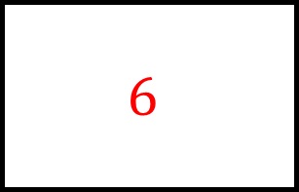

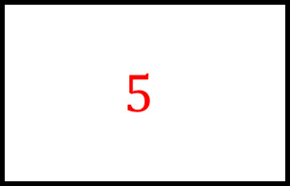
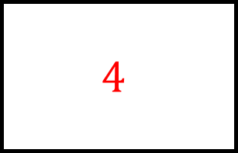
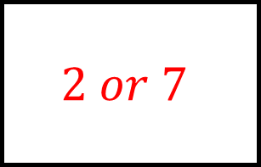
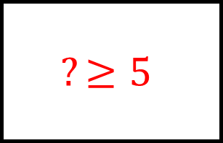
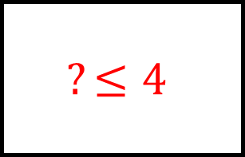
$$6$$
Place a number in each rectangle to make each “leg” true.
$$5$$
$$4$$
Average and Range Spider 1 - Answers
$$Mode=6$$
$$Mean=4.6$$
$$Mode=4$$
$$2 or 7$$
$$5,3,4,6,?$$
$$?≤4$$
$$Range=4$$
$$Median=4$$
$$Mean=5$$
$$Mean=6$$
$$Median=5$$
Is there more than one answer for some questions??
$$12$$
$$7$$
$$?≥5$$

Slide 3

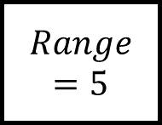
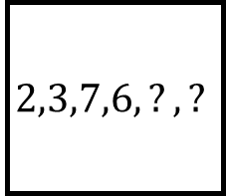
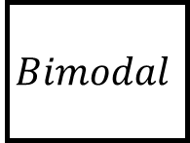
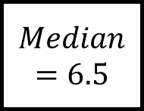
Place numbers in each rectangle to make each “leg” true.
Average and Range Spider 2
$$Mode=6$$
$$Bimodal$$
$$Mode=4$$
$$2,3,7,6,?,?$$
$$Range=5$$
$$Median=5$$
$$Mean=5$$
$$Mean=6$$
$$Median=6.5$$
Is there more than one answer for some questions?

Slide 4
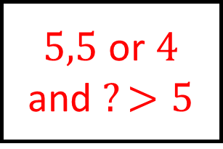
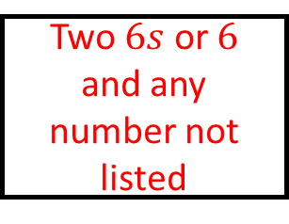
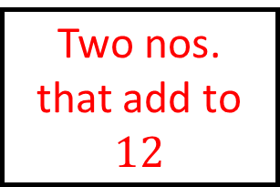
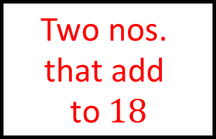
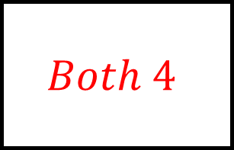
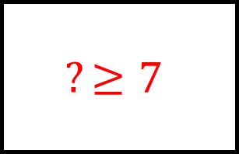
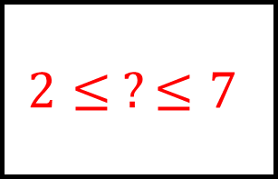
Two $6s$ or $6$ and any number not listed
Place numbers in each rectangle to make each “leg” true.
Two different numbers already listed
$$Both 4$$
Average and Range Spider 2 - Answers
$$Mode=6$$
$$Bimodal$$
$$Mode=4$$
$$2≤ ?≤7$$
$$2,3,7,6,?,?$$
$5,5$ or $4$ and $?>5$
$$Range=5$$
$$Median=5$$
$$Mean=5$$
$$Mean=6$$
$$Median=6.5$$
Is there more than one answer for some questions?
$$\text{Two} \text{nos}\text{. }\text{that} \text{add} \text{to} 18$$
Two nos. that add to $12$
$$?≥7$$

Slide 5
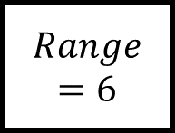
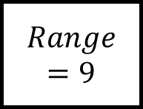
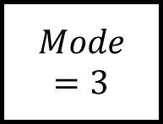
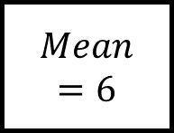
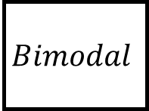

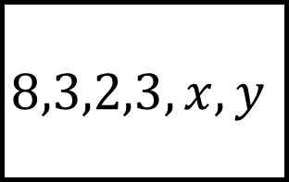
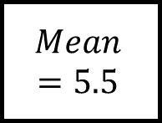
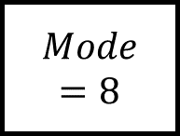
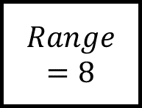
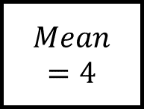
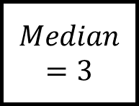


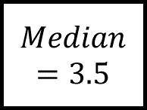

$$Mean=4$$
$$Mode=8$$
Average and Range Spider 3
$$Bimodal$$
$$Mean=6$$
$$Range=6$$
Find values for $x$ and $y$ to make each “leg” true.
$$8,3,2,3,x,y$$
$$Mean=5.5$$
$$Range=9$$
$$Mode=3$$
$$Median=3$$
Is there more than one answer for some questions?
$$Median=3.5$$
$$Range=8$$
$$Mean=4$$
$$Mean=4.5$$
$$Mode=3$$

Slide 6
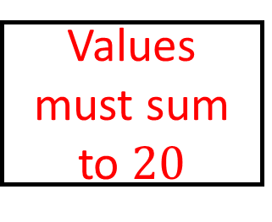
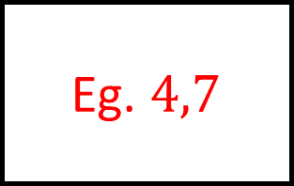
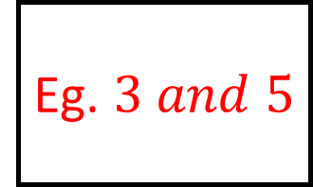
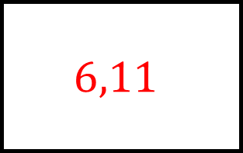
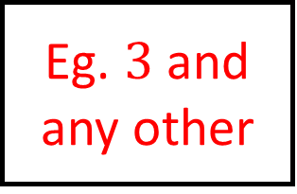
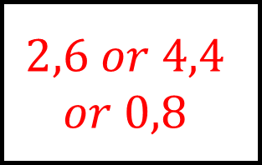
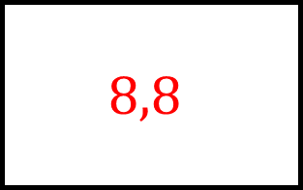
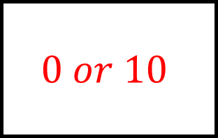
Values must sum to $20$
$$2,6 or 4,4$$
$$or 0,8$$
$$8,8$$
$$Mean=4$$
$$Mode=8$$
Average and Range Spider 3 - Answers
$$Bimodal$$
$$Mean=6$$
$$Range=6$$
Find values for $x$ and $y$ to make each “leg” true.
$$6,11$$
$$8,3,2,3,x,y$$
Eg. $3$ and any other
$$Mean=5.5$$
$$Range=9$$
$$Mode=3$$
$$Median=3$$
Is there more than one answer for some questions?
$$Median=3.5$$
$$Range=8$$
$$Mean=4$$
Eg. $4,7$
Eg. $3 and 5$
$$Mean=4.5$$
$$Mode=3$$
$$0 or 10$$

Slide 7
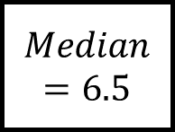
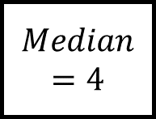

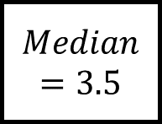












$$Bimodal$$
$$Range=4$$
Average and Range Spider 4
$$Median=6.5$$
$$Mean=7$$
$$Mode=6$$
Find values for $a,b,c,d$ to make each “leg” true.
$$a,b,c,d$$
$$Median=5.5$$
$$Mode=7$$
$$Mean=5$$
$$Mode=4$$
Is there more than one answer for some questions?
$$Mean=6$$
$$Median=3.5$$
$$Mode=5$$
$$Range=8$$
$$Median=4$$

Slide 8








Eg. $7,7,7,7$
Eg. $6,6,7,7$
Eg. $6,6,6,10$
$$Bimodal$$
$$Range=4$$
Average and Range Spider 4 - Answers
$$Median=6.5$$
$$Mean=7$$
$$Mode=6$$
Find values for $a,b,c,d$ to make each “leg” true.
Eg. $1,4,7,7$
$$a,b,c,d$$
Eg. $4,4,4,8$
$$Median=5.5$$
$$Mode=7$$
$$Mean=5$$
$$Mode=4$$
Is there more than one answer for some questions?
$$Mean=6$$
$$Median=3.5$$
$$Mode=5$$
Eg. $1,7,7,9$
Eg. $2,3,5,5$
$$Range=8$$
$$Median=4$$
Eg. $2,3,4,5$

