Slide 1
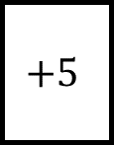
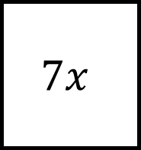
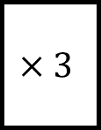
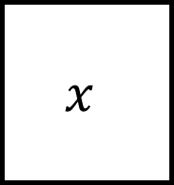
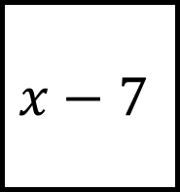
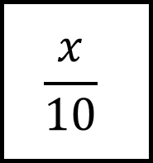
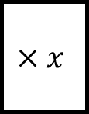
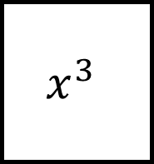
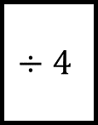
Algebraic Expressions Spider 1
$$x^{3}$$
$$7x$$
$$×3$$
$$x$$
$$×x$$
$$+5$$
$$÷4$$
$$\frac{x}{10}$$
$$x−7$$

Slide 2
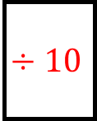
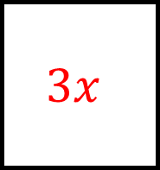
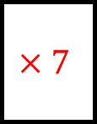
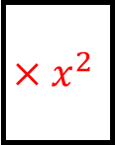
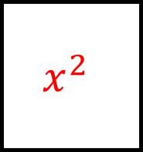
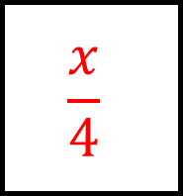
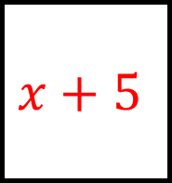
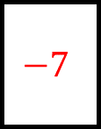
Algebraic Expressions Spider 1 - Answers
$$3x$$
$$x^{3}$$
$$7x$$
$$×3$$
$$×x^{2}$$
$$×7$$
$$x^{2}$$
$$x$$
$$x+5$$
$$×x$$
$$+5$$
$$÷10$$
$$÷4$$
$$−7$$
$$\frac{x}{10}$$
$$x−7$$
$$\frac{x}{4}$$

Slide 3
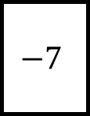
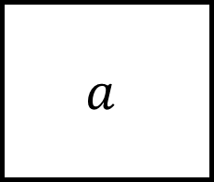
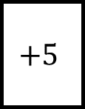
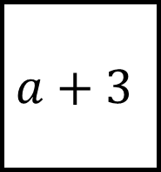
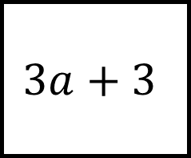
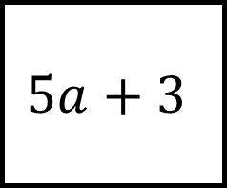
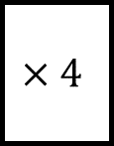
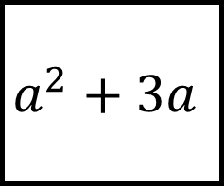
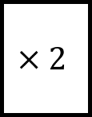
Algebraic Expressions Spider 2
$$a^{2}+3a$$
$$a$$
$$+5$$
$$a+3$$
$$×4$$
$$−7$$
$$×2$$
$$5a+3$$
$$3a+3$$

Slide 4
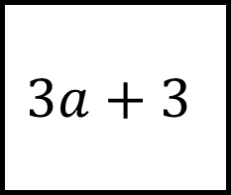
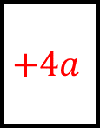
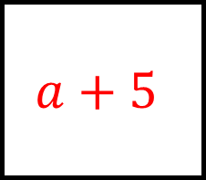
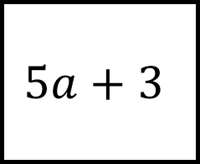
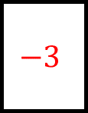
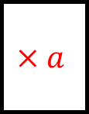
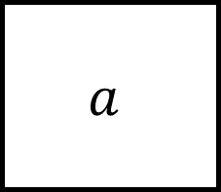
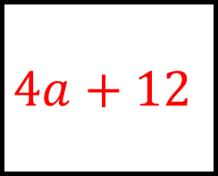
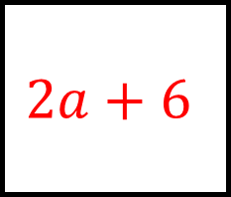
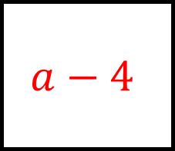
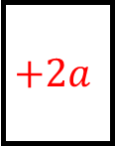
Algebraic Expressions Spider 2 - Answers
$$a+5$$
$$a^{2}+3a$$
$$a$$
$$+5$$
$$×a$$
$$−3$$
$$4a+12$$
$$a+3$$
$$a−4$$
$$×4$$
$$−7$$
$$+4a$$
$$×2$$
$$+2a$$
$$5a+3$$
$$3a+3$$
$$2a+6$$

Slide 5

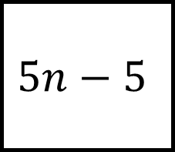

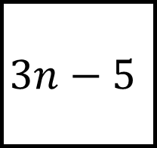
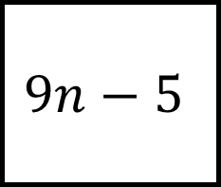
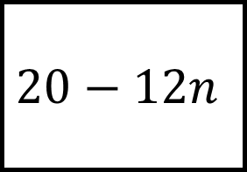
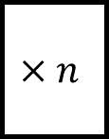
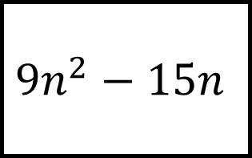
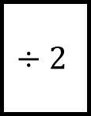
Algebraic Expressions Spider 3
$${9n}^{2}−15n$$
$$5n−5$$
$$+5$$
$$3n−5$$
$$×n$$
$$×2$$
$$÷2$$
$$20−12n$$
$$9n−5$$

Slide 6
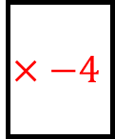
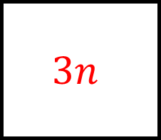
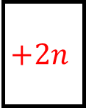
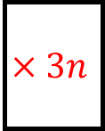
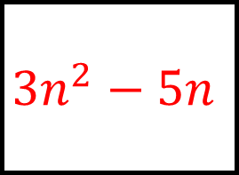
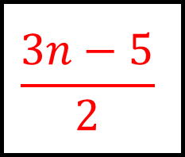


Algebraic Expressions Spider 3 - Answers
$$3n$$
$${9n}^{2}−15n$$
$$5n−5$$
$$+5$$
$$×3n$$
$$+2n$$
$${3n}^{2}−5n$$
$$3n−5$$
$$6n−10$$
$$×n$$
$$×2$$
$$×−4$$
$$÷2$$
$$+6n$$
$$20−12n$$
$$9n−5$$
$$\frac{3n−5}{2}$$

Slide 7









$$y^{2}$$
$$y^{2}+5y$$
$$2y+3$$
Algebraic Expressions Spider 4
$$\frac{y−5}{2}$$
$$y$$
$$5y−4$$
Is there more than one answer for any of these?
$$4y−8$$
$$2(y+1)$$
$${5y}^{3}$$

Slide 8














$$y^{2}$$
$$y^{2}+5y$$
$$2y+3$$
$$×y$$
$$+3$$
$$+5$$
$$×y$$
$$×2$$
Algebraic Expressions Spider 4 - Answers
$$\frac{y−5}{2}$$
$$y$$
$$5y−4$$
$$÷2$$
$$−5$$
$$×5$$
$$−4$$
Is there more than one answer for any of these?
$$−2$$
$$×{5y}^{2}$$
$$+1$$
$$4y−8$$
$$2(y+1)$$
$$×4$$
$$×2$$
$${5y}^{3}$$

Slide 9
Algebraic Expressions Spider - Blank

Slide 10
Algebraic Expressions Spider - Blank

