Slide 1
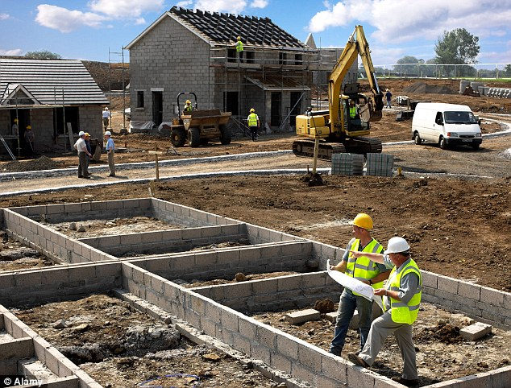

Ratio at work…
Click on one of the pictures below:

Slide 2
Ratio on site…
Can you help this building site with its ratio issues?

Slide 3
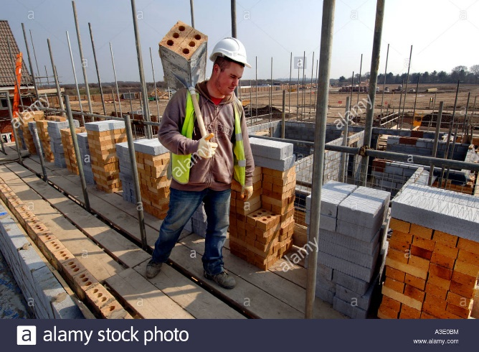
Delivering bricks…
For every hod carrier on the site there are 3 bricklayers.
If I have 15 bricklayers on site, how many hod carriers do I need to hire?
If I have a total of 12 people working with bricks, how many hod carriers are there?
Answer: 5
Answer: 3

Slide 4
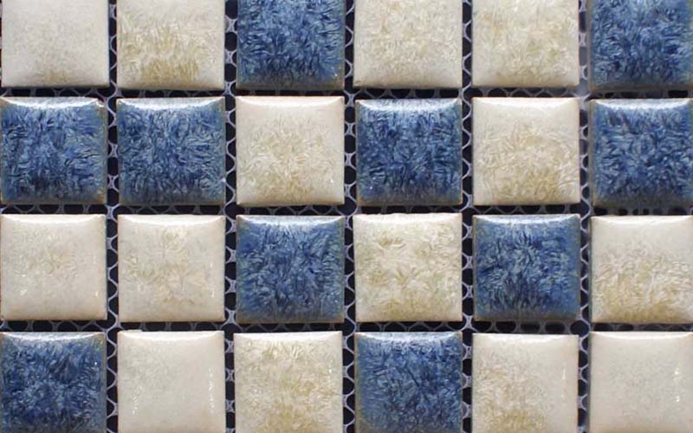
On the tiles…
The bathroom designers have made a pattern using white and blue tiles in the ratio 2:3.
The bathroom needs a total of 160 tiles.
How many of each colour tile do I need?
Answer:
White – 64
Blue – 96

Slide 5
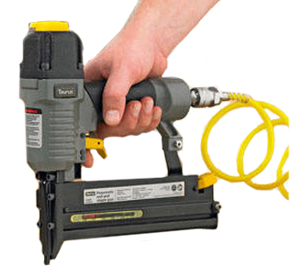
Nailed it…
The site uses nails and screws in the ratio 4:3.
On average they use 150 screws per day; how many nails do they use per day?
One site used a total of 8000 nails. How many days were they on site?
Answer: 200 nails
Answer: 40 days

Slide 6
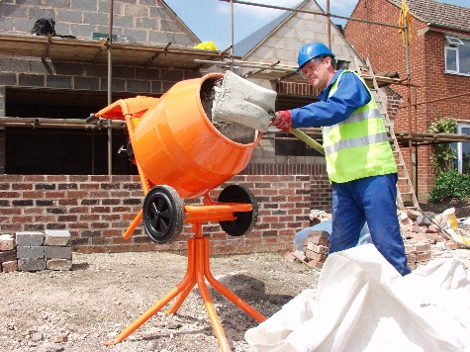
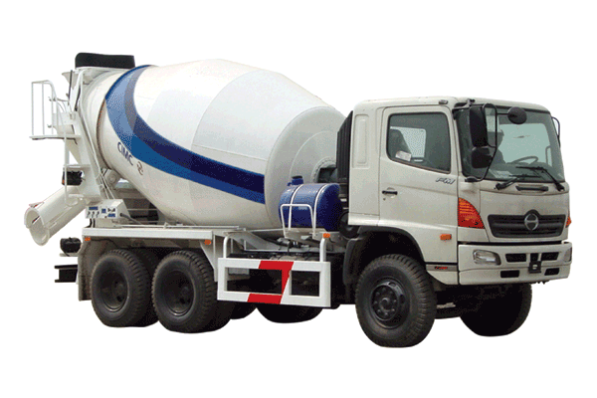
Mix it up…
To mix concrete you mix cement, sand and aggregate in the ratio 1:2:6.
If I need 180kg of concrete, how much of each ingredient do I need?
If I only have 30kg of sand, how much concrete can I make?
Answer: Cement 20kg, Sand 40kg, Aggregate 120kg
Answer: 135kg

Slide 7

Digging a hole…
One mechanical digger can dig the foundations for a house in 3 days.
How long will it take:
2 diggers?
3 diggers?
Answer: 1.5 days
Answer: 1 day

Slide 8
Now go to the office:

Slide 9
Ratio at the office…
Can you help this office with its ratio issues?

Slide 10
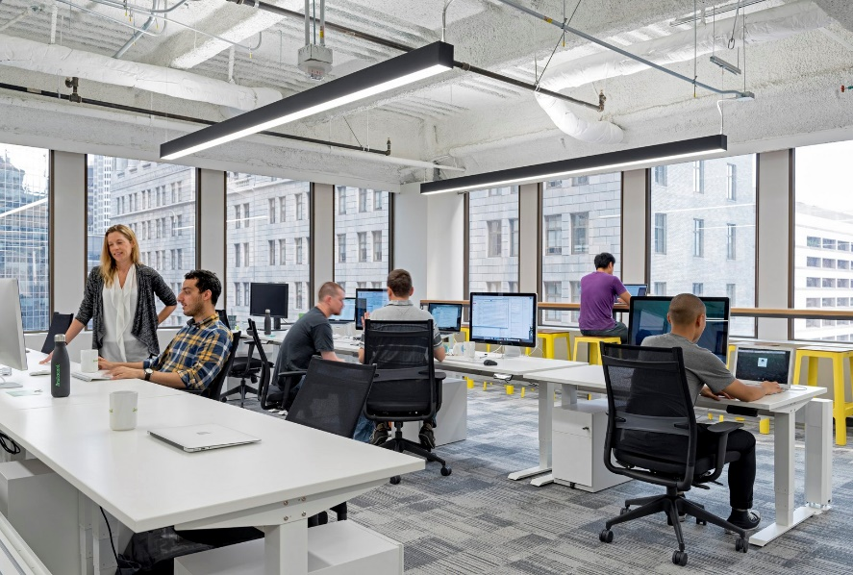
The office ratio…
There are 40 people working at the office in total.
The ratio of women to men is 3:2.
How many of each gender work at the office?
Answer:
24 women
16 men

Slide 11

Hot beverages…
In one section there are 14 people.
These people drink tea or coffee in the ratio 3:4 (they always have the same).
I know there have been 12 cups of tea drunk to today (there are 12 used tea bags on the kitchen side) but how many coffees have been drunk?
Answer:
16 coffees

Slide 12
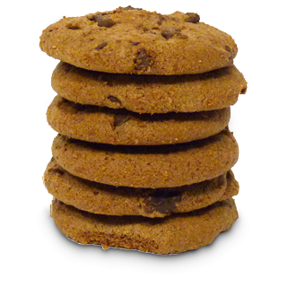
Biscuits…
Terry and Jenny work in the same section of the office.
They eat biscuits in the ratio 3:2.
A packet contains 20 biscuits.
How many of those will Terry eat?
If a packet of biscuits costs 60p, how much should Jenny pay towards it?
Answer:
12 biscuits
Answer:
24p

Slide 13
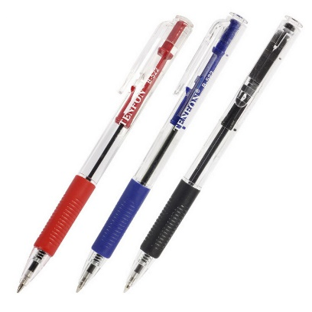
Pens in the pot…
Sylvia has 16 black pens, 12 red pens and 6 blue pens in her stock cupboard. What is the ratio of black to red to blue pens in its simplest form?
David takes a black pen, two red pens and a blue pen.
What is the ratio of black to red to blue pens in its simplest form now?
Answer:
8:6:3
Answer:
3:2:1

Slide 14

Does not compute…
Office guidelines say that for every hour I spend at my computer, I must have 15 minutes away from it.
What is the ratio of computer to non-computer time in its simplest form?
If spend 10 hours at work, how many hours should I be at the computer, assuming I follow these guidelines?
Answer:
4:1
Answer: 8 hours

Slide 15
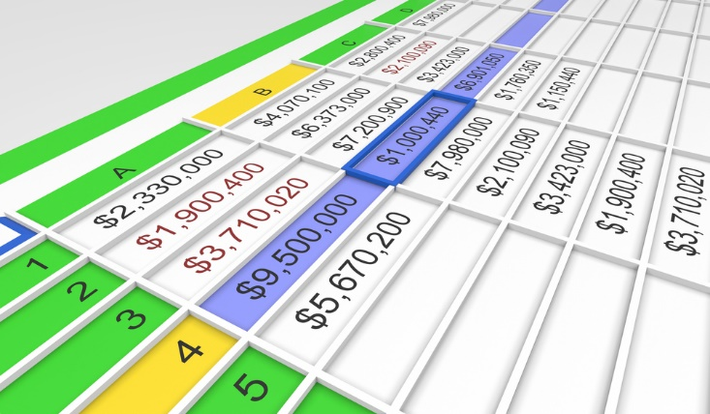
Populating a spreadsheet…
I takes 2 people 12 hours to populate a spreadsheet with all the necessary information required.
How long will it take:
4 people?
3 people?
Answer: 6 hours
Answer: 8 hours

Slide 16
Now go to the building site:

