Slide 1
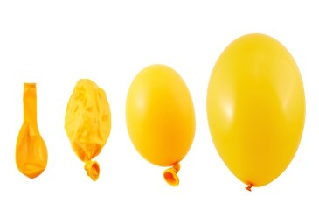
Expanding brackets
An investigation…

Slide 2

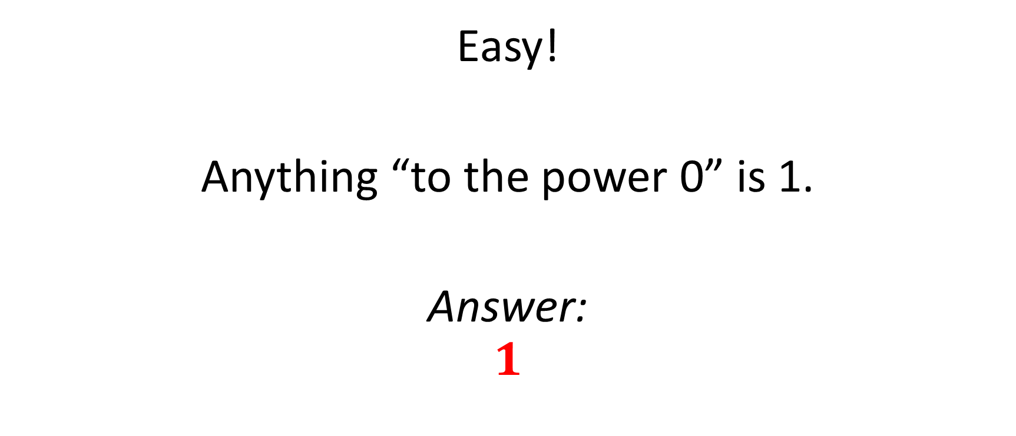

Expand ${(x+y)}^{0}$
Easy!
Anything “to the power 0” is 1.
Answer:
$$1$$

Slide 3


Expand ${(x+y)}^{1}$
Easy!
That’s just itself – it doesn’t change.
Answer:
$$x+y$$

Slide 4
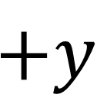
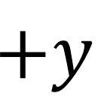
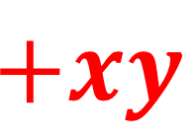

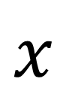
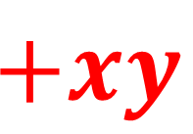
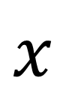
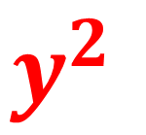

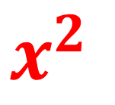
Expand ${(x+y)}^{2}$
Still easy!
$$x$$
$$+y$$
$$×$$
$$x$$
$$x^{2}$$
$$+xy$$
$$+y$$
$$+xy$$
$$y^{2}$$
Answer:
$$x^{2}+2xy+y^{2}$$

Slide 5

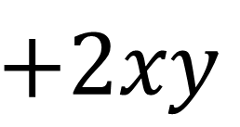
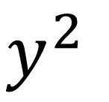
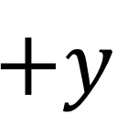
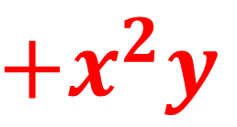
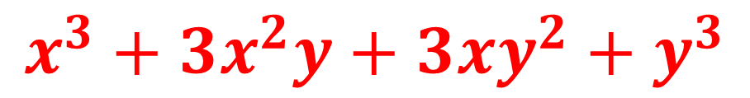

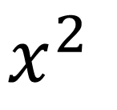
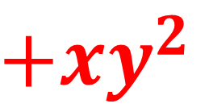
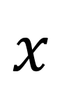
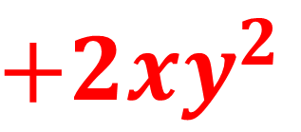
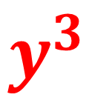

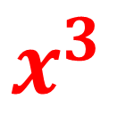
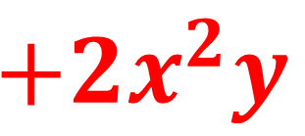
Expand ${(x+y)}^{3}$
Where did this line come from?
Not so easy!
$$x^{2}$$
$$+2xy$$
$$y^{2}$$
$$×$$
$$x$$
$$x^{3}$$
$$+2x^{2}y$$
$$+xy^{2}$$
$$+y$$
$$+x^{2}y$$
$$+2xy^{2}$$
$$y^{3}$$
Answer:
$$x^{3}+3x^{2}y+3xy^{2}+y^{3}$$

Slide 6


Expand ${(x+y)}^{4}$
There must be an easier way!!!!
Are there any patterns in our results?
Let’s have a look…

Slide 7



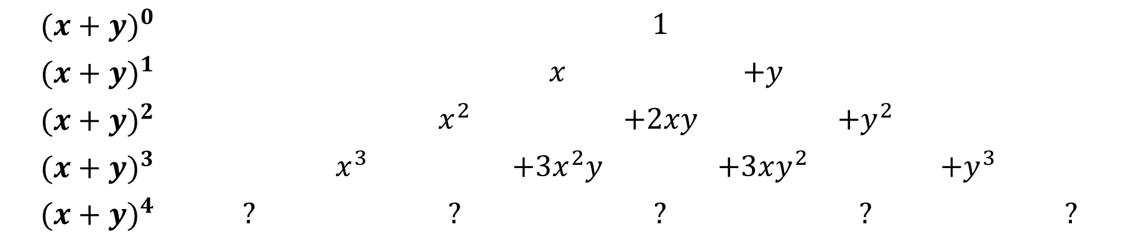



Our previous results:
$${(x+y)}^{0}$$ |  |  |  |  | $$1$$
$${(x+y)}^{1}$$ |  |  |  | $$x$$ |  | $$+y$$
$${(x+y)}^{2}$$ |  |  | $$x^{2}$$ |  | $$+2xy$$ |  | $$+y^{2}$$
$${(x+y)}^{3}$$ |  | $$x^{3}$$ |  | $$+3x^{2}y$$ |  | $$+3xy^{2}$$ |  | $$+y^{3}$$
$${(x+y)}^{4}$$ | $$?$$ |  | $$?$$ |  | $$?$$ |  | $$?$$ |  | $$?$$
$$x^{4}$$
$$4x^{3}y$$
$$6x^{2}y^{2}$$
$$4{xy}^{3}$$
$$y^{4}$$
Can you predict what the next row will look like?
Can you explain how you got your result?
The answer to both those questions is “Yes” by the way, or at the very least you can have a go!

Slide 8
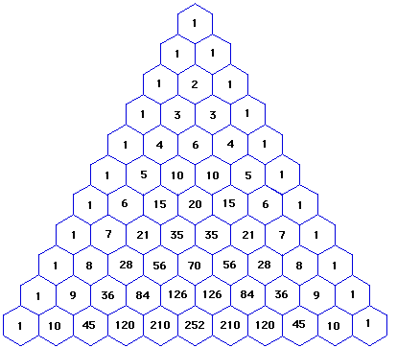
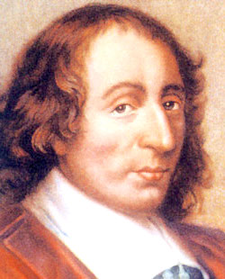

The coefficients make Pascal’s Triangle:
“To the power 0”
What is a coefficient you say?
“To the power 1”
For example: ${6x}^{5}$
“To the power 2”
“To the power 3”
The coefficient
“To the power 4”
Blaise Pascal 1623-1662
Can you spot any patterns?
How do you get the next row?

Slide 9
Pascal was a “thief”!
Whilst this triangle bears Pascal’s name (from the 17th century) it is clear that both Chinese and Persian mathematicians were using it as early as the 11th century.

Slide 10
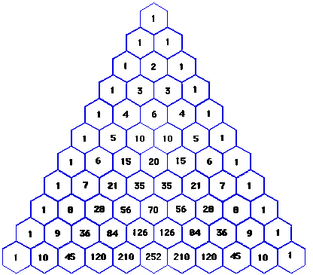

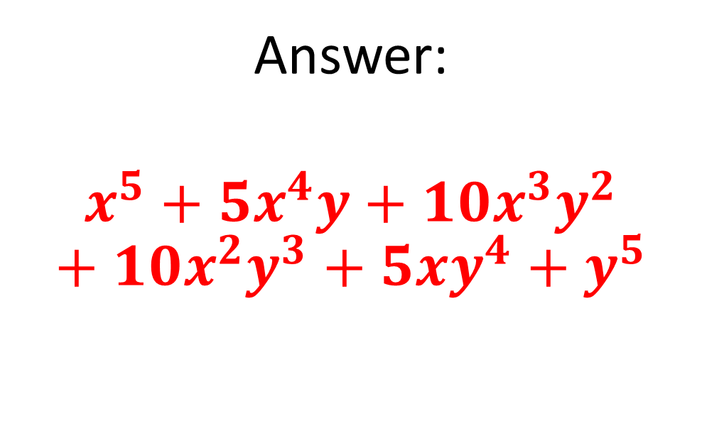

Using Pascal’s Triangle…
Expand ${(x+y)}^{5}$
Pascal’s Triangle:
Answer:
$$x^{5}+5x^{4}y+10x^{3}y^{2}+10x^{2}y^{3}+5xy^{4}+y^{5}$$

Slide 11

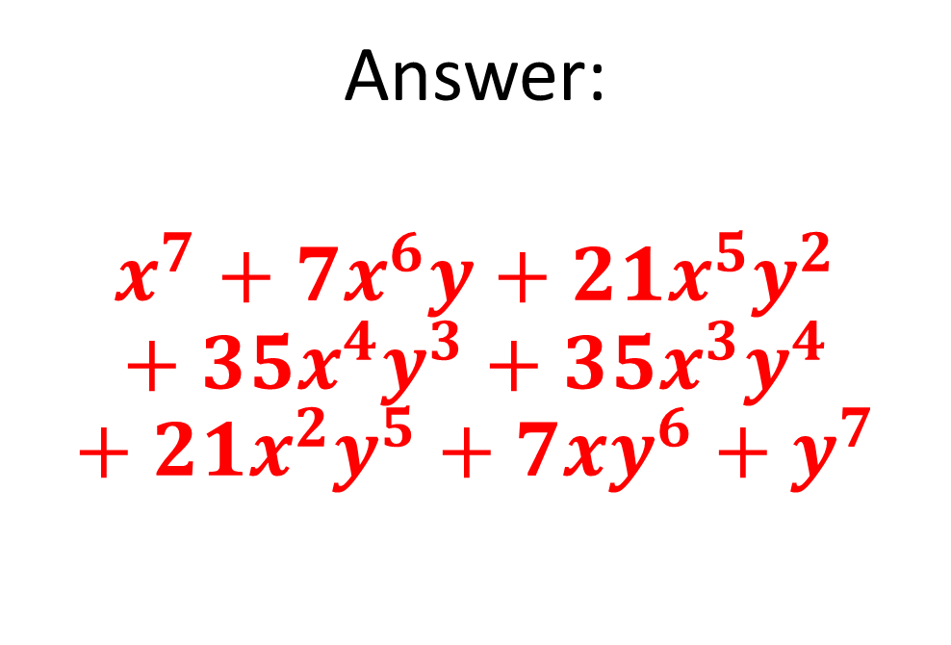

Try this…
Expand ${(x+y)}^{7}$
Pascal’s Triangle:
Answer:
$$x^{7}+7x^{6}y+21x^{5}y^{2}+35x^{4}y^{3}+35x^{3}y^{4}+21x^{2}y^{5}+7xy^{6}+y^{7}$$
What can you say about the powers of each letter?

Slide 12
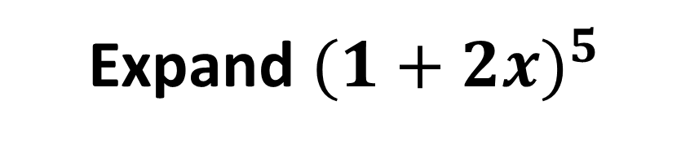

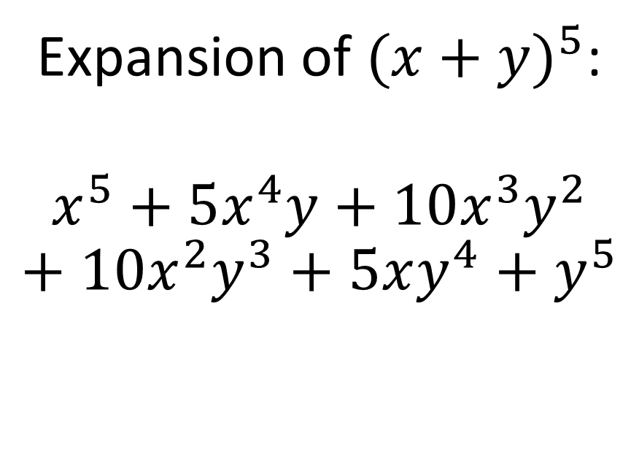
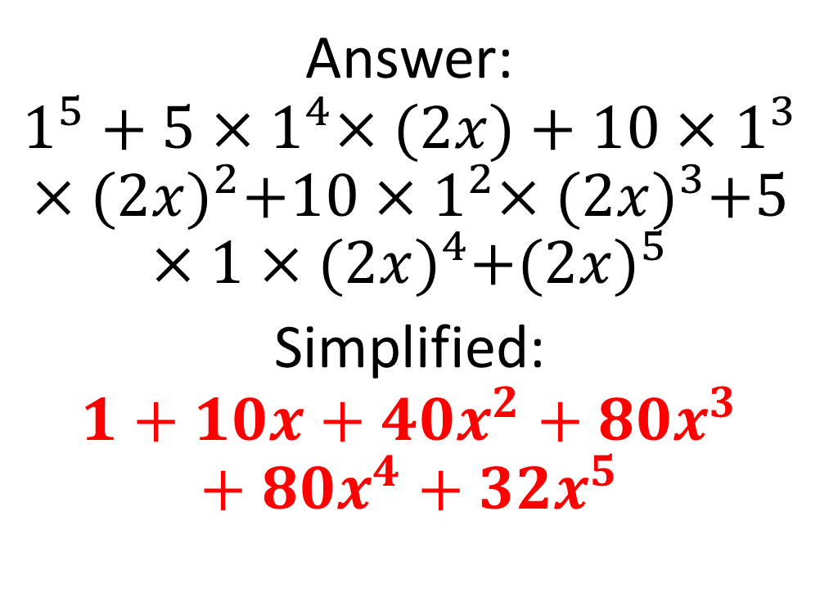
Can you use your previous result to expand ${(1+2x)}^{5}$?
Expand ${(1+2x)}^{5}$
Previous answer:
Answer:
$$1^{5}+5{×1}^{4}×(2x)+10×1^{3}×{(2x)}^{2}+10{×1}^{2}×{(2x)}^{3}+5×1×{(2x)}^{4}+{(2x)}^{5}$$
Simplified:
$$1+10x+40x^{2}+80x^{3}+80x^{4}+32x^{5}$$
Expansion of ${(x+y)}^{5}$:
$$x^{5}+5x^{4}y+10x^{3}y^{2}+10x^{2}y^{3}+5xy^{4}+y^{5}$$

Slide 13
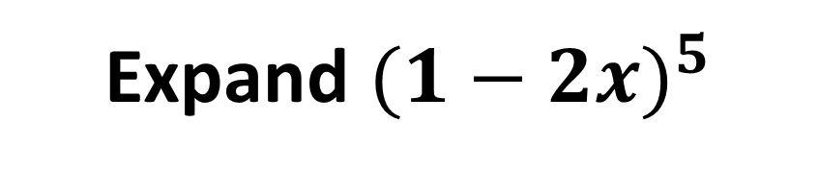
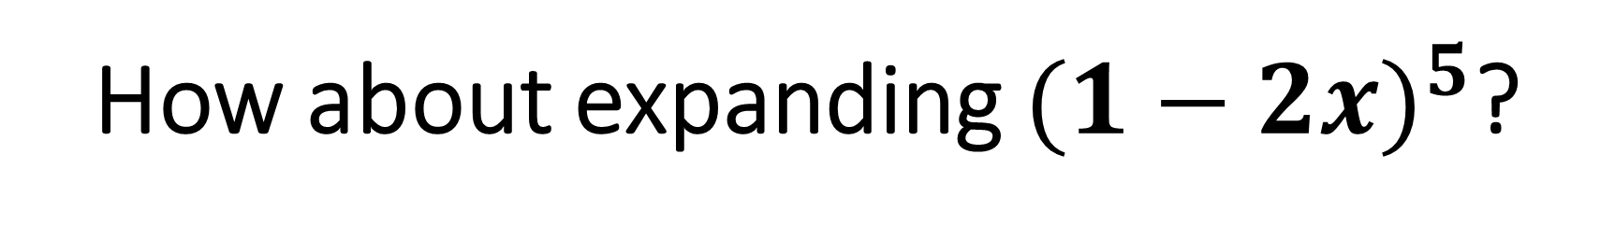
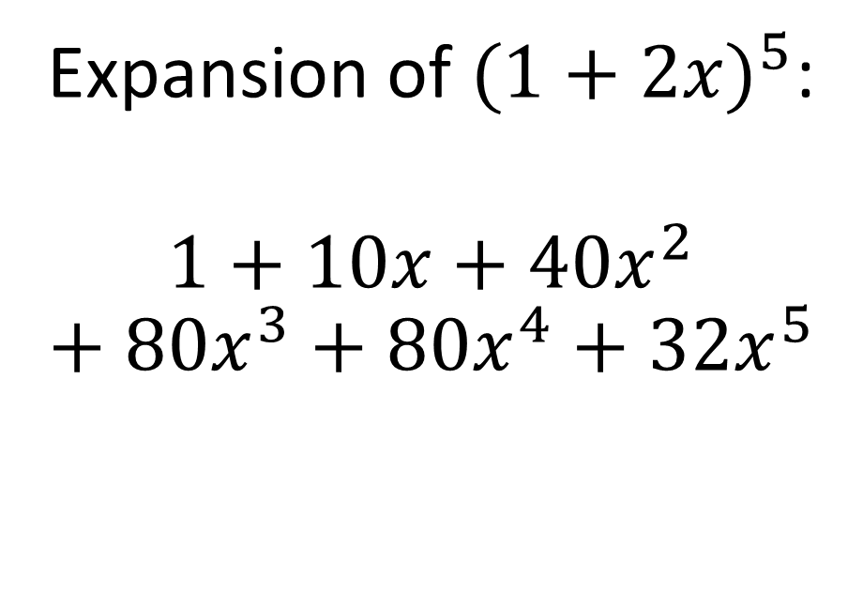
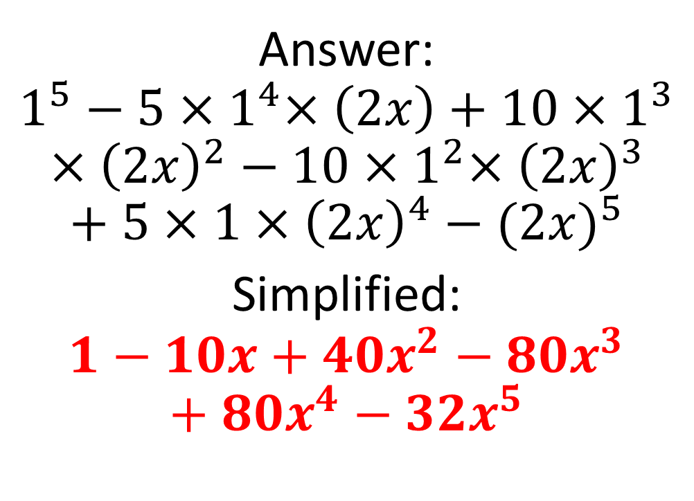
How about expanding ${(1−2x)}^{5}$?
Expand ${(1−2x)}^{5}$
Previous answer:
Answer:
$$1^{5}−5{×1}^{4}×\left(2x\right)+10×1^{3}×{\left(2x\right)}^{2}−10{×1}^{2}×{\left(2x\right)}^{3}+5×1×{\left(2x\right)}^{4}−{(2x)}^{5}$$
Simplified:
$$1−10x+40x^{2}−80x^{3}+80x^{4}−32x^{5}$$
Expansion of ${(1+2x)}^{5}$:
$$1+10x+40x^{2}+80x^{3}+80x^{4}+32x^{5}$$
Can you explain why this happens?

Slide 14
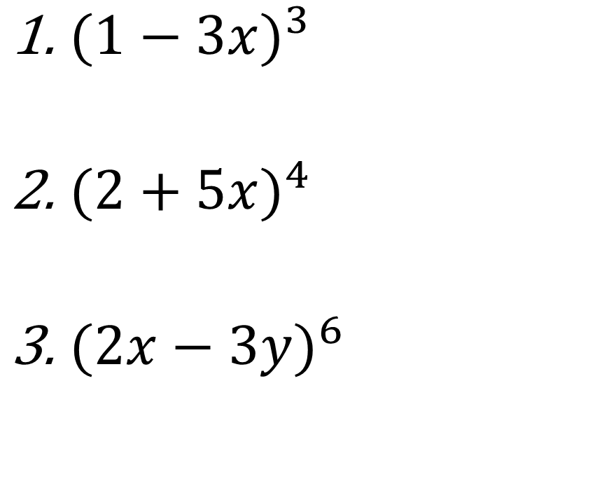
Now try expanding these:
${(1−3x)}^{3}$
${(2+5x)}^{4}$
${(2x−3y)}^{6}$

Slide 15
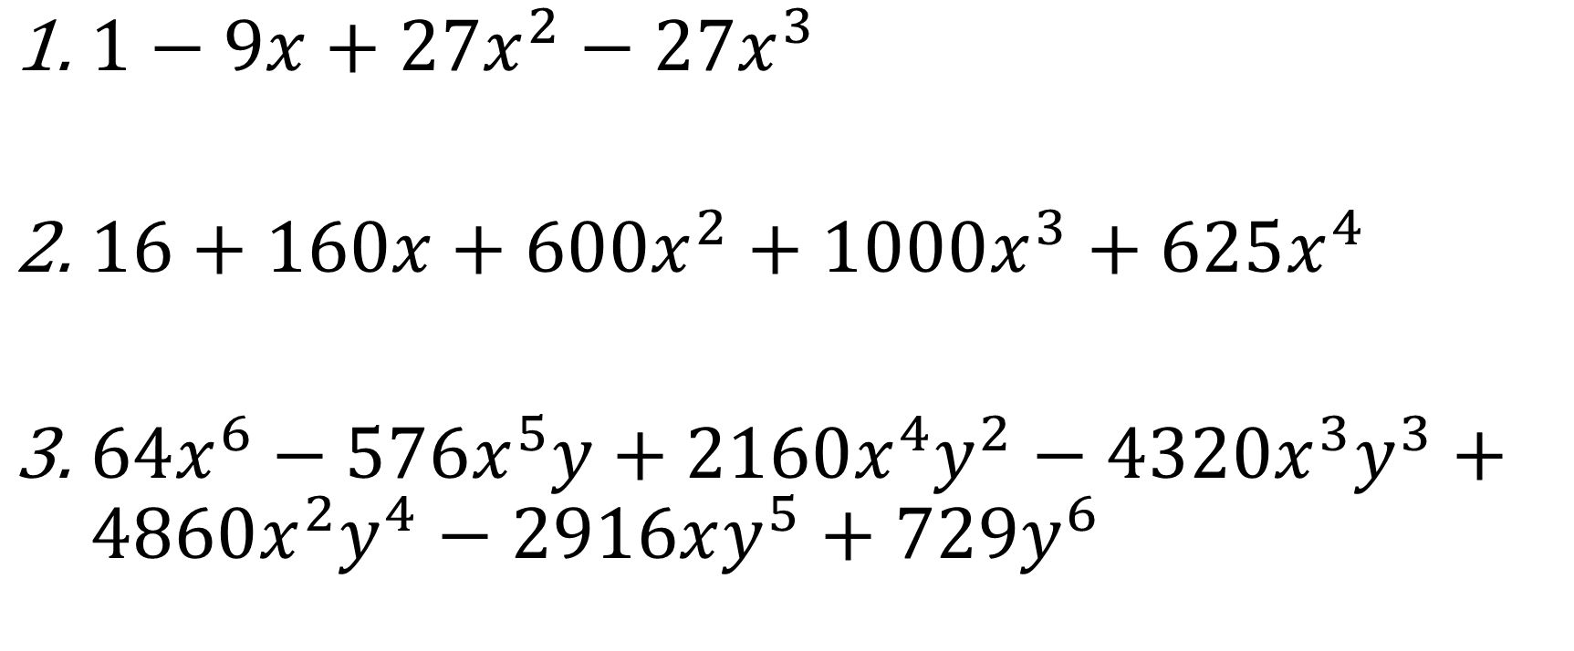
Answers:
$1−9x+27x^{2}−27x^{3}$
$16+160x+600x^{2}+1000x^{3}+625x^{4}$
$64x^{6}−576x^{5}y+2160x^{4}y^{2}−4320x^{3}y^{3}+4860x^{2}y^{4}−2916xy^{5}+729y^{6}$

