Slide 1


Function Machine Puzzles
Can you calculate what is happening at each stage?

Slide 2

What do you have to do?
Your help is required at the numerical building site.
The new boss (pictured below) needs to know what each worker is doing for each number machine without disturbing the workers themselves.
She needs to find the missing rules in each function machine and remember, the rule must work for every number input..

Slide 3
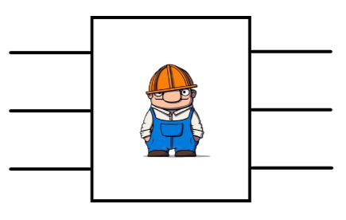
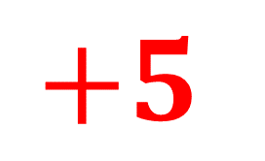
What is the worker doing to each number in this case and predict what will come out of the final input?
1
6
$$+5$$
7
2
3
8
Describe the rule

Slide 4
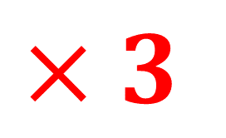
What is the worker doing to each number in this case and predict what will come out of the final input?
1
3
$$×3$$
6
2
4
12
Describe the rule

Slide 5
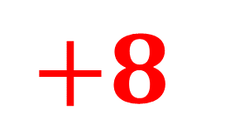
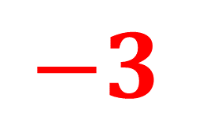
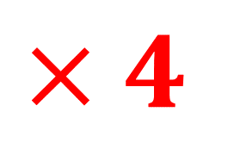
Try these:
1
9
2
8
$$+8$$
$$×4$$
4
12
5
20
6
14
7
35
5
2
$$−3$$
4
1
-3
-6

Slide 6
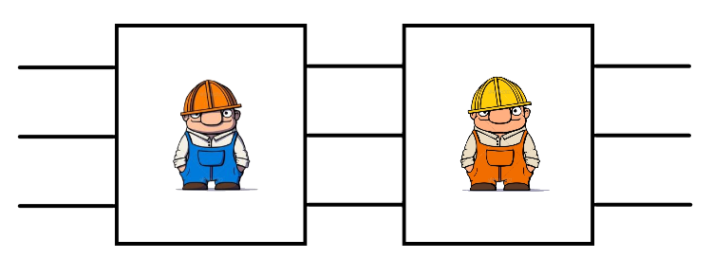
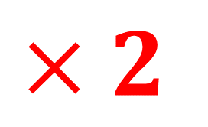
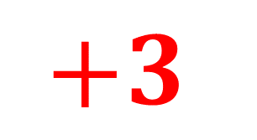
What is each worker doing to each number in this case and predict what will come out of the final input?
1
5
$$×2$$
$$+3$$
7
2
3
9
Describe the rule

Slide 7

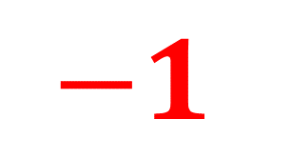
What is each worker doing to each number in this case and predict what will come out of the final input?
2
5
5
$$×3$$
$$−1$$
14
9
26
Describe the rule

Slide 8
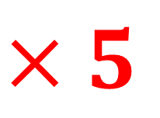
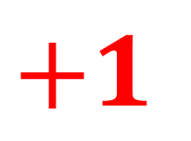
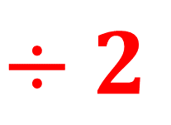
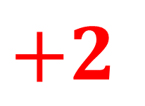
Try these:
1
7
$$×5$$
$$+2$$
4
22
10
52
10
6
16
$$÷2$$
$$+1$$
9
4
3

Slide 9
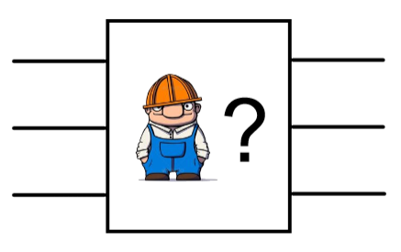
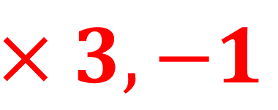
We don’t know how many workers are in the line so you need to work it out and predict what will come out of the final input?
1
2
2
$$×3,−1$$
5
4
11
Describe the rule

Slide 10
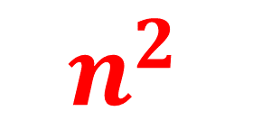
We don’t know how many workers are in the line so you need to work it out and predict what will come out of the final input?
2
4
4
$$n^{2}$$
16
5
25
Describe the rule

Slide 11
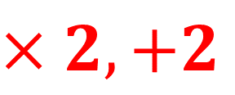
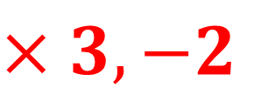
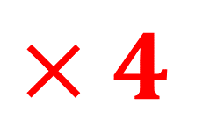
Try these:
1
4
1
1
$$×4$$
$$×3,−2$$
7
2
8
3
4
16
4
10
3
8
5
$$×2,+2$$
12
8
18

Slide 12
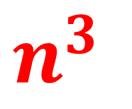
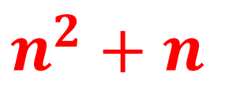
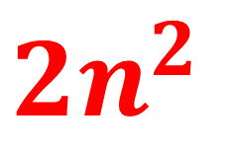
Try these challenging ones:
1
2
1
2
$${2n}^{2}$$
$$n^{2}+n$$
2
8
3
12
4
32
4
20
1
1
$$n^{3}$$
2
8
3
27

Slide 13
Can you design your own and test other people?

Slide 14

Thanks for all your help!

