Slide 1

Ant-Man’s Rates of Change
Help Ant-Man’s suit designers with their calculus…

Slide 2
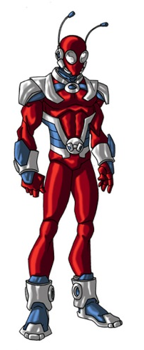
Ant-Man’s suit
Ant-Man changes size and has the relative strength of the aforesaid insect. This leads to some complicated maths for his suit designers.
They need help calculating the rate of change that the suit will go through as Ant-Man changes from normal human size to ant size.
We’re told that you are the people for the job…

Slide 3

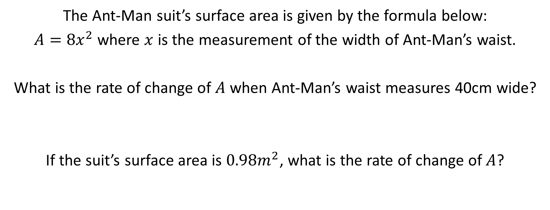
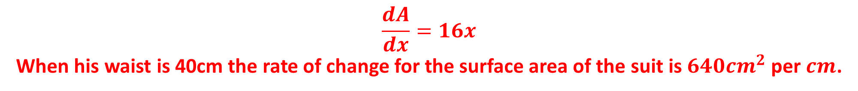
The calculations…
The Ant-Man suit’s surface area is given by the formula below:
$A={8x}^{2}$ where $x$ is the measurement of the width of Ant-Man’s waist.
What is the rate of change of $A$ when Ant-Man’s waist measures 40cm wide?
If the suit’s surface area is ${0.98m}^{2}$, what is the rate of change of $A$?
$$\frac{dA}{dx}=16x$$
When his waist is 40cm the rate of change for the surface area of the suit is ${640cm}^{2}$ per $cm$.
$x=0.35m$so $\frac{dA}{dx}=5.6$
When radius is 0.35m the rate of change for the surface area of the suit is $5.6m^{2}$ per $m$.

Slide 4
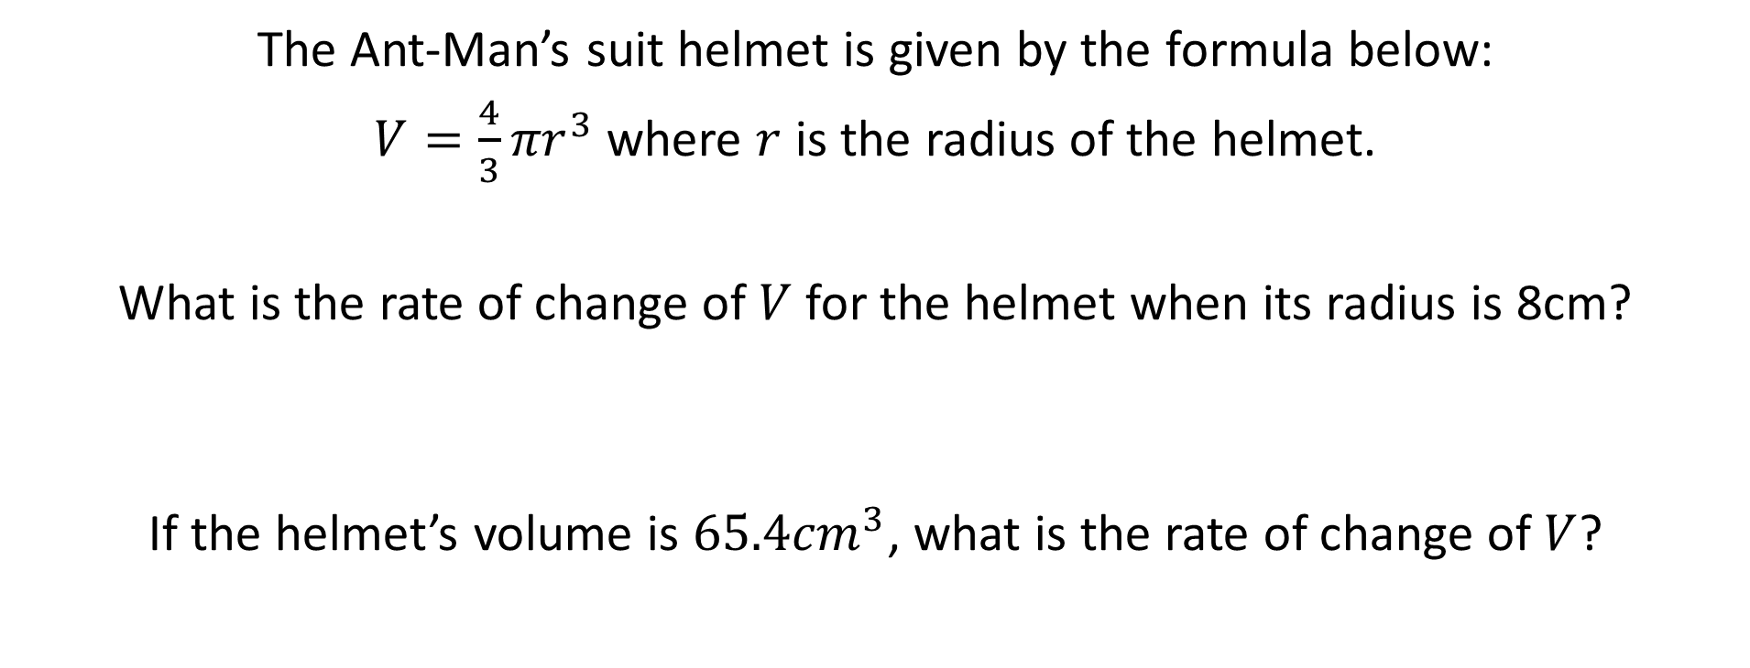

The calculations… part 2
The Ant-Man’s suit helmet is given by the formula below:
$V={\frac{4}{3}πr}^{3}$ where $r$ is the radius of the helmet.
What is the rate of change of $V$ for the helmet when its radius is 8cm?
If the helmet’s volume is ${65.4cm}^{3}$, what is the rate of change of $V$?
$$\frac{dV}{dr}={4πr}^{2}$$
When radius is 8cm the rate of change for the volume of the helmet is $804{cm}^{3}$ per $cm$.
$r=2.5cm$so $\frac{dV}{dr}=78.5$
When radius is 2.5cm the rate of change for the volume of the helmet is $78.5{cm}^{3}$ per $cm$.

Slide 5

Your help has been invaluable…
Cheers!

