Slide 1
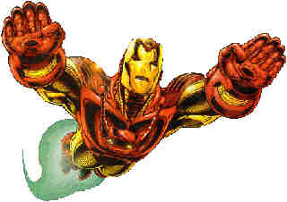
Ironman’s Calculus
Featuring J.A.R.V.I.S. the virtual butler…

Slide 2
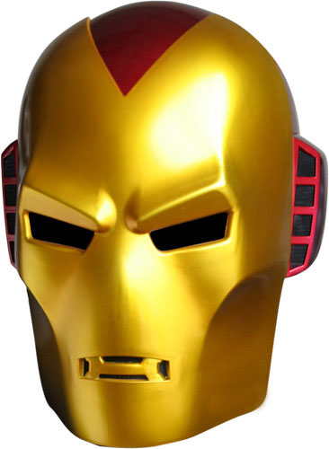
J.A.R.V.I.S. – what does he calculate?
Tony Stark’s virtual butler is always on the lookout for his boss, making calculations to check that he’s not trying to do things that are beyond his and the Ironman suit’s means.
The trouble is that in the heat of battle J.A.R.V.I.S. occasionally gets overwhelmed with work.
Remember that J.A.R.V.I.S. sees that world as one big co-ordinate grid.
Can you check that J.A.R.V.I.S. is functioning and calculating properly by performing the calculations yourself?

Slide 3
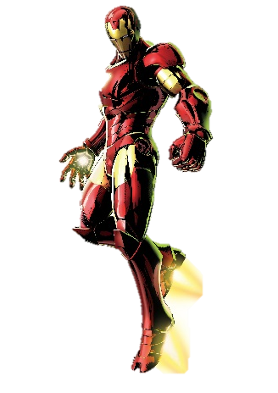

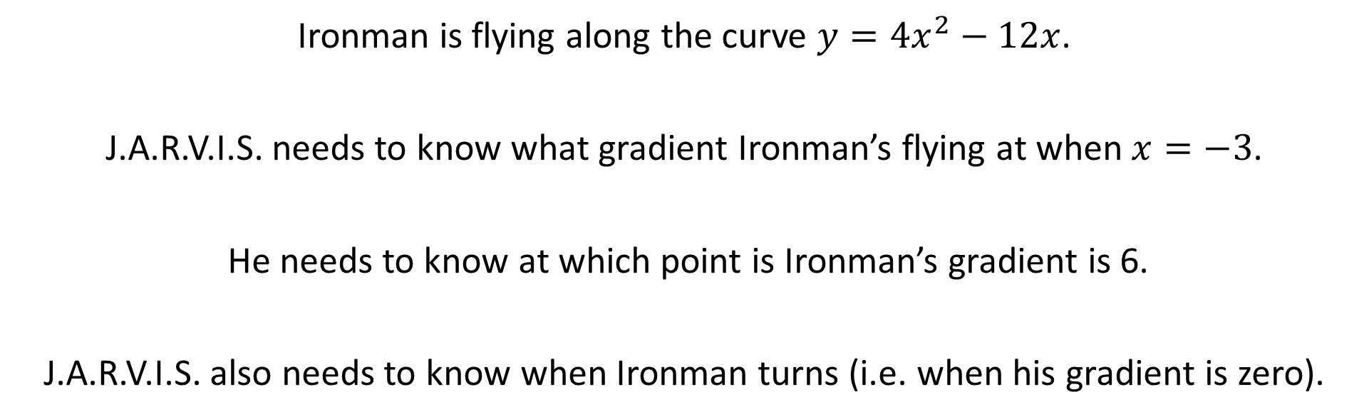

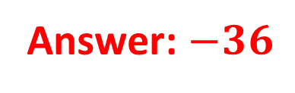
Situation 1
Ironman is flying along the curve $y={4x}^{2}−12x$.
J.A.R.V.I.S. needs to know what gradient Ironman’s flying at when $x=−3$.
He needs to know at which point is Ironman’s gradient is 6.
J.A.R.V.I.S. also needs to know when Ironman turns (i.e. when his gradient is zero).
Answer: $−36$
Answer: $(2.5,−5)$
Answer: $(1.5,−9)$

Slide 4
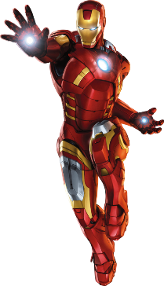
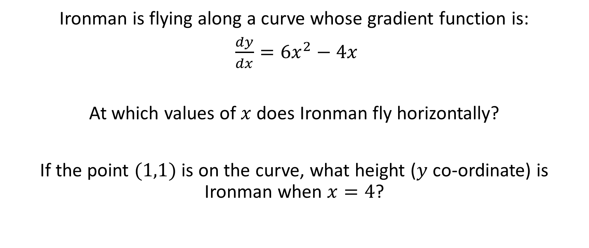
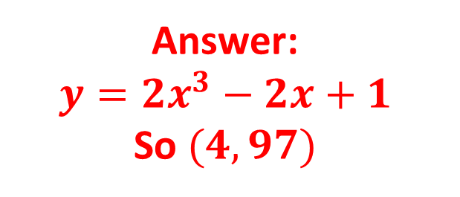
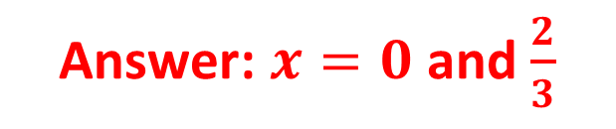
Situation 2
Ironman is flying along a curve whose gradient function is:
$\frac{dy}{dx}={6x}^{2}−4x$
At which values of $x$ does Ironman fly horizontally?
If the point $(1,1)$ is on the curve, what height ($y$ co-ordinate) is Ironman when $x=4$?
Answer: $x=0$ and $\frac{2}{3}$
Answer:
$$y={2x}^{3}−2x+1$$
So $(4,97)$

