Slide 1

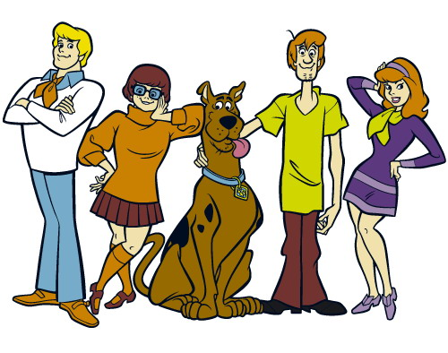
Differentiation with

Slide 2
The Health and Safety executive:
Scooby and his friends, in their quest for supernatural beings, often find themselves having to slide or drive down different slopes.
The health and safety representative at Mystery Incorporated has told them the parameters within which it is safe for them to continue, however the gang has lost some of its paperwork.
Can you help them complete the paperwork to keep them all safe?

Slide 3
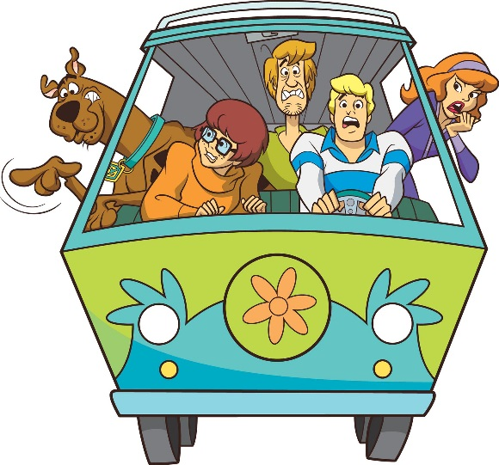
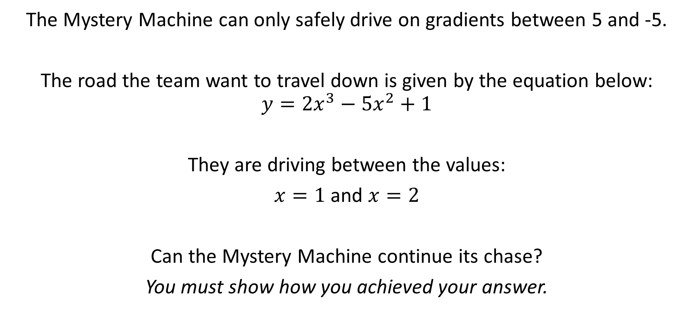
Situation 1
The Mystery Machine can only safely drive on gradients between 5 and -5.
The road the team want to travel down is given by the equation below:
$$y={2x}^{3}−{5x}^{2}+1$$
They are driving between the values:
$x=1$ and $x=2$
Can the Mystery Machine continue its chase?
You must show how you achieved your answer.

Slide 4
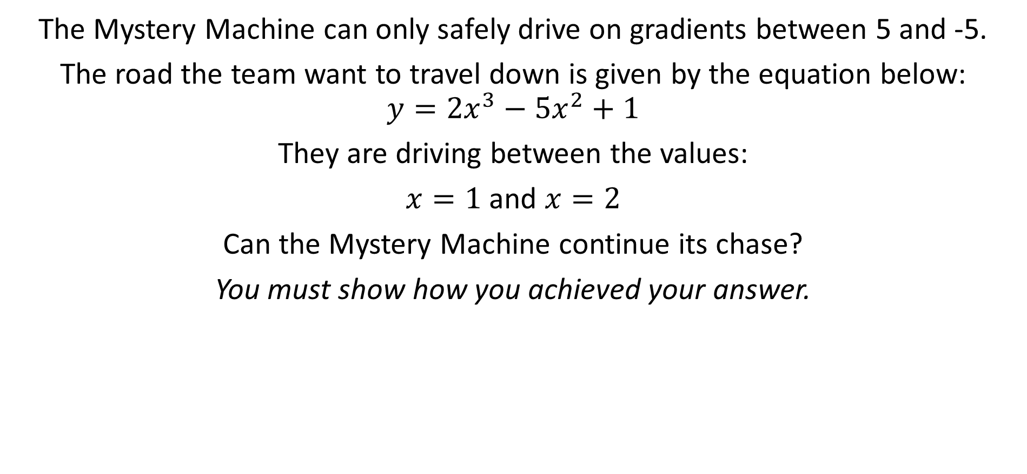
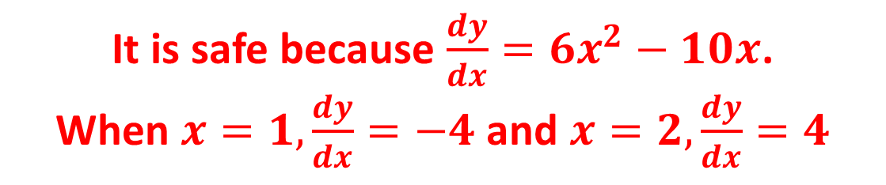
Situation 1
The Mystery Machine can only safely drive on gradients between 5 and -5.
The road the team want to travel down is given by the equation below:
$$y={2x}^{3}−{5x}^{2}+1$$
They are driving between the values:
$x=1$ and $x=2$
Can the Mystery Machine continue its chase?
You must show how you achieved your answer.
It is safe because $\frac{dy}{dx}={6x}^{2}−10x$.
When $x=1, \frac{dy}{dx}=−4$ and $x=2, \frac{dy}{dx}=4$

Slide 5
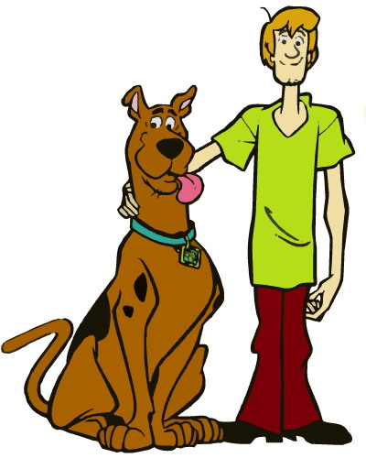
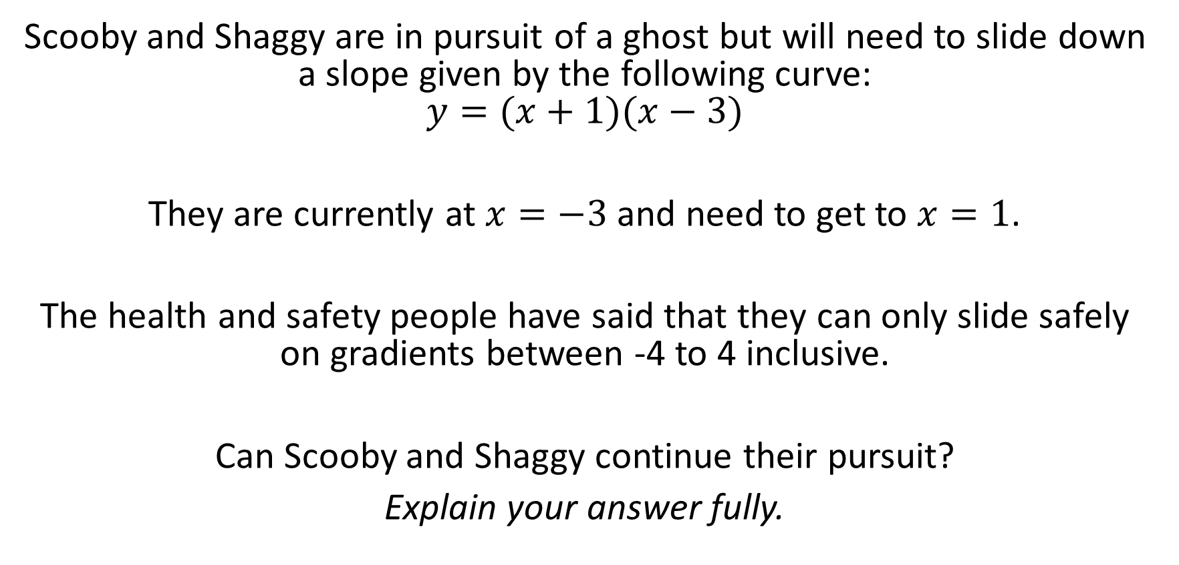
Situation 2:
Scooby and Shaggy are in pursuit of a ghost but will need to slide down a slope given by the following curve:
$$y=(x+1)(x−3)$$
They are currently at $x=−3$ and need to get to $x=1$.
The health and safety people have said that they can only slide safely on gradients between -4 to 4 inclusive.
Can Scooby and Shaggy continue their pursuit?
Explain your answer fully.

Slide 6
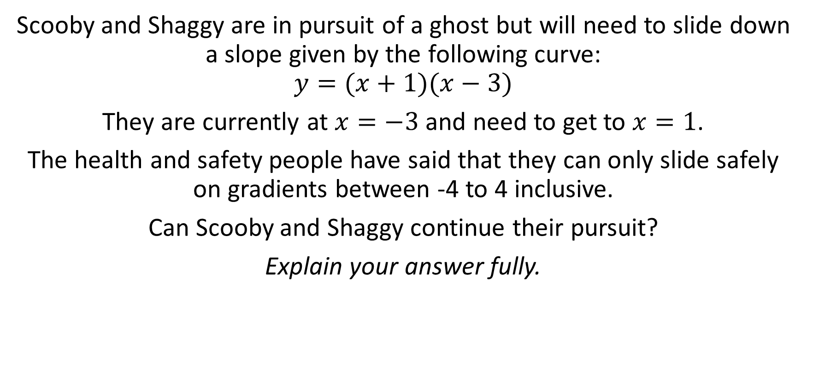
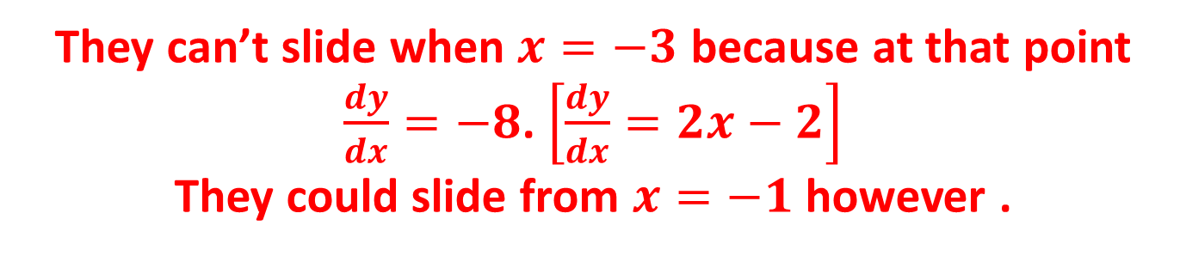
Situation 2:
Scooby and Shaggy are in pursuit of a ghost but will need to slide down a slope given by the following curve:
$$y=(x+1)(x−3)$$
They are currently at $x=−3$ and need to get to $x=1$.
The health and safety people have said that they can only slide safely on gradients between -4 to 4 inclusive.
Can Scooby and Shaggy continue their pursuit?
Explain your answer fully.
They can’t slide when $x=−3$ because at that point $\frac{dy}{dx}=−8$. $\left[\frac{dy}{dx}=2x−2\right]$
They could slide from $x=−1$ however .

Slide 7
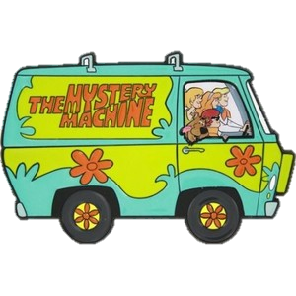
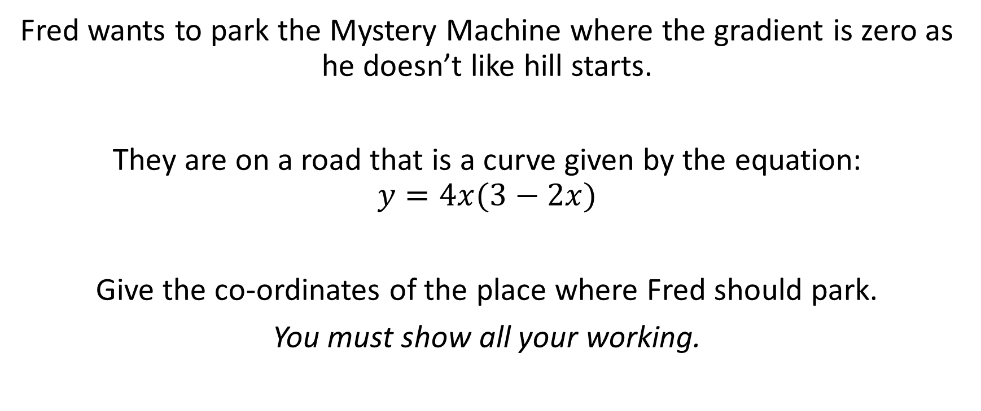
Situation 3:
Fred wants to park the Mystery Machine where the gradient is zero as he doesn’t like hill starts.
They are on a road that is a curve given by the equation:
$$y=4x(3−2x)$$
Give the co-ordinates of the place where Fred should park.
You must show all your working.

Slide 8
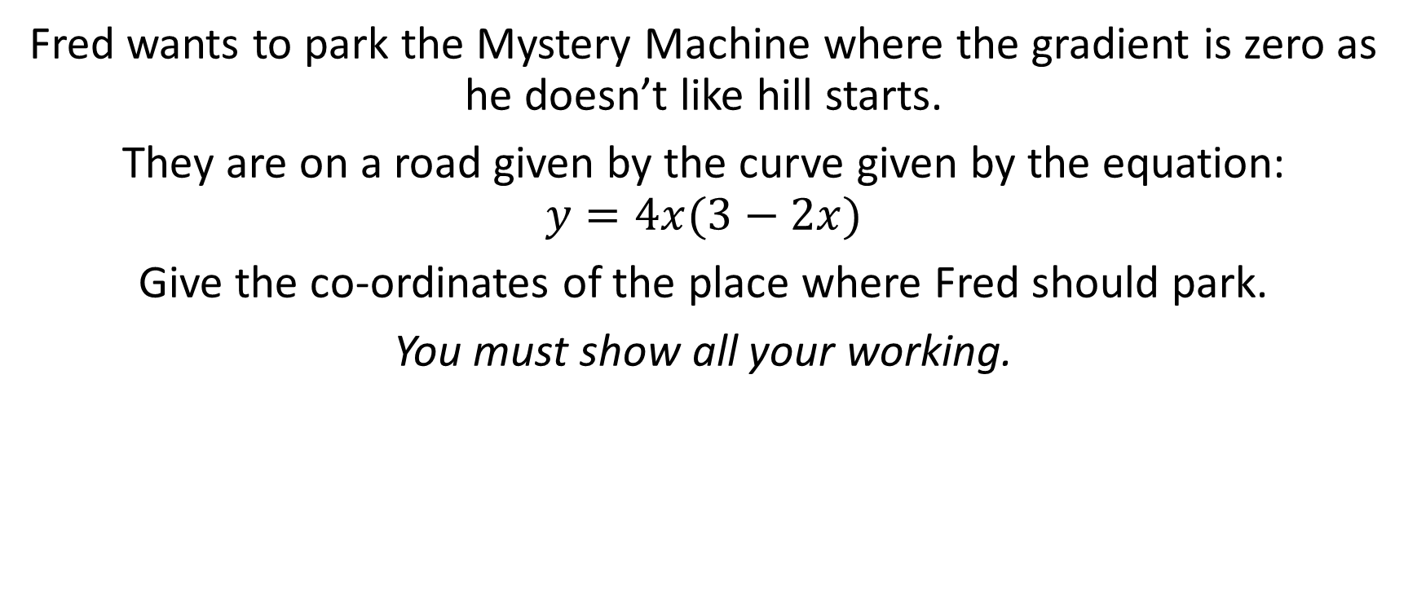
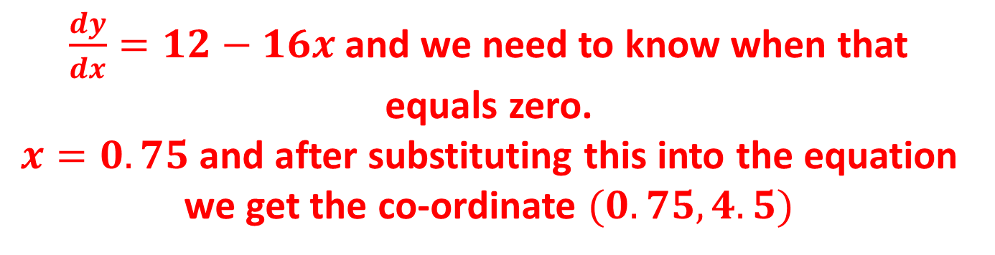
Situation 3:
Fred wants to park the Mystery Machine where the gradient is zero as he doesn’t like hill starts.
They are on a road given by the curve given by the equation:
$$y=4x(3−2x)$$
Give the co-ordinates of the place where Fred should park.
You must show all your working.
$\frac{dy}{dx}=12−16x$ and we need to know when that equals zero.
$x=0.75$ and after substituting this into the equation we get the co-ordinate $(0.75,4.5)$

Slide 9
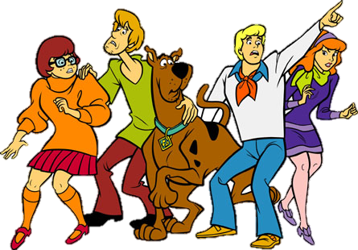
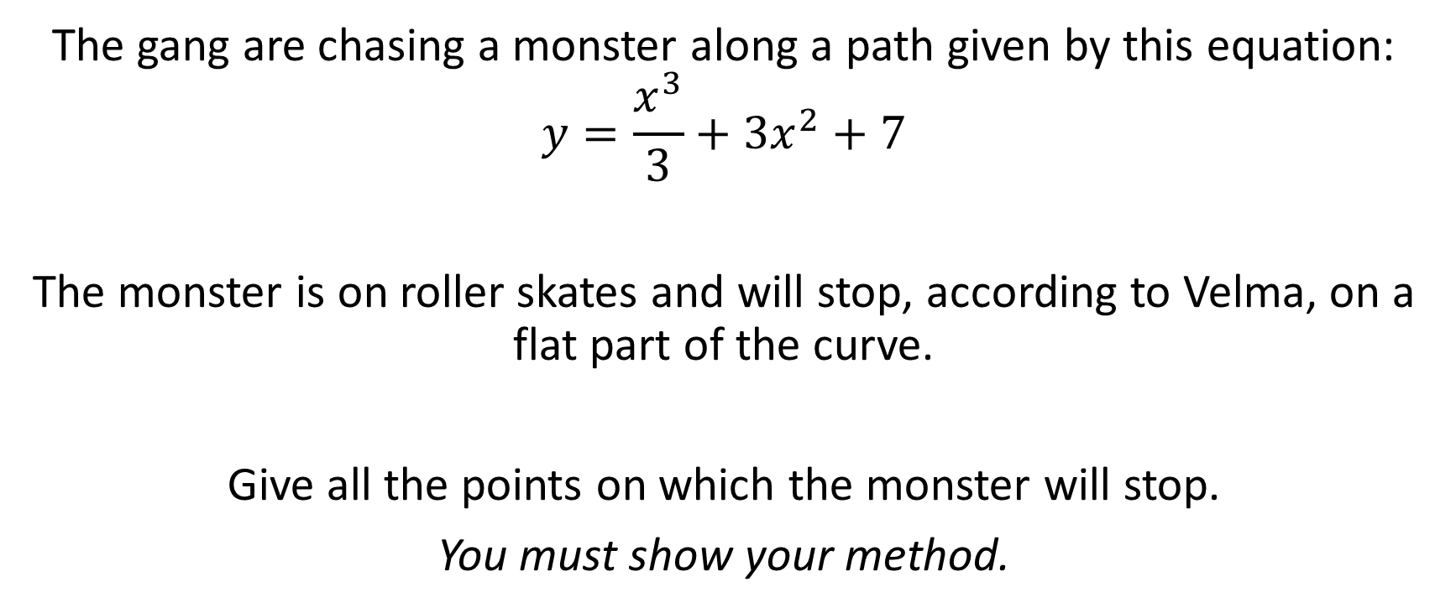
Situation 4:
The gang are chasing a monster along a path given by this equation:
$$y=\frac{x^{3}}{3}+{3x}^{2}+7$$
The monster is on roller skates and will stop, according to Velma, on a flat part of the curve.
Give all the points on which the monster will stop.
You must show your method.

Slide 10
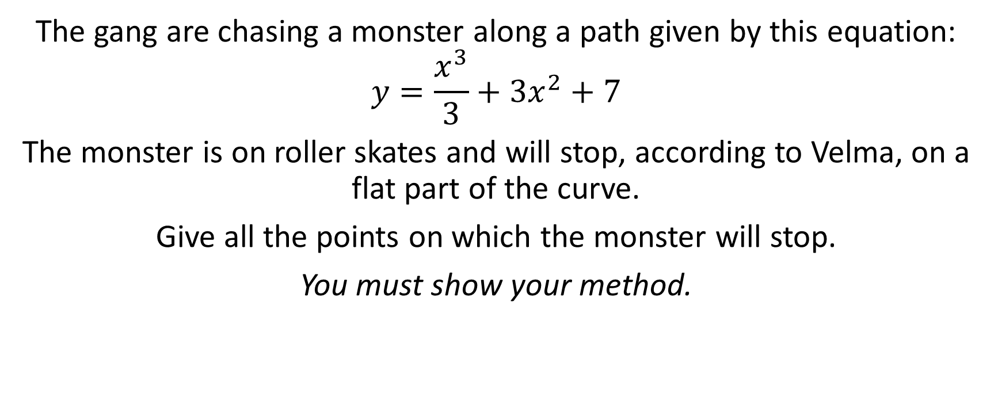
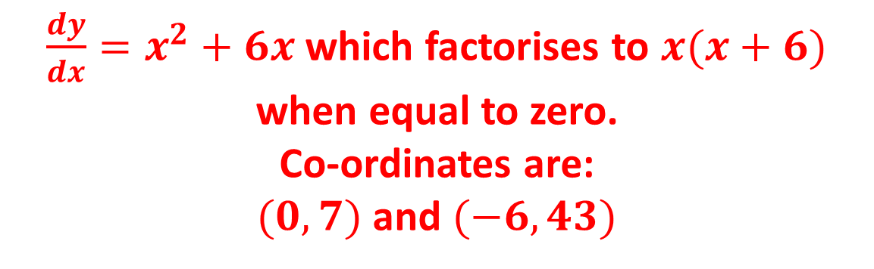
Situation 4:
The gang are chasing a monster along a path given by this equation:
$$y=\frac{x^{3}}{3}+{3x}^{2}+7$$
The monster is on roller skates and will stop, according to Velma, on a flat part of the curve.
Give all the points on which the monster will stop.
You must show your method.
$\frac{dy}{dx}=x^{2}+6x$ which factorises to $x(x+6)$ when equal to zero.
Co-ordinates are:
$(0,7)$ and $(−6, 43)$

Slide 11

Thanks for all your help!

