Slide 1

Batman's HCF and LCM Dilemma
Batman is placing some orders with his weapons manufacturer and doesn’t want any items left over when he put them into packs in readiness for his crime fighting exploits.
He is also tidying up the Batcave from previous orders.
Can you help with all his packing up issues?

Slide 2
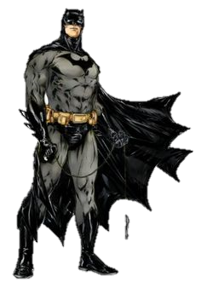
Issue 1
Batman wants to order some grenades and some grappling ropes.
Grenades come in boxes of 12.
Grappling ropes come in boxes of 16.
He wants to put 1 grappling rope with 1 grenade.
What is the smallest number of each item he should order?
48: 4 boxes of grenades and 3 boxes of ropes.

Slide 3
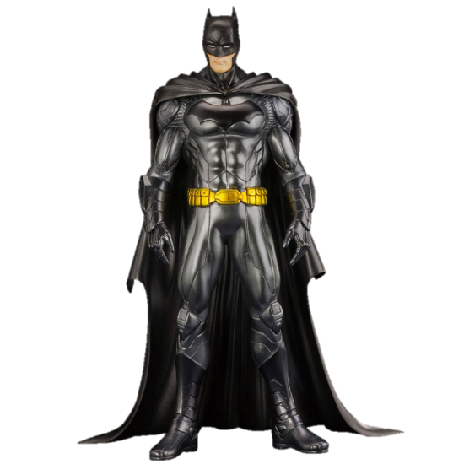
Issue 2
Batman wants to order some tyres and head gaskets for the Batmobile.
Tyres come in packs of 6.
Head gaskets come in boxes of 10.
He wants to put 2 tyres with 1 head gasket.
What is the smallest number of each item he should order?
30: 5 packs of tyres and 3 boxes of head gaskets.

Slide 4

Issue 3
Batman has some missiles and oil canisters that create oil slicks from the Batmobile lying around the Batcave.
He has 64 missiles and 24 oil canisters in total.
He wants to put them into the largest number of equal groups, using all the items.
How many groups should he make?
8 groups each containing 8 missiles and 3 oil canisters.

Slide 5

Issue 4
Batman also has some throwing stars and stun grenades that lying around the Batcave.
He has 90 throwing stars and 54 stun grenades in total.
He wants to put them into the largest number of equal groups, using all the items.
How many groups should he make?
18 groups each containing 5 throwing stars and 3 stun grenades.

Slide 6

Thanks for all your help!

