Slide 1
Confidence Intervals and Tests
Using the t-Distribution
Further Statistics 2 Chapter 7
Westie's Workshop

Slide 2
Teachings for Exercise 7E

Slide 3
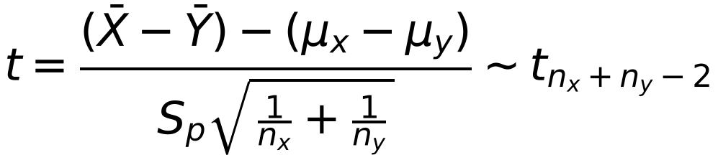
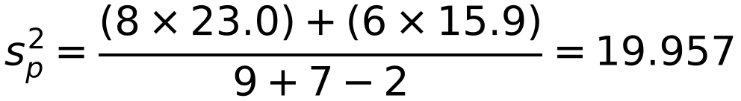
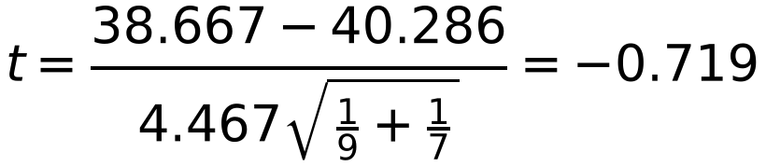
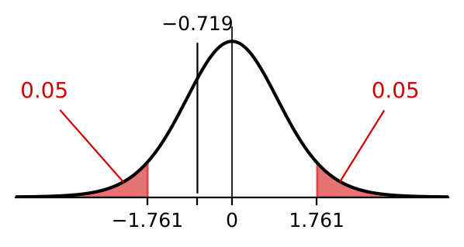
Hypothesis Test for the Difference Between Means
To test the difference between the means of two normal distributions with equal but unknown variances, use
Two groups of students, X and Y, were taught by different teachers. At the end of their course, a random sample of students from each class was selected and given a test. The test results out of 50 were as follows:
Group X: 40 37 45 34 30 41 42 43 36
Group Y: 38 43 36 45 35 44 41
The headteacher wishes to find out if there is a significant difference between the results for these two groups.
a) Write down any assumptions that need to be made in order to conduct a difference of means test on this data.
b) Assuming that these assumptions apply, test at the 10% level of significance whether or not there is a significant difference between the means.
Steps: H₀, H₁, α, ν = nₓ + nᵧ − 2, critical region, x̄, ȳ, sₓ², sᵧ², pooled sₚ², t, conclusion
Under H₀ usually μₓ − μᵧ = 0
a) The samples come from normal distributions, are independent, and the populations have the same variance
b) H₀: μₓ = μᵧ H₁: μₓ ≠ μᵧ
ν = 9 + 7 − 2 = 14, 0.05 in each tail
t₁₄(0.05) = 1.761: critical regions t ≤ −1.761 and t ≥ 1.761
x̄ = 38.667, sₓ² = 23.0; ȳ = 40.286, sᵧ² = 15.9
sₚ = 4.467
−1.761 < −0.719 < 1.761: not significant. No evidence of a difference between the means of the two groups
7E

Slide 4
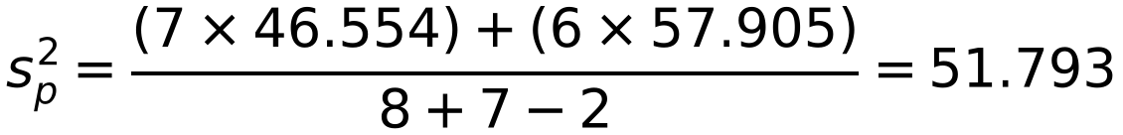
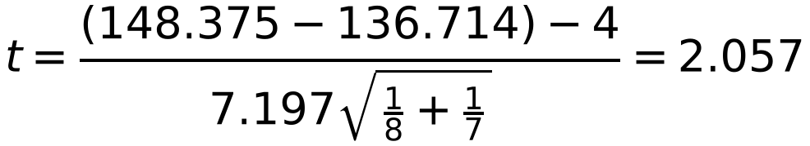
Hypothesis Test for the Difference Between Means
You can test whether the difference between two means is more than a given amount
If H₀ is μₓ = μᵧ + 4 then μₓ − μᵧ = 4 goes into the test statistic
A random sample of the heights, in cm, of sixth form boys and girls was taken with the following results:
Boys’ heights: 152, 148, 147, 157, 158, 140, 141, 144
Girls’ heights: 142, 146, 132, 125, 138, 131, 143
a) Carry out a two-sample t-test at the 5% significance level on these data to see whether the mean height of boys exceeds the mean height of girls by more than 4 cm.
b) State any assumptions that you have made.
x = height of a boy, y = height of a girl
a) H₀: μₓ = μᵧ + 4 H₁: μₓ > μᵧ + 4
5% one-tailed, ν = 8 + 7 − 2 = 13
t₁₃(0.05) = 1.771: critical region t ≥ 1.771
x̄ = 148.375, sₓ² = 46.554; ȳ = 136.714, sᵧ² = 57.905
sₚ = 7.197
μₓ − μᵧ = 4 from H₀
2.057 > 1.771: in the critical region, reject H₀
There is evidence that the mean height of boys exceeds the mean height of girls by more than 4 cm
b) The samples are independent, the population variances are equal and the populations are normally distributed
7E

