Slide 1
Confidence Intervals and Tests
Using the t-Distribution
Further Statistics 2 Chapter 7
Westie's Workshop

Slide 2
Teachings for Exercise 7D

Slide 3
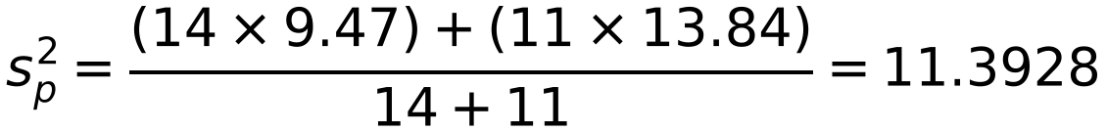
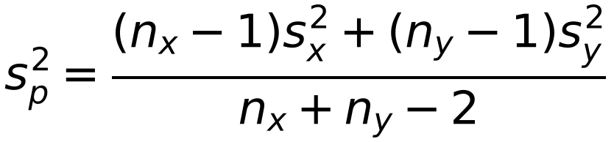
Difference Between Means of Two Independent Normal Distributions
If two populations have the same unknown variance σ², you can pool the two sample variances to get a better estimate of σ²
The pooled estimate is a weighted mean of the sample variances, with weights nₓ − 1 and nᵧ − 1
A random sample of 15 observations is taken from a population and gives an unbiased estimate for the population variance of 9.47. A second random sample of 12 observations is taken from a different population that has the same population variance as the first population, and gives an unbiased estimate for the variance as 13.84. Calculate an unbiased estimate of the population variance σ² using both samples.
nₓ = 15, sₓ² = 9.47 nᵧ = 12, sᵧ² = 13.84
nₓ − 1 = 14, nᵧ − 1 = 11
Pooled estimate sₚ² = 11.39 (4 s.f.)
7D

Slide 4
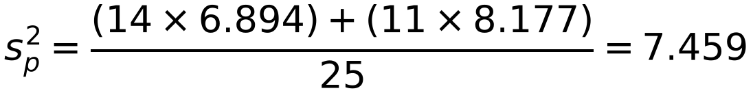
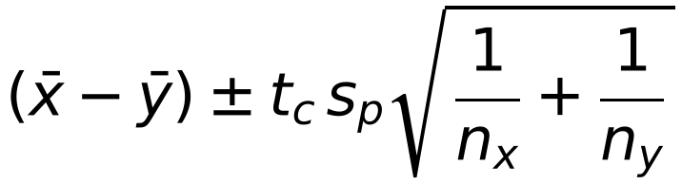
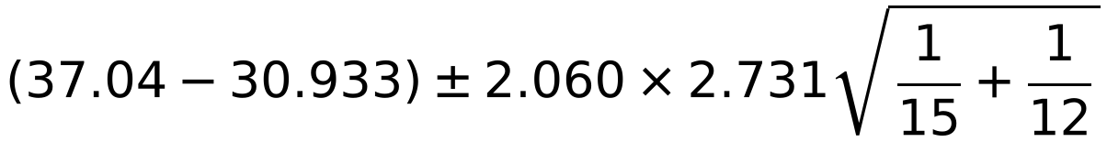
Difference Between Means of Two Independent Normal Distributions
For small samples, assume: the populations are normal, the samples are independent, and the population variances are equal
Then the difference of means uses a t-distribution with nₓ + nᵧ − 2 degrees of freedom
Confidence limits for μₓ − μᵧ:
In a survey on the petrol consumption of cars, a random sample of 12 cars with 2-litre engines was compared with a random sample of 15 cars with 1.6-litre engines. The following results show the consumption, in suitable units, of the cars:
2-litre: 34.4, 32.1, 30.1, 32.8, 31.5, 35.8, 28.2, 26.6, 28.8, 28.5, 33.6, 28.8
1.6-litre: 35.3, 34.0, 36.7, 40.9, 34.4, 39.8, 33.6, 36.7, 34.0, 39.2, 39.8, 38.7, 40.8, 35.0, 36.7
Calculate a 95% confidence interval for the difference between the two mean petrol consumption figures. You may assume that the variables are normally distributed and that they have the same variance.
2-litre: nᵧ = 12, ȳ = 30.933, sᵧ² = 8.177
1.6-litre: nₓ = 15, x̄ = 37.04, sₓ² = 6.894
Use your calculator
sₚ = √7.459 = 2.731
ν = 12 + 15 − 2 = 25: t₂₅(0.025) = 2.060
= 6.107 ± 2.179 = 3.928 and 8.286
The 95% confidence interval is (3.93, 8.29) (3 s.f.)
7D

