Slide 1
Confidence Intervals and Tests
Using the t-Distribution
Further Statistics 2 Chapter 7
Westie's Workshop

Slide 2
Teachings for Exercise 7B

Slide 3
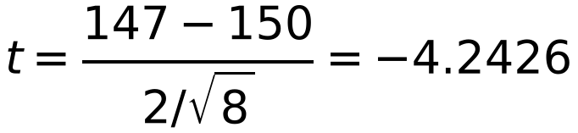
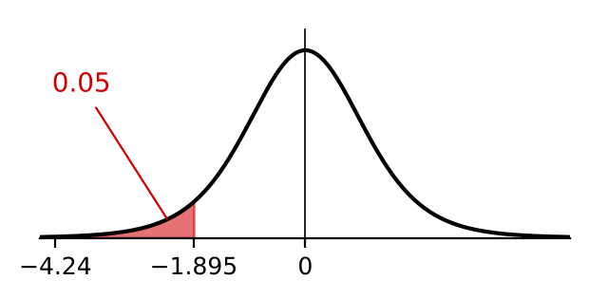
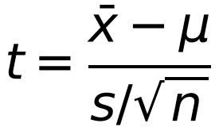
Hypothesis Test for the Mean of a Normal Distribution with Unknown Variance
Testing the mean of a normal distribution with unknown variance follows the same steps as before, but uses the t-distribution for the critical region
1 H₀ 2 H₁ 3 α 4 ν = n − 1
5 critical region 6 x̄, s², t 7 conclusion in context
Test statistic:
A shopkeeper sells jars of jam. The weights of the jars of jam are normally distributed with a mean of 150 g. A customer complains that the mean weight of 8 jars she had bought was only 147 g. An estimate for the standard deviation of the weights of the 8 jars of jam calculated from the 8 observations was 2 g.
a) Test, at the 5% significance level, whether 147 g is significantly less than the quoted mean.
b) Discuss whether the customer has cause for complaint.
a) H₀: μ = 150 H₁: μ < 150
Significance level 0.05 (one-tailed)
ν = 8 − 1 = 7
Critical value −t₇(0.05) = −1.895
Minus sign: left-hand tail
Critical region t ≤ −1.895
x̄ = 147, μ = 150, s = 2
−4.2426 < −1.895: significant, reject H₀
b) There is evidence that the mean weight is less than 150 g, so the customer does have cause for complaint
7B

Slide 4
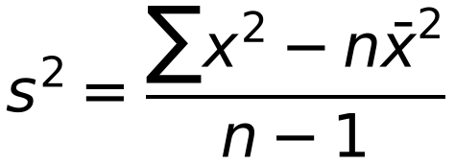
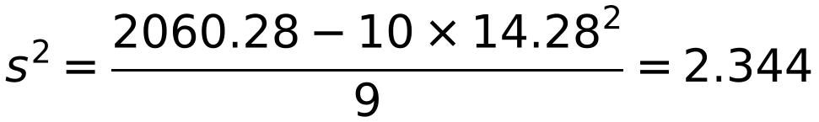
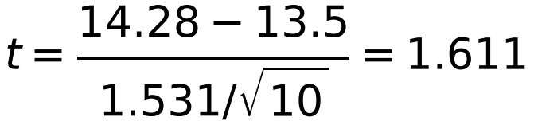
Hypothesis Test for the Mean of a Normal Distribution with Unknown Variance
If you are given raw data, find x̄ and s on your calculator, or use
The temperatures (°C) were measured at noon on 10 days during the month of March in West Cumbria. The readings were:
12.8 11.4 12.9 15.1 15.4 13.5 14.9 15.0 16.0 15.8
Using a 5% significance level, test whether or not this is an increase over the previous year when the average noon day temperature was 13.5 °C.
H₀: μ = 13.5 H₁: μ > 13.5
‘An increase’ means a one-tailed test with H₁: μ > …
Significance level 5%, ν = 9
Critical value t₉(0.05) = 1.833
Critical region t ≥ 1.833
x̄ = 142.8 ÷ 10 = 14.28
Σx = 142.8, Σx² = 2060.28
s = 1.531
1.611 < 1.833: not significant
Not enough evidence to suggest that the average temperature has increased
7B

Slide 5
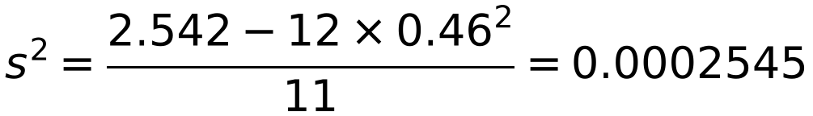
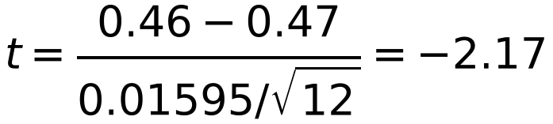
Hypothesis Test for the Mean of a Normal Distribution with Unknown Variance
‘Altered’ means a two-tailed test: halve the significance level to find the probability in each tail
The critical region is |t| ≥ tₙ₋₁(α/2)
If x̄ < μ then t is negative
A concrete manufacturer tests cubes of its concrete at regular intervals, and their compressive strengths in N m⁻¹ are determined. The mean value of the strengths is required to be 0.47 N m⁻¹. A new supplier of cement offers to supply the firm at a cheaper rate than the present supplier, and a trial bag of cement is used to make 12 concrete cubes. Upon testing, these cubes are found to have strengths (x) such that Σx = 5.52 and Σx² = 2.542. Assume that the strengths are normally distributed.
a) Stating your hypotheses clearly, test, at the 5% level of significance, whether or not the use of the new cement has altered the mean strength of the concrete.
b) In the light of your conclusion to the test in part a, what would you recommend the manufacturer to do?
a) H₀: μ = 0.47 H₁: μ ≠ 0.47
ν = 11, 0.025 in each tail
Critical value 2.201: critical region |t| ≥ 2.201
x̄ = 5.52 ÷ 12 = 0.46
s = 0.01595…
The book rounds s to 0.016 and gets −2.165
|−2.17| < 2.201: not significant
Not enough evidence to suggest that the mean strength has altered
b) Accept the new supplier, as they are cheaper. But −2.17 is close to −2.201, so a one-tailed test for a decrease, or a further sample, would be sensible
7B

