Slide 1
Confidence Intervals and Tests
Using the t-Distribution
Further Statistics 2 Chapter 7
Westie's Workshop

Slide 2
Teachings for Exercise 7A

Slide 3
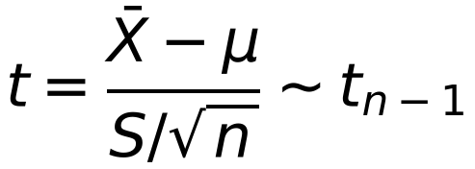
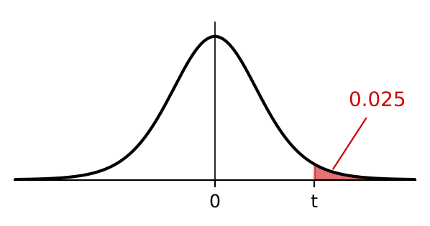
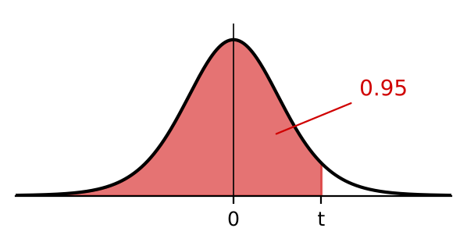
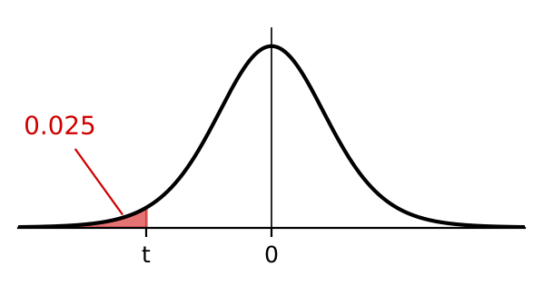
Mean of a Normal Distribution with Unknown Variance
If X₁, …, Xₙ is a random sample from a normal distribution with unknown variance, then
The random variable X has a t-distribution with 10 degrees of freedom. Determine values of t for which:
a) P(X > t) = 0.025 b) P(X < t) = 0.95 c) P(X < t) = 0.025 d) P(|X| > t) = 0.05 e) P(|X| < t) = 0.98
a) ν = 10. Look where the ν = 10 row meets the 0.025 column
where S² is an unbiased estimator of σ²
As ν → ∞ the t-distribution approaches N(0, 1²). It is used when n is small
The table gives the value of t exceeded with the probability shown
t₁₀(0.025) = 2.228
b) If P(X < t) = 0.95 then P(X > t) = 1 − 0.95 = 0.05
ν
0.10
0.05
0.025
0.01
0.005
t₁₀(0.05) = 1.812
4
1.533
2.132
2.776
3.747
4.604
c) By symmetry P(X < −2.228) = P(X > 2.228) = 0.025
5
1.476
2.015
2.571
3.365
4.032
6
1.440
1.943
2.447
3.143
3.707
7
1.415
1.895
2.365
2.998
3.499
8
1.397
1.860
2.306
2.896
3.355
9
1.383
1.833
2.262
2.821
3.250
10
1.372
1.812
2.228
2.764
3.169
t = −2.228
The book’s note has a misprint here (−0.228)
7A

Slide 4
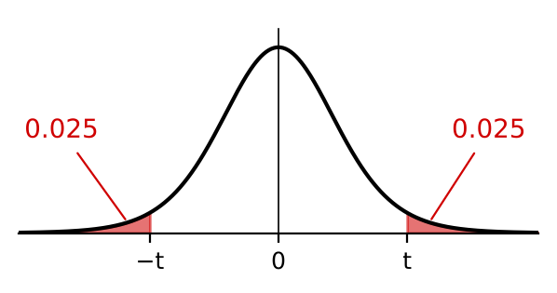
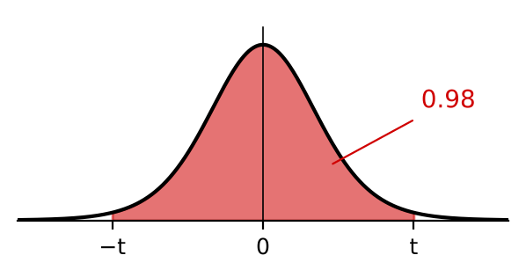
Mean of a Normal Distribution with Unknown Variance
The t-distribution is symmetrical about 0, like the normal distribution
P(X < −t) = P(X > t)
|X| means the modulus of X:
P(|X| > t) = P(X < −t) + P(X > t)
P(|X| < t) = P(−t < X < t)
Always draw a diagram so you are sure which areas you are dealing with
The random variable X has a t-distribution with 10 degrees of freedom. Determine values of t for which:
a) P(X > t) = 0.025 b) P(X < t) = 0.95 c) P(X < t) = 0.025 d) P(|X| > t) = 0.05 e) P(|X| < t) = 0.98
d) Two-tailed: 0.025 in each tail
From a and c, P(|X| > t) = 0.05 when X < −2.228 or X > 2.228
t = 2.228 (so the two boundary values are −2.228 and 2.228)
e) P(|X| < t) = 0.98, so 0.01 in each tail
t₁₀(0.01) = 2.764: P(|X| > 2.764) = 0.02
The book wrongly writes 0.01 here
t = 2.764 (−2.764 < X < 2.764)
7A

Slide 5
Mean of a Normal Distribution with Unknown Variance
You can also use the table backwards to find a probability
Find the value in the row for ν and read off the probability at the top of its column
The random variable Y has a t₄-distribution.
Determine: a) P(Y > 3.747) b) P(Y < −2.132)
ν
0.10
0.05
0.025
0.01
0.005
4
1.533
2.132
2.776
3.747
4.604
a) ν = 4: 3.747 is in the 0.01 column
P(Y > 3.747) = 0.01
b) 2.132 is in the 0.05 column, so P(Y > 2.132) = 0.05
By symmetry P(Y < −2.132) = 0.05
7A

Slide 6
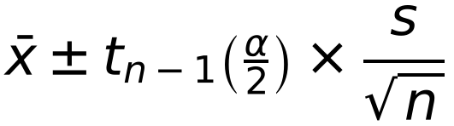
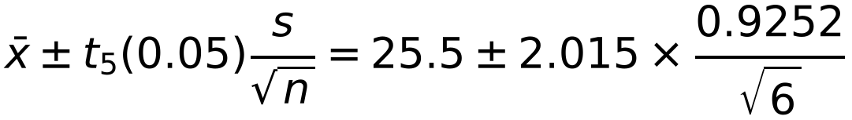
Mean of a Normal Distribution with Unknown Variance
For a small sample of size n from N(μ, σ²) with unknown mean and variance, the 100(1 − α)% confidence limits for μ are
A sample of 6 trout taken from a fish farm were caught and their lengths in centimetres were measured. The lengths of the fish were as follows:
26.8 26.0 25.8 25.5 24.3 24.6
Assuming that the lengths of trout are normally distributed, find a 90% confidence interval for the mean length of trout in the fish farm.
x̄ = 25.5 and s² = 0.8560
Use your calculator
s = √0.8560 = 0.9252
n = 6, so ν = 5: t₅(0.05) = 2.015
For a 90% confidence interval use tₙ₋₁(0.05); for a 95% confidence interval use tₙ₋₁(0.025)
ν = n − 1
The 90% confidence limits for μ are
= 25.5 ± 0.761
The book says limits “for x̄”: they are limits for μ
The 90% confidence interval is (24.739, 26.261)
7A

Slide 7
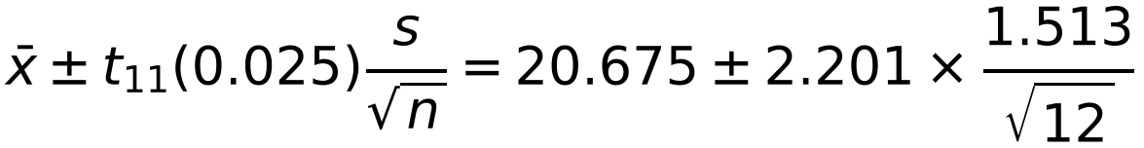
Mean of a Normal Distribution with Unknown Variance
Find x̄ and s using your calculator, then put them into the formula
Write your answer as an interval
The percentage starch content of potatoes is normally distributed with mean μ. In order to assess the mean value of the starch content, a random sample of 12 potatoes is selected and their starch content measured. The percentages of starch contents obtained were as follows:
23.2 20.3 18.6 20.0 20.8 21.6 19.4 18.7 22.1 19.5 21.3 22.6
Find a 95% confidence interval for the mean.
x̄ = 20.675 and s = 1.513
n = 12, so ν = 11: t₁₁(0.025) = 2.201
The 95% confidence limits for μ are
= 20.675 ± 0.961
The 95% confidence interval is (19.714, 21.636)
7A

