Slide 1
Further Hypothesis Tests
Further Statistics 2 Chapter 6
Westie's Workshop

Slide 2
Teachings for Exercise 6C

Slide 3
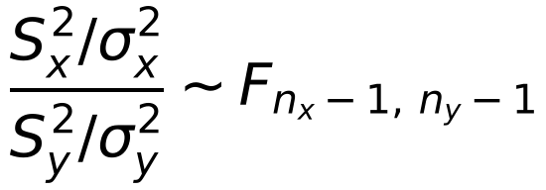
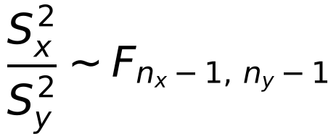
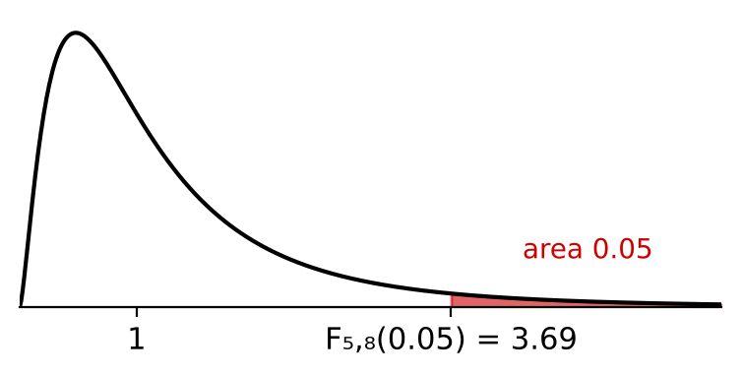
The F-Distribution
For independent random samples of sizes nₓ and nᵧ from N(μₓ, σₓ²) and N(μᵧ, σᵧ²):
Use the table to find:
a) the F₅,₈(0.05) critical value b) the F₈,₅(0.05) critical value.
Upper 5% critical values Fᵥ₁,ᵥ₂(0.05)
ν₂ \ ν₁
1
2
3
4
5
6
8
10
12
24
1
161.4
199.5
215.7
224.6
230.2
234.0
238.9
241.9
243.9
249.1
2
18.51
19.00
19.16
19.25
19.30
19.33
19.37
19.40
19.41
19.46
If σₓ² = σᵧ² this becomes
3
10.13
9.55
9.28
9.12
9.01
8.94
8.85
8.79
8.74
8.64
4
7.71
6.94
6.59
6.39
6.26
6.16
6.04
5.96
5.91
5.77
5
6.61
5.79
5.41
5.19
5.05
4.95
4.82
4.74
4.68
4.53
6
5.99
5.14
4.76
4.53
4.39
4.28
4.15
4.06
4.00
3.84
ν₁ = nₓ − 1 goes along the top of the table and ν₂ = nᵧ − 1 down the side: the order matters
Fᵥ₁,ᵥ₂(0.05) is the value exceeded with probability 0.05
7
5.59
4.74
4.35
4.12
3.97
3.87
3.73
3.64
3.57
3.41
8
5.32
4.46
4.07
3.84
3.69
3.58
3.44
3.35
3.28
3.12
9
5.12
4.26
3.86
3.63
3.48
3.37
3.23
3.14
3.07
2.90
a) ν₁ = 5 (column), ν₂ = 8 (row)
F₅,₈(0.05) = 3.69
b) ν₁ = 8 (column), ν₂ = 5 (row)
F₈,₅(0.05) = 4.82
Swapping ν₁ and ν₂ gives a different value
6C

Slide 4
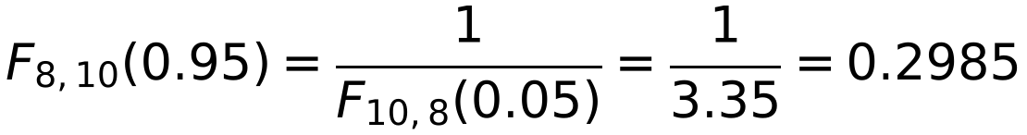
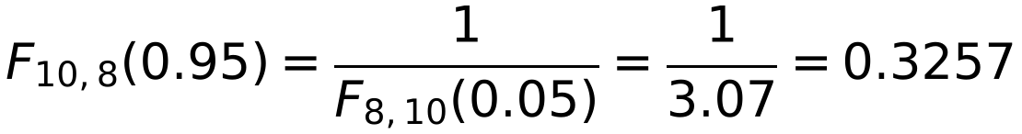
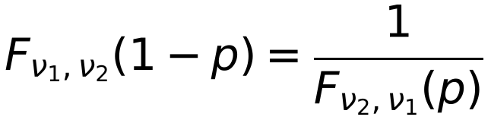
The F-Distribution
The tables only give upper critical values
A lower critical value Fᵥ₁,ᵥ₂(0.95) is exceeded with probability 0.95, so it has 5% of the distribution below it
Lower critical values are reciprocals of upper ones, with ν₁ and ν₂ swapped:
Find upper critical values for:
a) F₈,₁₀(0.95) b) F₁₀,₈(0.95)
a) From the tables F₁₀,₈(0.05) = 3.35
= 0.30 (2 d.p.)
Note the order of ν₁ and ν₂ changes
b) From the tables F₈,₁₀(0.05) = 3.07
= 0.33 (2 d.p.)
These are the 5% lower critical values of F₈,₁₀ and F₁₀,₈
6C

Slide 5
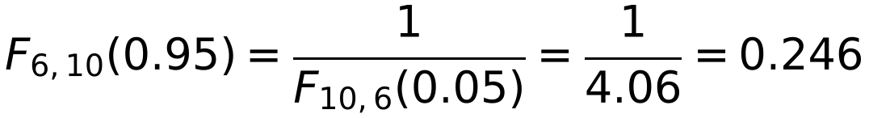
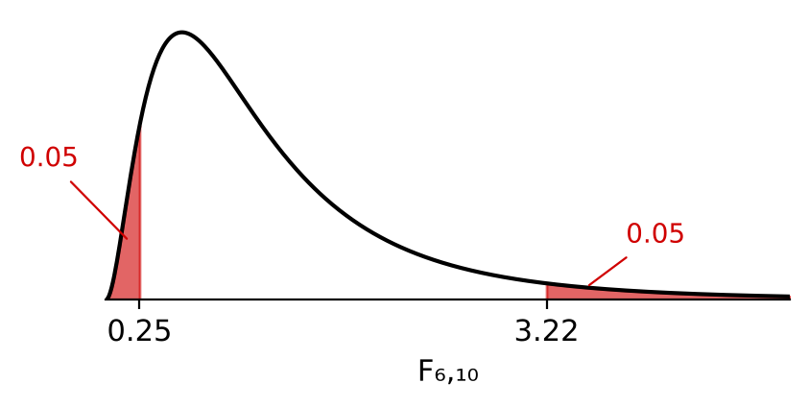
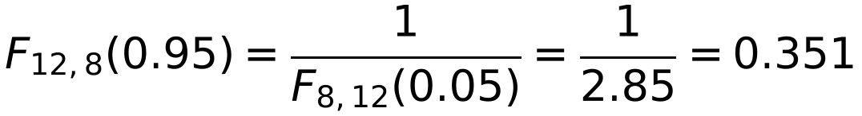
The F-Distribution
The upper 5% critical value comes straight from the table
The lower 5% critical value uses the reciprocal rule
Between the lower and upper 5% critical values lies 90% of the distribution
Find the lower and upper 5% critical values for an Fₐ,ᵦ-distribution in each of the following cases:
a) a = 6, b = 10 b) a = 12, b = 8
a) Upper: F₆,₁₀(0.05)
= 3.22
Lower:
= 0.25 (2 d.p.)
b) Upper: F₁₂,₈(0.05)
= 3.28
Lower:
= 0.35 (2 d.p.)
6C

Slide 6

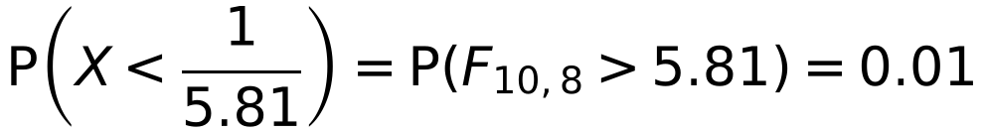
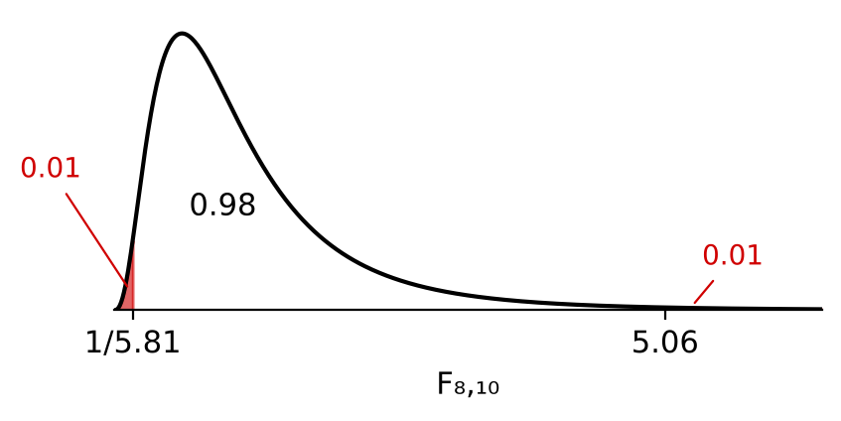
The F-Distribution
You can use the 1% table in the same way
P(Fᵥ₁,ᵥ₂ < f) = P(Fᵥ₂,ᵥ₁ > 1/f)
Draw a sketch to see which areas you need
The random variable X follows an F-distribution with 8 and 10 degrees of freedom.
From the tables: F₈,₁₀(5%) = 3.07, F₈,₁₀(1%) = 5.06
F₁₀,₈(5%) = 3.35, F₁₀,₈(1%) = 5.81
Upper tail: P(X > 5.06) = P(F₈,₁₀ > 5.06) = 0.01
so P(X < 5.06) = 1 − 0.01 = 0.99
Other tail:
Reciprocal rule
P(1/5.81 < X < 5.06) = P(X < 5.06) − P(X < 1/5.81)
= 0.99 − 0.01
= 0.98
6C

Slide 7
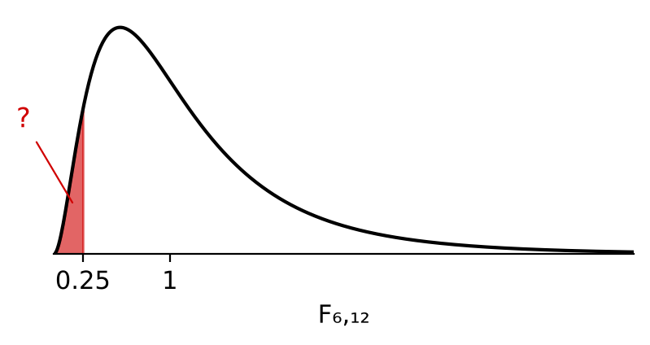
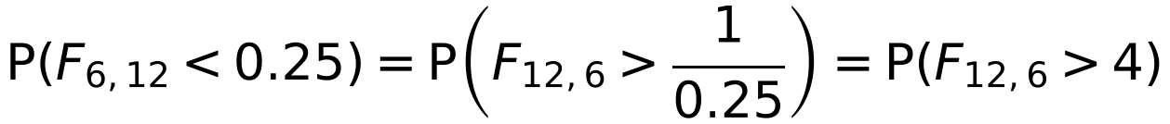
The F-Distribution
To find a probability in the lower tail, change it into an upper-tail probability by taking reciprocals and swapping the degrees of freedom
The random variable X follows an F₆,₁₂-distribution.
Find P(X < 0.25).
Swap the degrees of freedom and take the reciprocal
From the tables F₁₂,₆(0.05) = 4.00
4 is the upper 5% critical value
So P(X < 0.25) = P(F₁₂,₆ > 4) = 0.05
6C

