Slide 1
Further Hypothesis Tests
Further Statistics 2 Chapter 6
Westie's Workshop

Slide 2
Teachings for Exercise 6A

Slide 3
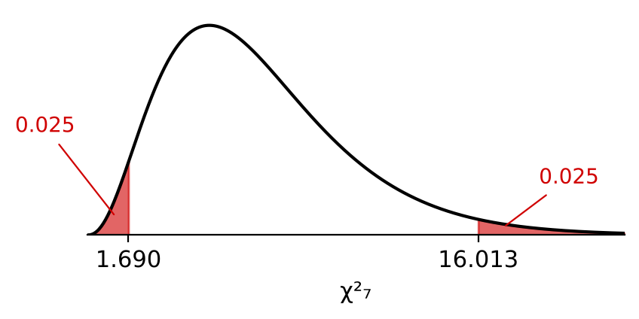
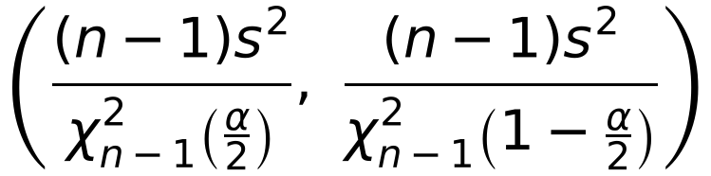
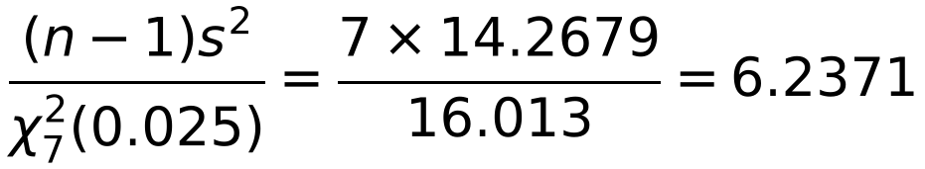
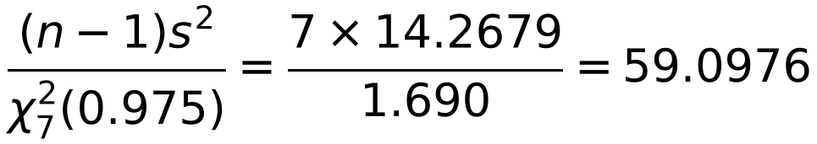
Variance of a Normal Distribution
You can find a confidence interval for the variance of a normal distribution
If X₁, X₂, …, Xₙ is a random sample from N(μ, σ²) then (n − 1)S²/σ² has a χ² distribution with n − 1 degrees of freedom
The 100(1 − α)% confidence interval for σ² is
In order to determine the accuracy of a new rifle, 8 marksmen were selected at random to fire the rifle at a target. The distances x, in mm, of the 8 shots from the centre of the target were as follows:
10, 14, 12, 8, 6, 11, 18, 14
Assuming that the distances are normally distributed, find a 95% confidence interval for the variance.
x̄ = 11.625 s² = 14.2679
Use your calculator to find x̄ and s²
n = 8, so ν = 7:
χ²₇(0.975) = 1.690 χ²₇(0.025) = 16.013
From the χ² table
Lower limit: divide by the bigger value
Upper limit
χ²ₙ₋₁(p) is the value exceeded with probability p. The χ² distribution is not symmetrical, so you need two values from the table
The 95% confidence interval for σ² is (6.237, 59.098)
6A

Slide 4
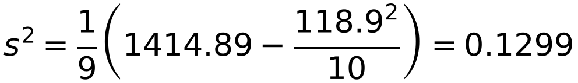
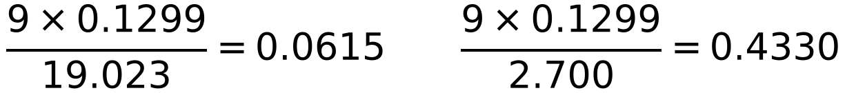
Variance of a Normal Distribution
If you are given Σx and Σx², use the formula for s²:
s² = (Σx² − (Σx)²/n) / (n − 1)
The confidence limits for the standard deviation σ are the square roots of the confidence limits for the variance
A company manufactures 12 amp electrical fuses. A random sample of 10 fuses was taken from a batch and the failure current (X) measured for each. The results are summarised below:
Σx = 118.9 Σx² = 1414.89
Assume that the data can be regarded as a random sample from a normal population.
a) Calculate an unbiased estimate for the variance of the batch based upon the sample.
b) Use your estimate from part a to calculate a 95% confidence interval for the standard deviation.
a) n = 10
b) ν = 9: χ²₉(0.975) = 2.700, χ²₉(0.025) = 19.023
The 95% confidence interval for σ² is (0.0615, 0.4330)
√0.0615… = 0.248, √0.4330 = 0.658
Square root both limits
The 95% confidence interval for σ is (0.248, 0.658)
The book gets 0.249 by rounding 0.0615 first
6A

