Slide 1
Estimation, Confidence Intervals and Tests Using a Normal Distribution
Further Statistics 2 Chapter 5
Westie's Workshop

Slide 2
Teachings for Exercise 5C

Slide 3
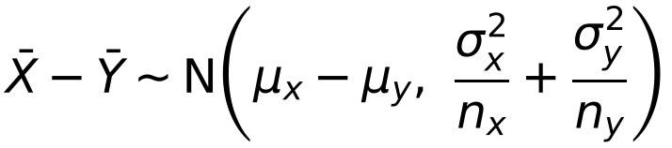
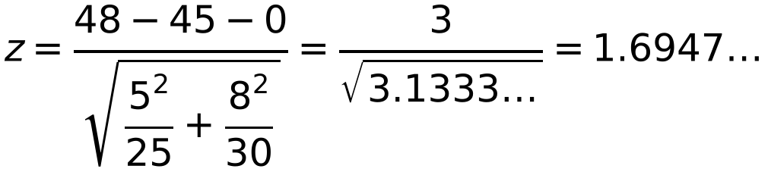
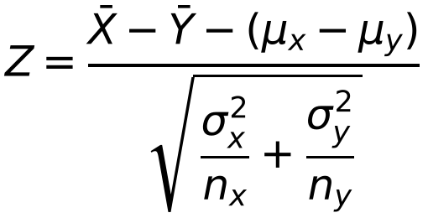
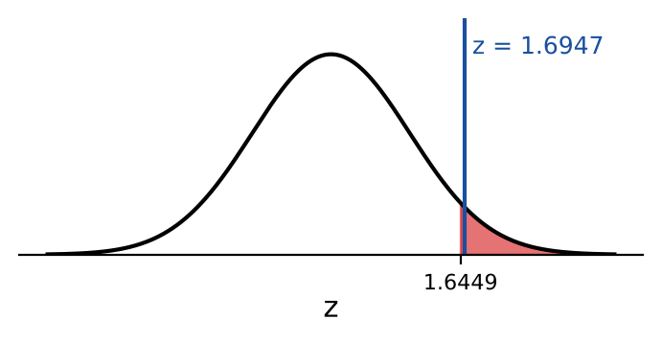
Hypothesis Testing for the Difference Between Means
If X ~ N(μx, σx²) and Y ~ N(μy, σy²) are independent, then for samples of size nx and ny
The weights of boys and girls in a certain school are known to be normally distributed with standard deviations of 5 kg and 8 kg respectively. A random sample of 25 boys had a mean weight of 48 kg and a random sample of 30 girls had a mean weight of 45 kg.
Stating your hypotheses clearly, test, at the 5% level of significance, whether there is evidence that the mean weight of the boys in the school is greater than the mean weight of the girls.
‘Greater than’: a one-tailed test
Test statistic for H₀: μx = μy
σ₁ = 5, n₁ = 25, σ₂ = 8 and n₂ = 30
μx − μy = 0 from H₀
5% one-tailed critical value: z = 1.6449
The formula for the test statistic is in the formula book
1.6947 > 1.6449: significant, so reject H₀
There is evidence that the mean weight of the boys is greater than the mean weight of the girls
5C

Slide 4
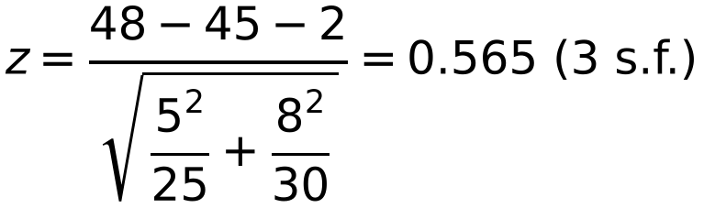
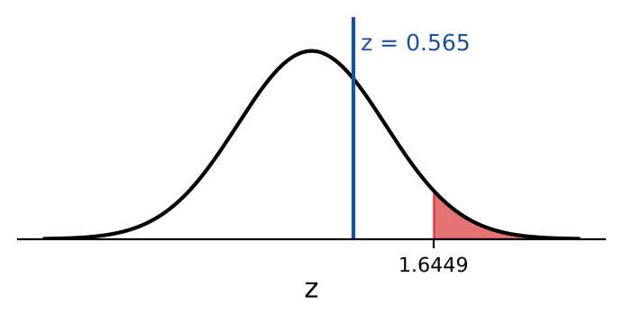
Hypothesis Testing for the Difference Between Means
You can test whether one mean exceeds another by more than a given amount
The hypotheses change: H₀ gives the value of μx − μy
Use that value of μx − μy in the test statistic
Always quote the critical value in full and give your conclusion in context
The weights of boys and girls in a certain school are known to be normally distributed with standard deviations of 5 kg and 8 kg respectively. A random sample of 25 boys had a mean weight of 48 kg and a random sample of 30 girls had a mean weight of 45 kg.
Stating your hypotheses clearly, test, at the 5% level of significance, whether there is evidence that the mean weight of the boys in the school is more than 2 kg greater than the mean weight of the girls.
The difference is greater than 2
σ₁ = 5, n₁ = 25, σ₂ = 8 and n₂ = 30
The 2 comes from μx − μy in H₀
5% one-tailed critical value: z = 1.6449
0.565 < 1.6449: not significant, so do not reject H₀
Insufficient evidence that the mean weight of the boys is more than 2 kg greater than that of the girls
5C

Slide 5
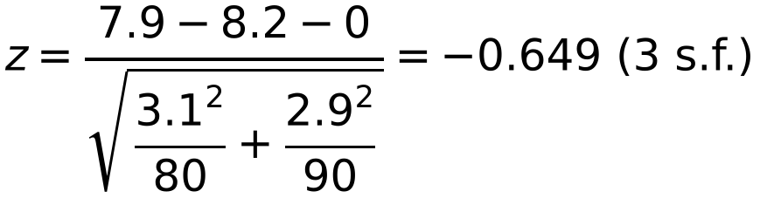
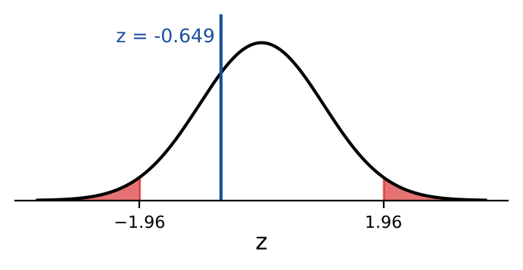
Hypothesis Testing for the Difference Between Means
If the sample sizes nx and ny are large, the test can be used even when the distributions of X and Y are not normal
This is because of the central limit theorem: X̄ − Ȳ is approximately normal
Testing for a difference (in either direction) needs a two-tailed test
A manufacturer of personal stereos can use batteries made by two different manufacturers. The standard deviation of lifetimes for Never Die batteries is 3.1 hours and for Everlasting batteries is 2.9 hours. A random sample of 80 Never Die batteries and a random sample of 90 Everlasting batteries were tested and their mean lifetimes were 7.9 hours and 8.2 hours respectively.
Stating your hypotheses clearly, test, at the 5% level of significance, whether there is evidence of a difference between the mean lifetimes of the two makes of batteries.
Let μx and μy be the mean lifetimes of Never Die and Everlasting batteries
‘Difference’: a two-tailed test
σx = 3.1, nx = 80, σy = 2.9, ny = 90
Samples are large, so the CLT lets you proceed without knowing the distributions
5% two-tailed critical values: z = ±1.96
−1.96 < −0.649 < 1.96: not significant, do not reject H₀
No significant evidence of a difference in the mean lifetimes of the two makes
5C

