Slide 1
Estimation, Confidence Intervals and Tests Using a Normal Distribution
Further Statistics 2 Chapter 5
Westie's Workshop

Slide 2
Teachings for Exercise 5B

Slide 3
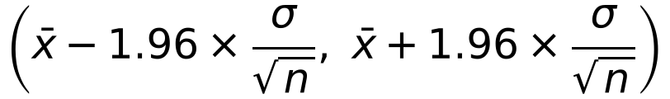
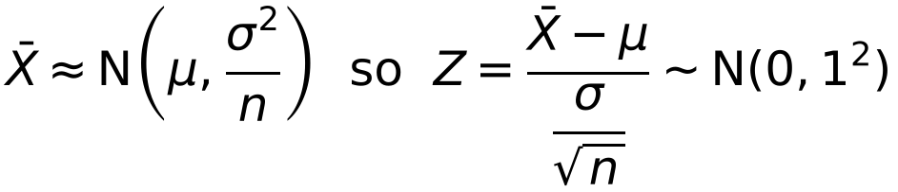
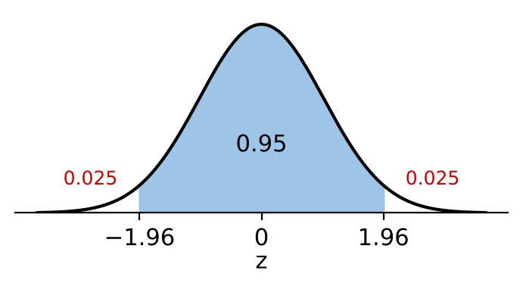
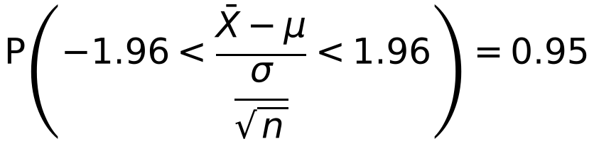
Confidence Intervals
A confidence interval for a population parameter θ is a range of values defined so that there is a specific probability that the true value of the parameter lies within that range
By the central limit theorem, X̄ is approximately normal whatever the distribution of X
If X ~ N(μ, σ²) then Z = (X − μ)/σ ~ N(0, 1²)
Show that a 95% confidence interval for μ, based on a sample of size n, is given by
P(Z > 1.96) = P(Z < −1.96) = 0.025
So P(−1.96 < Z < 1.96) = 0.95
From tables or your calculator
5B

Slide 4
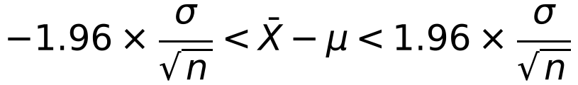
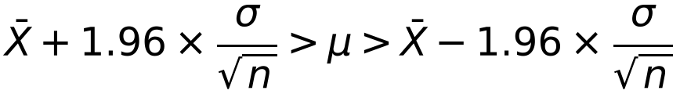

Confidence Intervals
The upper and lower values of a confidence interval are called the confidence limits
μ is fixed: it is the interval that varies from sample to sample
A 95% confidence interval contains μ with probability 0.95: about 1 in 20 such intervals will not contain μ
Look at the inequality inside the probability statement:
Start to isolate μ
Multiply by −1 and reverse the inequalities
So the 95% confidence interval for μ is
For 99% confidence, replace 1.96 by 2.5758;
for 90%, use 1.6449
5B

Slide 5
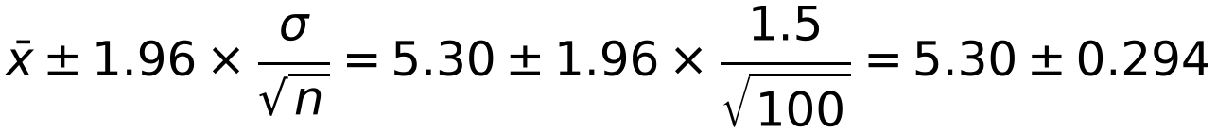
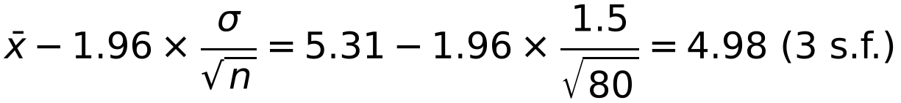
Confidence Intervals
In your exam you can give a confidence interval:
as confidence limits, e.g. 5.30 ± 0.294
in interval notation, e.g. (5.006, 5.594)
using inequalities, e.g. 5.006 < μ < 5.594
A value of 95% is commonly used if no other level is given
The breaking strains of reels of string produced at a certain factory have a standard deviation of 1.5 kg. A sample of 100 reels from a certain batch were tested and their mean breaking strain was 5.30 kg.
a Find a 95% confidence interval for the mean breaking strain of string in this batch.
The manufacturer becomes concerned if the lower 95% confidence limit falls below 5 kg. A sample of 80 reels from another batch gave a mean breaking strain of 5.31 kg.
b Will the manufacturer be concerned?
The distribution is not known, but n is large so, by the central limit theorem, X̄ is approximately normal
a
95% confidence interval: (5.006, 5.594)
b Lower 95% confidence limit:
4.98 < 5, so the manufacturer will be concerned
5B

Slide 6

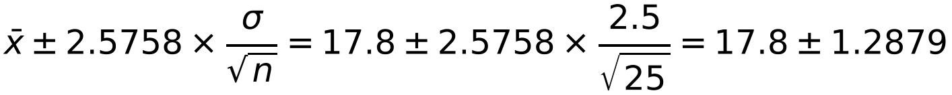

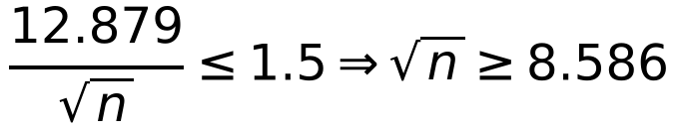
Confidence Intervals
The width of a confidence interval is the difference between the upper and lower confidence limits
A random sample of size 25 is taken from a normal population with standard deviation 2.5. The mean of the sample is 17.8.
a Find a 99% C.I. for the population mean μ.
b What size sample is required to obtain a 99% C.I. of width of at most 1.5?
a 99% confidence limits are
z is the percentage point from N(0, 1²), e.g. 1.6449, 1.96, 2.5758
Width depends on σ, n and the level of confidence: higher confidence gives a wider interval
99% confidence interval: (16.51, 19.09)
z = 2.5758 for 99%
b
n ≥ 73.719…
So you need n = 74
Round up to the next whole number
5B

Slide 7
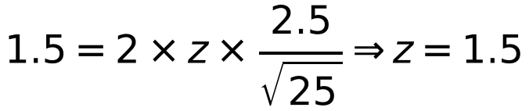
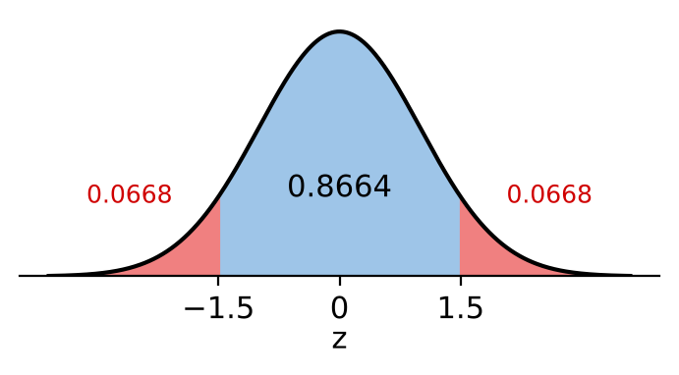
Confidence Intervals
To find the confidence level for a given width, rearrange the width formula to find z
The confidence level is the area between −z and z
A random sample of size 25 is taken from a normal population with standard deviation 2.5. The mean of the sample is 17.8.
c What confidence level would be associated with the interval based on the above sample of 25 but of width 1.5, i.e. (17.05, 18.55)?
P(Z < 1.5) = 0.9332
P(Z > 1.5) = P(Z < −1.5) = 1 − 0.9332 = 0.0668
From the normal distribution table
Confidence level = 100 × (1 − 2 × 0.0668)
= 86.6%
5B

