Slide 1
Estimation, Confidence Intervals and Tests Using a Normal Distribution
Further Statistics 2 Chapter 5
Westie's Workshop

Slide 2
Teachings for Exercise 5A

Slide 3
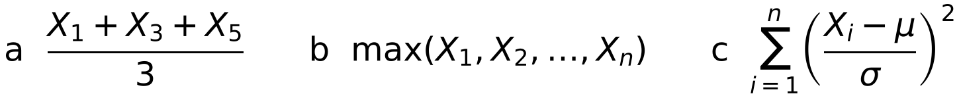
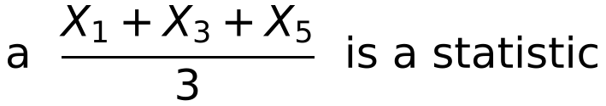
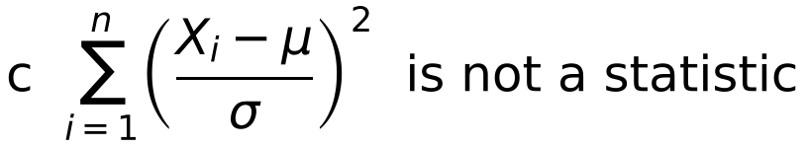
Estimators, Bias and Standard Error
A random sample of size n consists of n observations X₁, X₂, …, Xₙ of the random variable X
The Xᵢ are independent and each has the same distribution as X
A statistic, T, is a random variable consisting of any function of the Xᵢ that involves no other quantities, such as unknown population parameters
A sample, X₁, X₂, …, Xₙ, is taken from a population with unknown population parameters μ and σ.
State whether or not each of the following are statistics.
Only a function of the sample. It need not involve all of the Xᵢ
b max(X₁, X₂, …, Xₙ) is a statistic
Only a function of the sample
The function contains μ and σ, which are unknown
5A

Slide 4
Estimators, Bias and Standard Error
The sampling distribution of a statistic T is the probability distribution of T
If the distribution of the population is known, the sampling distribution of a statistic can sometimes be found
If Xᵢ ~ N(μ, σ²) then ΣXᵢ ~ N(nμ, nσ²)
Var(X − Y) = Var(X) + Var(Y) for independent X and Y
The weights, in grams, of a consignment of apples are normally distributed with a mean μ and standard deviation 4. A random sample of size 25 is taken and the statistics R and T are calculated as follows:
R = X₂₅ − X₁ and T = X₁ + X₂ + … + X₂₅
Find the distributions of R and T.
The sample is X₁, X₂, …, X₂₅ where each Xᵢ ~ N(μ, 4²)
State the distribution of each Xᵢ
R = X₂₅ − X₁ ⇒ R ~ N(μ − μ, 4² + 4²)
E(X − Y) = E(X) − E(Y); the variances add
R ~ N(0, (4√2)²)
T = X₁ + X₂ + … + X₂₅ ⇒ T ~ N(25μ, 25 × 4²)
Sum of 25 independent N(μ, 4²)
T ~ N(25μ, 20²)
5A

Slide 5
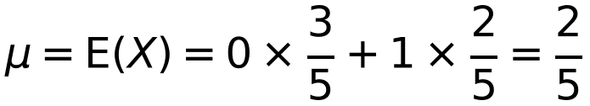
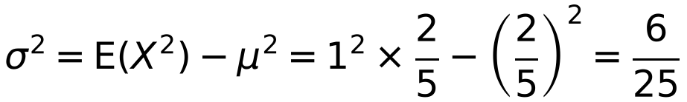
Estimators, Bias and Standard Error
You can find a sampling distribution by listing every possible sample
List the possible observations systematically
μ = E(X) = Σ x P(X = x)
σ² = Var(X) = Σ x² P(X = x) − μ²
A large bag contains counters. 60% of the counters have the number 0 on them and 40% have the number 1.
a Find the population mean μ and population variance σ² of the values shown on the counters.
A simple random sample of size 3 is taken from this population.
b List all the possible observations from this sample.
x
0
1
P(X = x)
3/5
2/5
E(X²) = 0² × 3/5 + 1² × 2/5
b (0, 0, 0)
(1, 0, 0) (0, 1, 0) (0, 0, 1)
(1, 1, 0) (1, 0, 1) (0, 1, 1)
(1, 1, 1)
5A

Slide 6
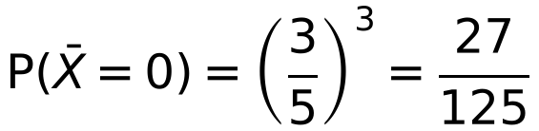
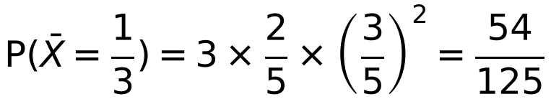
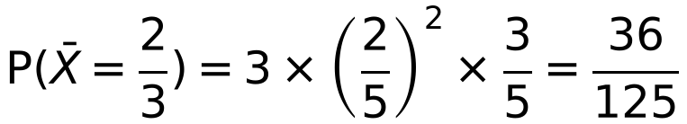
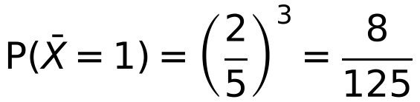
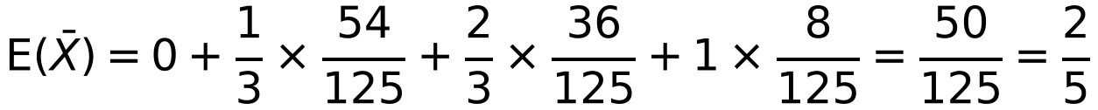
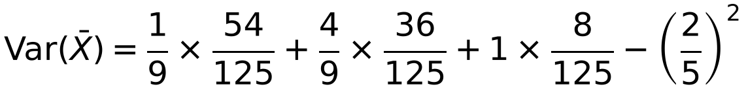
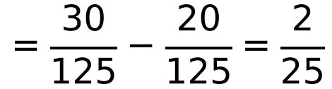
Estimators, Bias and Standard Error
The sample is random, so the observations are independent
P(1, 0, 0) = P(X₁ = 1) × P(X₂ = 0) × P(X₃ = 0)
Each arrangement with one 1 has the same probability, so multiply by 3
E(X̄) = μ but Var(X̄) is smaller than σ²
where X₁, X₂ and X₃ are the values shown on the three counters in the sample.
d Hence find E(X̄) and Var(X̄).
(0, 0, 0)
(1, 0, 0), (0, 1, 0), (0, 0, 1)
(1, 1, 0), (1, 0, 1), (0, 1, 1)
(1, 1, 1)
x̄
0
⅓
⅔
1
P(X̄ = x̄)
27/125
54/125
36/125
8/125
σ²/3 = 0.08 = 2/25
5A

Slide 7
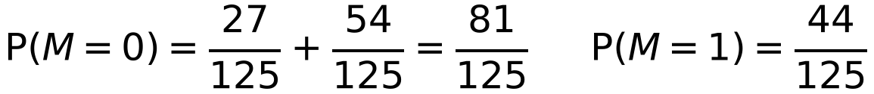
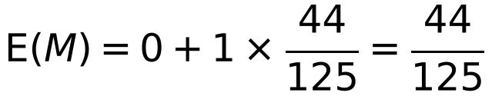
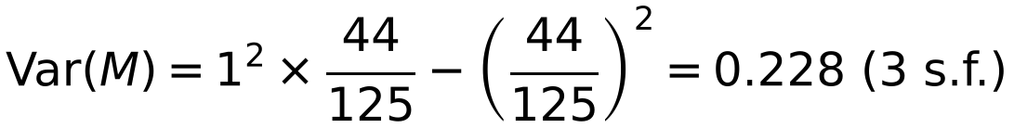
Estimators, Bias and Standard Error
The mode of a sample of three 0s and 1s is whichever value appears at least twice
Here E(X̄) = μ but E(M) ≠ μ
Neither E(X̄) nor E(M) equals the population mode, which is 0
A large bag contains counters. 60% of the counters have the number 0 on them and 40% have the number 1.
A simple random sample of size 3 is taken from this population.
e Find the sampling distribution for the mode, M.
f Hence find E(M) and Var(M).
e The mode can take values 0 or 1
M = 0 for (0, 0, 0) and the three cases with exactly one 1
m
0
1
P(M = m)
81/125
44/125
f
5A

Slide 8
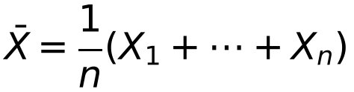
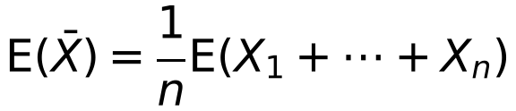
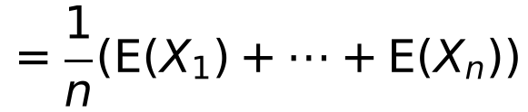
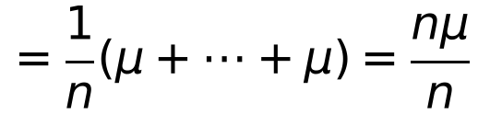
Estimators, Bias and Standard Error
A statistic used to estimate a population parameter is an estimator; the value it gives for a particular sample is an estimate
If T is an estimator for θ and E(T) = θ, then T is an unbiased estimator for θ
If T is used as an estimator for θ, then bias = E(T) − θ
For an unbiased estimator, the bias is 0
A random sample X₁, X₂, …, Xₙ is taken from a population with X ~ N(μ, σ²).
Show that E(X̄) = μ.
E(aX) = aE(X)
E(X + Y) = E(X) + E(Y)
E(X̄) = μ
So X̄ is an unbiased estimator of μ
In Example 3, E(M) = 44/125 but the population mode is 0,
so M is a biased estimator: bias = 44/125
5A

Slide 9
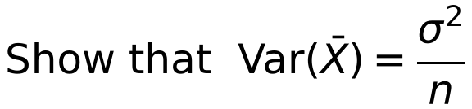
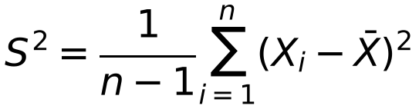
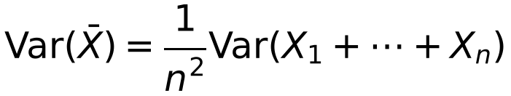
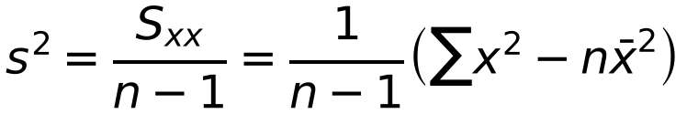
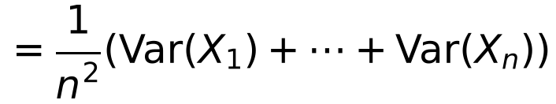
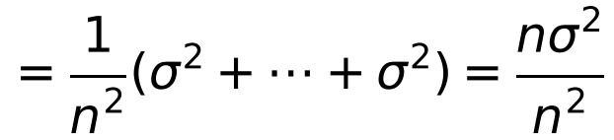
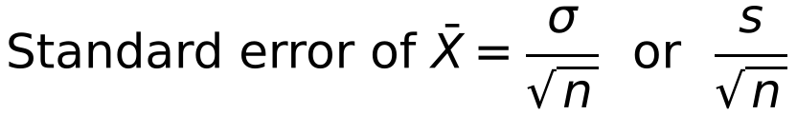
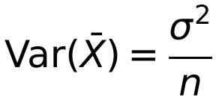
Estimators, Bias and Standard Error
The variance of a sample is not an unbiased estimator of σ²
An unbiased estimator for σ² is the sample variance S²
A random sample X₁, X₂, …, Xₙ is taken from a population with X ~ N(μ, σ²).
Var(aX) = a²Var(X)
Var(X + Y) = Var(X) + Var(Y) for independent X, Y
The standard deviation of an estimator is called its standard error
Var(X̄) decreases as n increases, so a larger sample gives a better estimator
5A

Slide 10
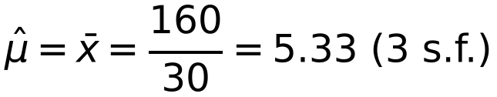
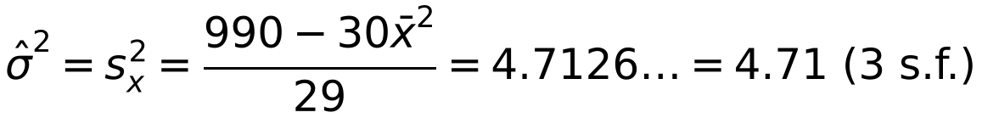
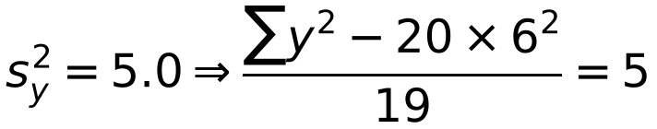
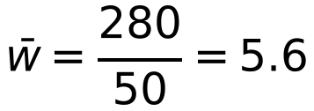
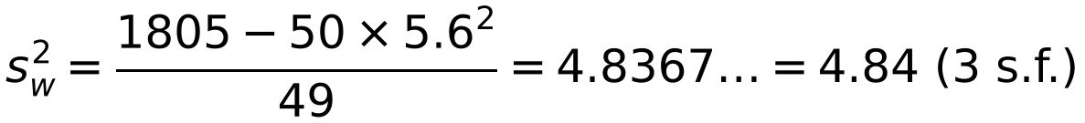
Estimators, Bias and Standard Error
Use s² = (Σx² − nx̄²)/(n − 1) when you have Σx² and x̄
To combine samples, ‘unwrap’ the formulae for ȳ and s² to find Σy and Σy²
A ‘hat’ over a parameter (e.g. on μ or σ²) means an estimate of that parameter
The table below summarises the number of breakdowns, X, on a town’s bypass on 30 randomly chosen days.
Breakdowns
2
3
4
5
6
7
8
9
Days
3
5
4
3
5
4
4
2
a Calculate unbiased estimates of the mean and variance of the number of breakdowns.
20 more days were randomly sampled and this sample had x̄ = 6.0 and s² = 5.0.
b Treating the 50 results as a single sample, obtain further unbiased estimates of the population mean and variance.
a By calculator, Σx = 160 and Σx² = 990
b ȳ = 6.0 ⇒ Σy = 20 × 6.0 = 120
Σy² = 5 × 19 + 20 × 36 = 815
Σw = 160 + 120 = 280, Σw² = 990 + 815 = 1805
5A

Slide 11
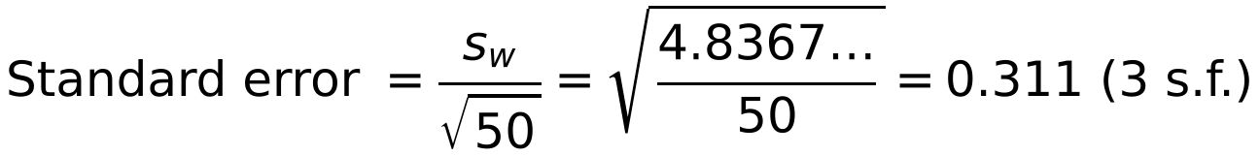
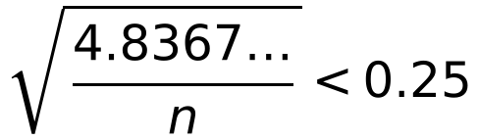
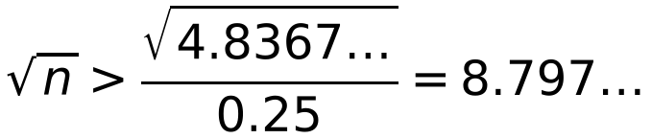
Estimators, Bias and Standard Error
Use the estimate from the largest sample: here the combined estimate from all 50 results
If σ is unknown, use s in the standard error
From part b: x̄ = 5.6 and s² = 4.8367… for the combined sample of 50.
c Find the standard error of this new estimate of the mean.
d Estimate the size of sample required to achieve a standard error of less than 0.25.
d
You do not know σ, so use your best estimate of it (from all 50 results)
n > 77.38…
So a sample size of at least 78 is needed
5A

