Slide 1
Combinations of Random Variables
Further Statistics 2 Chapter 4
Westie's Workshop

Slide 2
Teachings for Exercise 4A

Slide 3
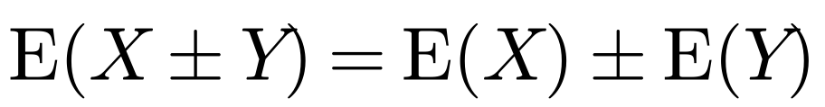
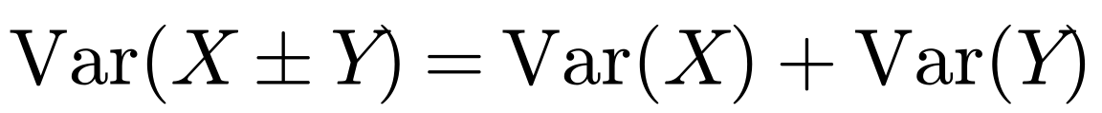
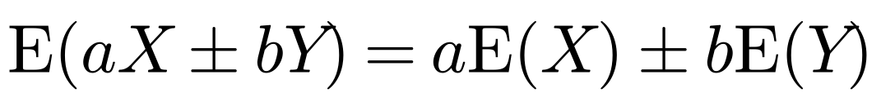
Combinations of Random Variables
Random variables are independent if the outcome of one does not affect the outcome of the other
If X is a random variable with E(X) = µ₁ and Var(X) = σ₁² and Y is an independent random variable with E(Y) = µ₂ and Var(Y) = σ₂², find the mean and variance of:
If X and Y are two random variables, then
a X + Y b X − Y
a
If X and Y are two independent random variables, then
b
You add the variances even when you subtract the random variables
Variances are always added
More generally, if X and Y are random variables:
and if X and Y are independent:
4A

Slide 4
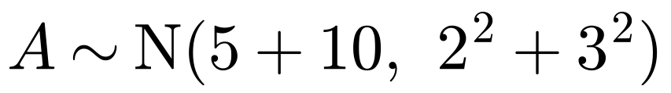
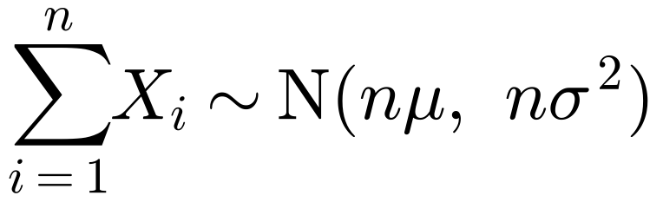
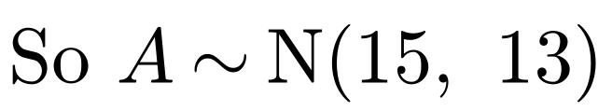
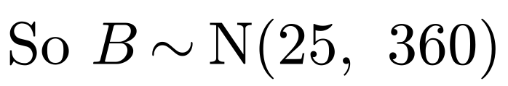
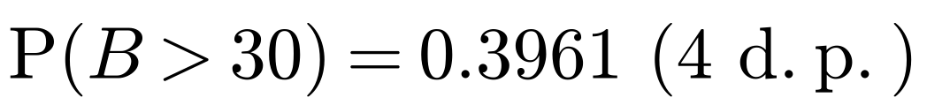
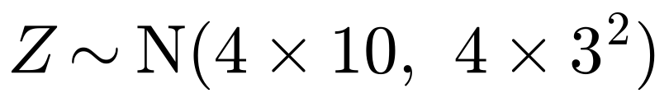
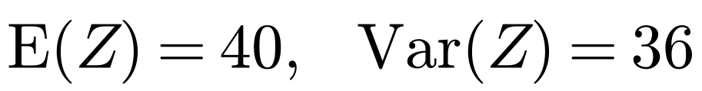
Combinations of Random Variables
If X and Y are independent with X ~ N(µ₁, σ₁²) and Y ~ N(µ₂, σ₂²), then
The independent random variables X and Y have distributions X ~ N(5, 2²) and Y ~ N(10, 3²).
a Find the distribution of: i A = X + Y ii B = 9X − 2Y
A linear combination of normal random variables is also normally distributed
b Find P(B > 30).
The independent random variables Y₁, Y₂, Y₃ and Y₄ all have the same distribution as Y. The random variable Z is defined as Z = Y₁ + Y₂ + Y₃ + Y₄.
If X₁, X₂, …, Xₙ are independent and identically distributed with Xᵢ ~ N(µ, σ²), then
c Find the mean and standard deviation of Z.
a i
ΣXᵢ is not the same as nX₁: Var(X₁ + X₂) = 2Var(X₁) but Var(2X₁) = 4Var(X₁)
ii
When you subtract random variables you still add the variances
b
Use your calculator: B has standard deviation √360
c
So Z has mean 40 and standard deviation 6
Be careful: Z has variance 36, so its standard deviation is 6
4A

Slide 5
Combinations of Random Variables
If X and Y are independent with X ~ N(µ₁, σ₁²) and Y ~ N(µ₂, σ₂²), then
The independent random variables X and Y have distributions X ~ N(25, 6) and Y ~ N(22, 10).
Find P(X > Y).
A linear combination of normal random variables is also normally distributed
Let C = X − Y
Compare two normal random variables by defining a new random variable for the difference
If X₁, X₂, …, Xₙ are independent and identically distributed with Xᵢ ~ N(µ, σ²), then
Then P(X > Y) = P(C > 0)
If X − Y > 0 then X > Y
P(C > 0) = 0.7734, so P(X > Y) = 0.7734 (4 s.f.)
ΣXᵢ is not the same as nX₁: Var(X₁ + X₂) = 2Var(X₁) but Var(2X₁) = 4Var(X₁)
4A

Slide 6
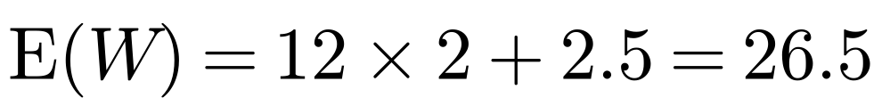
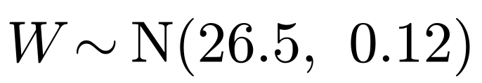
Combinations of Random Variables
If X and Y are independent with X ~ N(µ₁, σ₁²) and Y ~ N(µ₂, σ₂²), then
Bottles of mineral water are delivered to shops in crates containing 12 bottles each. The weights of bottles are normally distributed with mean weight 2 kg and standard deviation 0.05 kg. The weights of empty crates are normally distributed with mean 2.5 kg and standard deviation 0.3 kg.
A linear combination of normal random variables is also normally distributed
a Assuming that all random variables are independent, find the probability that a full crate will weigh between 26 kg and 27 kg.
If X₁, X₂, …, Xₙ are independent and identically distributed with Xᵢ ~ N(µ, σ²), then
b Two bottles are selected at random from a crate. Find the probability that they differ in weight by more than 0.1 kg.
c Find the weight, M, that a full crate should have on its label so that there is a 1% chance that it will weigh more than M.
a
The weight of a full crate = the weight of 12 bottles + the weight of the crate
ΣXᵢ is not the same as nX₁: Var(X₁ + X₂) = 2Var(X₁) but Var(2X₁) = 4Var(X₁)
12 separate bottles: 12Var(X), not 12²Var(X)
Use the normal distribution function on your calculator
4A

Slide 7
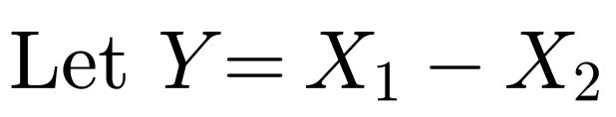
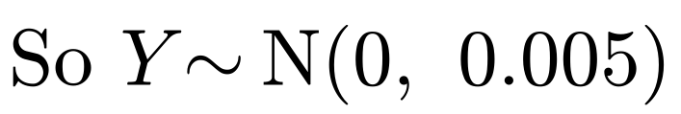
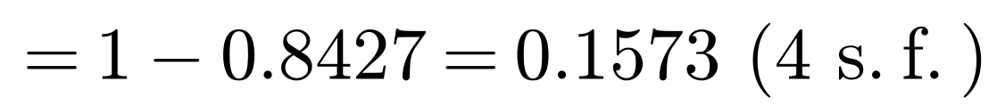
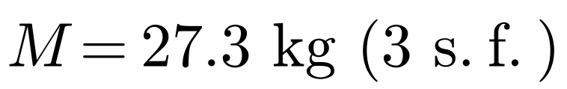
Combinations of Random Variables
If X and Y are independent with X ~ N(µ₁, σ₁²) and Y ~ N(µ₂, σ₂²), then
Bottles of mineral water are delivered to shops in crates containing 12 bottles each. The weights of bottles are normally distributed with mean weight 2 kg and standard deviation 0.05 kg. The weights of empty crates are normally distributed with mean 2.5 kg and standard deviation 0.3 kg.
A linear combination of normal random variables is also normally distributed
a Assuming that all random variables are independent, find the probability that a full crate will weigh between 26 kg and 27 kg.
If X₁, X₂, …, Xₙ are independent and identically distributed with Xᵢ ~ N(µ, σ²), then
b Two bottles are selected at random from a crate. Find the probability that they differ in weight by more than 0.1 kg.
c Find the weight, M, that a full crate should have on its label so that there is a 1% chance that it will weigh more than M.
b
Define a new random variable for the difference in weight
ΣXᵢ is not the same as nX₁: Var(X₁ + X₂) = 2Var(X₁) but Var(2X₁) = 4Var(X₁)
Either bottle could be more than 0.1 kg heavier, so consider both
c
Use the inverse normal function on your calculator
4A

