Slide 1
Continuous Distributions
Further Statistics 2 Chapter 3
Westie's Workshop

Slide 2
Teachings for Exercise 3F

Slide 3
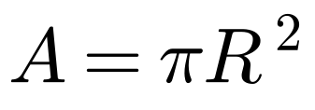
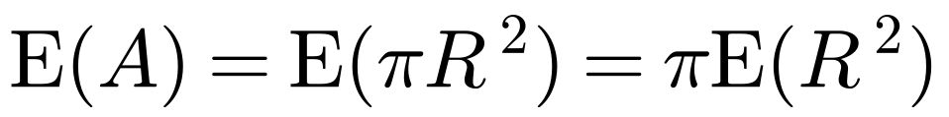
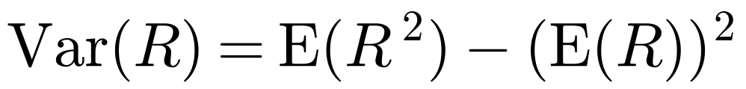
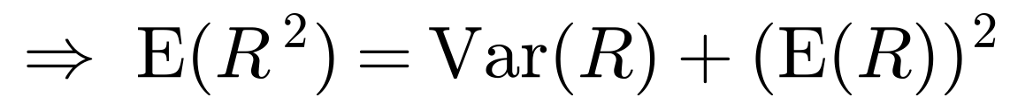
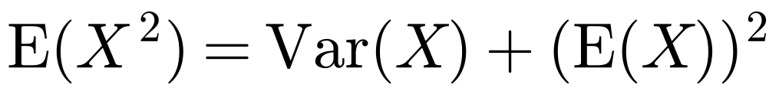
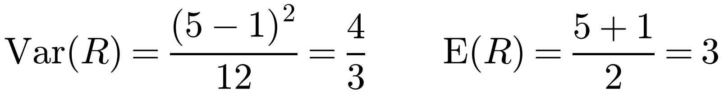
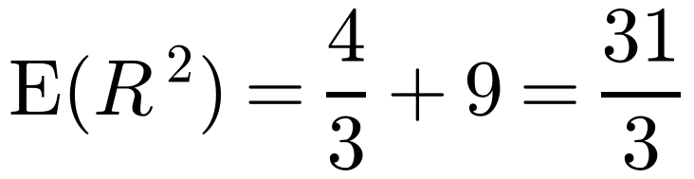
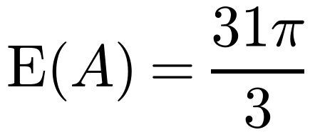
Modelling with the Continuous Uniform Distribution
The continuous uniform distribution is often used to model real-life situations
The trunk of a small tree varies in diameter from 10 cm at the bottom to 2 cm at the top. The tree is cut horizontally at a randomly chosen point, and the radius R cm of the cross-section is modelled as R ~ U[1, 5].
e.g. trains leave a station hourly and you arrive not knowing when the next one leaves: your waiting time, X minutes, could be modelled as X ~ U[0, 60]
Find the expected value of the area, A, of the cross-section of the tree.
It is often used to model rounding errors in measurements
E(R²) is not the same as (E(R))²
Remember E(X²) is not the same as (E(X))²:
Or E(R²) = ∫ ¼r² dr from 1 to 5 = [r³/12] = 125/12 − 1/12 = 31/3
3F

Slide 4
Modelling with the Continuous Uniform Distribution
The continuous uniform distribution is often used to model real-life situations
The length of a pencil is measured to the nearest cm. Write down the distribution of the rounding errors R.
e.g. trains leave a station hourly and you arrive not knowing when the next one leaves: your waiting time, X minutes, could be modelled as X ~ U[0, 60]
The error is the difference between the true length and the recorded length.
If a pencil is recorded as 20 cm long, its length is anywhere in the interval
It is often used to model rounding errors in measurements
19.5 cm ≤ length < 20.5 cm
The error is therefore in the interval
Remember E(X²) is not the same as (E(X))²:
−0.5 ≤ error < 0.5
It is reasonable to assume the error is equally likely to take any value in this range, so
The uniform distribution is often used as a model for errors made by rounding up or down
R ~ U[−0.5, 0.5]
3F

Slide 5
Modelling with the Continuous Uniform Distribution
The continuous uniform distribution is often used to model real-life situations
Write down the name of the distribution you would recommend as a suitable model for each of the following situations.
e.g. trains leave a station hourly and you arrive not knowing when the next one leaves: your waiting time, X minutes, could be modelled as X ~ U[0, 60]
a The masses of 200 g tins of tomatoes produced on a production line.
b The difference between the true length and the length of metal rods measured to the nearest centimetre.
It is often used to model rounding errors in measurements
a Normal
You expect more tins to have masses near 200 g
Remember E(X²) is not the same as (E(X))²:
b Continuous uniform
The difference is equally likely to take any value from −0.5 to 0.5
3F

