Slide 1
Continuous Distributions
Further Statistics 2 Chapter 3
Westie's Workshop

Slide 2
Teachings for Exercise 3E

Slide 3
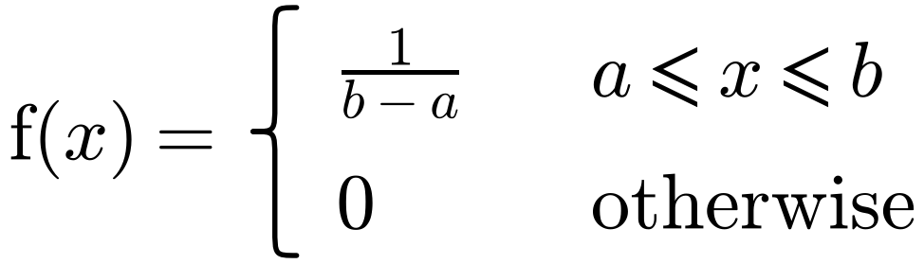
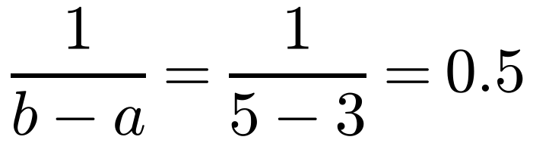
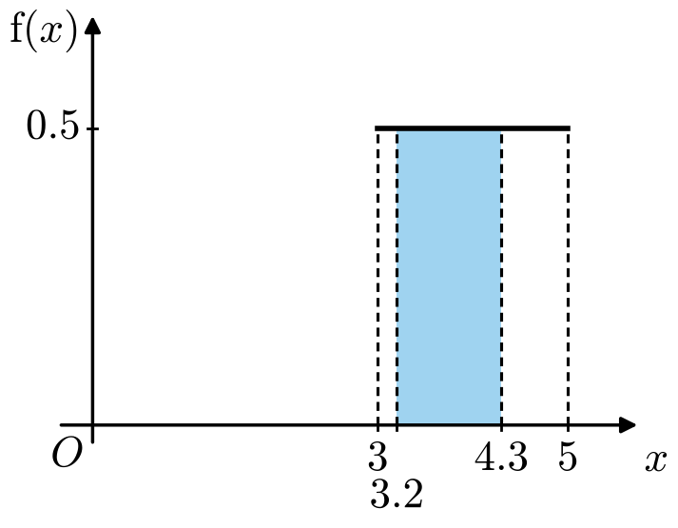
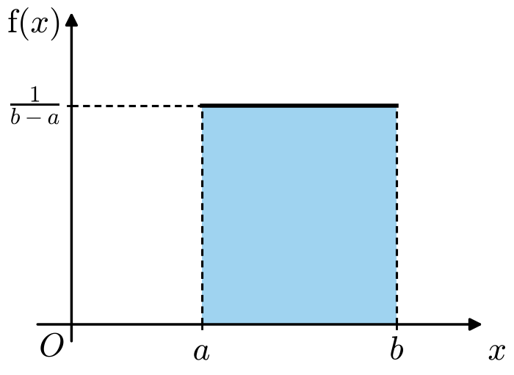
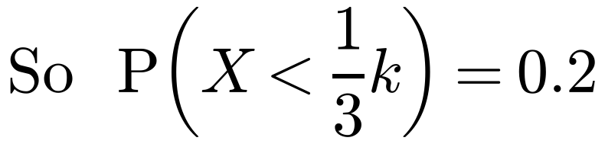
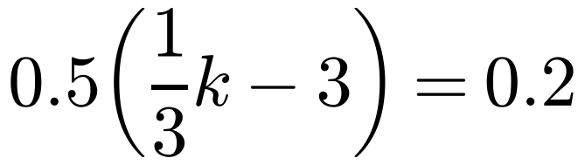
The Continuous Uniform Distribution
A continuous uniform distribution over [a, b] has p.d.f.
The continuous random variable X is uniformly distributed on [3, 5]. Find:
a P(3.2 < X < 4.3) b k such that P(2X < k − X) = 0.2.
a
You write X ~ U[a, b]
P(3.2 < X < 4.3) = (4.3 − 3.2) × 0.5 = 0.55
This is the area of the shaded rectangle. Or use proportion: 1.1 out of a width of 2, so 1.1/2 = 0.55
b 2X < k − X ⇒ X < k/3
The area of the rectangle to the left of k/3 is 0.2
k = 10.2
3E

Slide 4
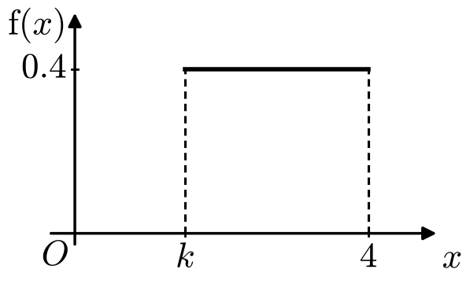
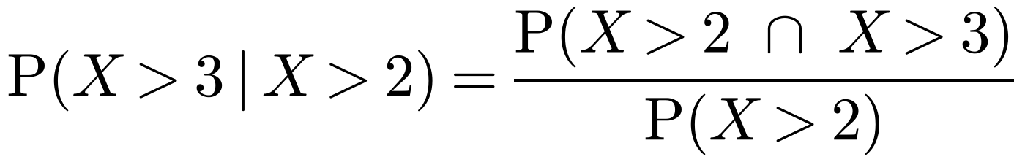
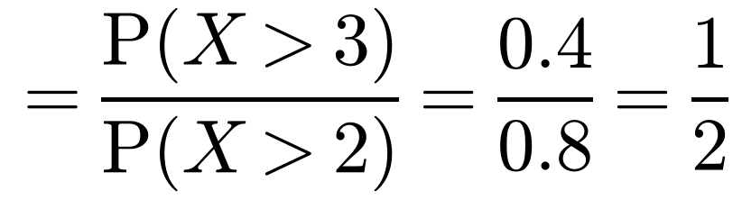
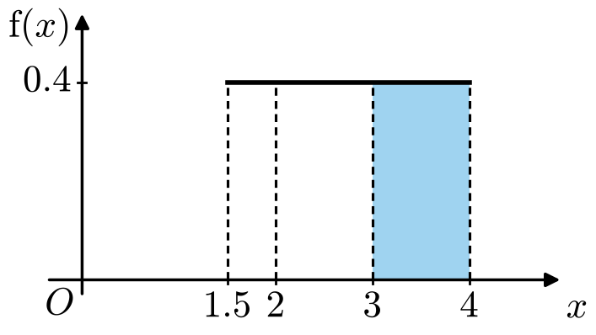
The Continuous Uniform Distribution
A continuous uniform distribution over [a, b] has p.d.f.
The continuous random variable X has p.d.f. as shown in the diagram. Find:
a the value of k b P(3 < X < 3.5)
c P(X > 3 | X > 2)
You write X ~ U[a, b]
a Area = 1: 0.4 × (4 − k) = 1
4 − k = 2.5 ⇒ k = 1.5
b P(3 < X < 3.5) = 0.4 × (3.5 − 3) = 0.2
c
Use P(A | B) = P(A ∩ B) / P(B)
X > 2 and X > 3 is just X > 3
Given X > 2, X is uniformly distributed on [2, 4], so P(X > 3 | X > 2) = 1/2
3E

Slide 5
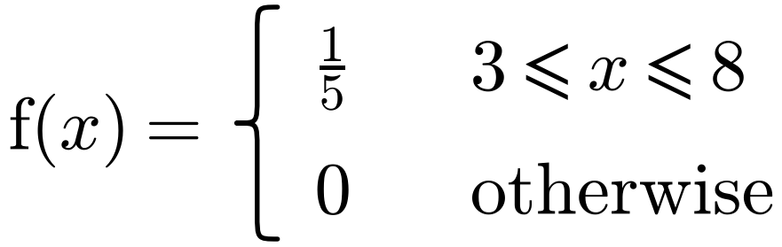
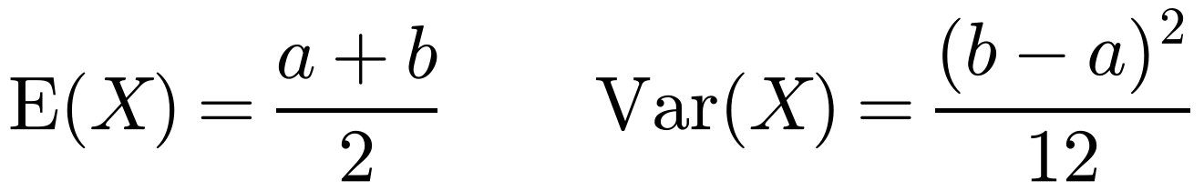
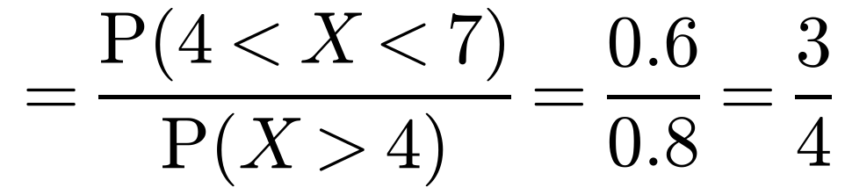
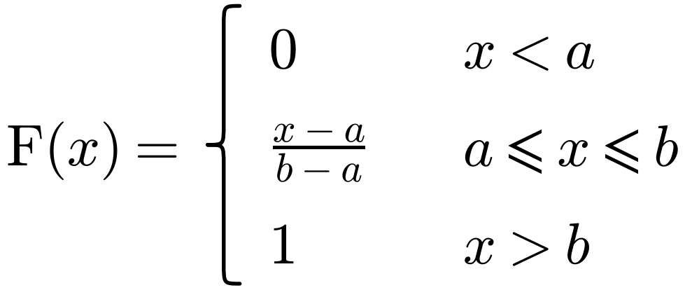
The Continuous Uniform Distribution
A continuous uniform distribution over [a, b] has p.d.f.
The continuous random variable X has probability density function
a Write down the name of this distribution.
You write X ~ U[a, b]
The continuous random variable Y = 12 − 3X. Find:
b E(Y) c P(Y > 0) d P(X < 7 | Y < 0)
a Continuous uniform distribution
b E(Y) = E(12 − 3X) = 12 − 3E(X) = 12 − 3 × 5.5 = −4.5
c P(Y > 0) = P(12 − 3X > 0) = P(4 > X) = 1/5
d
Write both probabilities in terms of X: Y < 0 means X > 4
Use proportion: 3 out of 5 and 4 out of 5
E(X) = (3 + 8)/2 = 5.5. You could also find the distribution of Y: a linear transformation of a uniform distribution is uniform, so Y ~ U[−12, 3]
3E

Slide 6
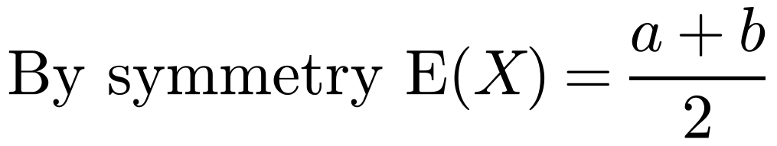
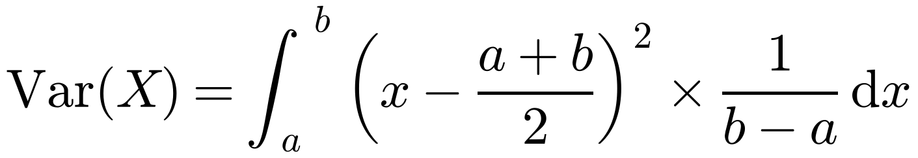
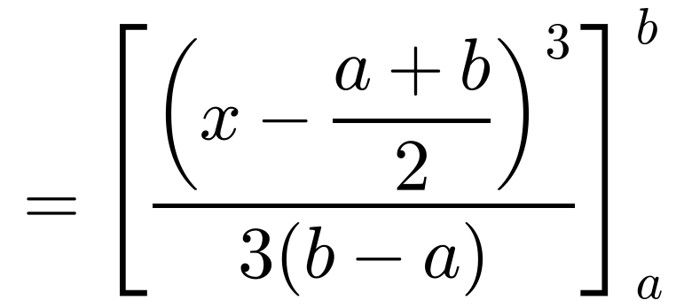
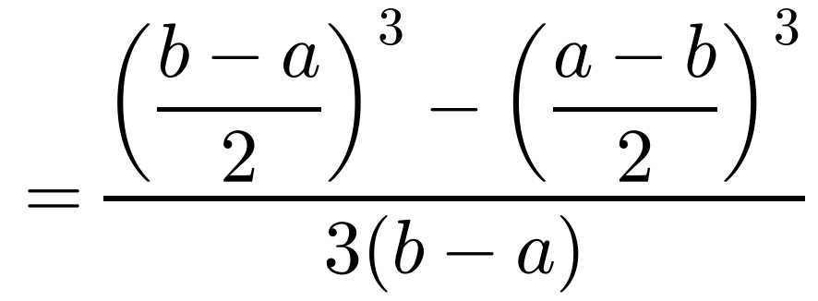
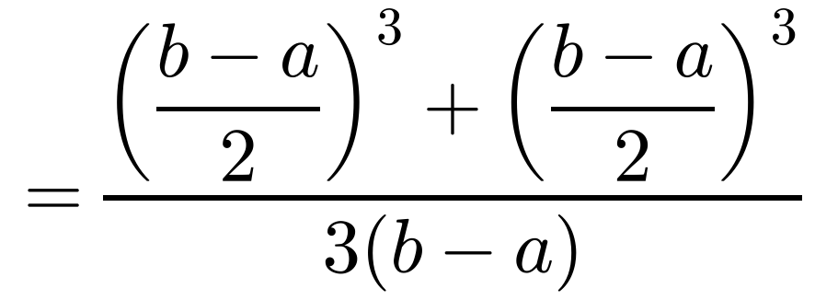
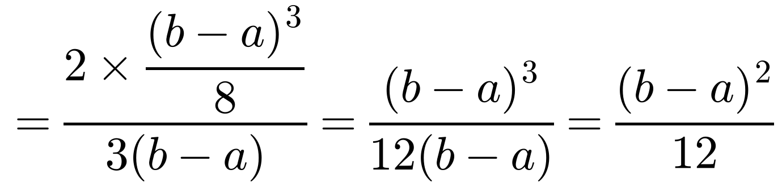
The Continuous Uniform Distribution
A continuous uniform distribution over [a, b] has p.d.f.
The continuous random variable X has probability density function
Find: a E(X) b Var(X) c F(x)
You write X ~ U[a, b]
a
b
Var(X) = ∫ (x − µ)² f(x) dx. E(X²) − (E(X))² is harder here
Using ∫ (x + c)ⁿ dx = (x + c)ⁿ⁺¹/(n + 1)
Using −(a − b)³ = (b − a)³
3E

Slide 7
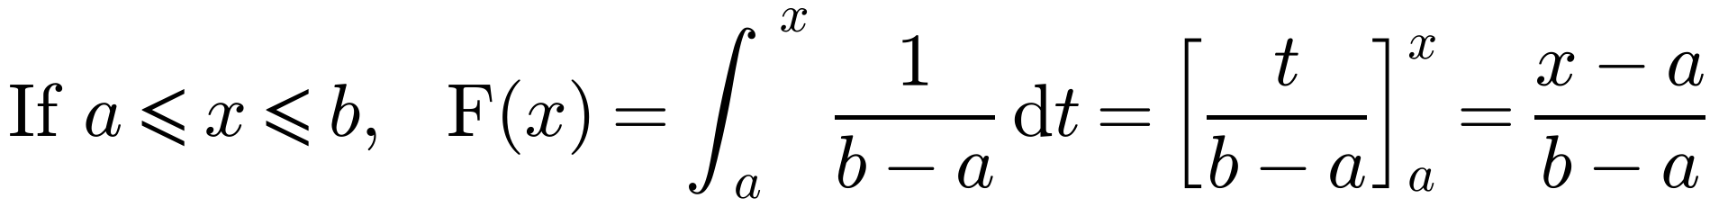
The Continuous Uniform Distribution
A continuous uniform distribution over [a, b] has p.d.f.
The continuous random variable X has probability density function
Find: a E(X) b Var(X) c F(x)
You write X ~ U[a, b]
c
The c.d.f. of a uniform distribution is not in the formulae booklet, so learn it or derive it like this
For a continuous uniform distribution U[a, b]:
Both are in the formulae booklet, but you should be able to derive them
3E

Slide 8
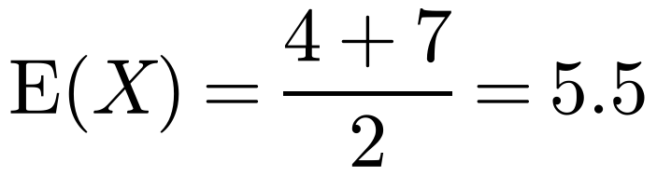
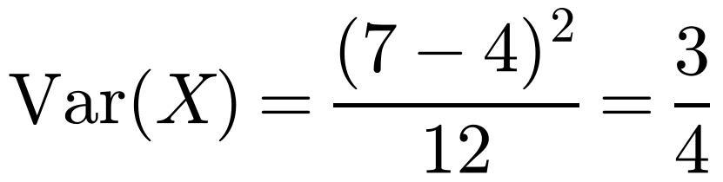
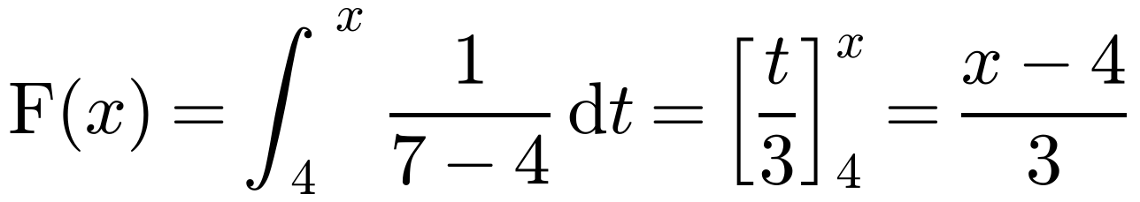
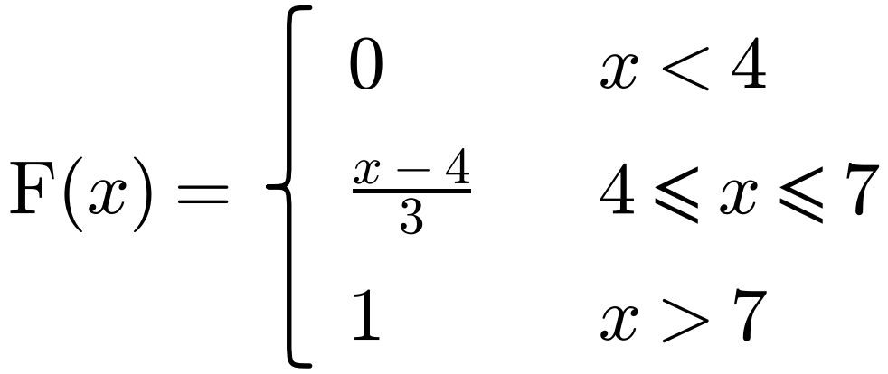
The Continuous Uniform Distribution
A continuous uniform distribution over [a, b] has p.d.f.
The continuous random variable X is uniformly distributed over the interval [4, 7]. Find:
a E(X) b Var(X) c the cumulative distribution function of X, for all x.
a
You write X ~ U[a, b]
b
c
You can write this down straight away if you learn the formula for F(x)
3E

Slide 9
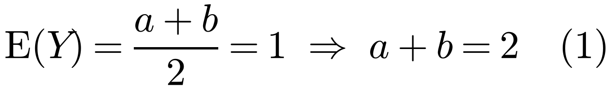
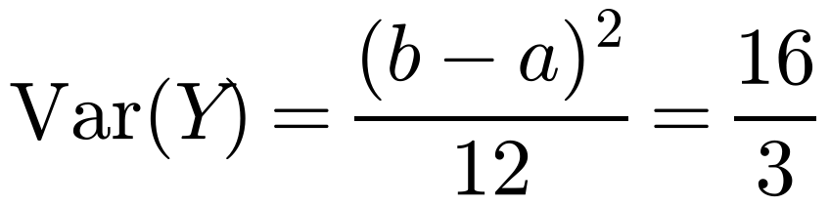
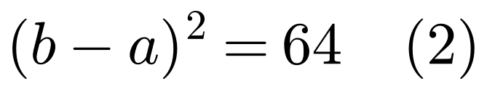
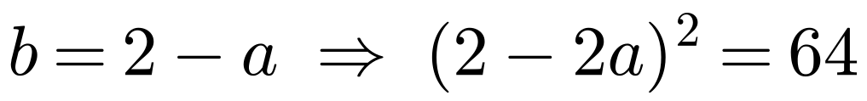
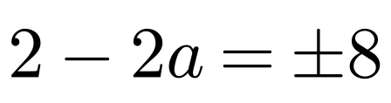
The Continuous Uniform Distribution
A continuous uniform distribution over [a, b] has p.d.f.
The continuous random variable Y is uniformly distributed over the interval [a, b]. Given that E(Y) = 1 and Var(Y) = 16/3, find the value of a and the value of b.
Use the formulae for the mean and variance of a continuous uniform distribution to form simultaneous equations in a and b
You write X ~ U[a, b]
Solving (1) and (2) simultaneously:
2 − 2a = 8 ⇒ a = −3, b = 5 2 − 2a = −8 ⇒ a = 5, b = −3
Since a < b, a = −3 and b = 5
3E

Slide 10
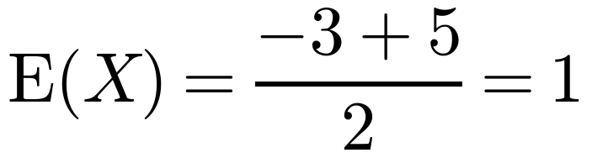
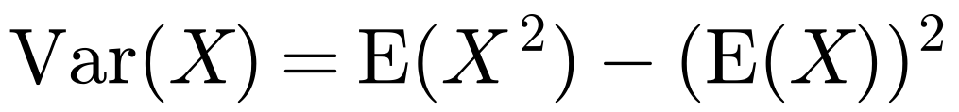
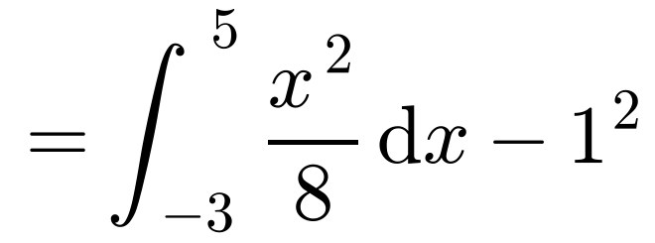
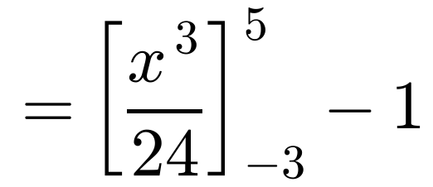
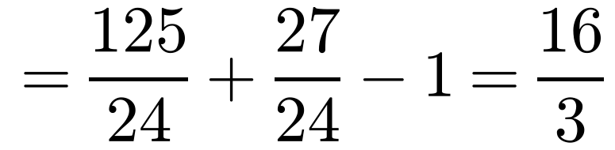
The Continuous Uniform Distribution
A continuous uniform distribution over [a, b] has p.d.f.
The continuous random variable X is uniformly distributed over the interval [−3, 5].
a Write down E(X).
b Use integration to find the variance of X.
You write X ~ U[a, b]
a
b
f(x) = 1/(5 − (−3)) = 1/8
You could also use ∫ (x − 1)²/8 dx from −3 to 5 = [(x − 1)³/24] = 4³/24 − (−4)³/24 = 16/3
Check: (5 − (−3))²/12 = 64/12 = 16/3
3E

