Slide 1
Continuous Distributions
Further Statistics 2 Chapter 3
Westie's Workshop

Slide 2
Teachings for Exercise 3D

Slide 3
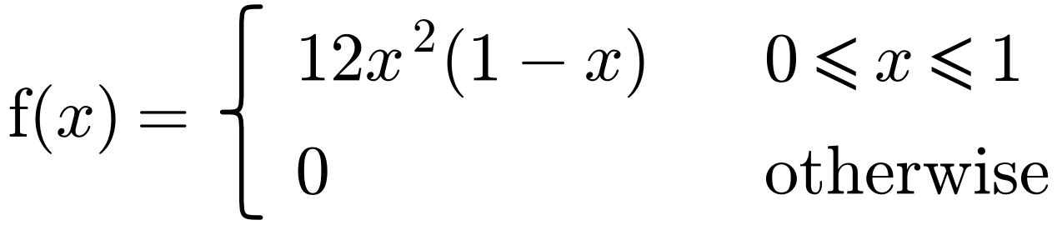
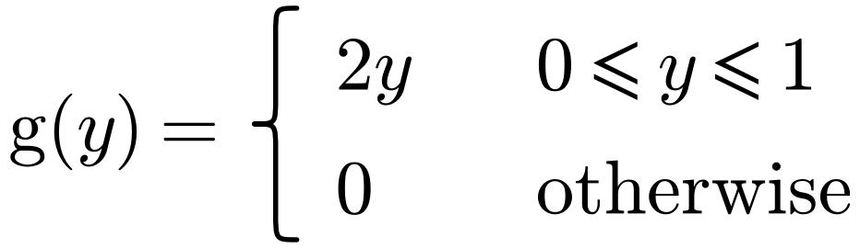
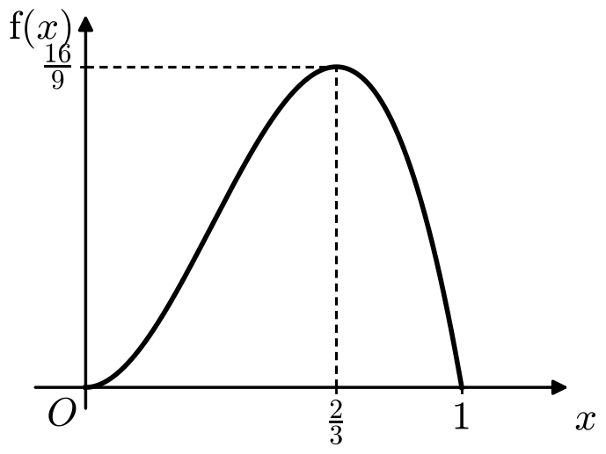
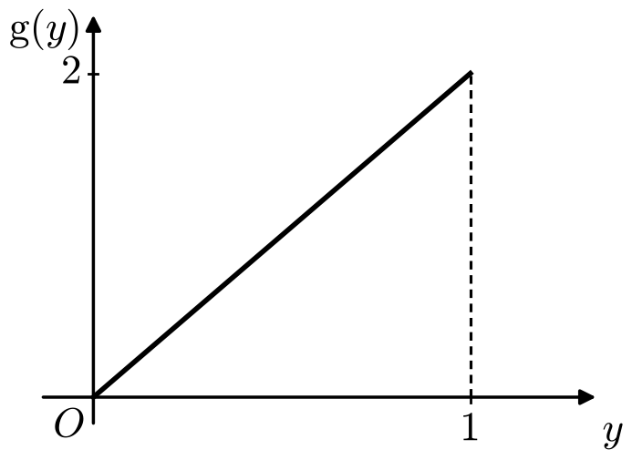
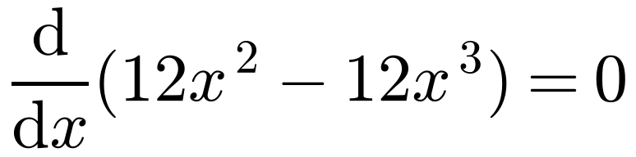
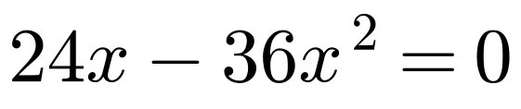
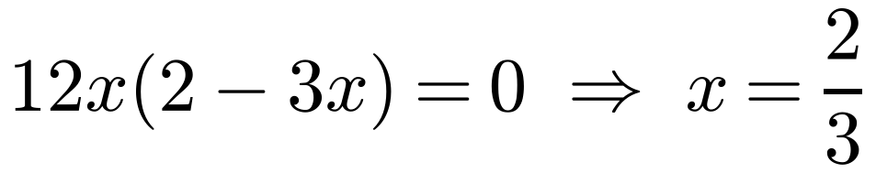
Mode, Median, Percentiles and Skewness
The mode of a continuous random variable is the value of x for which the p.d.f. is a maximum
The random variables X and Y have probability density functions f(x) and g(y) respectively.
Always sketch the p.d.f. first
If the maximum is a turning point, solve f′(x) = 0
Find the mode of: a X b Y
a
b
If f(x) is increasing (or decreasing) across its whole range, the mode is at an end point
The mode does not need to be at or near the middle of the distribution
Mode = 1
g′(y) = 2 > 0, so g(y) is strictly increasing on [0, 1] and 0 elsewhere, so the mode must be 1
Mode = 2/3
3D

Slide 4
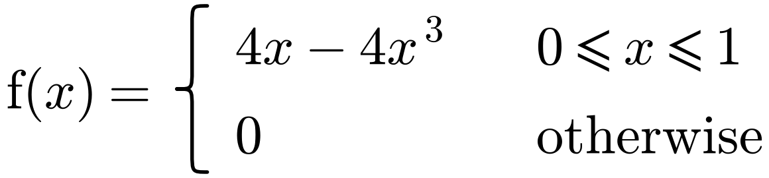
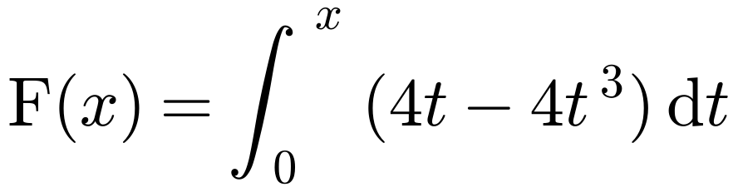
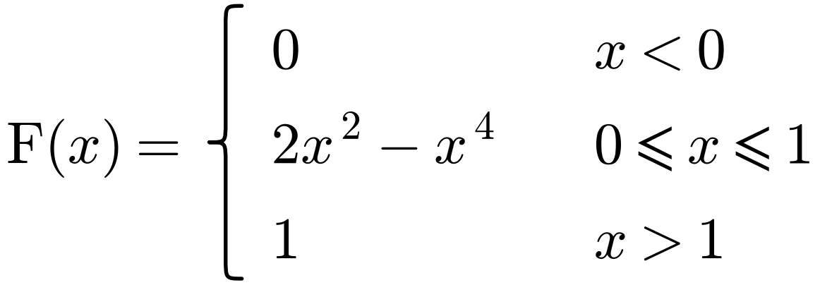
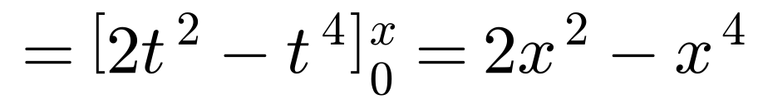
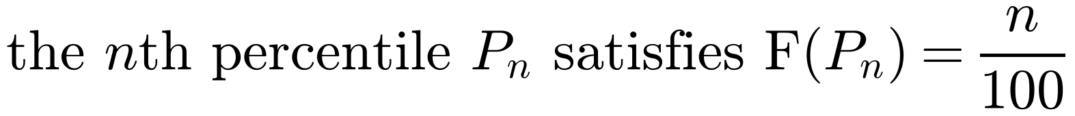
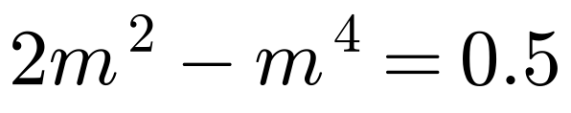
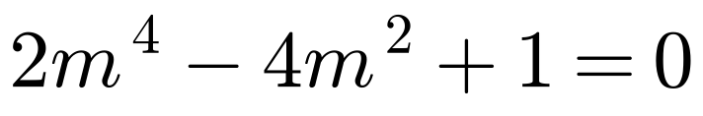
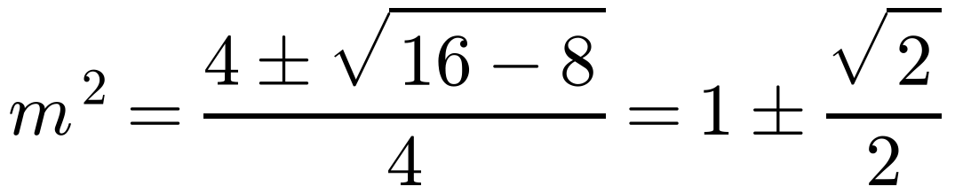
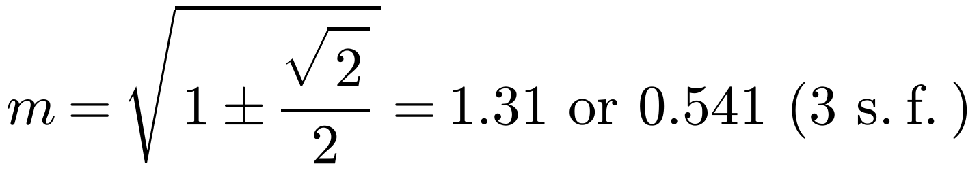
Mode, Median, Percentiles and Skewness
If X has c.d.f. F(x):
A continuous random variable X has probability density function
the median m satisfies F(m) = 0.5
the lower quartile Q₁ satisfies F(Q₁) = 0.25
Find: a the c.d.f. of X b the median value of X.
a
the upper quartile Q₃ satisfies F(Q₃) = 0.75
b
Solve F(m) = 0.5
For a symmetrical distribution, the median equals the mean
This is a quadratic equation in m²
Use the quadratic formula
If F(x) is piecewise, find F at the boundaries first to see which piece to use
Median = 0.541 (3 s.f.)
Select the value in the range 0 ≤ x ≤ 1
3D

Slide 5
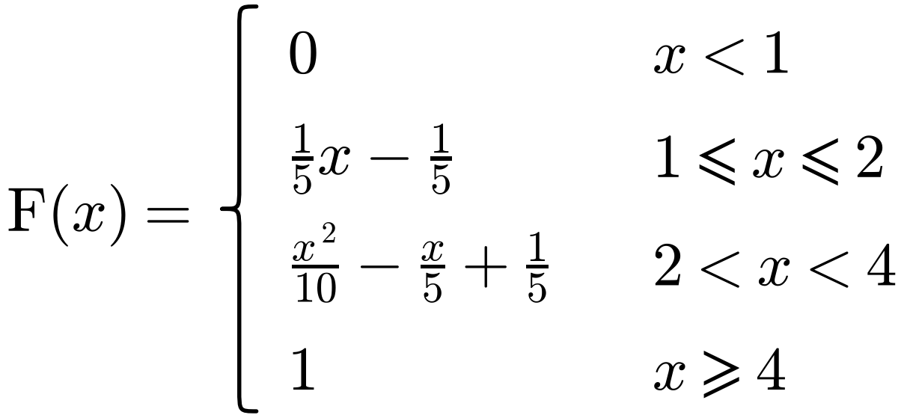
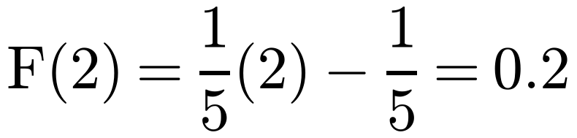
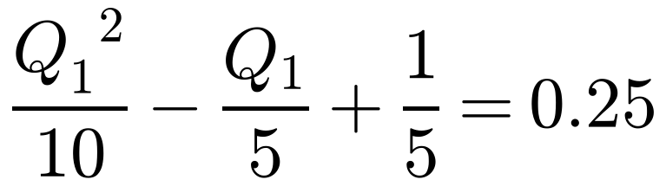
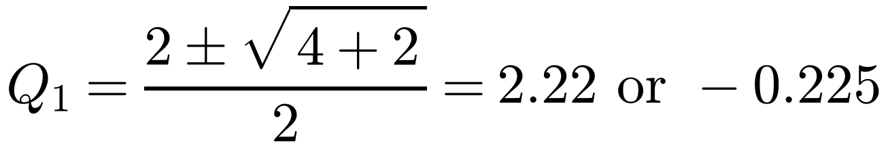
Mode, Median, Percentiles and Skewness
If X has c.d.f. F(x):
A continuous random variable X has the cumulative distribution function
the median m satisfies F(m) = 0.5
the lower quartile Q₁ satisfies F(Q₁) = 0.25
the upper quartile Q₃ satisfies F(Q₃) = 0.75
Find: a the interquartile range b the 10th percentile.
a
F(2) = 0.2, so both quartiles lie in the third section of F(x)
For a symmetrical distribution, the median equals the mean
Lower quartile:
If F(x) is piecewise, find F at the boundaries first to see which piece to use
Multiply through by 10
Q₁ = 2.22 (3 s.f.)
Select the value in the range 2 < x < 4
3D

Slide 6
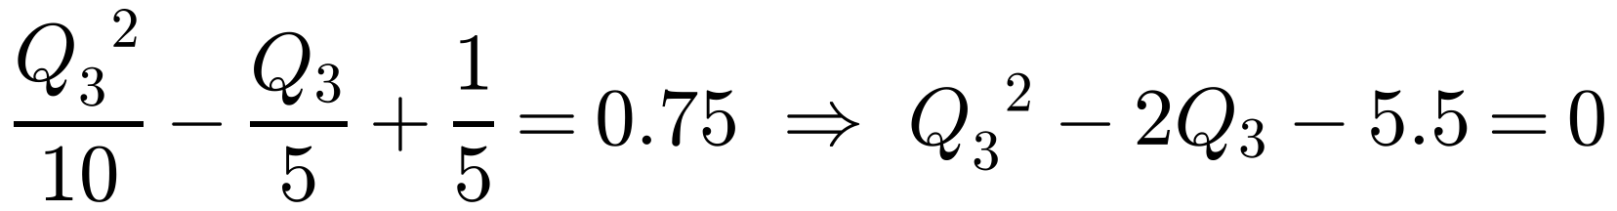
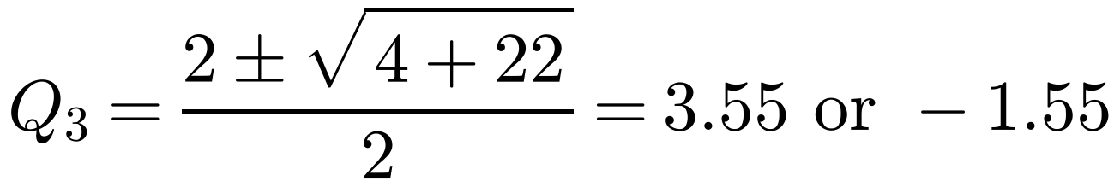
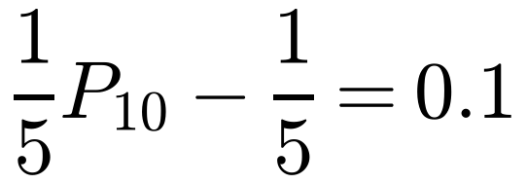
Mode, Median, Percentiles and Skewness
If X has c.d.f. F(x):
A continuous random variable X has the cumulative distribution function
the median m satisfies F(m) = 0.5
the lower quartile Q₁ satisfies F(Q₁) = 0.25
the upper quartile Q₃ satisfies F(Q₃) = 0.75
Find: a the interquartile range b the 10th percentile.
Upper quartile:
For a symmetrical distribution, the median equals the mean
If F(x) is piecewise, find F at the boundaries first to see which piece to use
Q₃ = 3.55 (3 s.f.)
Select the value in the range 2 < x < 4
Interquartile range = 3.5495… − 2.2247… = 1.32 (3 s.f.)
IQR = Q₃ − Q₁. Use unrounded values: 3.55 − 2.22 would give 1.33
b
F(2) = 0.2, so the 10th percentile is in the second section of F(x)
P₁₀ = 1.5
Check that P₁₀ < Q₁
3D

Slide 7
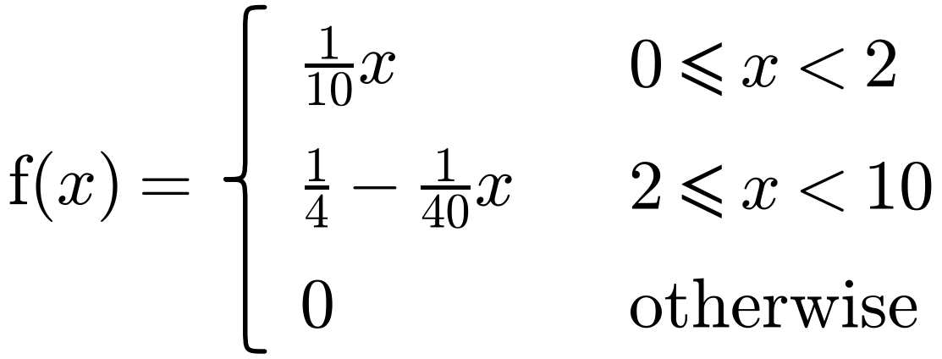
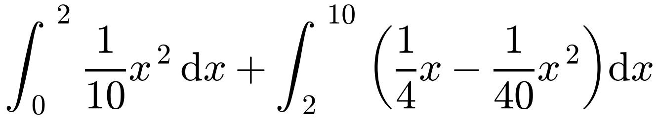
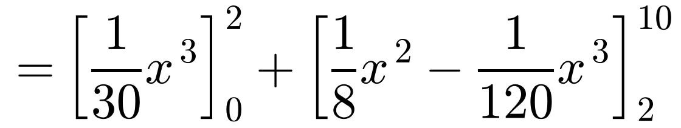
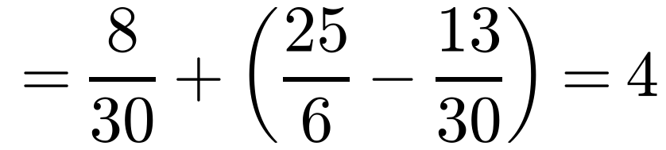
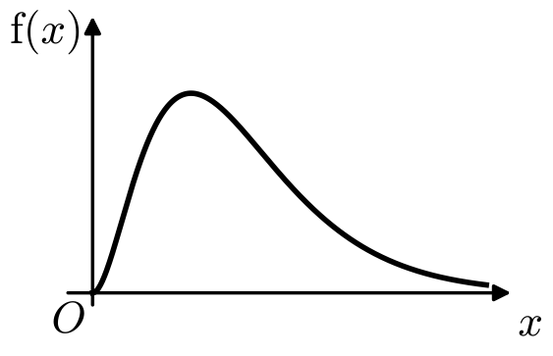
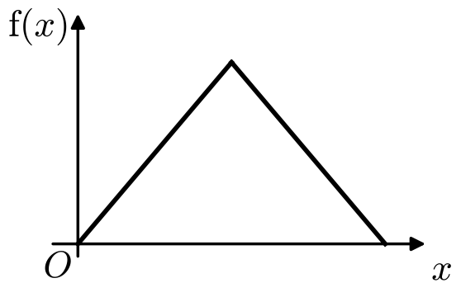
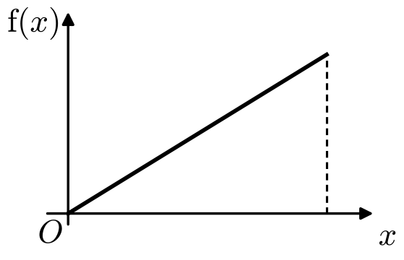
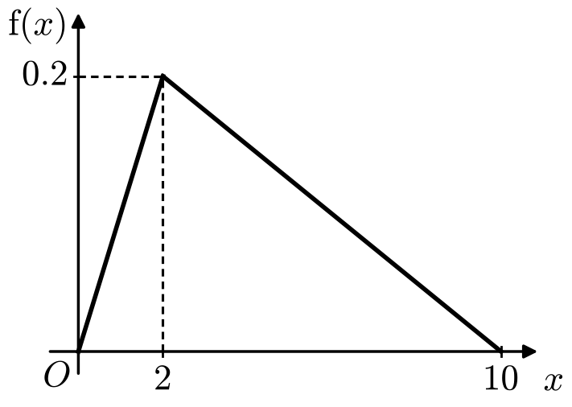
Mode, Median, Percentiles and Skewness
Skewness describes the symmetry of a distribution
A continuous random variable X has probability density function
Positive skew: mode < median < mean
Negative skew: mean < median < mode
a Find: i the mean of X ii the mode of X.
Comparing one pair of measures, or using a sketch, is enough to justify the skewness
b Comment on the skewness of the distribution.
a i
Integrate each section separately between the right limits
Correction: the book prints 8/3 here and gets 32/5. The first integral is 8/30, so the mean is 4
Mean of X = 4
ii
When the sections are linear, the mode is easiest to find from a sketch
Mode = 2
positive skew
no skew
negative skew
From the sketch, the p.d.f. is more dense for smaller values of x
b Mode < mean, so the distribution is positively skewed
3D

