Slide 1
Continuous Distributions
Further Statistics 2 Chapter 3
Westie's Workshop

Slide 2
Teachings for Exercise 3C

Slide 3
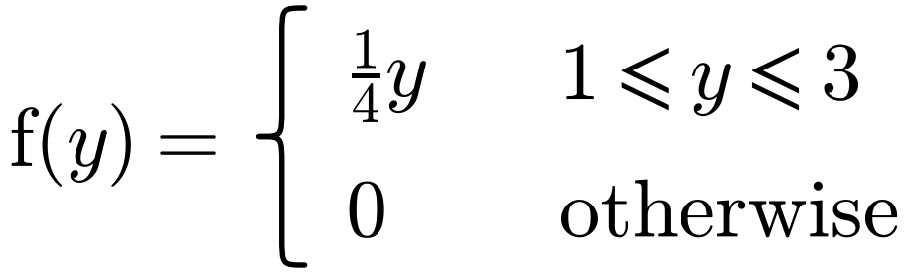
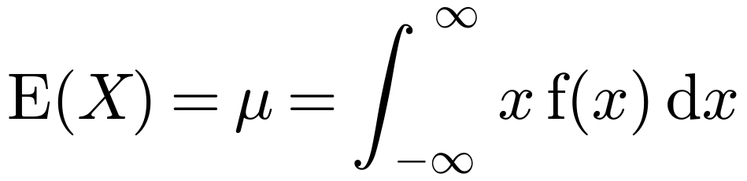
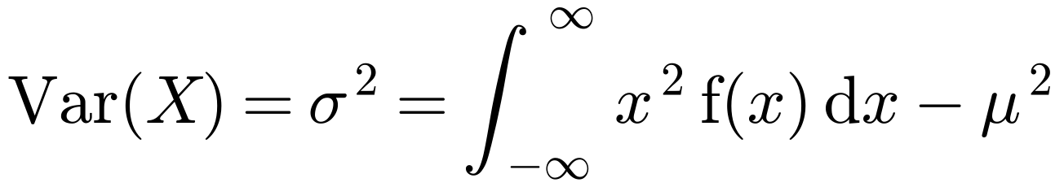
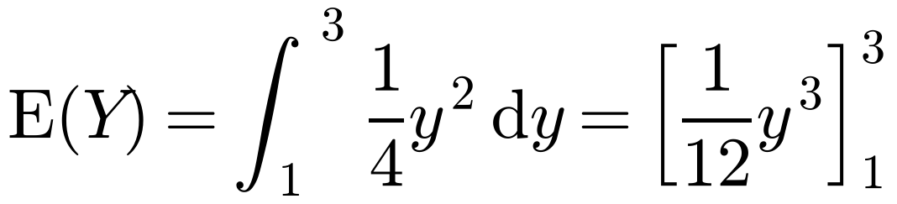
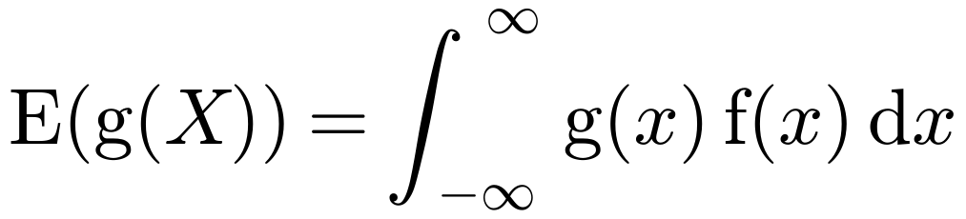
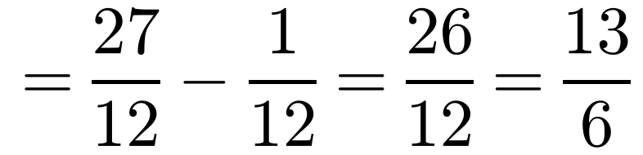
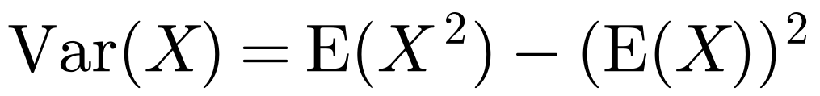
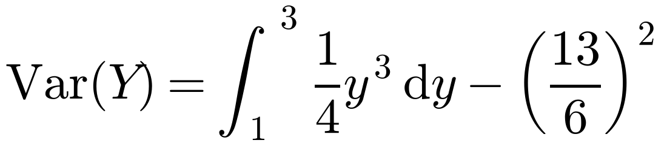
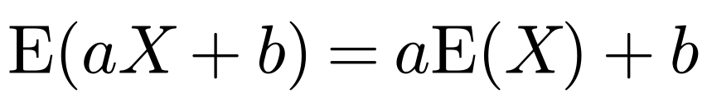
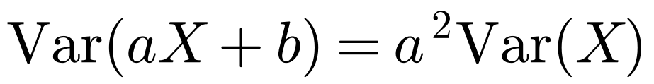
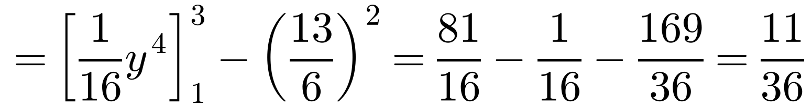
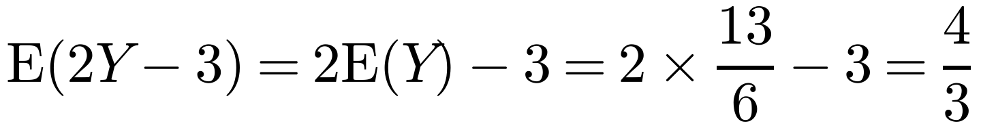
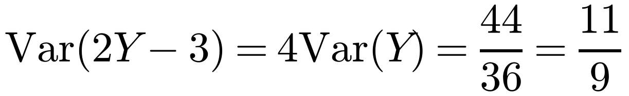
Mean and Variance of a Continuous Distribution
If X is a continuous random variable with p.d.f. f(x):
A random variable Y has probability density function
Find: a E(Y) b Var(Y) c E(2Y − 3) d Var(2Y − 3)
a
y f(y) = y × ¼y
If an exact answer is needed, leave it as a fraction
b
y² f(y) = y² × ¼y
These are the same as for discrete random variables, with Σ replaced by ∫
c
E(aX + b) = aE(X) + b
d
Var(aX + b) = a²Var(X)
3C

Slide 4
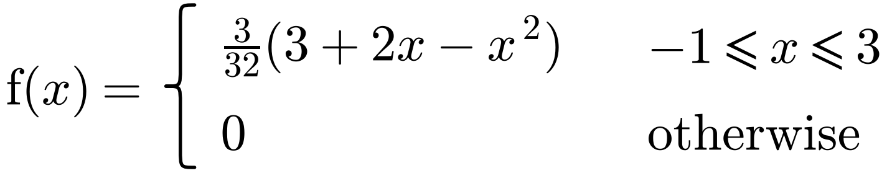
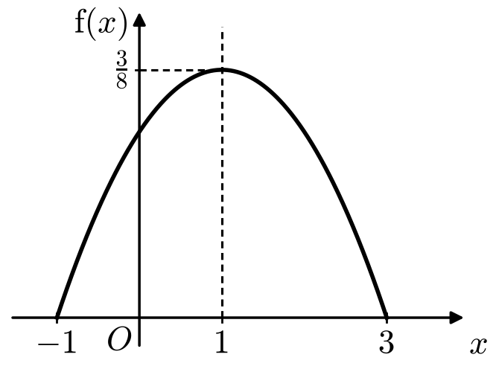
Mean and Variance of a Continuous Distribution
If X is a continuous random variable with p.d.f. f(x):
A random variable X has probability density function
a Sketch the probability density function.
b Find E(X).
a
f(x) = (3/32)(3 − x)(1 + x): a ∩-shaped parabola with roots −1 and 3, maximum 3/8 at x = 1
If the p.d.f. is symmetric about x = a, then E(X) = a
b By symmetry E(X) = 1
You could integrate (3/32)∫ x(3 + 2x − x²) dx from −1 to 3, but symmetry saves time
3C

Slide 5
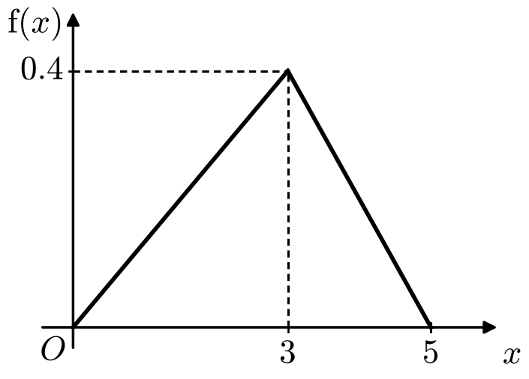
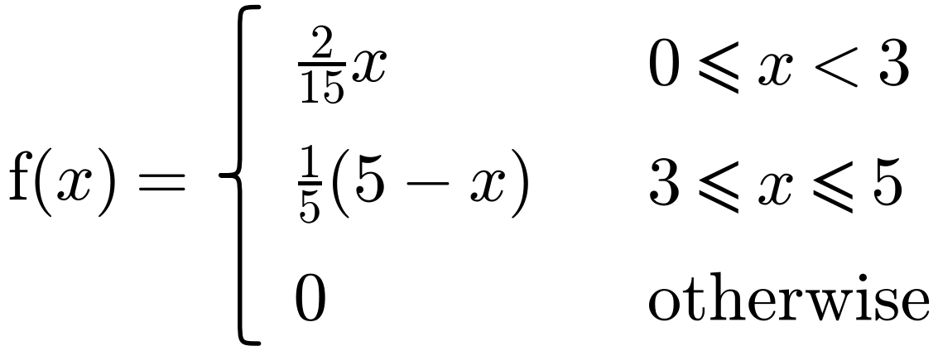
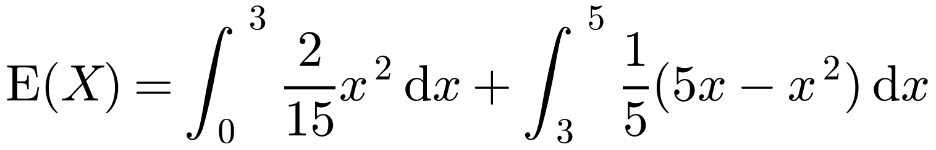
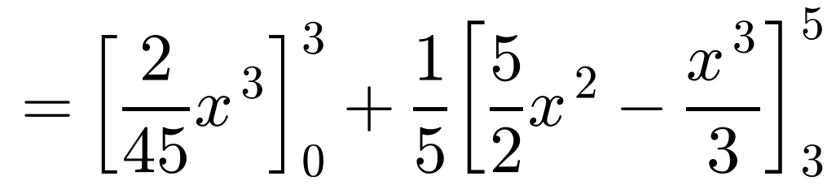
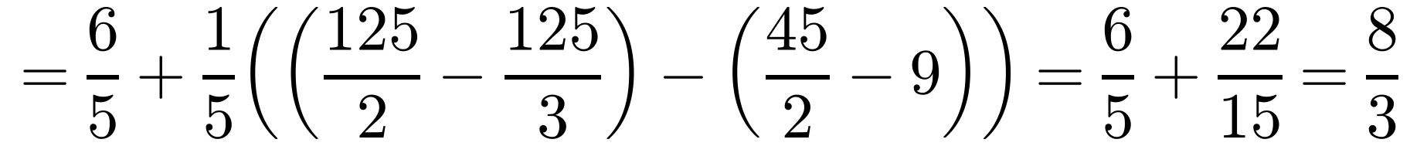
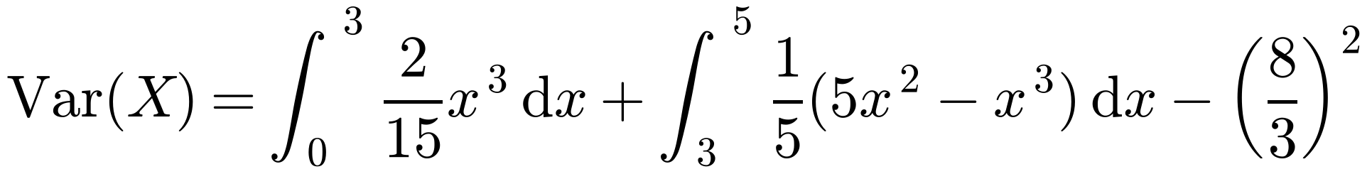
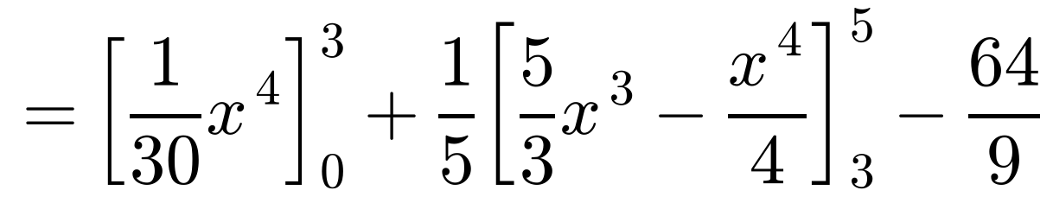
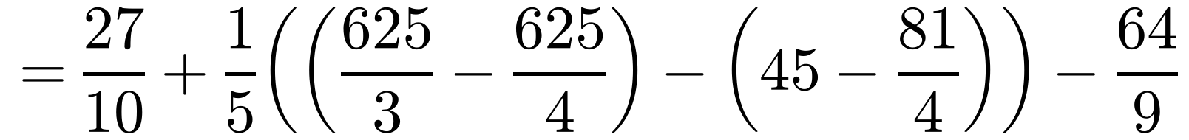
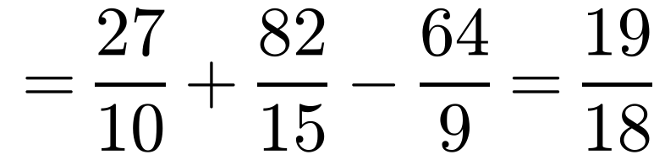
Mean and Variance of a Continuous Distribution
If X is a continuous random variable with p.d.f. f(x):
The random variable X has probability density function
Find: a E(X) b Var(X)
The p.d.f. is not symmetrical, so you need to integrate
a
b
For a piecewise p.d.f., integrate each part separately, then add
3C

Slide 6
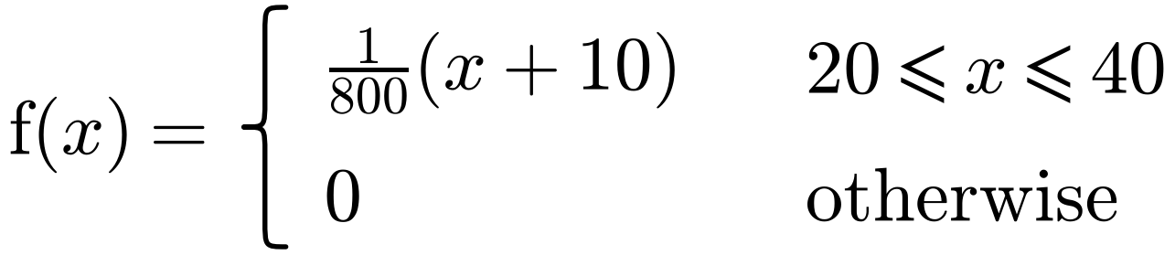
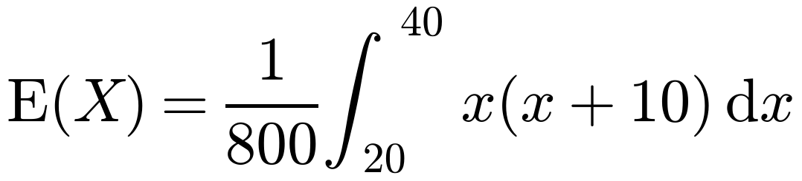
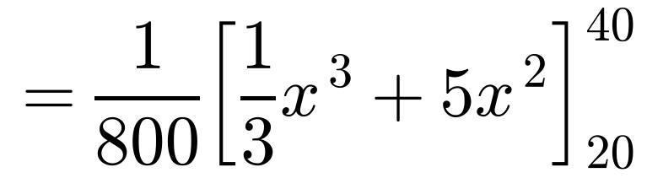
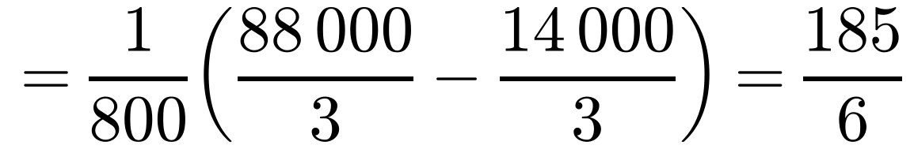
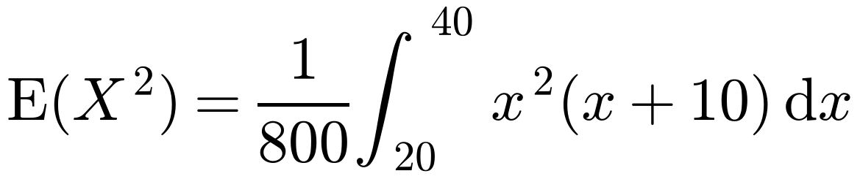
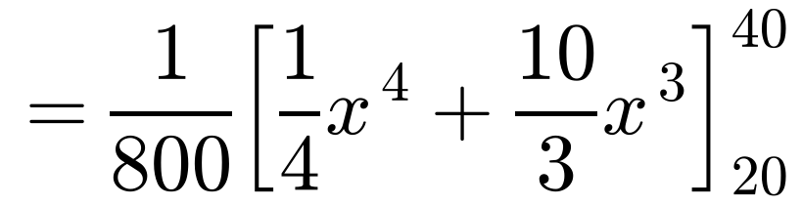
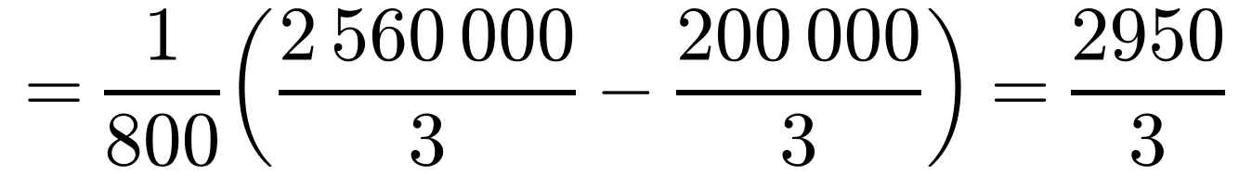
Mean and Variance of a Continuous Distribution
If X is a continuous random variable with p.d.f. f(x):
In a block-building video game, a cube of side length X pixels is randomly generated. X is a continuous random variable with probability density function
a Find: i E(X) ii E(X²) iii Var(X)
b Find the expected volume of the cube.
a i
ii
E(X²) = ∫ x² f(x) dx
3C

Slide 7
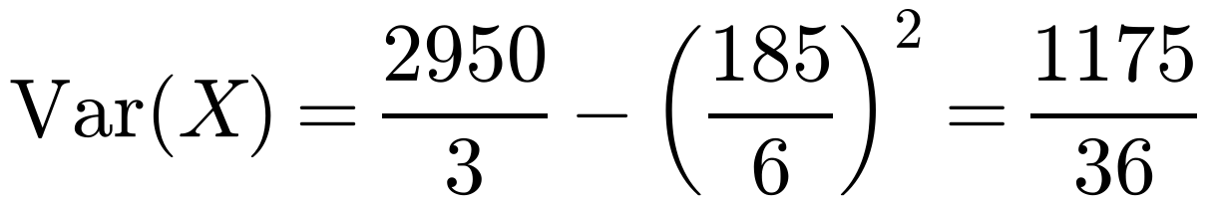

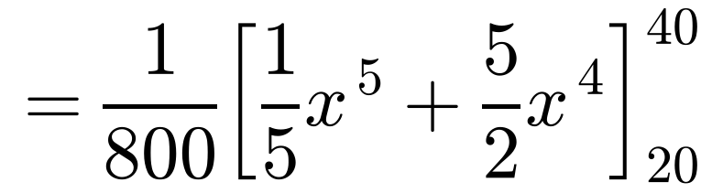
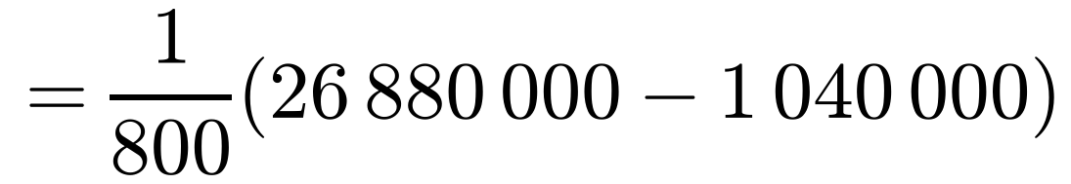
Mean and Variance of a Continuous Distribution
If X is a continuous random variable with p.d.f. f(x):
In a block-building video game, a cube of side length X pixels is randomly generated. X is a continuous random variable with probability density function
a Find: i E(X) ii E(X²) iii Var(X)
b Find the expected volume of the cube.
iii
You already know E(X) and E(X²), so use Var(X) = E(X²) − (E(X))²
b
The expected volume is E(X³). This is not the same as (E(X))³
= 32 300
The expected volume of the cube is 32 300 cubic pixels
3C

