Slide 1
Continuous Distributions
Further Statistics 2 Chapter 3
Westie's Workshop

Slide 2
Teachings for Exercise 3B

Slide 3
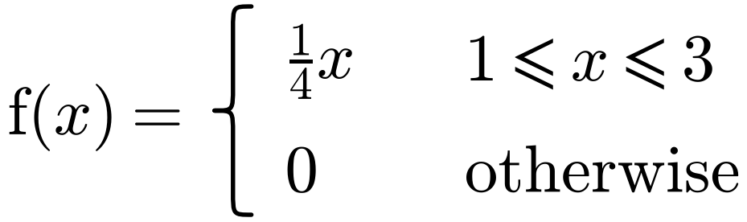
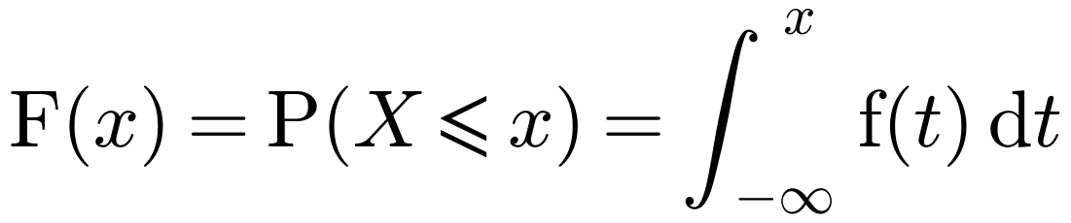
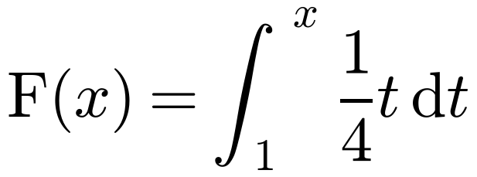
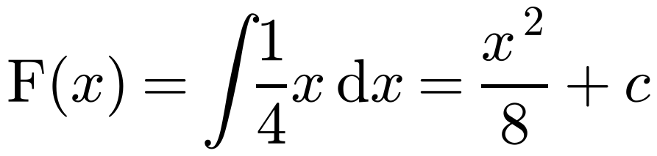
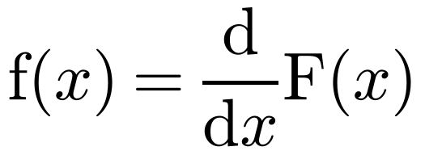
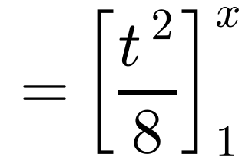
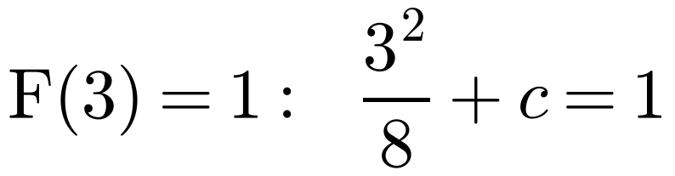
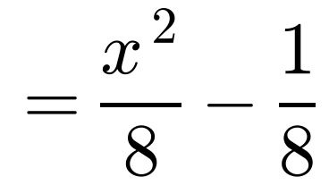
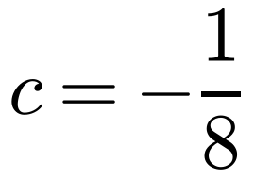
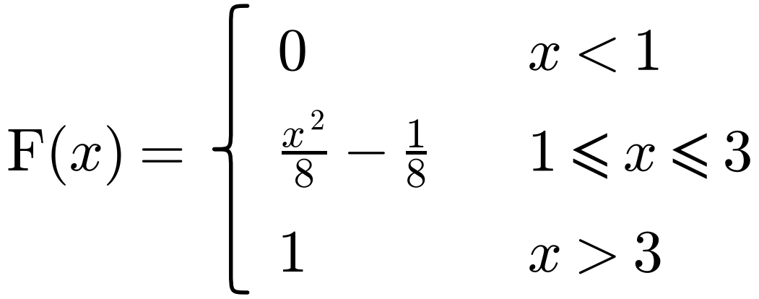
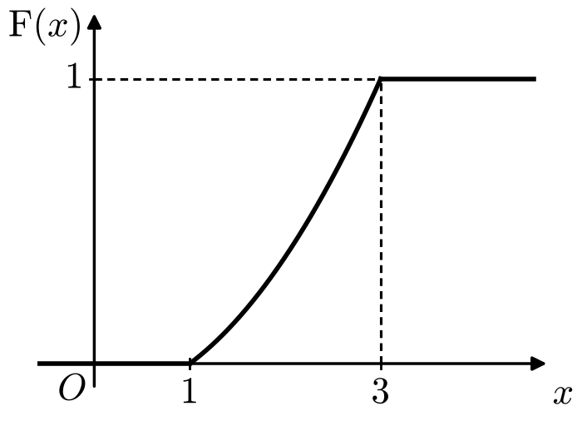
The Cumulative Distribution Function
For a random variable X, the cumulative distribution function (c.d.f.) is F(x) = P(X ≤ x)
The random variable X has probability density function
Find F(x).
This is the area under the p.d.f. to the left of x. Use t inside the integral so it is not confused with the limit x
Method 1
Method 2
Integrate the p.d.f. to get the c.d.f.; differentiate the c.d.f. to get the p.d.f.
Always define F(x) for all x ∈ ℝ: it is 0 below the range and 1 above it
The p.d.f. is 0 for x < 1, so 1 can be the lower limit. Use F(1) = 0 or F(3) = 1 to find c.
3B

Slide 4
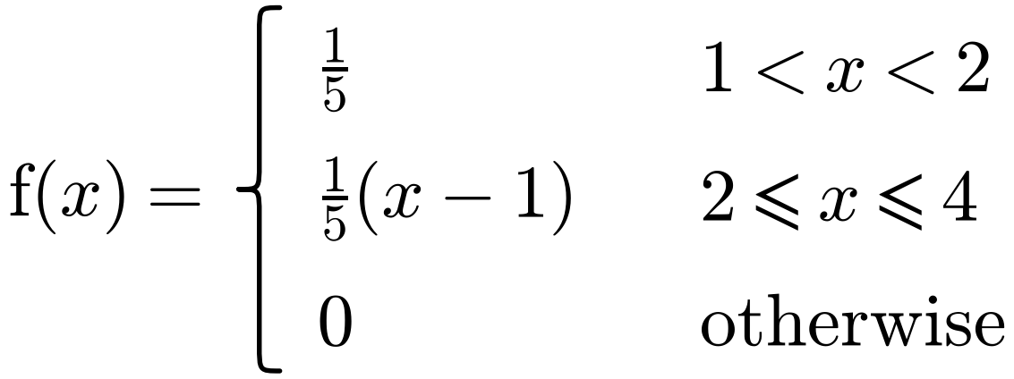
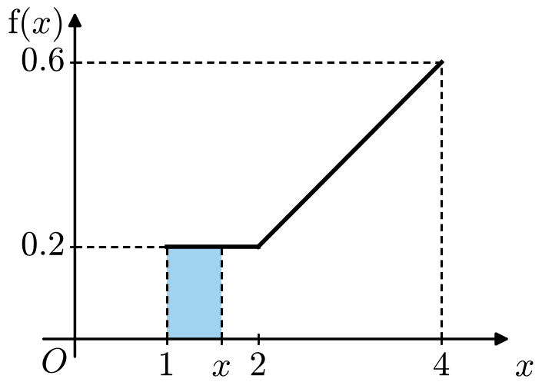
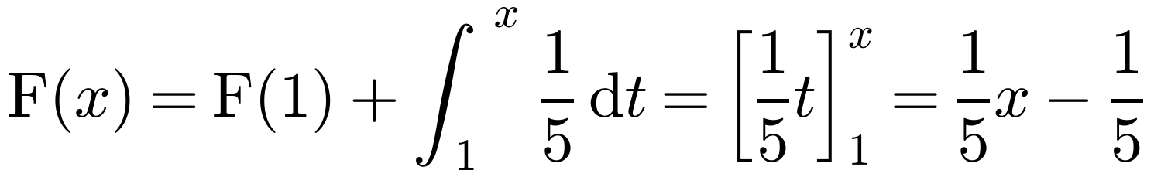
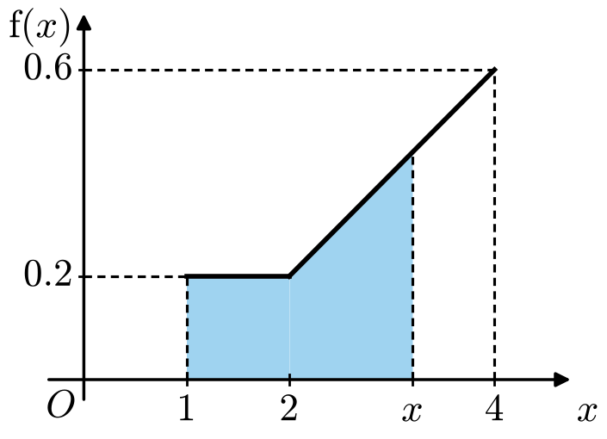
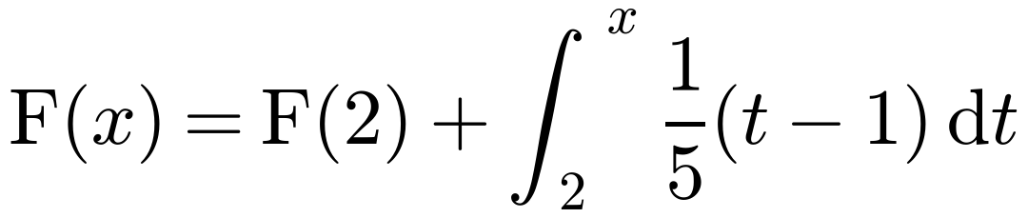
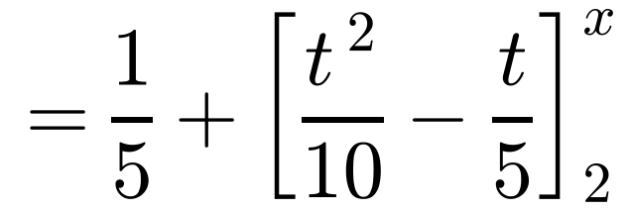
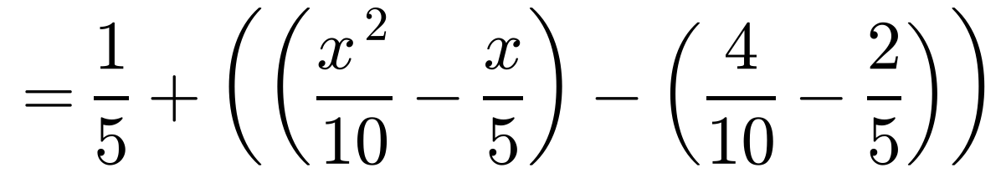
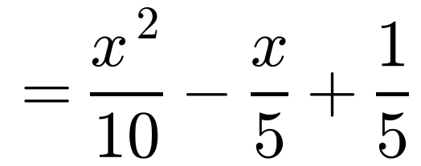
The Cumulative Distribution Function
For a random variable X, the cumulative distribution function (c.d.f.) is F(x) = P(X ≤ x)
The random variable X has probability density function
Specify fully the cumulative distribution function of X.
This is the area under the p.d.f. to the left of x. Use t inside the integral so it is not confused with the limit x
Method 1
If x ≤ 1: F(x) = 0, so F(1) = 0
If 1 < x < 2:
Integrate the p.d.f. to get the c.d.f.; differentiate the c.d.f. to get the p.d.f.
so F(2) = 1/5
Always define F(x) for all x ∈ ℝ: it is 0 below the range and 1 above it
If 2 ≤ x ≤ 4:
The c.d.f. is cumulative: for each section, add on the value of F at the end of the previous section
3B

Slide 5
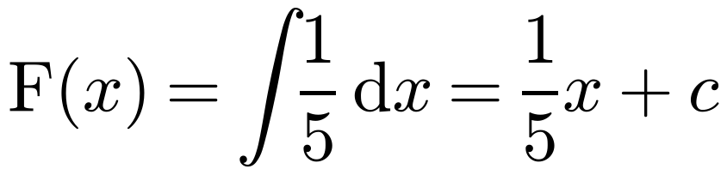
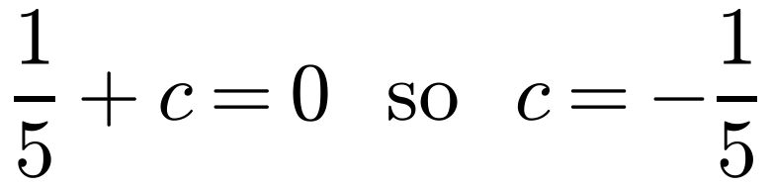
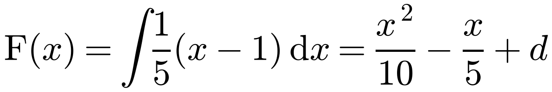
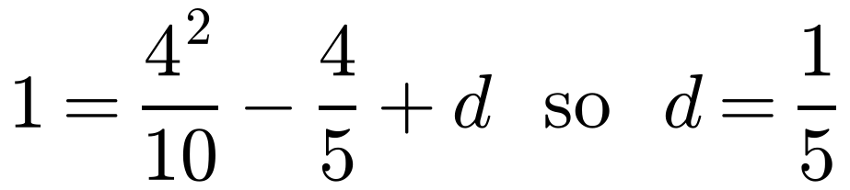
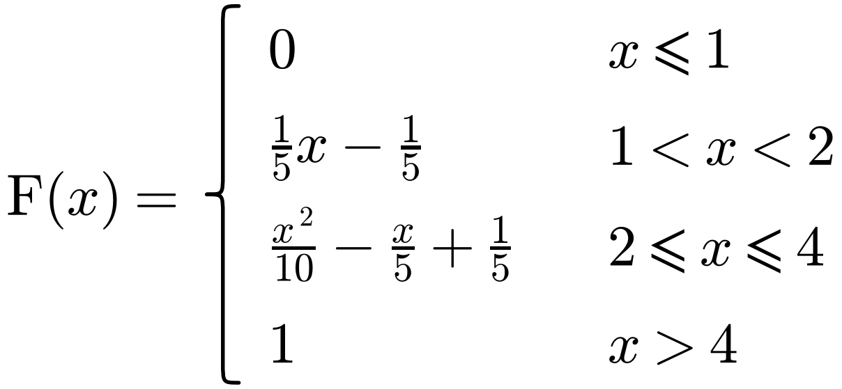
The Cumulative Distribution Function
For a random variable X, the cumulative distribution function (c.d.f.) is F(x) = P(X ≤ x)
The random variable X has probability density function
Specify fully the cumulative distribution function of X.
This is the area under the p.d.f. to the left of x. Use t inside the integral so it is not confused with the limit x
Method 2
If 1 < x < 2:
Integrate the p.d.f. to get the c.d.f.; differentiate the c.d.f. to get the p.d.f.
For the first part use F(1) = 0
If 2 ≤ x ≤ 4:
Always define F(x) for all x ∈ ℝ: it is 0 below the range and 1 above it
For the second part use F(4) = 1
Write the c.d.f. in full: define F(x) for all values of x ∈ ℝ
3B

Slide 6
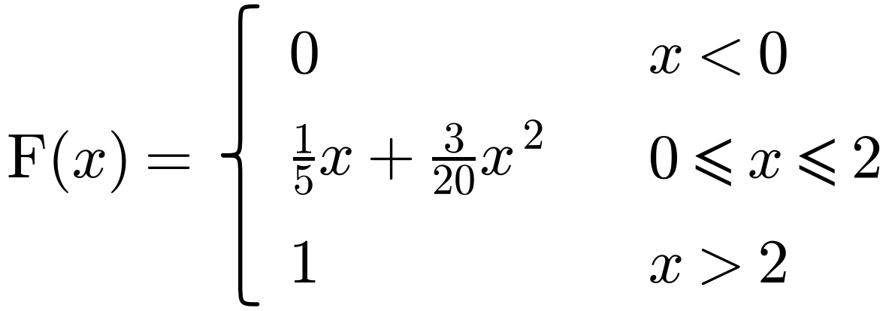
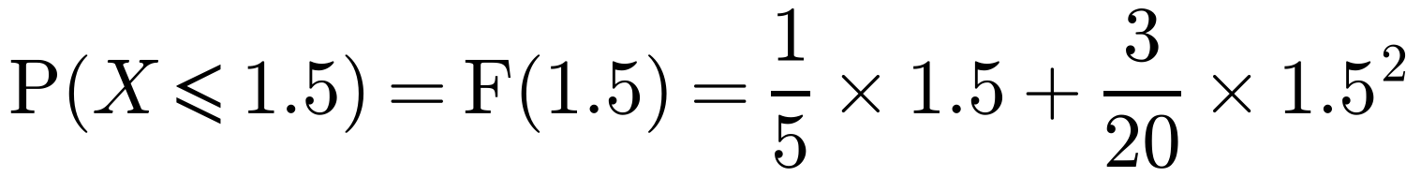
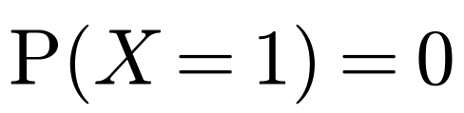
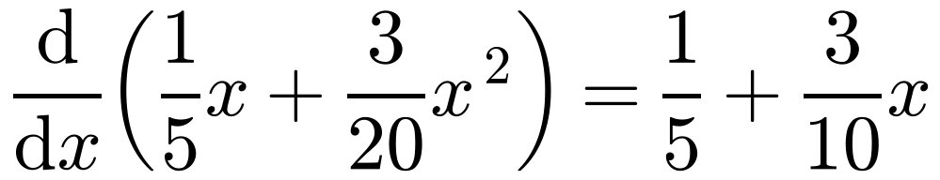
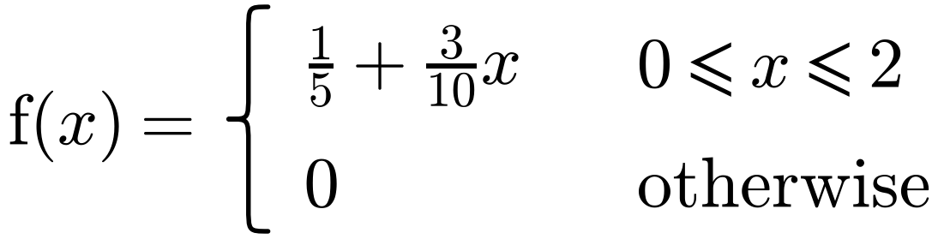
The Cumulative Distribution Function
For a random variable X, the cumulative distribution function (c.d.f.) is F(x) = P(X ≤ x)
The random variable X has cumulative distribution function
Find: a P(X ≤ 1.5) b P(0.5 ≤ X ≤ 1.5) c P(X = 1)
This is the area under the p.d.f. to the left of x. Use t inside the integral so it is not confused with the limit x
d the probability density function, f(x).
a
Using F(x) = P(X ≤ x)
= 0.6375
Integrate the p.d.f. to get the c.d.f.; differentiate the c.d.f. to get the p.d.f.
b
P(0.5 ≤ X ≤ 1.5) = P(X ≤ 1.5) − P(X ≤ 0.5)
= 0.6375 − 0.1375 = 0.5
Always define F(x) for all x ∈ ℝ: it is 0 below the range and 1 above it
c
For a continuous random variable P(X = x) = 0
d
Use f(x) = dF/dx
Where F(x) is constant (0 or 1), f(x) = 0
3B

