Slide 1
Continuous Distributions
Further Statistics 2 Chapter 3
Westie's Workshop

Slide 2
Teachings for Exercise 3A

Slide 3
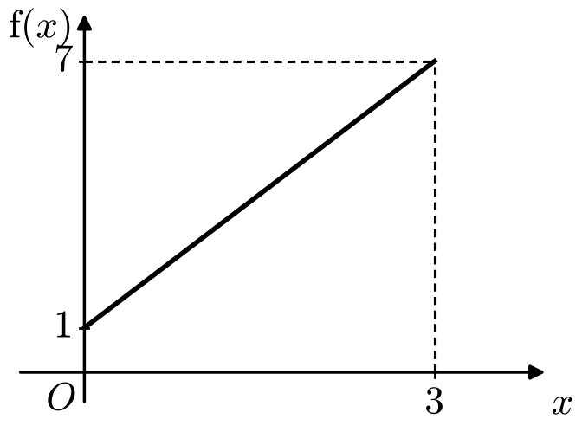
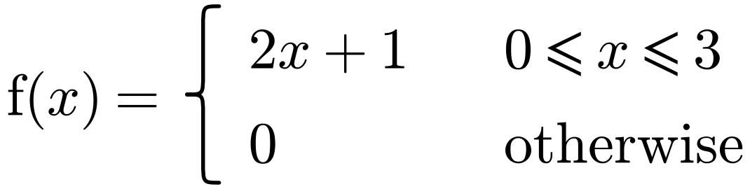
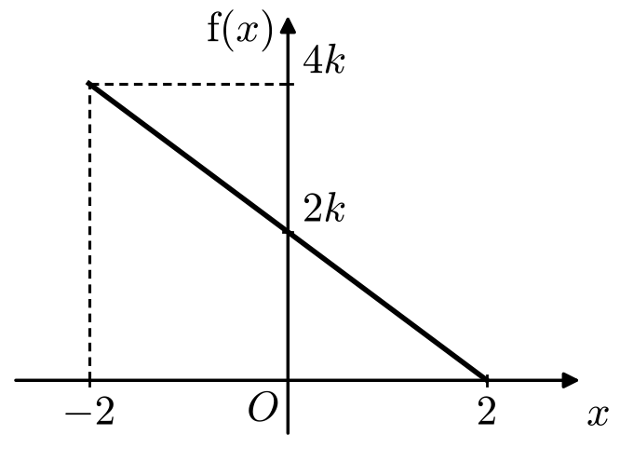
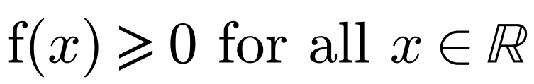
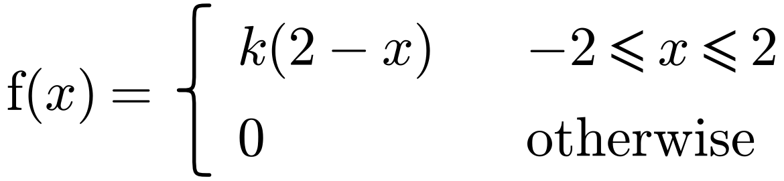
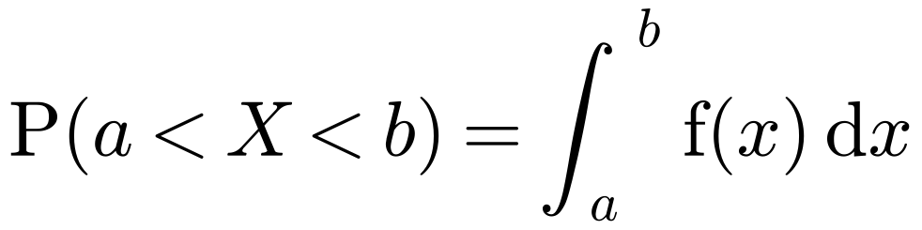
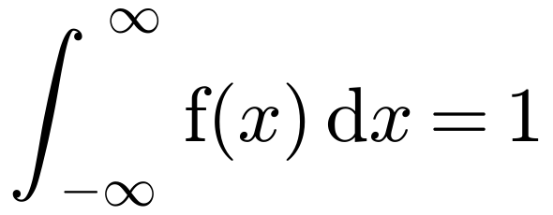
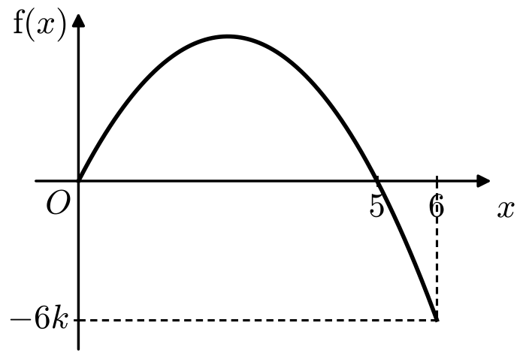
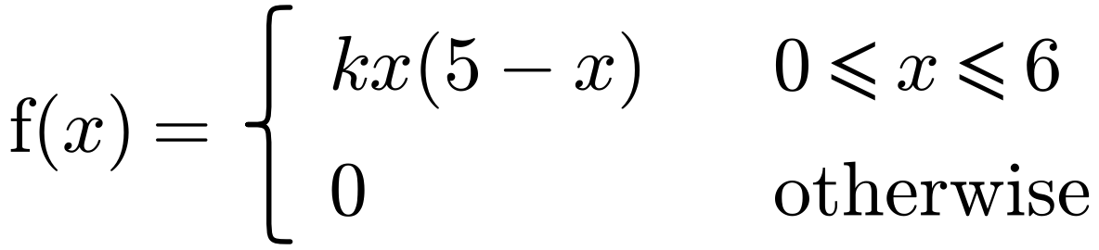
Continuous Random Variables
A continuous random variable can take any one of infinitely many values
In each case, state whether the function could be a probability density function, where k is a positive constant.
The probability that it takes any one specific value is 0, so its distribution is described by a probability density function (p.d.f.), f(x)
a
Area under f(x) = ½(1 + 7) × 3 = 12 ≠ 1, so f(x) cannot be a p.d.f.
If X is a continuous random variable with p.d.f. f(x), then:
b
Area under f(x) = ½ × 4 × 4k = 8k, so f(x) could be a p.d.f. if k = 1/8
In practice you only integrate over the values of x where f(x) is non-zero
c
For all positive k, f(x) < 0 for 5 < x ≤ 6, so f(x) cannot be a p.d.f.
Watch out: x can take negative values, but f(x) must never be negative. The total area under a p.d.f. must equal 1.
3A

Slide 4
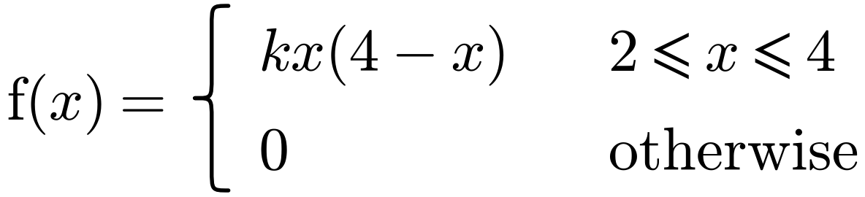
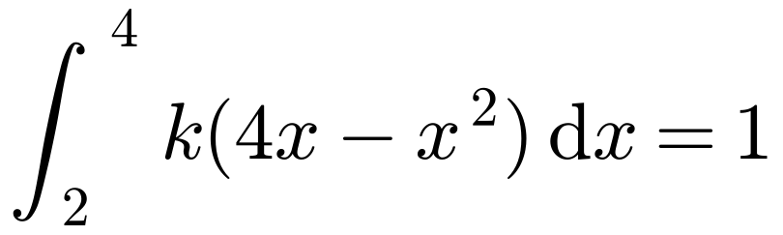
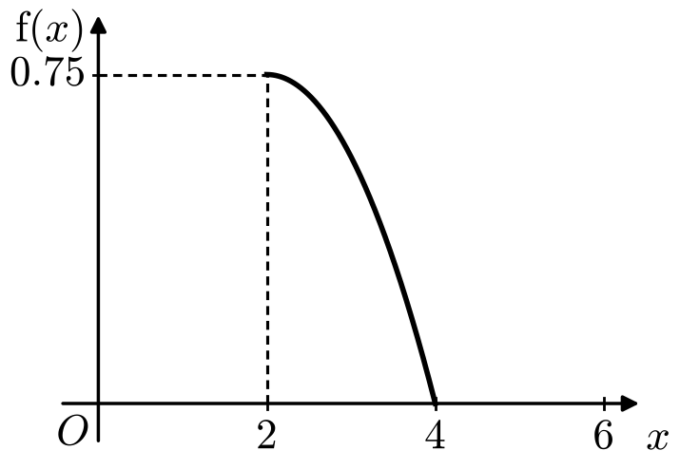
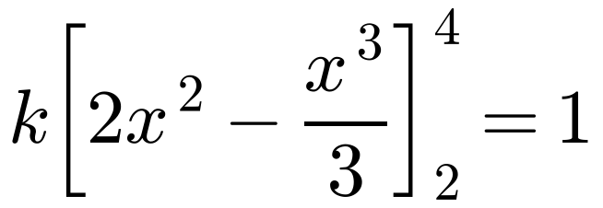
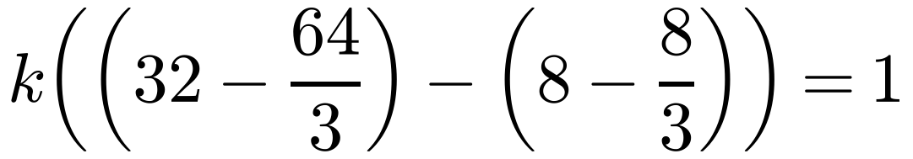
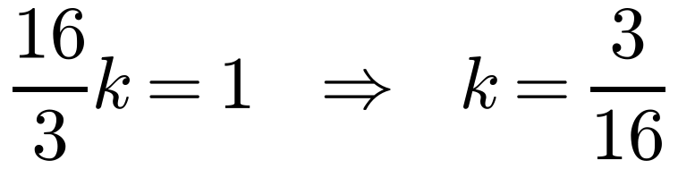
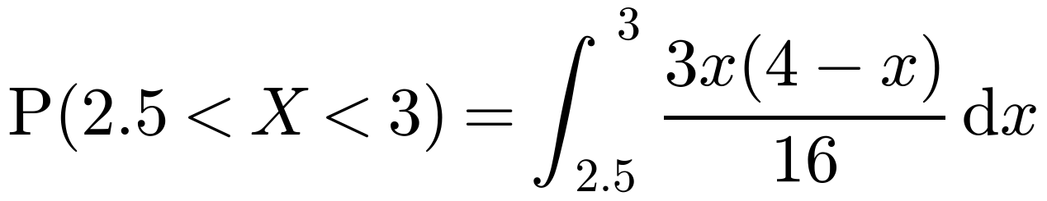
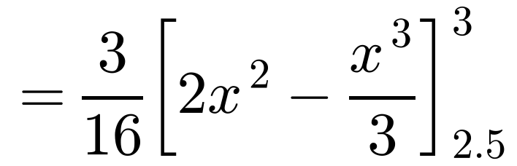
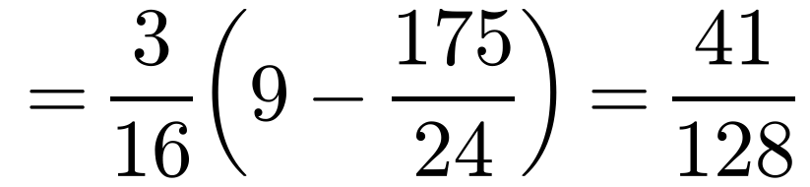
Continuous Random Variables
A continuous random variable can take any one of infinitely many values
The random variable X has probability density function
The probability that it takes any one specific value is 0, so its distribution is described by a probability density function (p.d.f.), f(x)
Find:
a the value of k and sketch the p.d.f.
If X is a continuous random variable with p.d.f. f(x), then:
b P(2.5 < X < 3), giving your answer to 3 decimal places.
a
Only draw the curve for 2 ≤ x ≤ 4
In practice you only integrate over the values of x where f(x) is non-zero
It doesn’t matter whether you use < or ≤ for a continuous random variable
b
= 0.320 (3 d.p.)
Your answer is a probability, so check it is between 0 and 1
3A

Slide 5
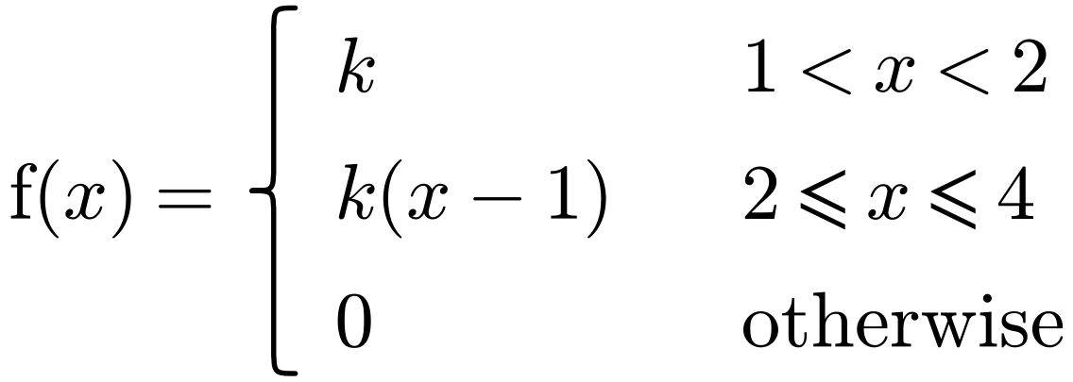
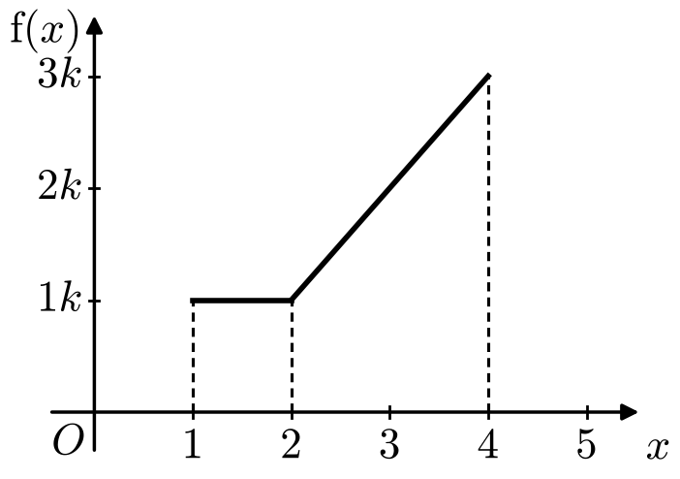
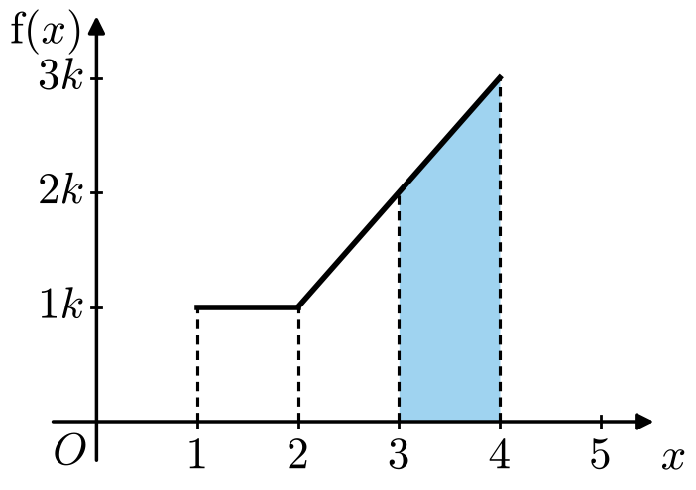
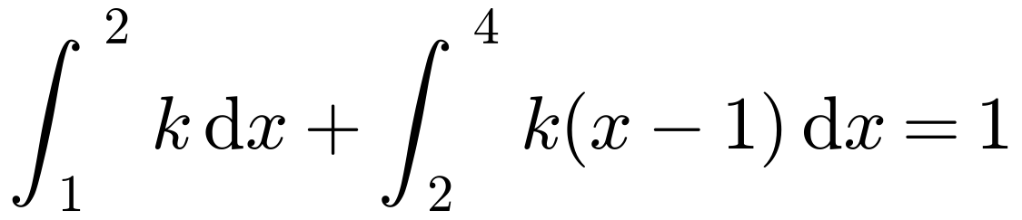
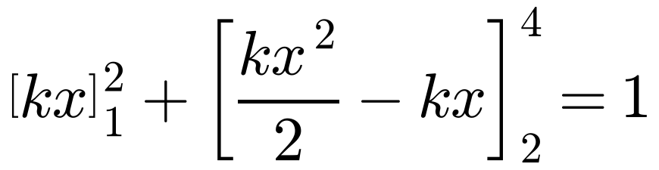
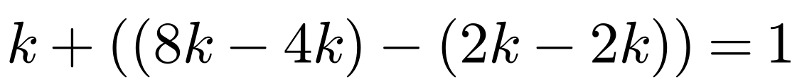
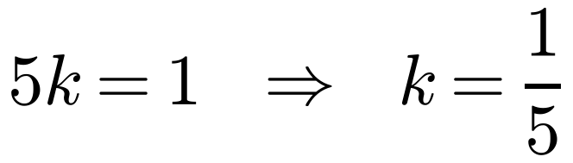
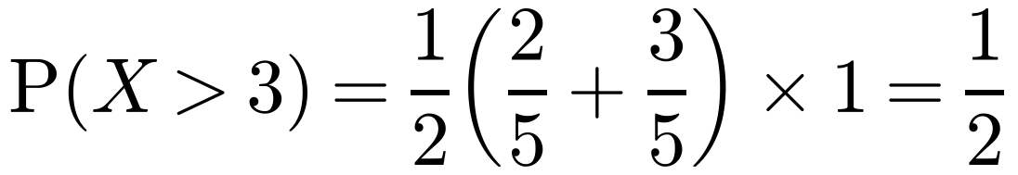
Continuous Random Variables
A continuous random variable can take any one of infinitely many values
The random variable X has probability density function
The probability that it takes any one specific value is 0, so its distribution is described by a probability density function (p.d.f.), f(x)
a Sketch f(x). b Find the value of k. c Find P(X > 3).
If X is a continuous random variable with p.d.f. f(x), then:
a
Use dotted lines to show where the function changes value
b
In practice you only integrate over the values of x where f(x) is non-zero
Or use areas from the sketch: k + ½ × 2 × (k + 3k) = 5k = 1
c
The shaded area is a trapezium with parallel sides f(3) = 2/5 and f(4) = 3/5
3A

