Slide 1
Correlation
Further Statistics 2 Chapter 2
Westie's Workshop

Slide 2
Teachings for Exercise 2C

Slide 3
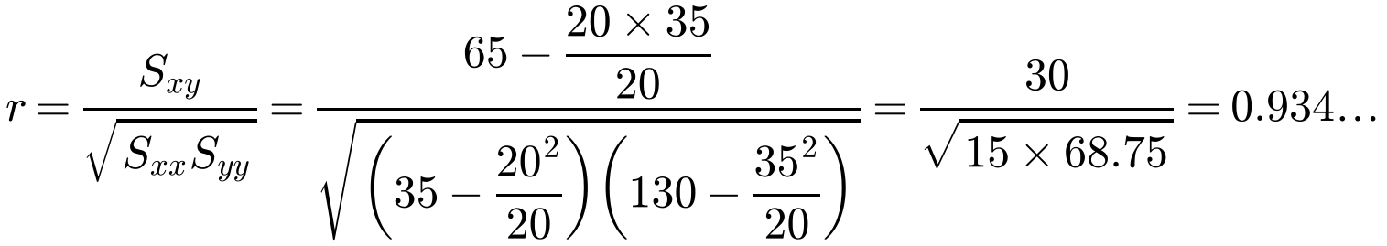
Hypothesis Testing for Zero Correlation
Use a hypothesis test to decide whether a sample shows evidence of non-zero correlation in the whole population
ρ = population correlation (r and r_{s} are for the sample)
One-tailed test
H₀: ρ = 0, H₁: ρ > 0 or
H₀: ρ = 0, H₁: ρ < 0
Two-tailed test
H₀: ρ = 0, H₁: ρ ≠ 0
halve the significance level for each tail
Critical values come from the tables in the formulae booklet. The PMCC and Spearman’s tables are different!
A chemist observed 20 reactions, and recorded the mass of the reactant, x grams, and the duration of a reaction, y minutes. She summarised her findings as follows:
Σx = 20 Σy = 35 Σxy = 65 Σx² = 35 Σy² = 130
Test, at the 5% significance level, whether these results show evidence of any correlation between the mass of the reactant and the duration of the reaction.
any correlation: two-tailed
H₀: ρ = 0, H₁: ρ ≠ 0
Sample size = 20, significance level in each tail = 0.025
From the PMCC table (0.025, n = 20) the critical values are ±0.4438, so the critical region is r < −0.4438 or r > 0.4438
0.934… > 0.4438, so r lies in the critical region: reject H₀.
There is evidence, at the 5% level of significance, that there is a correlation between the mass of the reactant and the duration of the reaction.
2C

Slide 4
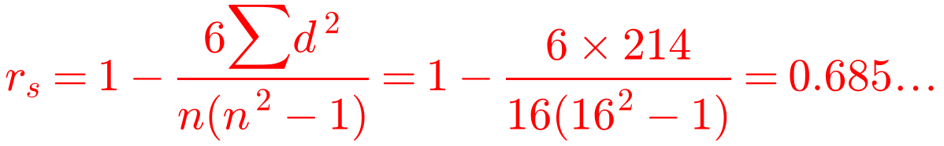
Hypothesis Testing for Zero Correlation
The popularity of 16 subjects at a comprehensive school was found by counting the number of boys and the number of girls who chose each subject and then ranking the subjects. The results are shown in the table below.
a) Calculate Spearman’s rank correlation coefficient. b) Using a suitable test, at the 1% level of significance, test the assertion that boys’ and girls’ choices are positively correlated.
Subject
A
B
C
D
E
F
G
H
I
J
K
L
M
N
O
P
Boys’ ranks, b
2
5
9
8
1
3
15
16
6
10
12
14
4
7
11
13
Girls’ ranks, g
4
7
11
3
6
9
12
16
5
13
10
8
2
1
15
14
d
−2
−2
−2
5
−5
−6
3
0
1
−3
2
6
2
6
−4
−1
d²
4
4
4
25
25
36
9
0
1
9
4
36
4
36
16
1
Extend the table
Add rows for d and d²
There are no tied ranks, so the formula gives r_{s} exactly
a) Σd² = 214
2C

Slide 5
Hypothesis Testing for Zero Correlation
Testing with Spearman’s coefficient
Use exactly the same method, but with the table of critical values for Spearman’s coefficient
Testing for positive correlation, so this is a one-tailed test
Write a conclusion in context
16 subjects ranked by boys and by girls: r_{s} = 0.685… (from part a)
b) Using a suitable test, at the 1% level of significance, test the assertion that boys’ and girls’ choices are positively correlated.
b)
one-tailed: positive correlation
H₀: ρ = 0, H₁: ρ > 0
From the Spearman’s table (0.01, n = 16) the critical value is 0.5824
Since 0.685… > 0.5824, the result is significant at the 1% level.
Reject H₀: there is evidence that boys’ and girls’ choices are positively correlated.
2C

