Slide 1
Correlation
Further Statistics 2 Chapter 2
Westie's Workshop

Slide 2
Teachings for Exercise 2B

Slide 3
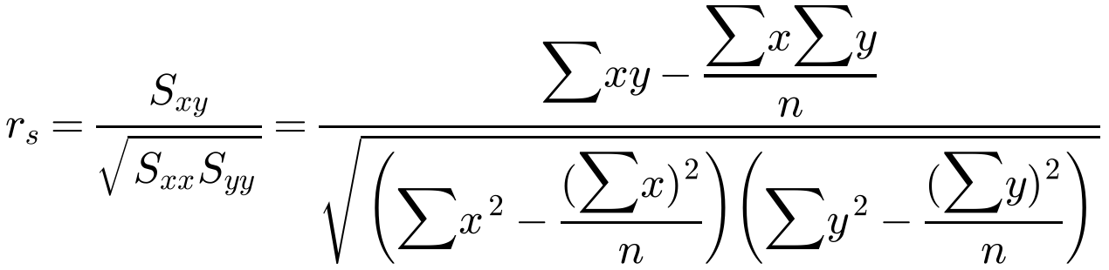
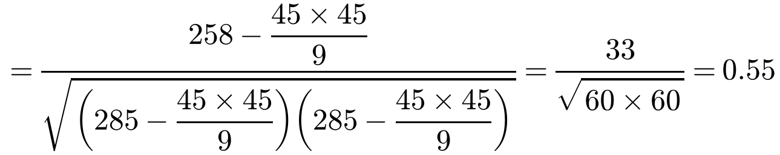
Spearman's Rank Correlation Coefficient
Spearman's rank correlation coefficient, r_{s}, is the PMCC of the ranks
Rank both sets of data: 1 for the highest, 2 for the next, and so on (or smallest first, as long as you do the same for both)
Use r_{s} rather than the PMCC when
one or both data sets are not from a normally distributed population
there is a non-linear relationship
the data already represent a ranking
Two tea tasters were asked to rank nine blends of tea in their order of preference. The tea they liked best was ranked 1. Their orders of preference are shown in the table. Calculate Spearman’s rank correlation coefficient for these data.
Blend
A
B
C
D
E
F
G
H
I
Σ
Taster 1 (x)
3
6
2
8
5
9
7
1
4
45
Taster 2 (y)
5
6
4
2
7
8
9
1
3
45
x²
9
36
4
64
25
81
49
1
16
285
y²
25
36
16
4
49
64
81
1
9
285
xy
15
36
8
16
35
72
63
1
12
258
2B

Slide 4
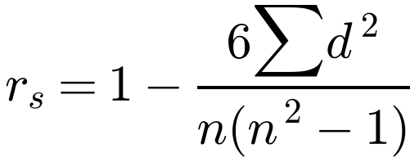
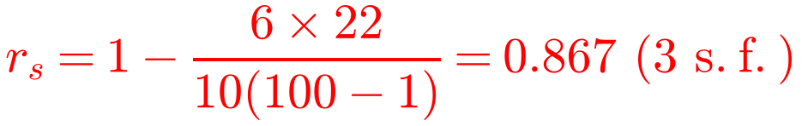
Spearman's Rank Correlation Coefficient
A Spearman’s rank correlation coefficient of
+1: rankings in perfect agreement
−1: rankings in exact reverse order
0: no correlation between the rankings
If there are no tied ranks
During a cattle show, two judges ranked ten cattle for quality according to the following table. Find Spearman’s rank correlation coefficient between the two judges and comment on the result.
Cattle
A
B
C
D
E
F
G
H
I
J
Σ
Judge A
1
5
2
6
4
8
3
7
10
9
Judge B
3
6
2
7
5
8
1
4
9
10
d
−2
−1
0
−1
−1
0
2
3
1
−1
d²
4
1
0
1
1
0
4
9
1
1
22
The data are already ranked and there are no tied ranks, so
d = difference between the ranks of each observation
n = number of pairs of observations
There is a reasonable degree of agreement between the two judges.
2B

Slide 5
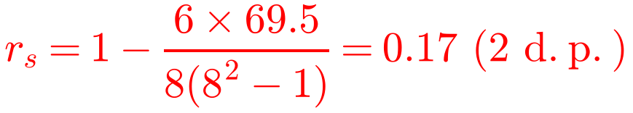
Spearman's Rank Correlation Coefficient
Tied ranks
Equal data values are given a rank equal to the mean of the tied ranks
e.g. two equal values sharing the 3rd and 4th places both get rank 3.5
With tied ranks, the formula for r_{s} only gives an estimate; fine for a small number of ties
Rank both sets in the same order (here smallest to largest)
The marks of eight pupils in French and German tests were as follows:
A
B
C
D
E
F
G
H
French, f %
52
25
86
33
55
55
54
46
German, g %
40
48
65
57
40
39
63
34
Rank, f
4
1
8
2
6.5
6.5
5
3
Rank, g
3.5
5
8
6
3.5
2
7
1
d
0.5
−4
0
−4
3
4.5
−2
2
d²
0.25
16
0
16
9
20.25
4
4
a) Use the formula r_{s} = 1 − 6Σd² ÷ n(n² − 1) to find an estimate for Spearman’s rank correlation coefficient, showing clearly how you deal with tied ranks. Give your answer to 2 decimal places.
The two 55s share ranks 6 and 7, so each gets 6.5.
The two 40s share ranks 3 and 4, so each gets 3.5.
Σd² = 69.5
2B

Slide 6
Spearman's Rank Correlation Coefficient
Thinking about the formula
r_{s} only depends on the ranks, not the actual values
If Σd² stays the same but n increases, 6Σd² ÷ n(n² − 1) gets smaller, so r_{s} increases
Many tied ranks
Use the PMCC formula with the ranked data
The marks of eight pupils in French and German tests were as follows:
A
B
C
D
E
F
G
H
French, f %
52
25
86
33
55
55
54
46
German, g %
40
48
65
57
40
39
63
34
From part a, r_{s} = 0.17 (2 d.p.)
b) Without recalculating the correlation coefficient, state how your answer to part a would change if:
i) pupil H’s mark for German was changed to 38%
ii) a ninth pupil was included who scored 95% in French and 89% in German.
The teacher collects extra data from other students in the class and finds that there are now many tied ranks.
c) Describe how she would now find a measure of the correlation.
b)
i) H’s German mark is still the lowest, so pupil H’s rank does not change: no effect on r_{s}.
ii) The new pupil has the same rank (9) in both tests, so d = 0 and Σd² does not change. But n has increased by 1, so the denominator is bigger and r_{s} will increase.
c)
Give each tied pupil the mean of the tied ranks, then calculate the PMCC directly from the ranked data, rather than using the formula for r_{s}.
2B

