Slide 1
Correlation
Further Statistics 2 Chapter 2
Westie's Workshop

Slide 2
Teachings for Exercise 2A

Slide 3
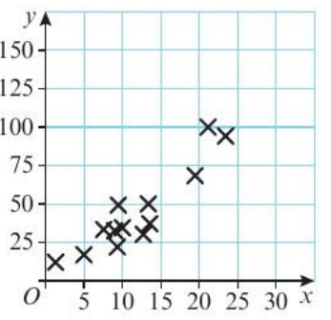
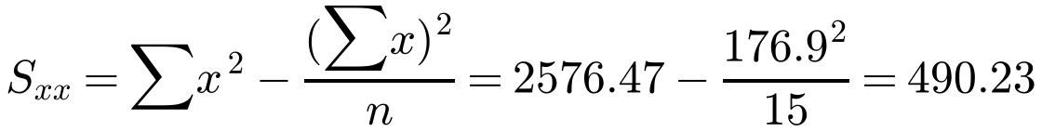
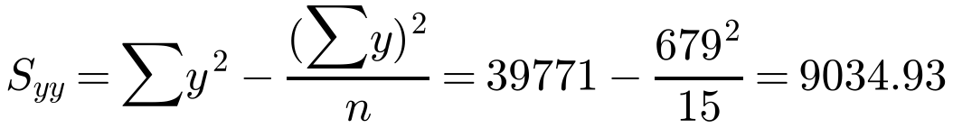
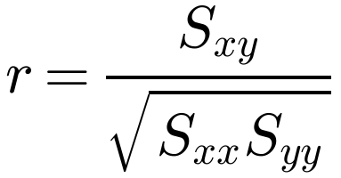
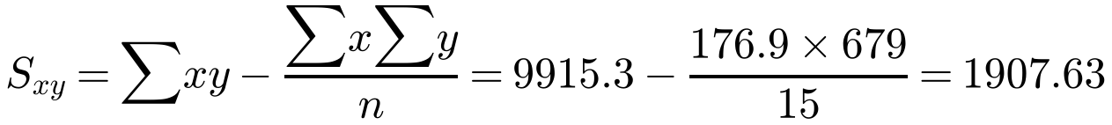
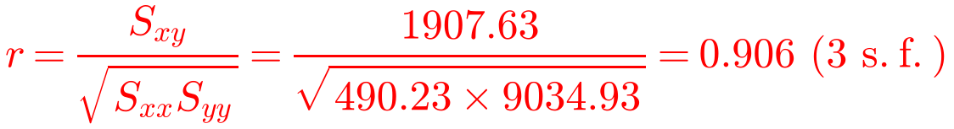
The Product Moment Correlation Coefficient
The PMCC measures the linear correlation between two variables
It takes values between −1 and 1
1: perfect positive linear correlation
−1: perfect negative linear correlation
The product moment correlation coefficient, r, is given by
The number of vehicles, x millions, and the number of accidents, y thousands, in 15 different countries were recorded. The following summary statistics were calculated and a scatter graph of the data is given to the right:
Σx = 176.9 Σy = 679 Σx² = 2576.47
Σy² = 39 771 Σxy = 9915.3
a) Calculate the product moment correlation coefficient between x and y.
b) With reference to your answer to part a and the scatter graph, comment on the suitability of a linear regression model for these data.
a)
(given in the formulae booklet)
You can also find r from raw data on your calculator
2A

Slide 4
The Product Moment Correlation Coefficient
Interpreting r
r = 0.906 is close to 1: strong positive linear correlation
The greater the number of vehicles, the higher the number of accidents
Use both the value of r and the shape of the scatter graph when you comment on a linear model
The number of vehicles, x millions, and the number of accidents, y thousands, in 15 different countries were recorded. The following summary statistics were calculated and a scatter graph of the data is given to the right:
Σx = 176.9 Σy = 679 Σx² = 2576.47
Σy² = 39 771 Σxy = 9915.3
a) Calculate the product moment correlation coefficient between x and y.
b) With reference to your answer to part a and the scatter graph, comment on the suitability of a linear regression model for these data.
From part a, r = 0.906 (3 s.f.)
b)
From the scatter graph, the data appear to be linearly distributed, and the correlation coefficient calculated in part a is close to 1, so a linear regression model appears suitable for these data.
2A

Slide 5
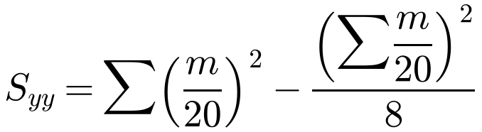
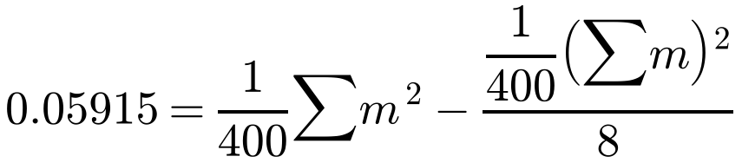
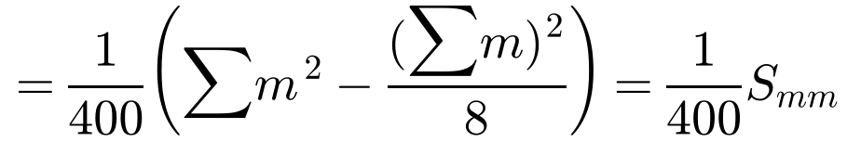
The Product Moment Correlation Coefficient
Coding
As long as the coding is linear, the PMCC is unaffected by coding
Linear coding is just a change of scale on the axes of a scatter graph
Problem-solving
Substitute the code into the formula for S_{yy}
Take out a factor of 1/20² = 1/400 from each term to leave the formula for S_{mm}
Data are collected on the amount of dietary supplement, d grams, given to a sample of 8 cows and their milk yield, m litres. The data were coded using x = d/2 − 6 and y = m/20. The following summary statistics were obtained:
Σd² = 4592 S_{dm} = 90.6 Σx = 44 S_{yy} = 0.05915
a) Use the formula for S_{yy} to show that S_{mm} = 23.66.
b) Find the value of the product moment correlation coefficient between d and m.
a)
Hence S_{mm} = 0.05915 × 400 = 23.66
2A

Slide 6
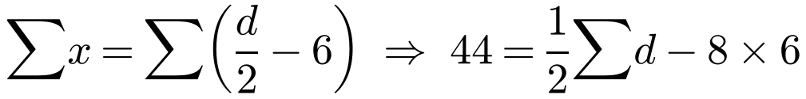
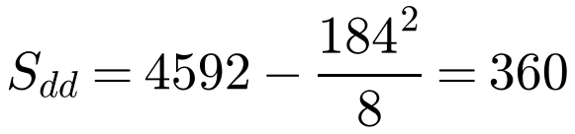
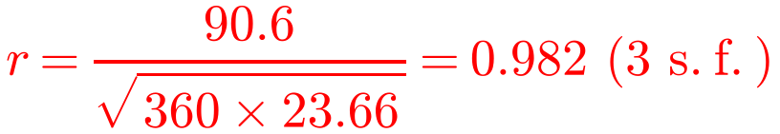
The Product Moment Correlation Coefficient
Find the missing summary statistic
Substitute the code into Σx and rearrange to find Σd
Then find S_{dd} using the standard formula
Now S_{dd}, S_{mm} and S_{dm} are all known, so use the PMCC formula
Data are collected on the amount of dietary supplement, d grams, given to a sample of 8 cows and their milk yield, m litres. The data were coded using x = d/2 − 6 and y = m/20. The following summary statistics were obtained:
Σd² = 4592 S_{dm} = 90.6 Σx = 44 S_{yy} = 0.05915
a) Use the formula for S_{yy} to show that S_{mm} = 23.66.
b) Find the value of the product moment correlation coefficient between d and m.
b)
Hence Σd = 184
2A

