Slide 1
Linear Regression
Further Statistics 2 Chapter 1
Westie's Workshop

Slide 2
Teachings for Exercise 1C

Slide 3
Residuals
If a set of bivariate data has regression equation y = a + bx, then the residual of the data point (x_{i}, y_{i}) is
ε_{i} = y_{i} − (a + bx_{i})
observed value − predicted value
If the observed value is less than the predicted value, the residual is negative
The sum of the residuals of all data points is 0
The table shows the relationship between the temperature, t °C, and the sales of ice cream, s, on five days in June:
Temp, t (°C)
15
16
18
19
21
Sales, s (100s)
12.0
15.0
17.5
p
24.0
The equation of the regression line of s on t is given as s = −17.154 + 1.9693t.
a) Calculate the residuals for the given regression line and hence find the value of p.
t
s
s = −17.154 + 1.9693t
ε
15
12.0
12.3855
−0.3855
16
15.0
14.3548
0.6452
18
17.5
18.2934
−0.7934
19
p
20.2627
p − 20.2627
21
24.0
24.2013
−0.2013
Σε = 0
−0.3855 + 0.6452 − 0.7934 + (p − 20.2627) − 0.2013 = 0
⇒ p = 20.9977… = 21.0 (3 s.f.)
The residual for t = 19 is 0.735
1C

Slide 4
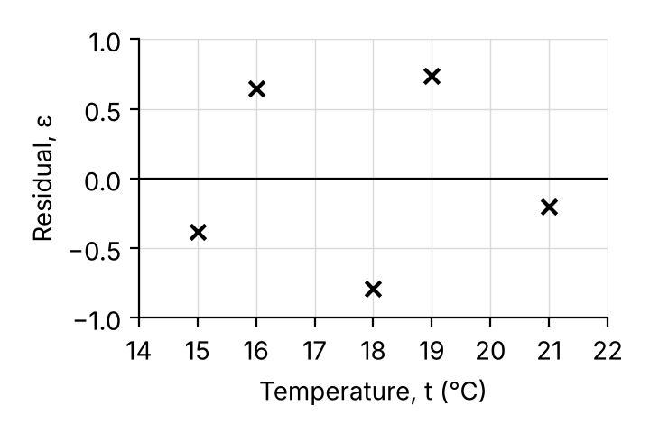
Residuals
A residual plot shows the residuals against x
If the residuals are randomly scattered about zero, a linear model is likely to be suitable
If the residuals follow a pattern (increasing, decreasing or curved), question whether a linear model is appropriate
The table shows the relationship between the temperature, t °C, and the sales of ice cream, s, on five days in June:
Residuals: −0.3855, 0.6452, −0.7934, 0.735, −0.2013
b) By considering the residuals, comment on whether a linear regression model is suitable for these data.
×
×
×
×
×
×
×
×
×
b)
The residuals appear to be randomly distributed around zero, so it is likely that the linear regression model is suitable.
They alternate in sign, with no obvious pattern
×
×
×
×
×
×
Patterns which suggest a linear model is not suitable
1C

Slide 5
Residuals
You can use residuals to identify possible outliers
You will often be told there is an outlier
Choose the value that is furthest from its predicted value
Its residual |ε| should be much larger than the others
Make sure you give a reason for your choice
The table shows the time taken, t minutes, to produce y litres of paint in a factory.
t
2.1
3.7
4.8
6.1
7.2
y
19.2
27.3
26.9
38.5
40.9
The regression line of y on t is given as y = 9.7603 + 4.3514t.
One of the y-values was incorrectly recorded.
a) Use residuals to identify the incorrect value.
t
y
y = 9.7603 + 4.3514t
ε
2.1
19.2
18.8982
0.3018
3.7
27.3
25.8605
1.4395
4.8
26.9
30.6470
−3.7470
6.1
38.5
36.3038
2.1962
7.2
40.9
41.0904
−0.1904
a)
The incorrect value is 26.9, as the magnitude of its residual is significantly greater than the others.
1C

Slide 6
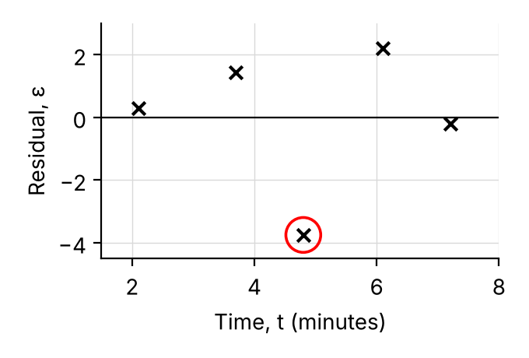
Residuals
Problem-solving
You could also say the data point is a valid piece of data, so it should be used, or that there are only five data points so you should keep them all
Any reasonable conclusion is fine as long as you give a reason
Use your calculator to find the new values of a and b
The table shows the time taken, t minutes, to produce y litres of paint in a factory.
t
2.1
3.7
4.8
6.1
7.2
y
19.2
27.3
26.9
38.5
40.9
Regression line of y on t: y = 9.7603 + 4.3514t. The incorrect value is 26.9.
b) Comment on the validity of ignoring this outlier in your analysis.
c) Ignoring the outlier, produce a new model.
d) Use the new model to estimate the amount of paint that is produced in 4.8 minutes.
b)
The residuals suggest that this data point does not follow the pattern of the rest of the data, so it is valid to remove it.
c)
calculator, without (4.8, 26.9)
New model: y = 10.669 + 4.3573t
d)
y = 10.669 + 4.3573 × 4.8
= 31.6 litres (3 s.f.)
1C

Slide 7
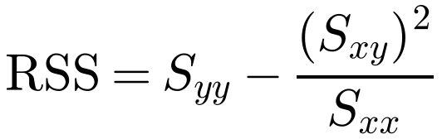
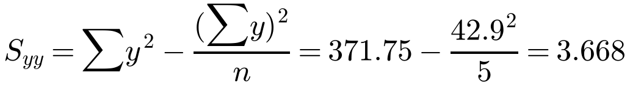
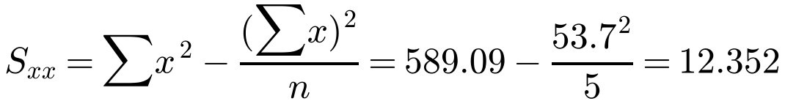
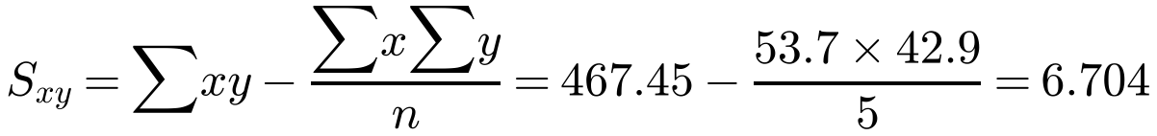
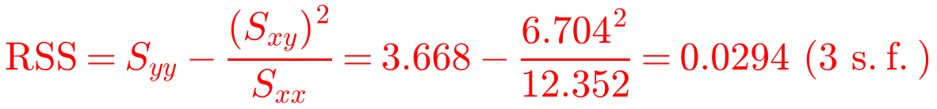
Residual Sum of Squares
The residual sum of squares (RSS) is the sum of the squares of the residuals
You can calculate it using
The data shows the sales, in 100s, y, of Slush at a riverside café and the number of hours of sunshine, x, on five random days during August.
x
8
10
11.5
12
12.2
y
7.1
8.2
8.9
9.2
9.5
Given that Σx = 53.7, Σy = 42.9, Σx² = 589.09, Σy² = 371.75, Σxy = 467.45
a) calculate the residual sum of squares (RSS).
The RSS for five random days in December is 0.0562.
b) State, with a reason, which month is more likely to have a linear fit between the number of hours of sunshine and the sales of Slush.
(given in the formulae booklet)
The least squares regression line is the linear model with the smallest RSS
The smaller the RSS, the more closely the data fits a linear model
a)
b)
0.0294 < 0.0562, so August is more likely to have a linear fit.
1C

