Slide 1
Linear Regression
Further Statistics 2 Chapter 1
Westie's Workshop

Slide 2
Teachings for Exercise 1A/B

Slide 3
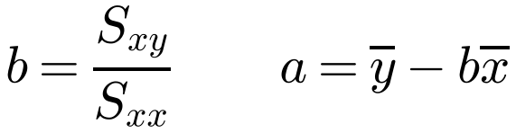
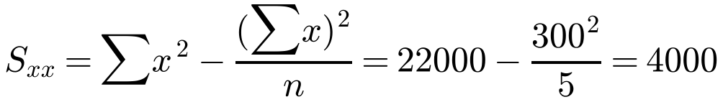
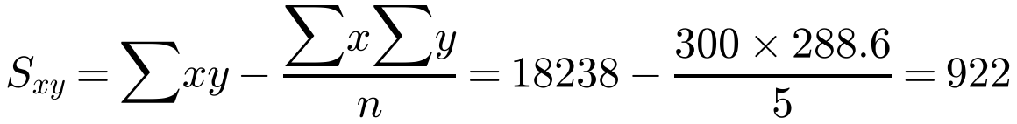
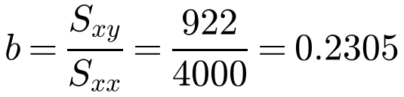
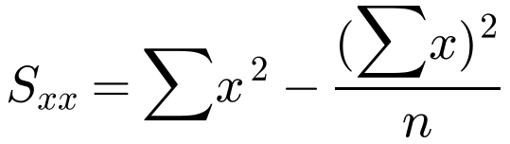
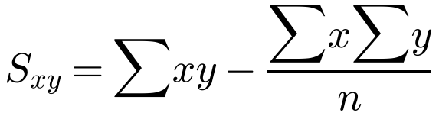
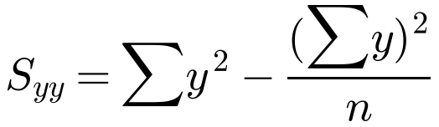
Least Squares Linear Regression
The regression line of y on x is
y = a + bx
where
The results from an experiment in which different masses were placed on a spring and the resulting length of the spring measured, are shown below.
Mass, x (kg)
20
40
60
80
100
Length, y (cm)
48
55.1
56.3
61.2
68
a) Calculate S_{xx} and S_{xy}.
(You may use Σx = 300, Σx² = 22 000, x̄ = 60, Σxy = 18 238, Σy² = 16 879.14, Σy = 288.6, ȳ = 57.72)
b) Calculate the regression line of y on x.
Use it to predict values of the response (dependent) variable y from the explanatory (independent) variable x
Summary statistics
a)
b)
Always finish by writing the equation
y = 43.9 + 0.2305x
1A/B

Slide 4
Least Squares Linear Regression
Making predictions
Substitute the value of x into the regression equation
Interpolation
Predicting within the range of the data: reliable
Extrapolation
Predicting outside the range of the data: less reliable
The results from an experiment in which different masses were placed on a spring and the resulting length of the spring measured, are shown below.
Mass, x (kg)
20
40
60
80
100
Length, y (cm)
48
55.1
56.3
61.2
68
From part b, the regression line of y on x is y = 43.9 + 0.2305x.
c) Use your equation to predict the length of the spring when the applied mass is:
i) 58 kg ii) 130 kg
d) Comment on the reliability of your predictions.
c)
i) y = 43.9 + 0.2305 × 58
= 57.3 cm (3 s.f.)
ii) y = 43.9 + 0.2305 × 130
= 73.9 cm (3 s.f.)
d)
The prediction for 58 kg is reliable, since 58 kg is within the range of the data (20 to 100 kg).
Interpolation
The prediction for 130 kg is unreliable, since 130 kg is outside the range of the data.
Extrapolation
1A/B

Slide 5
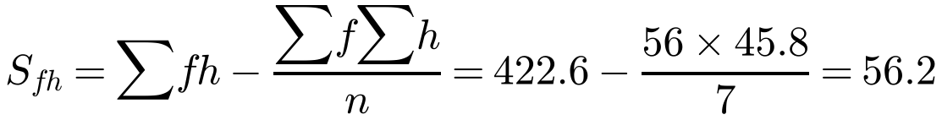
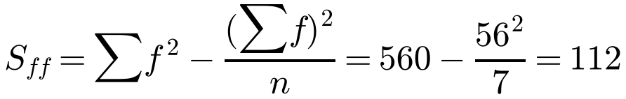
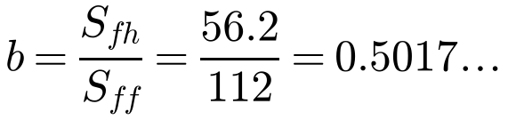
Least Squares Linear Regression
Watch out
The variables might not be called x and y
Write x next to the explanatory variable (f) and y next to the response variable (h), then use the formulae with f in place of x and h in place of y
For a real problem, give the units of a and b
A scientist working in agricultural research believes that there is a linear relationship between the amount of a certain food supplement given to hens and the hardness of the shells of the eggs they lay. As an experiment, controlled quantities of the supplement were added to the hens’ normal diet for a period of two weeks and the hardness of the shells of the eggs laid at the end of this period was then measured on a scale from 1 to 10, with the following results:
Food supplement, f (g/day)
2
4
6
8
10
12
14
Hardness of shells, h
3.2
5.2
5.5
6.4
7.2
8.5
9.8
a) Find the equation of the regression line of h on f.
(You may use Σf = 56, Σh = 45.8, f̄ = 8, h̄ = 6.543, Σf² = 560, Σfh = 422.6)
b) Interpret what the values of a and b tell you.
a)
h = 2.53 + 0.502f
1A/B

Slide 6
Least Squares Linear Regression
Interpreting a and b
a
the value of y when x = 0
b
the change in y for each increase of 1 in x (the rate of increase)
Answer in the context of the question: comment on the rate, not just that one variable increases as the other does
A scientist working in agricultural research believes that there is a linear relationship between the amount of a certain food supplement given to hens and the hardness of the shells of the eggs they lay. As an experiment, controlled quantities of the supplement were added to the hens’ normal diet for a period of two weeks and the hardness of the shells of the eggs laid at the end of this period was then measured on a scale from 1 to 10, with the following results:
Food supplement, f (g/day)
2
4
6
8
10
12
14
Hardness of shells, h
3.2
5.2
5.5
6.4
7.2
8.5
9.8
From part a: h = 2.53 + 0.502f
b) Interpret what the values of a and b tell you.
b)
a = 2.53 tells you the hardness of the shells when no supplement is given (when f = 0).
units: hardness units
Zero is only just outside the range of f, so it is reasonable to use this value.
b = 0.502 tells you the rate at which the hardness increases with the food supplement: for every extra 1 gram of food supplement per day, the hardness increases by 0.502 hardness units.
units: hardness units per g per day
1A/B

Slide 7
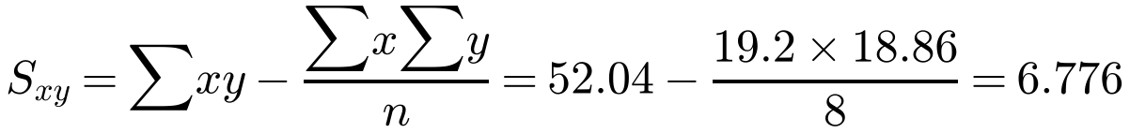
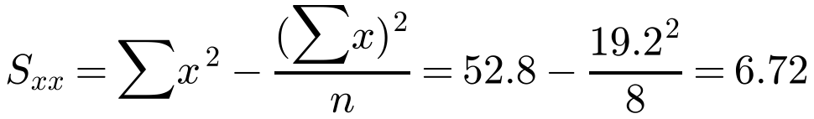
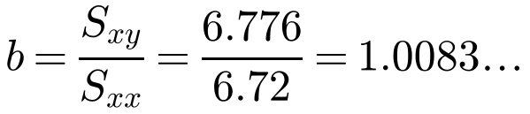
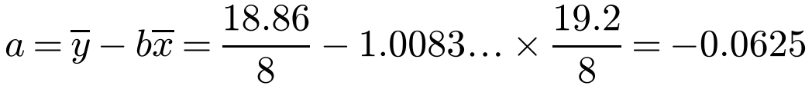
Least Squares Linear Regression
Quote the formula you are going to use before substituting the values
Use x̄ = Σx ÷ n and ȳ = Σy ÷ n
You can check a and b using the linear regression mode (y = a + bx) on your calculator
A repair workshop finds it is having a problem with a pressure gauge it uses. It decides to have it checked by a specialist firm. The following data was obtained.
Gauge reading, x (bars)
1.0
1.4
1.8
2.2
2.6
3.0
3.4
3.8
Correct reading, y (bars)
0.96
1.33
1.75
2.14
2.58
2.97
3.38
3.75
(You may use Σx = 19.2, Σx² = 52.8, Σy = 18.86, Σy² = 51.30, Σxy = 52.04)
a) Show that S_{xy} = 6.776 and find S_{xx}.
It is thought that a linear relationship of the form y = a + bx could be used to describe these data.
b) Use linear regression to find the values of a and b, giving your answers to 4 decimal places.
a)
b)
y = −0.0625 + 1.0083x
1A/B

Slide 8
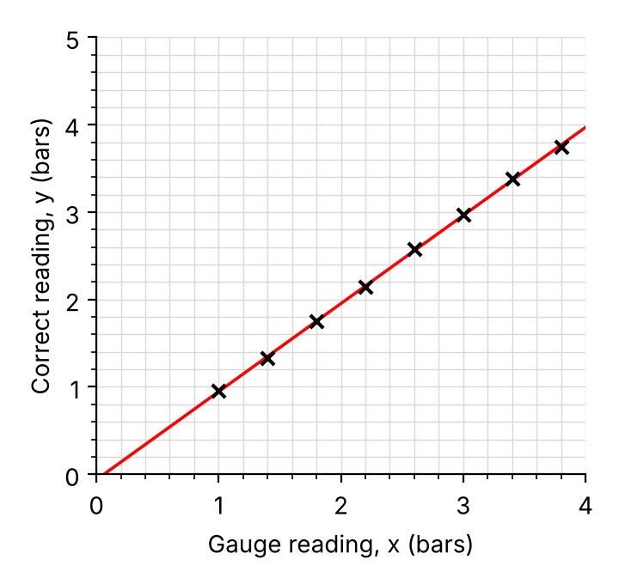
Least Squares Linear Regression
Drawing the regression line
Either plot the point (0, a) and use the gradient b, or find two points on the line
Here x = 1 gives y = 0.95 and x = 3 gives y = 2.96
The regression line always passes through (x̄, ȳ)
From part b: y = −0.0625 + 1.0083x
c) Draw a scatter diagram to represent these data and draw the regression line on your diagram.
d) The gauge shows a reading of 2 bar. Using the regression equation, work out what the correct reading should be.
Gauge reading, x (bars)
1.0
1.4
1.8
2.2
2.6
3.0
3.4
3.8
Correct reading, y (bars)
0.96
1.33
1.75
2.14
2.58
2.97
3.38
3.75
c)
d)
y = −0.0625 + 1.0083 × 2
= 1.95 bar (3 s.f.)
1A/B

Slide 9
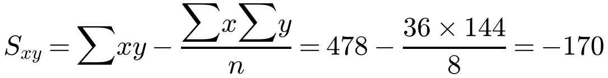
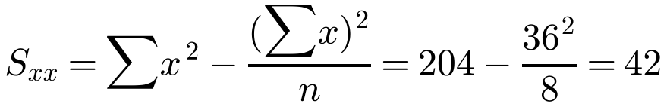
Linear Regression with Coding
Coding
Sometimes the original data is coded to make it easier to manage
Find the regression line for the coded data first, in the usual way
Use x̄ = Σx ÷ n and ȳ = Σy ÷ n
Eight samples of carbon steel were produced with different percentages, c%, of carbon in them. Each sample was heated in a furnace until it melted and the temperature, m in °C, at which it melted was recorded.
The results were coded such that x = 10c and y = (m − 700) ÷ 5. The coded results are shown in the table.
Percentage of carbon, x
1
2
3
4
5
6
7
8
Melting point, y
35
28
24
16
15
12
8
6
a) Calculate S_{xy} and S_{xx}. (You may use Σx² = 204 and Σxy = 478.)
b) Find the regression line of y on x.
c) Estimate the melting point of carbon steel which contains 0.25% carbon.
Σx = 1 + 2 + … + 8 = 36, Σy = 35 + 28 + … + 6 = 144
a)
b)
y = 36.2 − 4.05x
1A/B

Slide 10
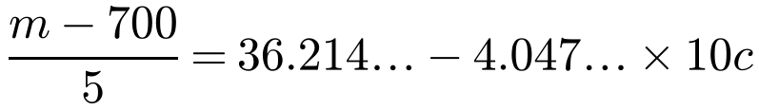
Linear Regression with Coding
x and y are coded values
Method 1
Code the given value of c, use the regression line, then reverse the coding for y
Method 2
Substitute the codes into the regression line of y on x, then rearrange into the form m = p + qc
Check your answer makes sense: x = 0.25 in the coded equation would give 35 °C, which is clearly wrong
x = 10c, y = (m − 700) ÷ 5, regression line of y on x: y = 36.214… − 4.047…x
c) Estimate the melting point of carbon steel which contains 0.25% carbon.
Method 1
c = 0.25, so x = 10 × 0.25 = 2.5
y = 36.214… − 4.047… × 2.5 = 26.095…
Method 2
m − 700 = 181.07… − 202.38…c
m = 881.07… − 202.38…c
m = 881.07… − 202.38… × 0.25 = 830 (3 s.f.)
The estimate for the melting point is 830 °C (3 s.f.)
1A/B

